Slide 1
Recommendations for Facilitators:
Key: Ideas for accompanying suggested narrative for each slide are in italics. General recommendations and notes in standard text.
We strongly recommend allowing some time to prepare for the session. This will enable you to adapt the slides and format the resource according to the needs of your group. It is also best to watch the videos before the session itself as part of this prep. *You can watch the quick supporting Vlog we created which lives on the website with these resources: It is only a few minutes long but provides a handy intro to delivering the session and how to use the resources to support the notes provided here*
*You can amend the content within the slides and you can use the activities and content in this pack as and when you need. It has been designed to provide flexible options that can be used by you tailored for your groups and settings. It is not obligatory to use all the content here, or to use it or frame it in any particular way. How, when and where you deliver this is up to you and your groups’ needs.*
Notes:
https://gohigherwestyorks.ac.uk/resources/teachers-carers-advisors/employability-essentials/

Slide 2
Welcome to your Employability Essentials Workshop
Notes:
This is the first slide of the actual workshop resource.
Provide an energised, positive introduction and welcome the group to the session.

Slide 3
What we will cover today
Introduce Go Higher West Yorkshire.
Cover the employability basics
What is employability? Why is it so important?
Get involved; complete a series of interactive activities.
Watch some employability video case studies.
Understand what employers want.
Get motivated; how can you improve your employability?
Discover where to go to find out more!
Notes:
Run the audience through what to expect – you can tweak this as per your session if required.
For younger/less experienced groups it might be helpful to explain: ‘Agenda’ means what we will cover – our plan for the session, it’s a term often used in the work-place at the start of a meeting to cover what the meeting will address. Sometimes agenda’s are sent out / circulated in advance of / before a meeting so everyone attending knows what to expect.
For parents/carers this explanation wouldn’t be necessary.

Slide 4
The Purpose of today…
Help you understand what employability is and enhance your employability skills.
Notes:
In many presentations and sessions it is important to have a clear goal, a simple aim. Ours for this session is… (read slide)
The above suggested narrative applies to all session formats and audiences

Slide 5
A quick intro…
Go Higher West Yorkshire is a partnership of Higher Education Providers across West Yorkshire, this includes Colleges and Universities.
GHWY Partners work together to improve access to Higher Education across West Yorkshire.
They want to help young people and their parents/carers make informed choices about whether Higher Education is the right option.
There are regional groups like GHWY all over the UK ☺
Notes:
This resource was developed by Go Higher West Yorkshire – here’s a bit more info about them….

Slide 6
Notes:
These are the Go Higher Partners
They represent a wide range of Higher Education options.
Some of you may be thinking of studying at one of the Colleges or Unis up here already - or know someone who is!

Slide 7
Today’s session facilitator…
Your photo / intro here
Clare Addy – Campaign Manager; GHWY NCOP
Notes:
Introduce yourself: Who you are, why you are qualified to talk about this stuff! Of course if the audience know you well already there is no need do to this.
You can add your own photo / brief bio onto this slide.
Please note – Clare, the facilitator pictured is not generally available to deliver sessions.

Slide 8
A quick show of hands please…
Who has heard of the term ‘Employability’?
Notes:
Right then – over to you, a simple one to get us warmed up
A prompt here could be ;
You might have heard of employability being referred to as ‘Soft Skills’ as-well.
Not everyone will have heard either term… but let’s have a show of hands to see who has….even if you don’t totally understand what it means.

Slide 9
In small groups – a 3 minute task…
What is ‘Employability’?
Jot down your ideas, it’s a broad term so there’s not really a wrong answer!
One person from each group to feedback at the end of the 3 minutes please…
Notes:
Now a quick task to get us all thinking… in small groups/pairs (depending on room set up / size of group)
Chat about and jot down what you think employability means….. It’s a broad term and means lots of things so there isn’t a wrong answer. But here’s a clue (use if needed)
Think of it in terms of Employ - ability….
If needed be even more explicit: Introduce using this simple explanation which makes the terms even more accessible – and perhaps more memorable:
Here’s a clue – think of it in terms of Employ: to be employed, to find and attain work / a career
And, Ability – your ability to do this.
(reiterate what it is they need to do for instance…) Please break out into groups of 2-4 and take a few minutes to consider what we mean when we use the term employability.
One person from each group will then need to briefly feedback your thoughts to us.

Slide 10
Employability, a definition
“A set of achievements, understandings and personal attributes that make an individual more likely to gain employment and be successful in their chosen occupations”
Yorke & Knight 2003
Notes:
Thank the participants for their contributions when they have fed back to the group from the last task.
This is one definition of employability but as we have seen, the word is open to interpretation. The whole spectrum of skills that employability represents is so broad that the list could go on and on! This is just one, sensible definition – there are heaps outs there. Read the definition.
As shown in the image on screen…
Employability relates to all job types too – the skills we are going to learn about come in handy whatever career you choose!

Slide 11
How employable are you right now?
Hands up for:
Very – I’m great at this kind of stuff!
Kind of – I’ve got some of it covered.
Not at all – let’s work on all of it…
Notes:
This could be done before or after the individual skills have been covered.
Now we have more of an idea about what employability is, let’s see how we feel about our own employability capability right now… there’s no right or wrong option to pick.
If majority 1 (although this may be unlikely) ‘Ooh, interesting. Well, confidence is a key employability skill and you have certainly demonstrated confidence by choosing option 1. However I am very confident we can all still get something useful out of this session, so – let’s see if I’m right and explore the skills more. And what you can do to get even better at them!’
If majority 2 – It’s good to see you feel you have some of this skill set covered – I am confident by the end of our session/s you will feel like you have up-skilled even more!
If majority 3 – Not to worry, to get better at this stuff is why we are here today, so let’s make the most of what the session/s has to offer…

Slide 12
What is employability? Let’s hear from some experts, employers & parents/carers ☺
Notes:
Facilitator to ensure they have watched any video content they intend to use and that it is suitable for the group they are working with on all levels. (each video is only Circa 2min long)
Now, to watch one of the videos from Go Higher West Yorkshire’s ‘Inspire to Go Higher’ Employability Campaign.
This campaign was initially developed for parents and carers of teenagers but also has lots of helpful information for young people, and ideas about how you could work with the people at home to improve your employability – and vice versa!
It’s based on real life, real people and features real employers too…

Slide 13
The skills employers want, need & value
It’s over to you again!
Notes:
Now we are going to think some more about the key skills that the employability skill set relates to…

Slide 14
The skills employers want, need & value Which on this list do you think are the top 5?
Respect
Team work
Creativity
Learning
Communication
Self belief (confidence)
Technology
Initiative and enterprise
Self management
Problem solving
Have a think on your own for a minute or two and please write them down
Notes:
According to youth employment UK which 5 skills do you think ranked top of this list as the most important employability skills or abilities. We won’t be asking anyone to read these out but – we will go on to discuss them.
Before you move onto the next slide it is helpful to point out…
All of the skills listed on the screen are considered to be useful skills – so whichever you have picked they are relevant to employability in some way! But let’s see which came out top in recent research….

Slide 15
The skills employers want, need & value The top 5!
Respect
Team work
Creativity
Learning
Communication
Self belief (confidence)
Technology
Initiative and enterprise
Self management
Problem solving
…But it’s worth noting that all the skills listed are useful skills to have
Notes:
These are the skills that came out top…
Now let’s take a look at them in more detail.
Now, please write them down in this order:
From 1 to 5 - with 1 being good at and 5 being not so good at.
Don’t worry if you don’t feel that you have had chance to become practised in any of these skills – that’s partly why we are here today!
The answers from this could provide an indicator for which skills you want to focus on most in this or subsequent sessions (aided by the content relating to that skill which you can find next up in this resource pack).

Slide 16
Presenting… The videos!
And now…
Presenting… The Employability Top 5
Notes:
https://www.gohigherwestyorks.ac.uk/inspire-to-go-higher/
Ok, let’s explore those skills individually so we can understand a little more about what they mean.

Slide 17
Self-belief
Notes:
We have already explored this one in the video we watched earlier.
Self belief also means confidence.
Your confidence in your abilities, or ability to learn to do something. And feeling good about this.
Also, the ability to talk clearly and honestly about your abilities and qualities. We all have them, the self-belief trick is learning to recognise and be proud of our abilities. Understand what makes us great and an individual and being unafraid to talk about our achievements in the right environment (such as an interview).
Confidence isn’t something we all have oodles of naturally, but we can all work on building our confidence in little ways most days, eventually confidence building can become a habit really. And it’s worth it. (facilitator can give examples relevant to group if appropriate).

Slide 18
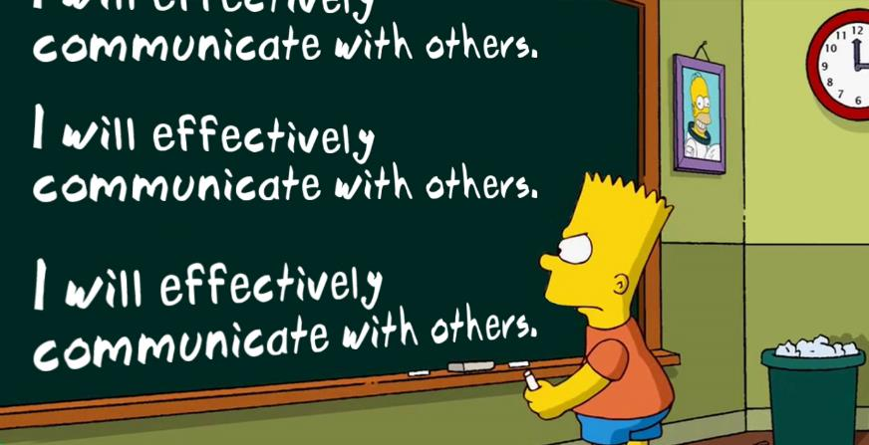
Communication
Notes:
In all areas of life good communication is key and yet it is a skill that many people struggle with.
When we talk about communication in employability terms we mean all forms of this skill including:
- Written communication – writing a report or composing an email for example
- Physical communication: Body language so how you hold yourself, making an effort to smile, make eye contact where appropriate, shake hands, even sitting up straight can demonstrate motivation and alertness rather than a causal slouch!
- Verbal communication: across many different environments from presenting (like I am today) to having a 1 to 1 conversation with a colleague, or perhaps answering a question or making a spoken contribution at a meeting.
So communication is quite complex but we can all do it well, It just helps to understand how.
It’s also pretty important to be able to alter/tailor your communication style to the audience and environment. For instance in a presentation to lots of people in a big room about something exciting you need to stand tall, smile and project your voice. However if you were discussing a sensitive issue in a private conversation with one other person only that style of communication would be rather unsuitable!
(note – this may need to be adapted for groups with SEND, EAFL, Disabilities so that is suits the ways they might best communicate)

Slide 19
Problem solving
Notes:
We all come across problems all the time – in our personal life, throughout school college and Uni and also at work!
Big, small, some easier to solve and some that just feel super difficult to understand let alone sort out – problems are a part of life sometimes! However we can equip ourselves with better problem solving abilities in a variety of ways.
Including:
- Using communication to help you and help you and those involved completely understand the issue, barrier, whatever it is that is causing the problem. You might need to ask questions to do this thoroughly.
- Staying positive and focussing on finding and actioning the solution.
- Engaging with those who could help you in the tricky situation.
- Trying your best to remain calm and composed so you can think clearly.
- Thinking of a time where you successfully solved a similar problem and perhaps applying some of the same techniques.
Understanding what you have learnt from the problem and how you solved (or maybe struggled to solve) it.
You may even want to give an example of where you have effectively solved a problem.
For parents use the Elon Musk example/quote for older groups.
“You get paid in direct proportion to the difficulty of problems you solve”

Slide 20
Team work
Notes:
We have probably all heard the phrase ‘team work makes the dream work’ but, cheesy as it is there’s some truth in it!
Being able to use your communication and problem solving abilities to motivate and co-operate with not just your direct team but perhaps others internal or external to your workplace is so important.
Whilst it’s important to be able to stand on your own two feet, being part of a team feels good. Knowing that you are on their team can make the others around you feel good too.
Many jobs have working in teams at their core, so it’s helpful to have experienced team work before you enter the world of work – many of us work in teams everyday but don’t even realise it, at home or school or in your social life, there will probably be a time when you have successfully worked with others to make something great happen.
Every day we all work as part of a team whether we know it or not. At home, school, college - so many areas of life require team work, it’s certainly not limited to the workplace.

Slide 21
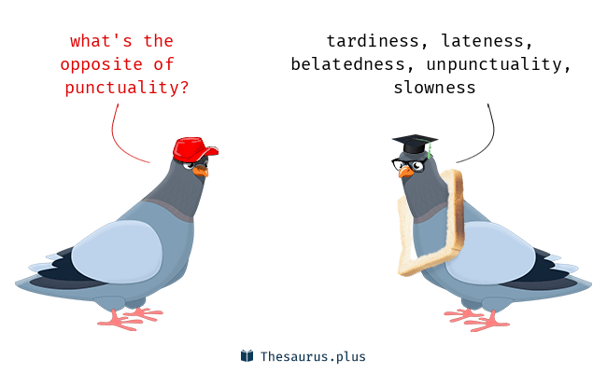
Self management
Notes:
Self Management covers a whole host of things.
From punctuality – being on time, every time.
To staying motivated, and showing it (something that employers love to see).
The real value here is in the word ‘self’ though, so being responsible for your own time management: eg setting your alarm on a night or planning your travel to work or College or an appointment in a sensible fashion.
Working on your resilience so you really can stay motivated and focussed when the going gets tough.
Staying calm and positive in a challenging situation or during a difficult conversation so that you can get the best result from it - not relying on others to do this for you.
When you start to manage things for yourself you are more likely to set and achieve personal goals – and your self-believe will often grow too! I can do this thing and I can do it myself, feels great!

Slide 22
The skills employers want, need & value Please rank your employability skills…
Team work
Communication
Self belief (confidence)
Self management
Problem solving
Notes:
Now that we have explored them in a little more detail let’s rank our own individual employability skills.
Please write down from top to bottom (1= best at 5 = worst at) how proficient you feel you are in each skill.
And don’t worry if you don’t feel that you have had chance to become practised in any of these skills – that partly is why we are here today!
If you have a group where there is a trend in how they rank their own skills: The answers from this exercise could provide an indicator for which skills you want to focus on most (aided by the content/video relating to that particular skill in this resource)

Slide 23
How many adults in the UK have awesome ‘employability’? Hands up…
A: 27%
B: 40%
C: 82%
Notes:
Now a quick question -
How many adults in the UK do you think have this employability stuff sorted according to Barclays Life skills….. How many of the millions of working adults out there in the UK are terrific team workers, cracking communicators, big self believers?
A 27% B 40% or C 82%?
Discuss, write down or hands up!
You may want to merge the two slides (23&24) here and remove image when presenting to adults as more geared towards a youth audience.

Slide 24
UK Employability, the status quo…
The answer is…. B! only 40%
Current employability ‘skills gap’…
60% of adults lack employability skills
Barclays life skills
Notes:
The correct answer is B – according to Barclays life skills only 40% of UK adults are currently ace-ing employability.
Meaning there is a current skills gap of 60%!
So - now is the time to tool up so we can change that figure in the future and be the most employability generation yet!

Slide 25
Employability, very human skills…
Notes:
Why the cute robot?
Sometimes you might hear employability skills being referred to as ‘soft’ skills. And to a certain extent that’s right. These things can’t be easily hard wired into machines…
Skills/attributes such as: communication, empathy, creativity, team work – totally different to data crunching and…not so easy to teach a robot.
Therefore, it’s super important to future proof your skill set by up-skilling your employability. Because, even as technology advances there are some things us humans will just always be better at! At least in our lifetime!

Slide 26
Employability and Education
Notes:
Of course we go to College or University to study and get a qualification which is very important. But also – you will gain life experience throughout your education journey. Why not take up some opportunities to enhance your employability too.
Schools, Colleges and Universities now offer heaps of options to help you increase your employability. From sports teams, to societies to really practical stuff like CV writing workshops and Work experience. Get clued up on what's on offer where you are (or where you are heading) and see which options feel would be useful to get involved in!
This kind of ‘co-curricular’ activity will give you an edge in a competitive job market when you leave education with not just a great qualification but a great set of employability skills too!
Universities and Colleges offer the things that they know will work in terms of upskilling your employability.
With Higher Education options like Higher and Degree Apprenticeships on the up Colleges and Universities continue to work closely with employers and have a strong idea of what employers want from a fantastic employee in addition to your qualification.
A lot of the stuff on offer from Colleges/Uni to enhance your employability is also really good fun! Like, Societies, Clubs, Volunteering/Social Action, work placements…. The list goes on!
Make this local to your group E.G if you know of a volunteering opportunity in the community or something the school/college might be running that could help with any of the skills talked about. You may even want to hand out or forward information on about any opportunities to enable or encourage participation.
This could also be relevant to the individual video Q&A: e.g. when reflecting on the ‘Communication’ piece, if you know of a public speaking/debating society – flag it to the group.

Slide 27
Inspire to go higher www.gohigherwestyorks.ac.uk/inspire-to-go-higher
Notes:
Here – you could download, print and hand out the PDF ( https://www.gohigherwestyorks.ac.uk/wp-content/uploads/2018/12/INSPIRE-TO-GO-HIGHER-Employability-Skills-WEB-1.pdf ) or encourage the young people to read it at home then complete a quiz sheet on it (Short homework task)
This is the Go Higher West Yorkshire Inspire to go Higher employability campaign that we mentioned earlier.
Now let’s watch some videos about real young people and their parents and carers working on employability skills - and do some more thinking about the skills you told me you feel less confident about…..
This is one option however you may want to run the group through all videos or split them across several lessons/sessions depending on your time, the learning outcomes you require and the groups needs.

Slide 28
Employability Skill: Communication
Notes:
Link to version of this video with additional parent/carer content: https://vimeo.com/306188877
The version of this video accessed by using the link above is more suited to groups of parents/carers as at the end of the video there are specific tips/advice for parents/carers.
Link to the actual video embedded in this slide: https://public.3.basecamp.com/p/DHRzk8vbudc16tdqSKLS6CVw

Slide 29
Communication: Exercise
Ewan’s mum is keen that he works on his communication skills to help him succeed in his future education and career - What kind of activities do you think you could do to help with your communication skills?
How do you think the following activity could help a young person with their communication skills?
Joining a school committee / debating club, volunteering, work experience
Scenario / Home work task – You have been invited to an interview for a job you applied for. Great! Please compose your response to the email sent by the company inviting you to interview.
Notes:
Reflection/Question:
1) Ewan’s mum is keen that he works on his communication skills to help him succeed in his future education and career - What kind of activities do you think you could do to help with your communication skills?
Again, you may want to offer some examples relevant to your locality and the group here.
2) How do you think the following activity could help a young person with their communication skills?
Joining a school committee/debating club/volunteering
Make it relevant to your area and local/accessible provision.
3) Scenario / home work task – You have been invited to an interview for a job you applied for. Great! Please compose your response to the email sent by the company inviting you to interview. Keep it brief but make sure you include everything you think is necessary, remember that employers are busy people who will have lots of emails to read each day. At the very most a few short paragraphs will suffice.
What we want to see here is….. Enthusiasm, clarity, gratitude/polite email etiquette, organisational skills. For younger, less experienced groups you may want to prompt this – EG Remember to express how pleased you are about the opportunity and also remain professional. It’s also important that they know you are attending. This could be your chance too to ask any questions about the role or the interview before you attend.
This task (as with all homework tasks) could be also done in the classroom / in the session itself if homework is not appropriate.

Slide 30
Employability Skill: Teamwork
Notes:
Link to version of this video with additional parent/carer content: https://vimeo.com/306189111
The version of this video accessed by using the link above is more suited to groups of parents/carers as at the end of the video there are specific tips/advice for parents/carers.
Link to the actual video embedded in this slide: https://public.3.basecamp.com/p/tZFd2LTYTiXWf4SwU1S1v1p3

Slide 31
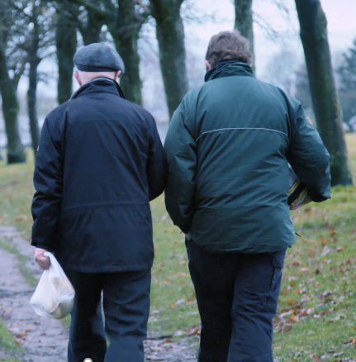
Teamwork: Exercise
Leon and his Grandad have been buddying up to better his ability to work well as part of a team…why do you think it’s important to be able to work well as part of a team?
In what situations do you think good team work skills would come in handy?
What kinds of things do you think you could do to get more practise working as a team member?
Homework exercise: Research opportunities to take part in the activities identified in the above question, you may even want to sign up for some too!
Notes:
1) Leon and his Grandad have been buddying up to better his ability to work well as part of a team…why do you think it’s important to be able to work well as part of a team? In what situations do you think good team work skills would come in handy?
2) What kinds of things do you think you could do to get more practise as working as a team member?
You may want to offer up some suggestions for less experienced groups

Slide 32
Employability Skill: Self-belief
Notes:
Link to version of this video with additional parent/carer content: https://vimeo.com/306188601
The version of this video accessed by using the link above is more suited to groups of parents/carers as at the end of the video there are specific tips/advice for parents/carers.
Link to the actual video embedded in this slide: https://public.3.basecamp.com/p/5oqJngEyoqyJ3PQAHn2GrAxu

Slide 33
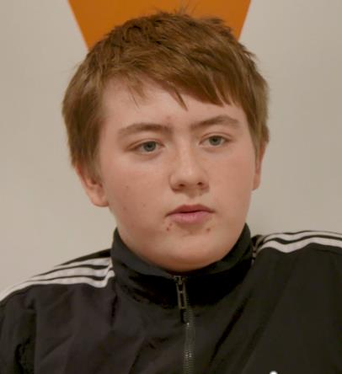
Exercise: Self-belief
In this video – Chris, the employer in charge of apprenticeships at Nestle says that a business can or can’t teach/train self belief?
Alternative – more advanced Q
Reflecting on Chris’s statement about an employers ability to train this skill, why do you think he said it’s something that employers struggle to train or teach?
What other words/scenarios do you associate with;
A healthy, good sense of self belief:
e.g. Knowing you are able to do a task, or willing to try!
2) A lack of self belief: Thinking you can’t do a task – not willing to try.
Homework exercise: Let’s work on our own self-belief…What do you think are your strengths and qualities? Think of something you have done that has made you feel good about yourself and your abilities. You could discuss this with someone at home if it helps – what has made them proud of you!?
Notes:
Simple question
1) In this video – Chris, the employer in charge of apprenticeships at Nestle say that a business can or can’t teach/train self belief?
2 )What other words/scenarios do you associate with
A healthy, good sense of self belief:
Give this example if you feel it is needed Knowing you are able to do a task, or willing to try! (willing and able)
A lack of self belief: Ditto Thinking you can’t do a task – not willing to try. (reluctant, unable)
3) What do you think are your strengths and qualities – lets work on our own self-belief. Perhaps think of something you have done that has made you proud or others proud of you.
You may want to offer a prompt of something like: Did your football team perform well in your last match? Did you do better than expected in your last exams? Are you a really great cook or the person that people trust to talk to when they have a problem – this could be anything that is important to you and makes you feel good about yourself.
If the group (or individuals within) are really struggling with this one then you could offer the option of thinking about someone you love or admire and considering their strengths/qualities. However, try to avoid going to this too early as for many it could be the easier (but less beneficial) option.
4) Reflecting now on Chris’s statement about an employers ability to train this skill, why do you think he said it’s something that employers struggle to train or teach?

Slide 34
Employability Skill: Problem Solving
Notes:
Link to version of this video with additional parent/carer content: https://vimeo.com/306189208
The version of this video accessed by using the link above is more suited to groups of parents/carers as at the end of the video there are specific tips/advice for parents/carers.
Link to the actual video embedded in this slide: https://public.3.basecamp.com/p/mNXY7HEBUVHHM4pUBaYAJHEa

Slide 35
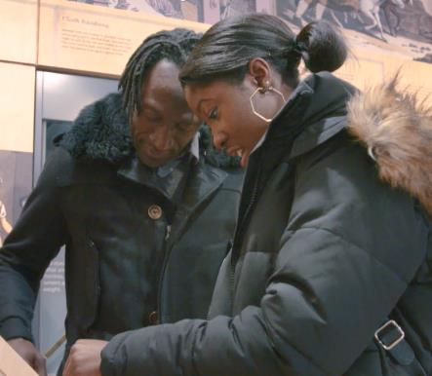
Exercise: Problem solving
What does Anise’s Dad Joel decide to do to help Anise with her problem solving abilities?
Why do you think this might help Anise to learn about how to better solve problems?
Can you think of any other ways you can practice problem solving? By yourself or with other people?
Lisa – the Employability Officer says when you are able to solve problems it means you are better able to:
Get on with the job in hand or
Get out of work early some days ???
Homework exercise: Think of a time you have successfully solved a problem and how you went about this. Which other skills did you call upon to enable you to solve the problem in hand?
Notes:
1) What does Anises Dad Joel decide to do to help Anise with her problem solving abilities?
A – Escape rooms
Why do you think this might help Anise to learn about how to better solve problems?
2)Can you think of any other ways you can practise problem solving? By yourself or with other people?
3) Lisa – the Employability Officer says when you are able to solve problems it means you are better able to:
Get on with the job in hand or
Get out of work early some days

Slide 36
Employability Skill: Self-management
Notes:
Link to version of this video with additional parent/carer content: https://vimeo.com/306189307
The version of this video accessed by using the link above is more suited to groups of parents/carers as at the end of the video there are specific tips/advice for parents/carers.
Link to the actual video embedded in this slide: https://public.3.basecamp.com/p/wr29AQYwcm6V8KpJ7ybTpB4y

Slide 37
Exercise: Self-management
Self-management covers a range of skills and qualities: How many can you name?
Alternative Q
Which of the below do you think are part of self management?
Punctuality, thoughtfulness, motivation, focus, hard-work, consistency, reliability, honesty, attention to detail
The employer Martin that we hear from says that Self Management is important:
A; frequently – on a day to day basis or
B; occasionally – only in certain situations ???
Homework task: Take two of the self-management qualities we have identified and explain how you can ensure you manage these yourself.
e.g. Ensuring I set an alarm to get up and arrive on time when I have something important to do. Not relying on anyone else to make this happen or forgetting about it. (Punctuality/Organisation)
Notes:
1) Self-management covers a range of skills and qualities: How many can you name?
Or…
1i) Which of the below do you think are part of self management?
Punctuality, thoughtfulness, motivation, focus, hard-work, consistency, reliability, honesty
2) The employer Martin that we hear from says that self management is important:
A; frequently – on a day to day basis
B; occasionally – only in certain situations

Slide 38
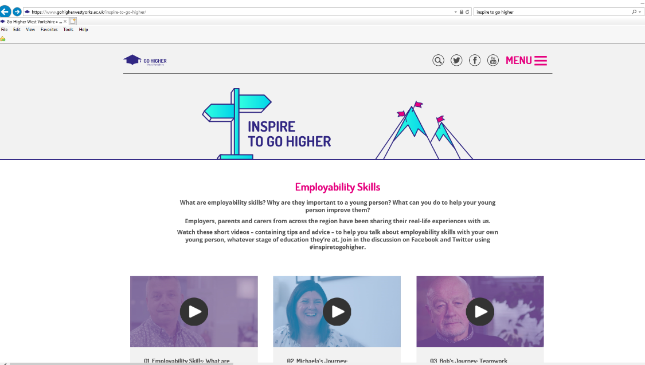
Further reading
Notes:
This is where all the videos we just watched live – the Inspire to go Higher website - Alongside a handy pdf booklet that you can download onto your mobile, computer or even go old school and print! It’s called ‘Employability Essentials’ and it covers a lot of what we have discussed today.
Why not show the videos to people at home? Can you discuss the session today or watch the videos with someone? See what conversations this inspires. It could be a parent/carer, brother/sister, friend or neighbour.
For adult participants perhaps ask them to watch the videos with their child or partner/friend. Also share with their networks who might benefit on social media etc.
Website link: https://www.gohigherwestyorks.ac.uk/inspire-to-go-higher/

Slide 39
‘The Interview’
Choose who will be the candidate first and who will be ‘The Hiring Manager’
2. ’The Hiring Manager’ picks 3 of the following questions to ask….
3. Fair’s fair – once you have completed the first round it’s time to swap roles!
20min in total to complete this task
Top tip: think quick and be brave with your answers!
Questions – Hiring Manager picks 3…
What skills and qualities will you bring to my organisation?
Can you give me an example of when you have had to solve a problem?
Can you give me an example of when you have worked well in a team?
What’s been your proudest achievement so far – at work, in education or in life in general!
What kind of things do you enjoy doing in your spare time?
Notes:
When explaining this task it might be worth mentioning that;
The Hiring Manager is the person who is going to make the decision about whether you will be hired. The person who will likely have sifted/selected your application and progressed you to interview stage. Sometimes you might hear a Hiring Manager being referred to as a Boss, Manager, Employer.
Also – to manage a young person’s expectations of interview it would be worth mentioning –
Sometimes interviews are held with a panel of people and you might be asked to present a short talk about the job you have applied for - but in this case it’s a simple 1-2-1 question and answer interview. Interviews can also be held in several rounds, over the telephone / skype or as online assessments.
The questions suggested on the slide map to….
Q1 – self belief, communication, self reflection
Q2 – problem solving
Q3 - team work
Q4 – confidence and communication
Q5 – self management, creativity, confidence

Slide 40
What’s your personal employability pledge?
What one thing will you do to enhance your employability?
Think, jot it down, discuss with the person next to you…
5 min to complete this task
Notes:
Open with:
We are nearly done. But first, bearing in mind what we have learned and watched today: What one thing can you do to improve your employability?
it could be anything from doing some voluntary work to increase your self belief and problem solving skills or joining a sports team to work on team work…. Through to signing up for a public speaking committee to improve your communication skills
Again make these suggestions within reach of what is available to them.
Even something as simple as going away and looking at the Inspire to Go Higher website, reading the pdf, perhaps sharing the videos at home with your parents/carers can really help your skills. Small actions will make a difference!
Close:
Does anyone want to share their pledge? (optional – if group look a little unsure/shy then you can simply re-iterate the ideas/suggestions above).

Slide 41
Any questions / thoughts?
Notes:
You could keep this to any questions related to the session or broaden out to any questions related to employability as a whole if you are more confident with the topic.

Slide 42
That’s it….Thanks ☺
Notes:
Finish. Thanking everyone for their time, energy, input and attention.

