Slide 1
Greater Higher West Yorkshire
Funding Information Team
23rd February 2023

Slide 2
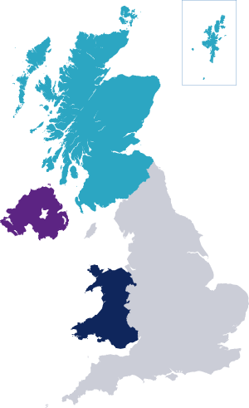
The Student Loans Company
The Student Loans Company (SLC) is a non-profit making government-owned organisation that administers loans and grants to students in colleges and universities in the UK. Depending on where you live, you should apply to either
Student Finance England
Student Finance Wales
Students Finance Northern Ireland
Student Awards Agency Scotland
Did You Know? Every year, approximately 1.6 million students apply for student support for their university and college studies

Slide 3
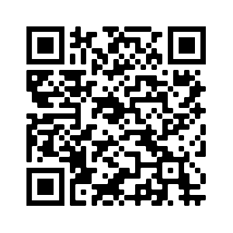
Prepare for Launch…
New Figures for 2023/24
Tuition Fee Loans
Maintenance Loans
Disabled Students Allowance
Grants for Dependants
Postgraduate Loans
Cost of Living Considerations
New Guidance for students
Financial Hardship Guidance
Multiple Change of Address
Application and Evidence Updates
Birth Certificates
New Repayment Plan 5
Once Earning over £25,000 per year

Slide 4
STUDENT FINANCE OVERVIEW
WHAT SUPPORT COULD YOU GET?
ACADEMIC YEAR 2023/24

Slide 5
Tuition Fee Loans
Maximum tuition fees for 2023/24 in England will be maintained at the levels that applied in 2022/23
academic year. The sixth year in succession that fees have been frozen and maximum fee levels will
be frozen until 2024/25
Maximum tuition fee for standard full-time courses offered will remain at £9,250
Maximum tuition fee for standard part-time courses offered will remain at £6,935
Key Points to Note :
Tuition Fee Loans are non means tested (we don’t need parents income for this bit!)
Loans are paid directly to the university on behalf of the student
Most of the 1.6m students every year apply for the maximum loan available
It is the easy part of the application – just tell us which university you are going to and how much you want to borrow (usually students tick ‘max’)

Slide 6
Maintenance Loans – Max
Full-Time SFE students, not eligible for benefits or aged over 60
£
£8,400
Parental Home Rate:
Live at home while they study
£
Elsewhere Rate:
Live and study away from home, outside London
£9,978
£
London Rate:
Live and study away from home, in London
£13,022
i
Different rates of Maintenance Loan are available to full-time students who
are entitled to benefits or aged over 60 before the first day of their course
Notes:
https://www.gov.uk/student-finance-calculator
The income assessment for full year and final year rates of loans for living costs is calculated as follows:
Parental Home Rate: £1 reduction in loan for every complete £7.08 increase in income above £25,000.
London Rate: £1 reduction in loan for every complete £6.89 increase in income above £25,000.
Elsewhere Rate: £1 reduction in loan for every complete £7.01 increase in income above £25,000.
Overseas Rate: £1 reduction in loan for every complete £6.94 increase in income above £25,000.
The income threshold for the minimum non-income assessed full rate of overseas loan is: £65,967.
The income thresholds for the minimum non-income assessed final year rates of loans are: £56,910 (Home), £67,422 (London), £60,836 (Elsewhere), and £62,678 (Overseas).

Slide 7
Maintenance Loans – NMT, MT and Maximum
2016 cohort FT students, not eligible for benefits or aged over 60
Full Year Student* | Maximum Loan | Non-Income Assessed | Income Assessed
Parental Home | £8,400 | £3,698 | £4,702
Elsewhere | £9,978 | £4,651 | £5,327
London | £13,022 | £6,485 | £6,537
Overseas | £11,427 | £5,524 | £5,903
*Lower amounts available for final year students
Notes:
The income assessment for full year and final year rates of loans for living costs is calculated as follows:
Parental Home Rate: £1 reduction in loan for every complete £7.08 increase in income above £25,000.
London Rate: £1 reduction in loan for every complete £6.89 increase in income above £25,000.
Elsewhere Rate: £1 reduction in loan for every complete £7.01 increase in income above £25,000.
Overseas Rate: £1 reduction in loan for every complete £6.94 increase in income above £25,000.
The income threshold for the minimum non-income assessed full rate of overseas loan is: £65,967.
The income thresholds for the minimum non-income assessed final year rates of loans are: £56,910 (Home), £67,422 (London), £60,836 (Elsewhere), and £62,678 (Overseas).

Slide 8
Maintenance Loans – Overview & Calculator
Full-Time SFE students, not eligible for benefits or aged over 60
Household Income | Home | Elsewhere | London
£25,000 & under | £8,400 | £9,978 | £13,022
£35,000 | £6,988 | £8,552 | £11,571
£45,000 | £5,576 | £7,125 | £10,120
£55,000 | £4,163 | £5,699 | £8,668
£65,000 | £3,698 | £4,651 | £7,217
£75,000 | £3,698 | £4,651 | £6,485
i
You can get an estimate of your loan entitlement using the calculator on:
www.gov.uk/student-finance-calculator
Notes:
https://www.gov.uk/student-finance-calculator
The income assessment for full year and final year rates of loans for living costs is calculated as follows:
Parental Home Rate: £1 reduction in loan for every complete £7.08 increase in income above £25,000.
London Rate: £1 reduction in loan for every complete £6.89 increase in income above £25,000.
Elsewhere Rate: £1 reduction in loan for every complete £7.01 increase in income above £25,000.
Overseas Rate: £1 reduction in loan for every complete £6.94 increase in income above £25,000.
The income threshold for the minimum non-income assessed full rate of overseas loan is: £65,967.
The income thresholds for the minimum non-income assessed final year rates of loans are: £56,910 (Home), £67,422 (London), £60,836 (Elsewhere), and £62,678 (Overseas).

Slide 9
Disabled Students Allowance
The maximum allowance (£26,291) will apply to both full-time and part-time undergraduate and postgraduate DSA recipients in 2023/24. This replaced the four DSA allowances available in previous years
Work on DSA Reforms (tbc)
Work on DSA Assessment Improvements (tbc)
Previous Allowance Categories | Single DSA Rate 23/24
Non-Medical Helper | £26,291 + Further DSA support above the regulated maximum to pay for additional disability related travel costs
Specialist Equipment
General Allowance
Travel Allowance
Notes:
DISABLED STUDENTS ALLOWANCE FOR FULL-TIME UNDERGRADUATE STUDENTS (Not means-tested).
The undergraduate DSA allowance was simplified into one allowance for 2021/22. The same maximum allowance - £26,291 - will apply to both full-time and part-time undergraduate and postgraduate DSA recipients in 2023/24.
This will apply for both new and continuing students. An exception for travel costs will be made to this maximum cap, which means that travel costs will in effect be uncapped.

Slide 10
Dependants Grants
GFD AY 23/24 Income Assessments | PLA | ADG | CCG (*52 Week Rate)
 |  |  | 1 Child | 2+ Children
Maximum entitlement | £1,915 | £3,354 | £9,822.80* | £16,840.20*
Lower income threshold for maximum grant | £14,910 | £8,746 | £9,727 | £11,118
Upper income threshold for minimum grant | £18,739.98 | £15,453.98 | £19,549.79 | £27,958.19
i
*Weekly maximum CCG amount for one child: £188.90
*Weekly maximum CCG amount for two or more children: £323.85
Notes:
Where dependants’ incomes are from £18,640 to £18,739.98 students qualify for a minimum £50 PLA.
Weekly maximum CCG for one child is £188.90.
Weekly maximum CCG for two or more children is £323.85.

Slide 11
Postgraduate Loans
Maximum loans for new students starting postgraduate master’s or doctoral degree courses in AY
2023/24 will be increased by 2.8%:
Maximum Postgraduate Master’s Loan
£12,167
Maximum Postgraduate Doctoral Loan
£28,673
Maximum Postgraduate Disabled Students’ Allowance
£26,291
Notes:
Loans for students undertaking postgraduate master’s degree courses.
Maximum loans for new students starting postgraduate master’s degree courses in 2023/24 will be increased by 2.8% to £12,167.
Loans for students undertaking postgraduate doctoral degree courses.
Maximum loans for new students starting postgraduate doctoral degree courses in 2023/24 will be increased by 1.8% to £28,673.
Disabled Students’ Allowance.
The maximum Disabled Students’ Allowance for postgraduate students will be increased by 2.8% to £26,291 in 2022/23, in line with the changes to the undergraduate Disabled Students’ Allowance.

Slide 12
If you’re studying any of these NHS courses, extra funding is available…
Dental therapy or dental hygiene (level 5 and 6 courses)
Dietetics
Midwifery
Nursing (adult, child, mental health, learning disability, joint nursing, and social work)
Occupational therapy
Operating department practitioner (level 5 and 6 courses)
Orthoptics
Orthotics and prosthetics
Paramedics
Physiotherapy
Podiatry or chiropody
Radiography (diagnostic and therapeutic)
Speech and language therapy
£5000 Training Grant every year
£2000 Parents Support every year
£1000 Specialist Subject every year
Travel Costs
Hotel Costs
Hardship Fund

Slide 13
Independent Student Guidance
If you're not financially supported by your parents or a partner, then you might be
classed as an independent student when SFE work out your loan entitlement:
www.ucas.com/finance/student-finance-england/finance-independent-students
To be classed as independent, students need to be aged 25 or over on the first
day of the academic year or meet one of the other criteria, including:
Are or have been married/in a civil partnership
Have care of a person under the age of 18
Supported themselves financially for 3 years before the start of their course
Have no contact with or are estranged from their parents (standalone.org.uk)
Are a Care Leaver, looked after by a local authority (propel.org.uk)
Notes:
If you're not financially supported by your parents, then you might be classed as an independent student.
This means Student Finance England won't take your parents' income into account when working out the household income contribution.
To be classed as an independent student you'll meet one of the following conditions:
• You have the care of a person under the age of 18 on the first day of the academic year.
• You’re 25 or over on the first day of the academic year.
• You’ve been married or in a civil partnership before the start of the academic year, even if you’re now divorced or separated.
• You have no living parents.
• You’ve supported yourself for at least 3 years before the start of your course.
This includes any time you: - were in paid, full-time employment - received Income Support, Jobseeker’s Allowance or other state benefits - received any pension, allowance or other benefit because of a disability or by any reason of confinement, sickness or illness - received training under any scheme for the unemployed or other funding by any state authority or agency
• Your parents can’t be traced or it’s not practical or possible to contact them.
• Your parents live outside the European Union and an income assessment would put them in jeopardy, or it’s not reasonably practical for them to send funds to the UK if a contribution were assessed (this may apply to you if you’re a refugee).
• You’ve not communicated with your parents for one year before the beginning of the academic year, or you can demonstrate you’re permanently estranged from your parents.
• Subject to certain exceptions, you were looked after by a local authority throughout any 3 month period ending on or after the date on which you turned 16, and before the first day of the first academic year of your course.

Slide 14
What Can I Get?
PARENT SUPPORT?
STUDENT FINANCE ENGLAND
NHS SUPPORT?
PART TIME WORK?
UNIVERSITY BURSARIES AND SCHOLARSHIPS
STUDENT BANK ACCOUNTS

Slide 15
Cost of Living Considerations
Cost of Living – updated guidance on Gov.UK
Financial Hardship Guidance
Multiple Change of Address

Slide 16
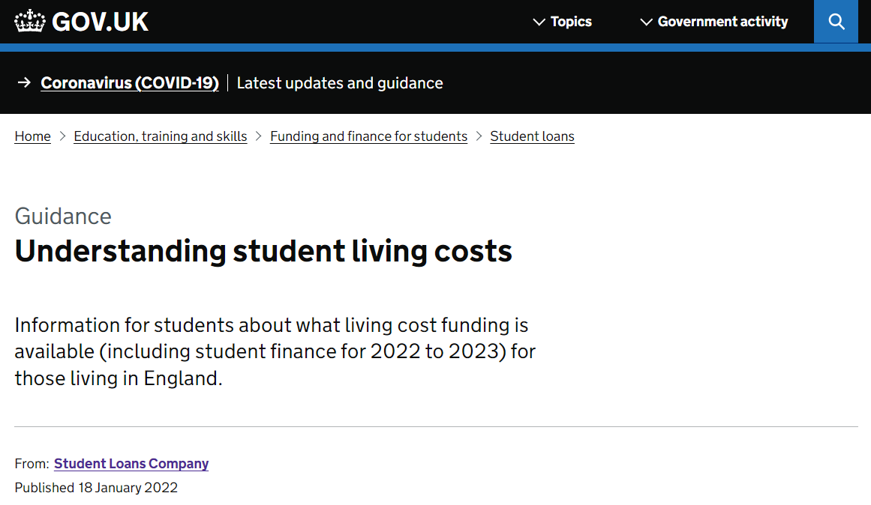
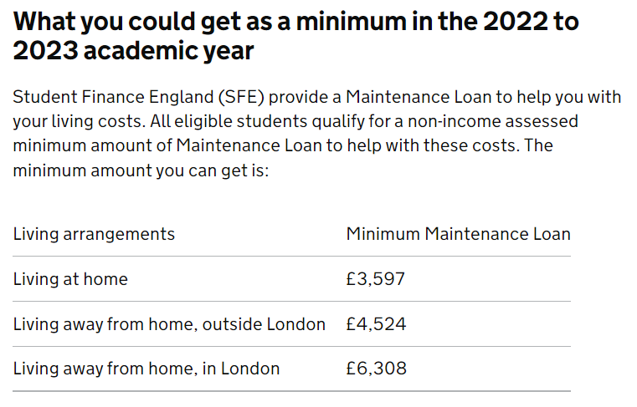
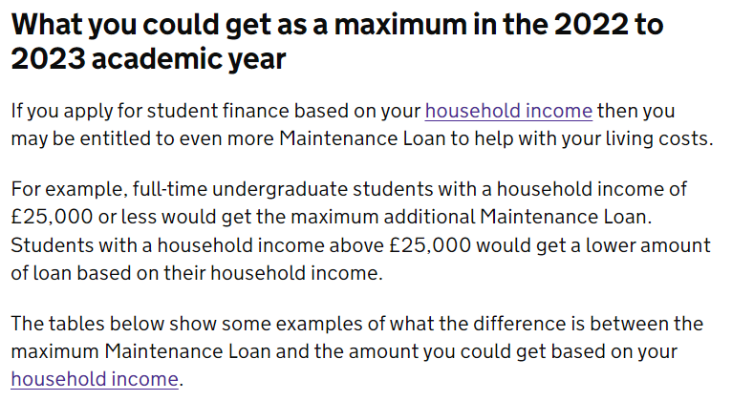
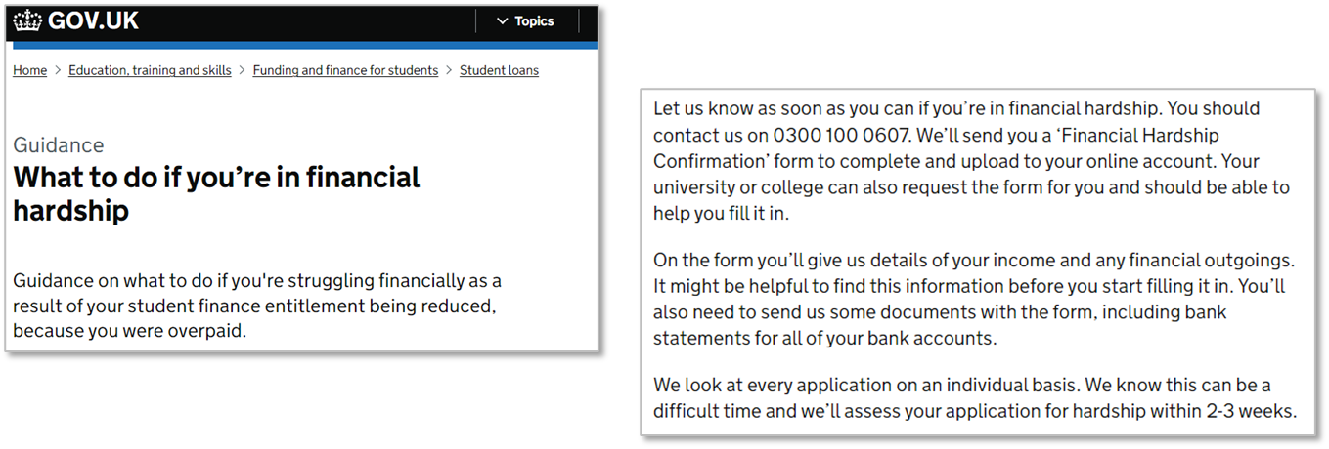
Cost of Living Consideration – Guidance
A GOV.UK page has been designed to
Help students consider the range of
living costs they may face and
understand the funding they can access.
The information covers means testing,
budgeting, sources of additional support
and links to useful resources, including
Student Space
Specific advice has been updated for
students who are experiencing financial
hardship.

Slide 17
Cost of Living Consideration – Financial Hardship
The process of applying for Financial Hardship has been updated to ensure an improvement to the student experience and on overall processing times. We’ve made it easier for students to apply for financial hardship by replacing the previous 3 Hardship Forms with a new Financial Hardship Confirmation PDF
This updated Financial Hardship Form has been designed to make it easier for students to understand and complete. Upon request, the Hardship Confirmation Form will be sent directly to students via email, or by post if specifically requested by the student
Undergraduate students can upload the form and supporting evidence directly from their online account, so there’s no need for them to post anything to us. These enhancements will also allow our teams to process received forms faster so that students can receive an answer on their hardship claim sooner
Hardship applications can be considered from students who:
Overpayment and their Entitlement has been reduced
Suspended and want funding to be extended
scheduled payment brought forward
withdrawn from study, having been awarded grants*
*We can only award grant support (not ML) to the end of the term in which the student withdrew
Notes:
The process for students applying for Financial Hardship has been updated, to ensure an improvement on the overall processing times.
We have replaced the 3 Financial Hardship forms with a new Financial Hardship Confirmation PDF, this is sent direct to students and can be uploaded via digital upload.
We’ve made it easier for students to apply for financial hardship
Students can now apply for financial hardship by uploading the application form and their evidence via their online account.
Financial hardship form
We’ve updated the financial hardship form to make it easier for students to complete. The updates also allow our staff to process the forms faster so that students can receive an answer sooner. The form and evidence can also be uploaded to their online account, so there’s no need to post anything to us.
Who qualifies for financial hardship?
Before issuing a financial hardship form to a student, advisers will make sure their circumstances fall into one of the set categories for consideration.
We can only accept applications from students who:
• have an overpayment on their account, and their entitlement has been reduced to recover the overpayment
• have suspended from their studies and want their funding extended to cover the suspension period
• need a payment brought forward due to being in financial hardship
• have withdrawn from their studies, have been awarded grants (such as Childcare Grant) and want their funding extended beyond the point they left their studies (due to the student finance regulations, we cannot accept applications from withdrawn students who have not been awarded grants) We can only award grants, no maintenance loan, to the end of the term in which the student withdrew.
The FHC form can now be sent by email, this option will be offered to students in the first instance as this is the quickest way for the to receive the form.
Advisors should issue an explanatory email to students which contains a link to the FHC form and advises them of the next steps to take.
Students can send Financial Hardship Confirmation form and any accompanying evidence via Digital Evidence upload.
How to issue a financial hardship form
Once it has been confirmed that a student is eligible to apply for financial hardship, advisers can provide them with the financial hardship form to complete.
The form will be sent to the student via email, unless they specifically ask for a paper copy.
When issuing the form to students, advisers will inform them how they should send us their completed form and evidence.
Essential steps for students to be aware of and to follow when completing and returning their Hardship Form include:
1. Complete the financial hardship form and save the file to their device.
2. Gather their evidence to support their application, the form will explain what they need. The evidence will ideally be in a digital format such as a downloaded bank statement, we can also accept clear photographs.
3. Sign in to their online account and select ‘Upload supporting evidence’ under the heading ‘Manage your student finance’.
4. Upload the financial hardship form and supporting evidence together, uploading them separately can slow down the application process

Slide 18
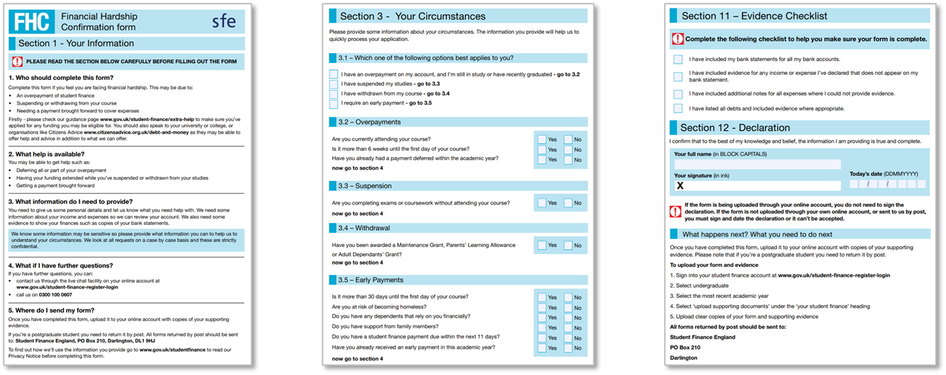
Cost of Living Consideration – Financial Hardship
Once it has been established that a student is eligible to apply for financial hardship, advisers will provide them with the Financial Hardship Form:
The form will be sent via email and this option will be offered to students in the first instance as this is the quickest way to get it to them. The explanatory email will contain a link to the Financial Hardship Confirmation Form and will advise the student of the steps to take to complete and return it
Students can find information on financial hardship and how to request and submitting Financial Hardship forms on the GOV.UK guidance page
Notes:
The process for students applying for Financial Hardship has been updated, to ensure an improvement on the overall processing times.
We have replaced the 3 Financial Hardship forms with a new Financial Hardship Confirmation PDF, this is sent direct to students and can be uploaded via digital upload.
We’ve made it easier for students to apply for financial hardship
Students can now apply for financial hardship by uploading the application form and their evidence via their online account.
Financial hardship form
We’ve updated the financial hardship form to make it easier for students to complete. The updates also allow our staff to process the forms faster so that students can receive an answer sooner. The form and evidence can also be uploaded to their online account, so there’s no need to post anything to us.
Who qualifies for financial hardship?
Before issuing a financial hardship form to a student, advisers will make sure their circumstances fall into one of the set categories for consideration.
We can only accept applications from students who:
• have an overpayment on their account, and their entitlement has been reduced to recover the overpayment
• have suspended from their studies and want their funding extended to cover the suspension period
• need a payment brought forward due to being in financial hardship
• have withdrawn from their studies, have been awarded grants (such as Childcare Grant) and want their funding extended beyond the point they left their studies (due to the student finance regulations, we cannot accept applications from withdrawn students who have not been awarded grants) We can only award grants, no maintenance loan, to the end of the term in which the student withdrew.
The FHC form can now be sent by email, this option will be offered to students in the first instance as this is the quickest way for the to receive the form.
Advisors should issue an explanatory email to students which contains a link to the FHC form and advises them of the next steps to take.
Students can send Financial Hardship Confirmation form and any accompanying evidence via Digital Evidence upload.
How to issue a financial hardship form
Once it has been confirmed that a student is eligible to apply for financial hardship, advisers can provide them with the financial hardship form to complete.
The form will be sent to the student via email, unless they specifically ask for a paper copy.
When issuing the form to students, advisers will inform them how they should send us their completed form and evidence.
Essential steps for students to be aware of and to follow when completing and returning their Hardship Form include:
1. Complete the financial hardship form and save the file to their device.
2. Gather their evidence to support their application, the form will explain what they need. The evidence will ideally be in a digital format such as a downloaded bank statement, we can also accept clear photographs.
3. Sign in to their online account and select ‘Upload supporting evidence’ under the heading ‘Manage your student finance’.
4. Upload the financial hardship form and supporting evidence together, uploading them separately can slow down the application process

Slide 19
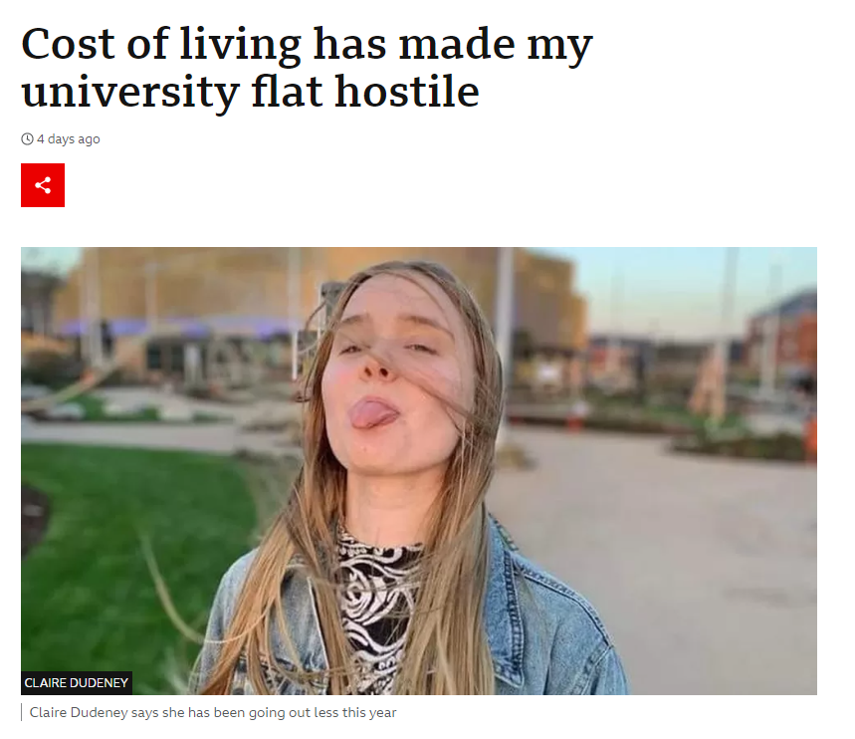
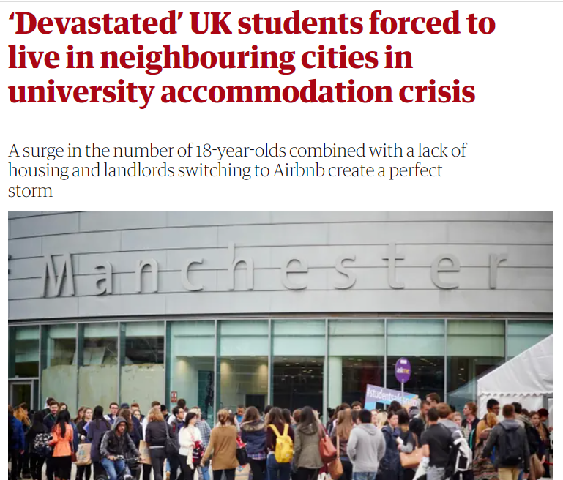
Cost of Living Consideration – Change of Addresses
Best Practice Advice/Suggestions
Students can change their contact details online at any time during the AY. Once the customer has passed authentication they can change their contact details over the phone at any time during the AY.
If the student is moving from the parental home to elsewhere or elsewhere to the parental home this will require a re-assessment, see below for further information.
Students can change their preferred contact method to electronic – but the customer may still receive correspondence by post such as system generated information. Customers can keep up to date via their online account where they can view and print correspondence.
In exceptional circumstances (between addresses or homeless) a student may wish to use a 3rd party address (or email address) on their account. They can do so with the 3rd parties permission – but must be granted and noted on the account (written confirmation should be digitally uploaded on student account).

Slide 20
Application Review
How to Guidance
Digital Evidence Upload – (what can/cannot be uploaded)

Slide 21
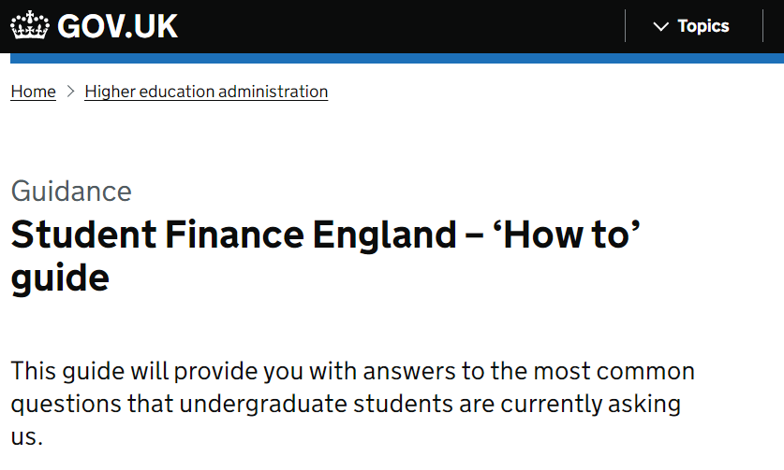
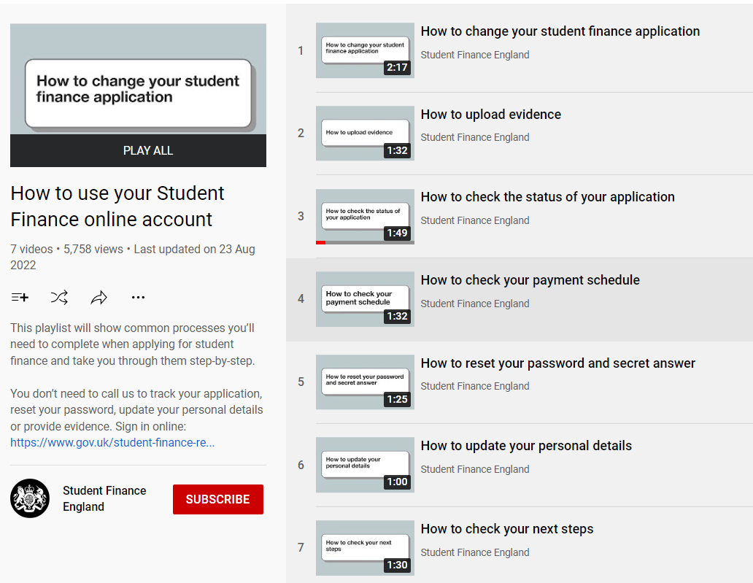
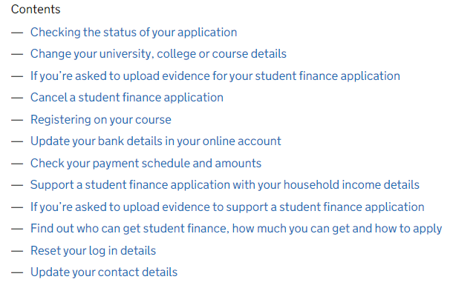
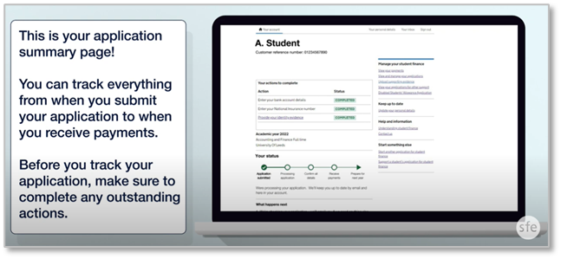
Application Enhancement – “How To”
A guidance page has been added to GOV.UK providing an answer to some of the most common
questions asked on student finance and applications. Essential messages are provided for each
subject along with a selection of short films and links to additional information or resources
Notes:
Links in pictures
https://www.gov.uk/guidance/student-finance-england-how-to-guide

Slide 22
Application Enhancement – Digital Evidence Upload
Providing SFE with the right evidence in the right way at the right time can seem confusing for many
students and their parents or partners:
To address this we have created guidance and a short film to explain evidence requirements and submission, including digital upload
Notes:
Links in pictures
https://www.gov.uk/guidance/guidance-for-students-parents-and-partners-providing-evidence-to-support-a-student-finance-application

Slide 23
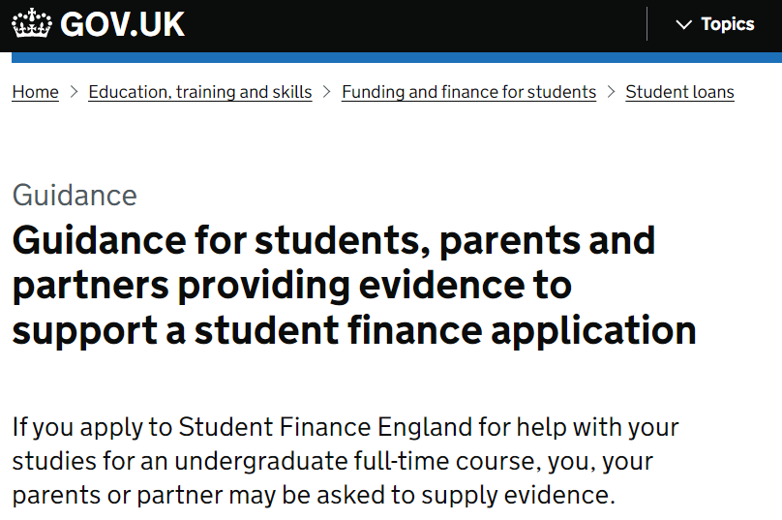
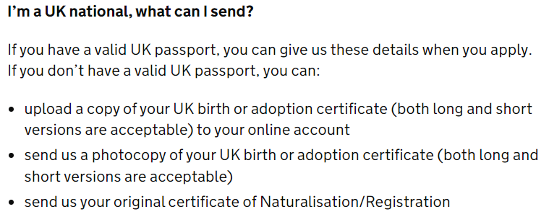
Application Enhancement – Digital Evidence Upload
UK customers applying for SFE undergraduate products will no longer be required to submit an original physical copy of their birth certificate to SFE. Instead, they will be able to upload a digital copy of their birth certificate using the evidence upload functionality from their online accounts
The customer facing guidance pages on GOV.UK have been updated to include this message
Our Customer Experience Team are leading an initiative to reduce the evidence burden on customers
This includes, where we can, to reduce the physical/original evidence burden by moving to digital alternatives
Or where we can, remove/reduce the evidence requirement in specific customer journeys
Ukrainian Nationals
From 2023/24
A Share Code, which will confirm Ukraine Scheme status and the issue and expiry date of that status (this can be accepted without a BRP or passport)
Notes:
Summary of Change
UK Customers applying for SFE UG products will no longer be required to submit an original physical copy of their birth certificate to SFE, instead they will be able to upload a digital copy of their birth certificate using the evidence upload functionality.
For background Information
CX are leading an initiative to reduce the evidence burden on customers, this includes scenarios where we can reduce the physical/original evidence burden by moving to digital alternatives or where we can remove or reduce the evidence requirement in specific customer journeys.
The focus of the first piece of work has been on UK customers who submit original physical birth certificates to support SFE UG applications, the reasoning behind this approach is there is functionality existing to already support a move to digital evidence, the regulatory policy in this space does not stipulate we need to see an original physical copy of a birth certificate and from a security risk position we have confidence that we can support the change without greater risk exposure for SLC.
Conclusion
This reduction in evidence, if greenlit will be a significant reduction in physical/original evidence for customers and will greatly enhance the customer journey.

Slide 24
STUDENT FINANCE OVERVIEW
REPAYMENT

Slide 25
Repayment – Plan 5 (2023/24)
From academic year 2023/24, loan repayment policies for undergraduate students
in England will be changing and key facts about how repayments will work include:
You won’t have to make repayments until your income is over a set threshold, which will be £25,000 a year until April 2027
From April 2027 the threshold is set to rise annually with inflation (RPI)
If you study a full-time course, you will be due to start repaying from the April
after completing your course or leaving/withdrawing from higher education
You’ll repay 9% of any income earned over the threshold and if employed in
the UK, the deductions will be made from your pay through the tax system
If your income drops below the threshold, your repayments will stop and any outstanding balance will be written-off 40 years after entering repayment
Notes:
https://educationhub.blog.gov.uk/2022/02/24/get-the-facts-about-student-loan-reform/
New borrowers commencing study from academic year 2023-24 onwards
There will be a new loan plan type for students who start courses from academic year 2023/24. The new loans will have:
o In-and-post-study interest rates of RPI+0%.
o A repayment threshold of £25,000, maintained at this level up to and including financial year 2026-27, and uprated by inflation (RPI) from April 2027 onwards.
o A repayment term length of 40 years.
Key messages
The new loan plan does ask graduates to repay for longer and from an income threshold of £25,000, but it also increases certainty for borrowers by reducing interest rates to match inflation only.
This ensures that, under these new terms, borrowers will not have to repay more than they have borrowed in real terms.
A student who completes their degree in summer 2026 with a loan on the new terms, and who commences a job with a salary of £28,000 a year, would expect to repay around £17 per month towards the cost of their higher education over financial year 2027-28.
Compared with borrowers on Plan 2 loan terms, borrowers with a loan on the new terms will repay – at most – up to £30 per month more in financial year 2027-28.
The Government will be keeping these new loan terms under review.

Slide 26
Repayment – Plan 5 (as at 2023/24)
Approximate repayment amounts based on the initial Plan 5 threshold of £25,000 using the applied deduction
rate of 9% of income earned over the threshold:
Income each year before tax | 9% will be deducted from | Monthly Repayment (Approx)
£25,000 | £0 | £0
£35,000 | £10,000 | £75
£40,000 | £15,000 | £112
£45,000 | £20,000 | £150
£50,000 | £25,000 | £187
9% Deducted from?
£22
Income
£28,000
£3,000
Monthly
Repayment?
Notes:
https://educationhub.blog.gov.uk/2022/02/24/get-the-facts-about-student-loan-reform/
New borrowers commencing study from academic year 2023-24 onwards
There will be a new loan plan type for students who start courses from academic year 2023/24. The new loans will have:
o In-and-post-study interest rates of RPI+0%.
o A repayment threshold of £25,000, maintained at this level up to and including financial year 2026-27, and uprated by inflation (RPI) from April 2027 onwards.
o A repayment term length of 40 years.
Key messages
The new loan plan does ask graduates to repay for longer and from an income threshold of £25,000, but it also increases certainty for borrowers by reducing interest rates to match inflation only.
This ensures that, under these new terms, borrowers will not have to repay more than they have borrowed in real terms.
A student who completes their degree in summer 2026 with a loan on the new terms, and who commences a job with a salary of £28,000 a year, would expect to repay around £17 per month towards the cost of their higher education over financial year 2027-28.
Compared with borrowers on Plan 2 loan terms, borrowers with a loan on the new terms will repay – at most – up to £30 per month more in financial year 2027-28.
The Government will be keeping these new loan terms under review.

Slide 27
Repayment – Plan 5 (projection at 2027/28)
How much per month? (projected figures)
Gross Annual Income | Approx Monthly (2023/24) @ £25,000 | Approx Monthly (2027/28) @ £25,710
£25,000 | £0 | £0
£28,000 | £22 | £17
£30,000 | £37 | £32
£35,000 | £75 | £69
£40,000 | £112 | £107
£45,000 | £150 | £144
£50,000 | £187 | £182
Notes:
Plan 2
The thresholds are £524 a week or £2,274 a month (before tax and other deductions). They change on 6 April every year.
Example
You’re paid weekly and your income changes each week. This week your income was £600, which is over the Plan 2 weekly threshold of £524.
Your income was £76 over the threshold (£600 minus £524). You will pay back £6 (9% of £76) this week.
Example
Your annual income is £28,800 and you are paid a regular monthly wage. This means that each month your income is £2,400 (£28,800 divided by 12). This is over the Plan 2 monthly threshold of £2,274.
Your income is £126 over the threshold (£2,400 minus £2,274). You will pay back £11 (9% of £126) each month.

Slide 28
STUDENT FINANCE OVERVIEW
BUDGETING AND KEY MESSAGES

Slide 29
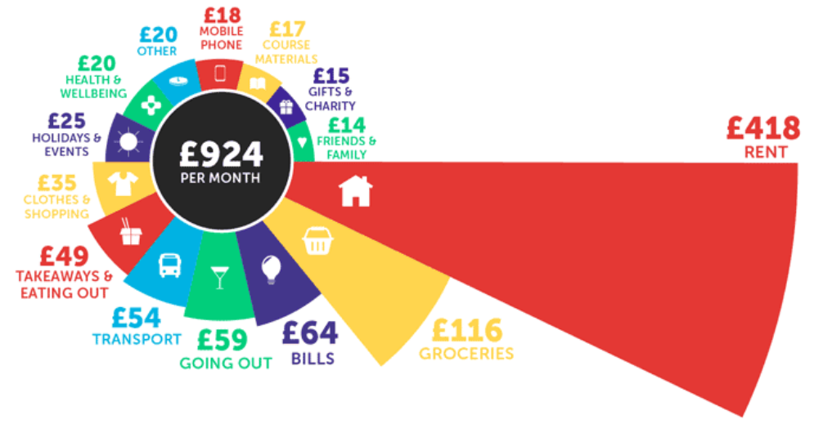
Step 1 - Consider the Costs…
Students across the UK spend an average of £924 each month, but on what?
Figures from Savethestudent.org Student Money Survey
Notes:
https://www.savethestudent.org/money/surveys/student-money-survey-2022-results.html
In last year's survey, the average student spent £810 per month. This has increased by around 14% this year, with students now spending an average of £924 each month.
Rent is by far the biggest monthly expense, accounting for about 45% of the monthly living costs.
Despite students generally spending much more this year than last year, rent is actually relatively consistent with the previous two years. In 2020, the average student spent £418 per month on rent, and in 2021, it went up slightly to £421. This year, the average has returned to £418 per month.

Slide 30
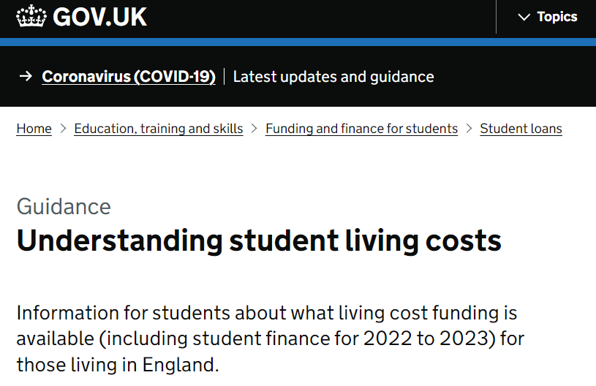
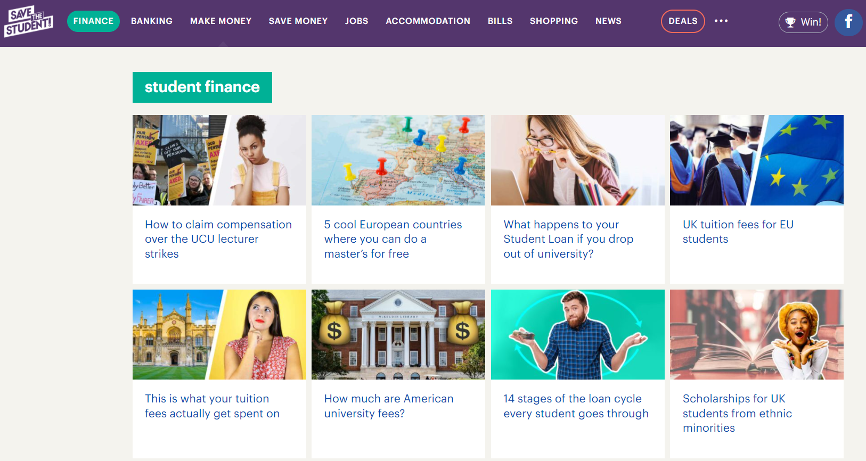
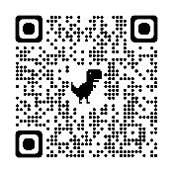
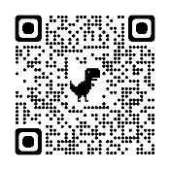
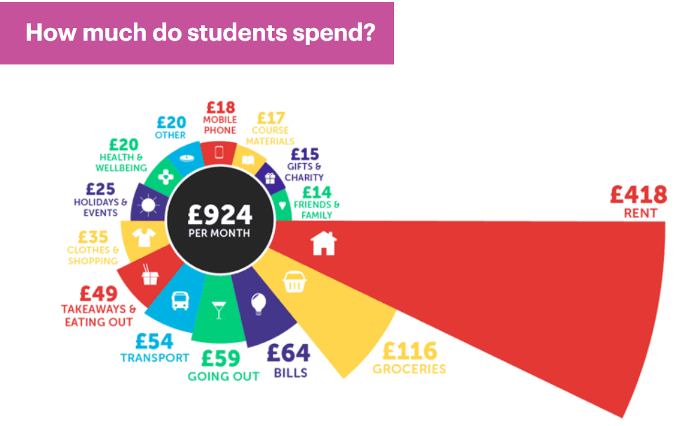
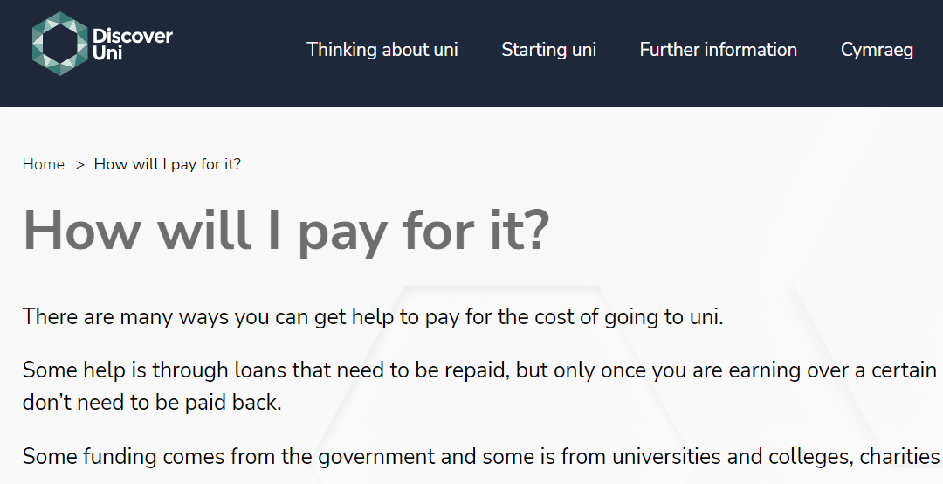
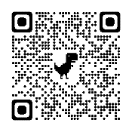
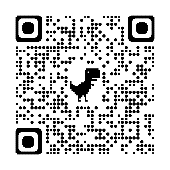
Step 2 – …Consider your Income
Sources of student money management and budgeting information include:
GOV.UK: www.gov.uk/student-finance
Understanding Living Costs guidance page
Discover Uni: https://discoveruni.gov.uk
Dedicated student money section
Save the Student: www.savethestudent.org
Advice and resources including money and accommodation surveys
Money Saving Expert: www.moneysavingexpert.com/students
Information, opinion, blogs and budgeting advice
i
Many university and college websites also feature helpful student finance guidance, budget planners and knowledge of local costs and expenses
Notes:
Links in text
https://www.gov.uk/guidance/understanding-student-living-costs
https://discoveruni.gov.uk/how-will-i-pay-for-it/
https://www.savethestudent.org/student-finance
https://www.moneysavingexpert.com/students/
https://www.thisismoney.co.uk/money/studentfinance/article-1633418/Student-budget-calculator-spend-fund-it.html

Slide 31
DSA OVERVIEW

Slide 32
WHAT IS DISABLED STUDENTS ALLOWANCE?
You can get the allowances on top of your other student finance
Disabled Students’ Allowance (DSA) helps pay the essential extra costs you might have as a direct result of your disability, including a long-term health condition, mental-health condition or specific learning difficulty, such as dyslexia
DSA doesn't depend on your household income – what you can get depends on your needs
You don’t have to pay or give anything back
A package of support will be pulled together to make sure that you can get the most out of your time at university – both in classroom and socially
DSA exists because anyone with a disability or condition that affects their ability to study should be at no disadvantage when studying at university. DSA support is meant to bridge the gap

Slide 33
STUDENTS WITH A DISABILITY / LEARNING DIFFICULTY
Apply Online at www.gov.uk.slc
Digitally Upload your medical evidence
We will ask you to attend a Study Needs Assessment
You will receive a breakdown of your support package (DSA2)
You will receive confirmation that you are eligible (DSA1)
Payments made to Providers
Apply online at www.gov.uk/slc. A 2-minute video about the application process is available here
The medical evidence you need to send depends on the disability or condition – more information available here
What is a Study Needs Assessment? Find out here
DSA Allowance per year for equipment, non medical help and general allowance. But in addition, extra allowance is available for travel costs – this is not subject to the cap
This maximum will be available to all DSA students (FT, PT, UG, PG)
Suppliers will invoice the DSA Team directly for support they have provided to students (students are liable for a £200 contribution of any laptop/PC recommendations). Some students are also agreed a General Allowance and are able to send receipts (student claims) to claim back these costs

Slide 34
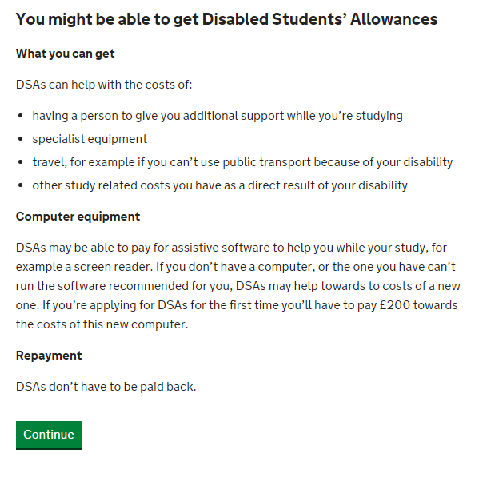
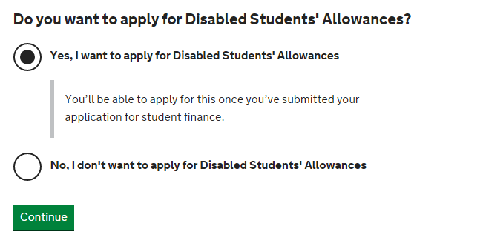
APPLY ONLINE – SFE UNDERGRAD ONLY
Notes:
Payments for DSA will come in the form of either a Supplier Invoice or a Student Claims.
Supplier Invoices are our largest workflow and we try to process these with 20 working days.
Student Claims are for those items where we have agreed reimbursement on the DSA2 letter and will generally cover Ink, Paper, Printing Costs which the student is required to purchase up front and then send the receipts to SFE. Again, like Medical Evidence, we can accept these receipts by email so do not require originals.
We know that the overall end to end journey takes around 14 weeks from Application to Entitlement and this is something we are aiming to reduce.

Slide 35
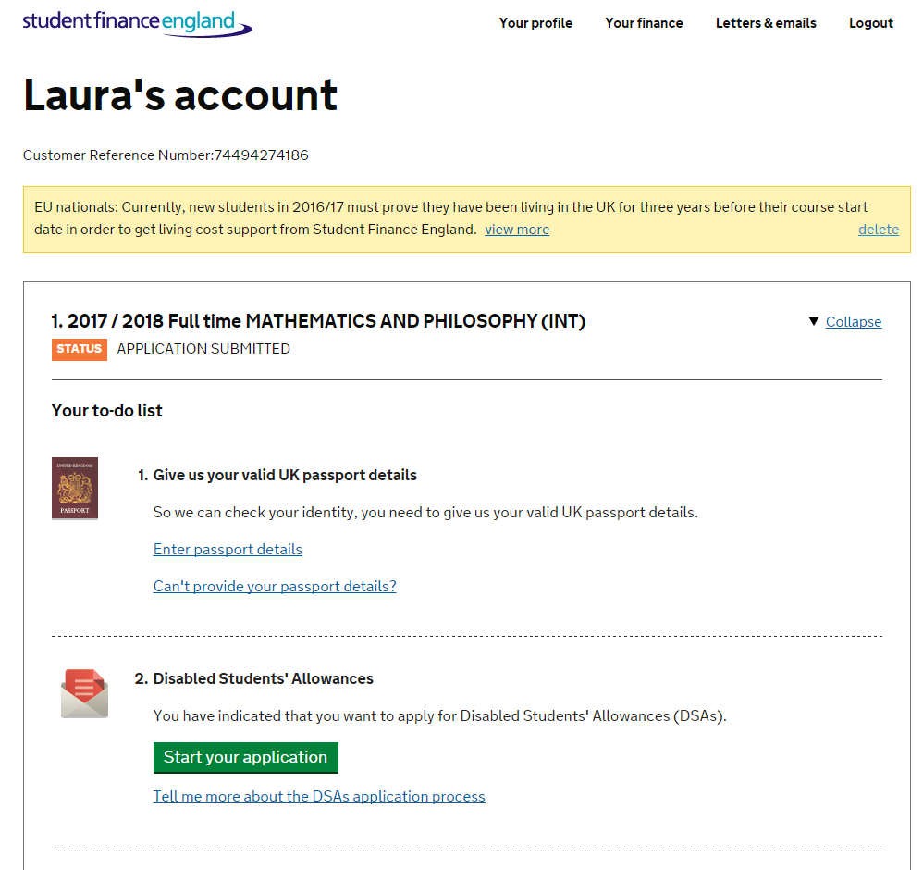
ONLINE APPLICATION – MY ACCOUNT
Notes:
Payments for DSA will come in the form of either a Supplier Invoice or a Student Claims.
Supplier Invoices are our largest workflow and we try to process these with 20 working days.
Student Claims are for those items where we have agreed reimbursement on the DSA2 letter and will generally cover Ink, Paper, Printing Costs which the student is required to purchase up front and then send the receipts to SFE. Again, like Medical Evidence, we can accept these receipts by email so do not require originals.
We know that the overall end to end journey takes around 14 weeks from Application to Entitlement and this is something we are aiming to reduce.

Slide 36
DSA 2021/22 – Application Submissions by Total % (New Only)

Slide 37
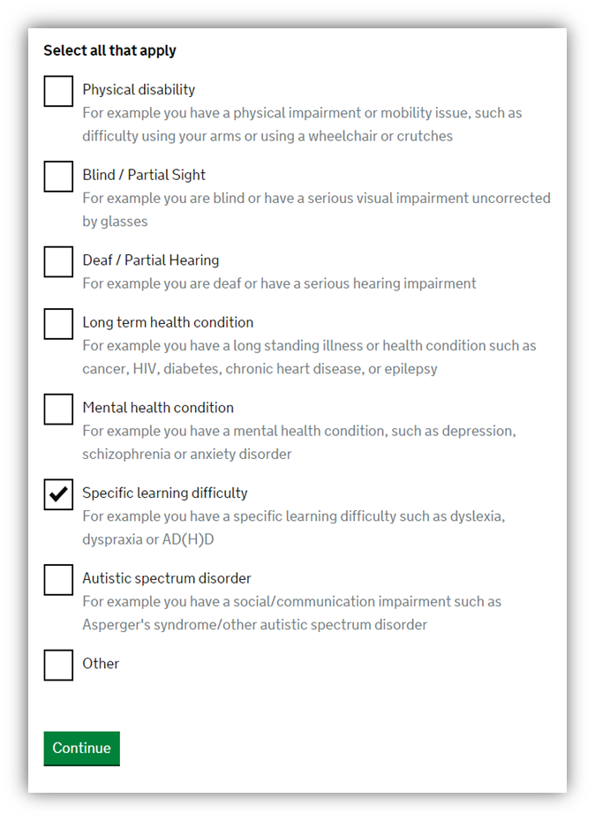
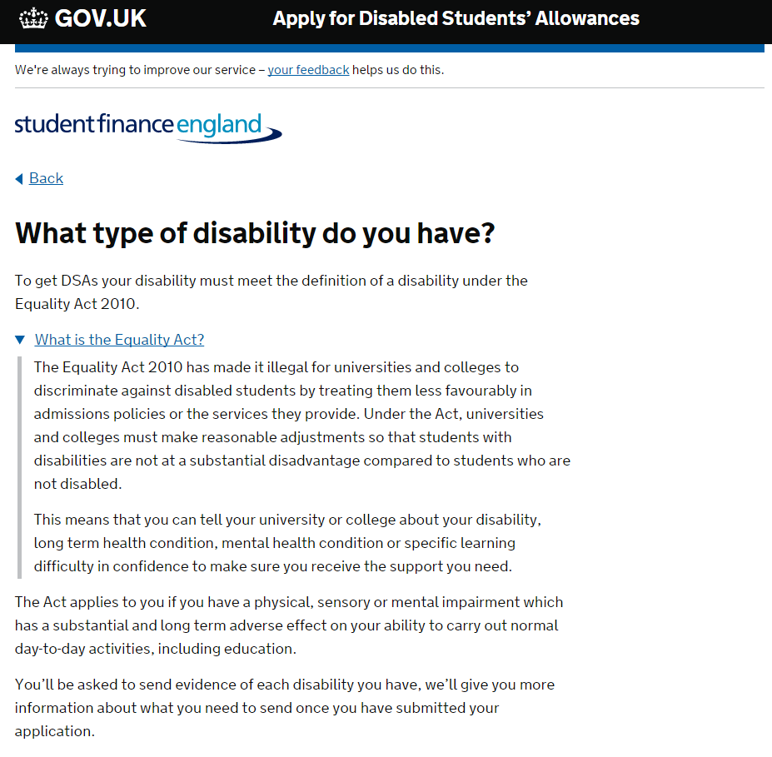
ONLINE APPLICATION – WHAT TYPE OF DISABILITY
Notes:
Payments for DSA will come in the form of either a Supplier Invoice or a Student Claims.
Supplier Invoices are our largest workflow and we try to process these with 20 working days.
Student Claims are for those items where we have agreed reimbursement on the DSA2 letter and will generally cover Ink, Paper, Printing Costs which the student is required to purchase up front and then send the receipts to SFE. Again, like Medical Evidence, we can accept these receipts by email so do not require originals.
We know that the overall end to end journey takes around 14 weeks from Application to Entitlement and this is something we are aiming to reduce.

Slide 38
DSA 2021/22 – Application Overview

Slide 39
Average Processing Times by Disability
Key
Red – Above the average end to end timescale (+98.63 days)
Amber – Average End to End timescale
Green – Below the average end to end timescale (-98.63 days)
Supporting Documents
Evidence Form :
https://media.slc.co.uk/sfe/2122/ft/sfe_dsa_disability_evidence_form_2122_o.pdf
Full DSA Guidance :
https://www.practitioners.slc.co.uk/media/1338/sfe_dsa_guidance-document-for-new-dsa-students_pdf_1617_d.pdf

Slide 40
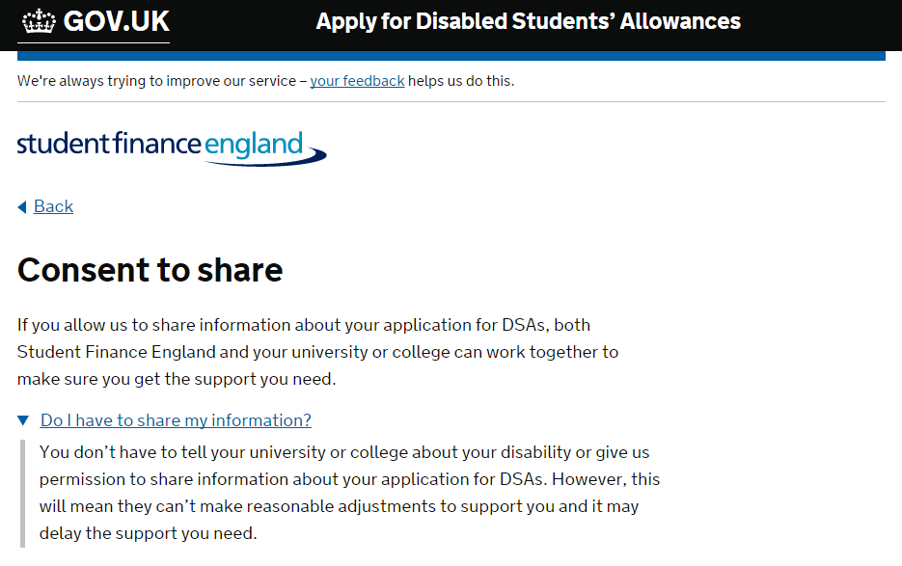
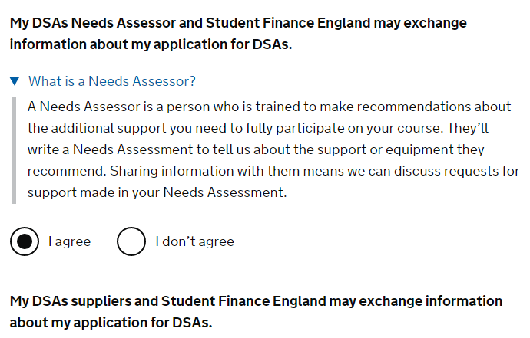
CONSENT TO SHARE
Notes:
Payments for DSA will come in the form of either a Supplier Invoice or a Student Claims.
Supplier Invoices are our largest workflow and we try to process these with 20 working days.
Student Claims are for those items where we have agreed reimbursement on the DSA2 letter and will generally cover Ink, Paper, Printing Costs which the student is required to purchase up front and then send the receipts to SFE. Again, like Medical Evidence, we can accept these receipts by email so do not require originals.
We know that the overall end to end journey takes around 14 weeks from Application to Entitlement and this is something we are aiming to reduce.

Slide 41
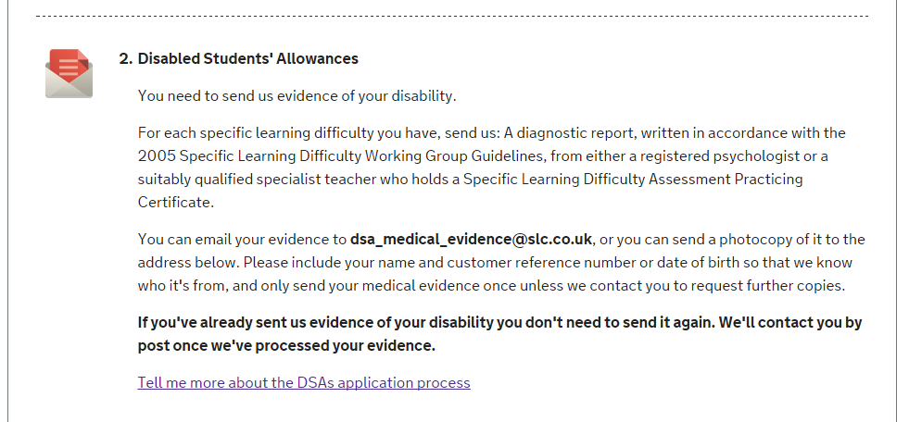
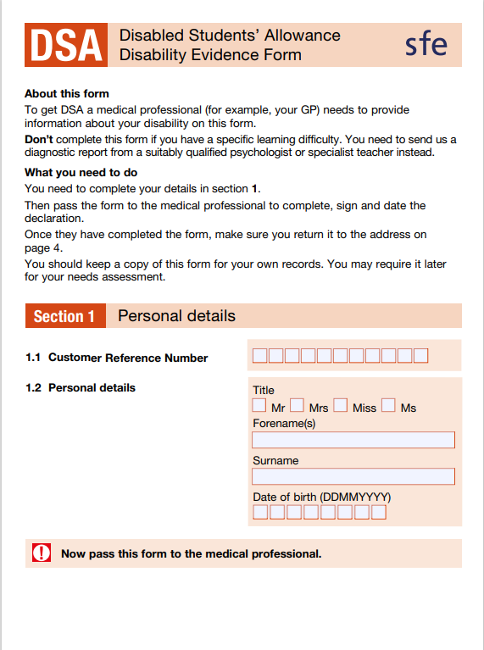
EVIDENCE AND SIGNATURE
Notes:
Payments for DSA will come in the form of either a Supplier Invoice or a Student Claims.
Supplier Invoices are our largest workflow and we try to process these with 20 working days.
Student Claims are for those items where we have agreed reimbursement on the DSA2 letter and will generally cover Ink, Paper, Printing Costs which the student is required to purchase up front and then send the receipts to SFE. Again, like Medical Evidence, we can accept these receipts by email so do not require originals.
We know that the overall end to end journey takes around 14 weeks from Application to Entitlement and this is something we are aiming to reduce.

Slide 42
Student Finance England
Facebook – https://www.facebook.com/SFEngland/
Twitter – https://twitter.com/SF_England
Instagram – https://www.instagram.com/studentfinance_england/
YouTube - https://www.youtube.com/user/SFEFILM
Student Finance Wales
Facebook – https://www.facebook.com/SFWales/
Twitter – https://twitter.com/SF_Wales
YouTube – https://www.youtube.com/user/SFWFILM

Slide 43
Many thanks for attending.
These slides and a recording of the session
will be delivered to the host shortly after finishing.

