Slide 1
CC Skills Creative Industries Overview and Resource Update
@ccskills ccskills.org.uk

Slide 2
Overview
Part A CC Skills who are we?
Part B Understanding the Creative Industries
Part C What are the jobs in the sector?
Part D Further Sources of Information
@ccskills ccskills.org.uk
Notes:
Introduce the session and Tony and remember to mention:
Timings
Breaks
Chat function and interactive activities

Slide 3
Creative & Cultural Skills – who are we?
UK wide charity
Work to create a fair and skilled cultural sector
Shape skills, education and employment best practice
Open up entry routes for those who are underrepresented
@ccskills ccskills.org.uk

Slide 4
Please help us to:
Increase understanding about the sector’s skills needs
Raise the profile of routes into the sector, including apprenticeships
Increase engagement between the sector and education providers
@ccskills ccskills.org.uk
Notes:
In order to help a more diverse range of young people pursue a career in the creative industries, we need more careers professionals to value the breadth and impact of our sector’s work along with the range of roles that exist. We hope some of the information we’ll share today will provide you with information that is of use when supporting the next generation to make career choices.
Some of our skills needs are misunderstood or overlooked, which potentially perpetuates myths about who should be working in our sector.
We must ensure that anyone with potential, regardless of background, personal circumstance or previous educational achievement are able to pursue a career in the creative industries
We believe educators will better understand the skills we need if they are working closely with the industry

Slide 5
Part B
Understanding the Creative Industries
@ccskills ccskills.org.uk
Notes:
Let’s take a look at how the sector is made up and how it impacts us day to day…

Slide 6
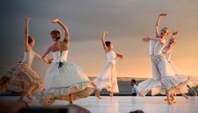
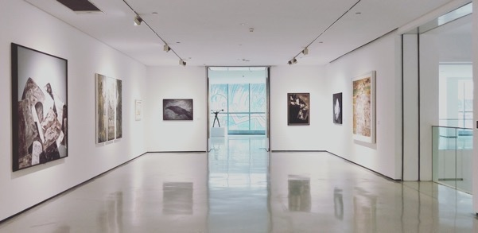
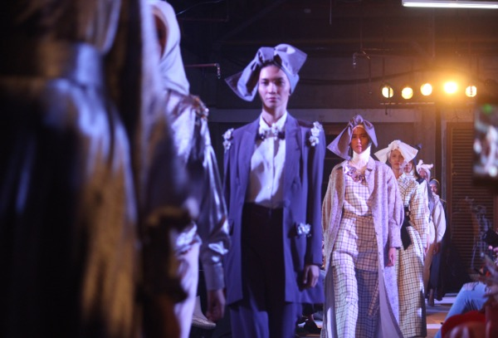
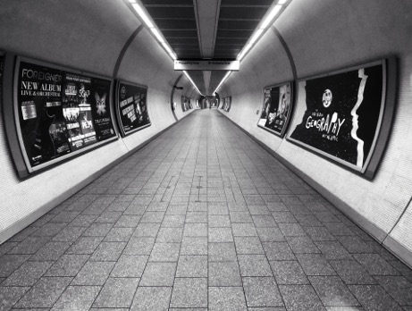
What do we mean by ‘Creative Industries’?
@ccskills ccskills.org.uk
Notes:
The term ‘creative industries’ started to be used about twenty years ago to describe a range of activities, some of which are amongst the oldest in history and some of which only came into existence with the advent of digital technologies.
In 1997, the Labour government decided to try and define the Creative Industries and assess the impact of the sector on the British economy. Drawing on research, they defined a number of areas of activity which all had in common the fact that they have their origin in individual creativity, skill and talent and have the potential to make money through the generation of intellectual property. 20 years later the concept of the creative industries and their importance is recognised by government.
In the UK we identify the creative industries as having a number of subsectors, which we’ll come onto.
Before I share the sector’s make up it would be good to hear:
Who here has worked in the Creative Industries before?
How would those who haven’t [worked in the sector] define the creative industries?
Before I take you through the sector’s make-up, let’s have a look at some examples (show film)

Slide 7
The12 Sub-sectors:
@ccskills ccskills.org.uk
Notes:
Introduce the subsectors: These are defined as: Advertising and marketing; Architecture; Crafts; Design (product, graphic, fashion); Film, TV, video, radio and photography; IT, software and computer services; Publishing; Museums, galleries and libraries; Music, performing and visual arts; Animation and VFX (visual effects); Video games; Heritage
Which subsectors do you currently work with?
Are there any subsectors you’re surprised to see feature within the creatine industries?

Slide 8
How do we connect with the Creative Industries?
The Creative Industries penetrate our lives each and every day…
When was the last time you turned on the TV?
Have you accessed a Podcast?
Used Youtube/Instagram/TikTok?
When was the last time you visited a museum or Library?
When was the last time you read or listened to a book?
@ccskills ccskills.org.uk
Notes:
Which of the following have you engaged with during lockdown? Radio/Music/Podcasts/Books/Online Museum Tours/Online Theatre/Films/TV/YouTube/Video Games/Crafts
What would you never leave the house without?
Summarise how the creative industries penetrate our lives, sometimes without even knowing it!

Slide 9
How do we connect with the Creative Industries?
The Creative Industries penetrate our lives each and every day…
The clothes you wear
The Packaging of your snack
Your wallpaper design
Your sofa
@ccskills ccskills.org.uk
Notes:
Which of the following have you engaged with during lockdown? Radio/Music/Podcasts/Books/Online Museum Tours/Online Theatre/Films/TV/YouTube/Video Games/Crafts
What would you never leave the house without?
Summarise how the creative industries penetrate our lives, sometimes without even knowing it!

Slide 10
Facts and Figures - Question 1
1. In 2019, the UK economic contribution (Gross Value Added) of the Creative Industries was?
£119. Billion
£110.2 Million
£1.5 Billion
@ccskills ccskills.org.uk
Notes:
​

Slide 11
Facts and Figures - Question 2
2. How many jobs do you think the Creative Industries accounts for?
500, 000 2 million 10 million
@ccskills ccskills.org.uk

Slide 12
Facts and Figures – Question 3
3. Which sector employs more people?
Creative Life Sciences Oil and Gas
@ccskills ccskills.org.uk
Notes:
Q3 – Creative (we are actually bigger than the automotive sector, life sciences, oil and gas and aerospace combined!),

Slide 13
Facts and Figures - Question 4
4. What percentage of creative industries workers are self-employed?
10% 25% 33%
@ccskills ccskills.org.uk
Notes:
Q4: What percentage of creative industries workers are self employed: 8% / 22% / 33%?​
A4: 33% ​

Slide 14
Facts and Figures – Question 5
68% of creative industries businesses have a turnover of less than £100,000:
True False
@ccskills ccskills.org.uk
Notes:
Q5 – true - this is a higher % than UK businesses as a whole which sits at 55%)​
​
Ask the group if there were any surprises?
​Encourage a brief discussion on their own perceptions of the industry verses actual facts.​
​

Slide 15
Creative businesses/employment
95%
Almost 95% of businesses are micro businesses
289,000 businesses operating in 2018
Vast majority (92%) operate in England
@ccskills ccskills.org.uk
Notes:
So you now know that the creative industries employs 2 million people and accounts for 1 in 11 jobs across the UK
But let me give you some more facts:
CI businesses account for 1 in 8 of all businesses in the UK
Almost 95% of creative industries businesses are micro businesses (less than 10 employees)
There are approximately 289,000 businesses operating within the creative industries (2018). The vast majority of these (92%) operate in England.
The largest single clusters are in London (50,000 businesses) followed by 22,000 in the South East (25% of the sector in total). This means 75% of the sector is outside of London and the SE.
60% of our jobs are filled by people with a degree or equivalent, compared to 34% of the rest of the working population, we believe this is contributing to us failing to be representative.
Almost 90% of workers at low or no risk from future automation
Much or our growth comes from new businesses, so we want to continue encouraging entrepreneurial spirit outside of London – we want schools to nurture this!
Creative industries exports make up 12% of the UK’s total exports, for example British music artists account for one in every eight album sales around the world. Therefore the creative industries help make us a great, global trading Nation.
If the creative industries keep growing at the same pace, they could create 900,000 new jobs by 2030! The current crisis poses a risk to this growth.
But, we have some issues, which is why we want to encourage a broader demographic to consider a career in the sector (go to next slide)…

Slide 16
In the Creative industries…
33% are self employed
12% have a declared disability
12.6% are from a minority community
38% of workers are aged between 16 and 34
40% of workers are female
@ccskills ccskills.org.uk
Notes:
Compare the above to the UK working population as follows:
15% self employed
13% have declared a disability so the CI is underperforming here (1% represents thousands of people)
12% BAME – BAME data should be understood at a region level, there are regions and subsectors which aren’t representative here.
35% aged 16-34
47% female
Important to note these statistics change by region and subsector. E.g. in the cultural sector 50% of creative workers are self employed. In screen only 5% declare a disability.
Explain that in terms of regional information, between 2010 and 2016, the creative industries have grown in every region of the UK. Advise participants that for regional statistics the further reading section at the end of the activity book contains some links, including the Nesta local profiles map, go to the next slide…

Slide 17
The North
North of England (North East, North West, Yorkshire and the Humber) represents 15% of Creative Industries employment, 13% of businesses and 10% of economic output (GVA)
https://pec.ac.uk/news/national-statistics-on-the-creative-industries

Slide 18
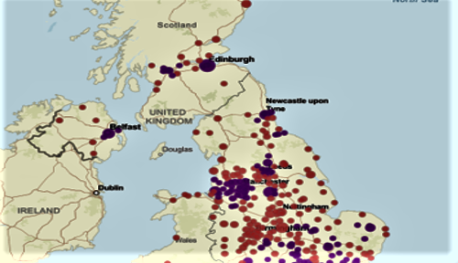
Creative Clusters
https://www.pec.ac.uk/research-reports/creative-radar
@ccskills ccskills.org.uk

Slide 19
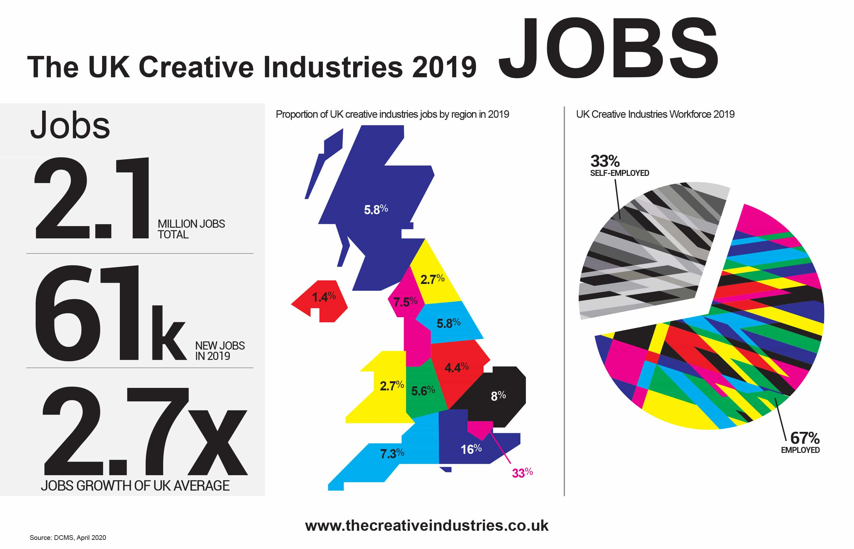
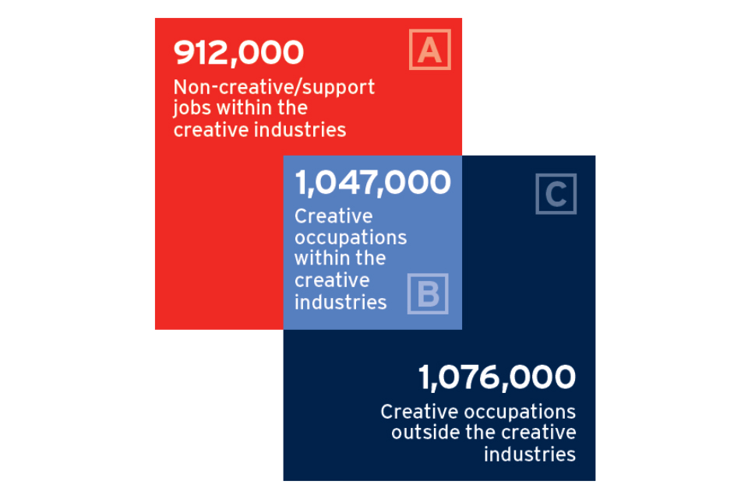
Some more data
Further Reading
@ccskills ccskills.org.uk
Notes:
We will send you some further reading following this session, which includes
Overview of the 12 sub-sectors (plus a note explaining it’s based on the DCMS definitions)
Sample job profiles
Career case studies (two case studies from the same subsector: one where someone has followed a linear career path and one that progressed via portfolio working).
Key agencies and bodies – England and UK-wide, Scotland, NI, Wales
Further reading

Slide 20
Yorkshire & Humberside
Employment
In 2017, the ONS estimated there were around 67,000 worker in the CIs in Yorkshire and the Humber which is 2.7% of the total employment in the region (ONS 2018). This puts the region 8th in terms of creative industries employment with a profile similar to that of Scotland. Five sub-sectors of the creative industries have above expected concentrations: advertising and marketing; architecture; design; IT, software and computer services; and museums, galleries and libraries. Almost 56% of the region’s creative industries employment is found in Leeds (33%), Sheffield (12%) and Bradford (11%) as one might expect given the size of these cities. Sheffield has significant employment in ‘crafts’ and Bradford does well for ‘publishing’.
https://screen-network.org.uk/wp-content/uploads/2021/02/Mapping-the-Scale-and-Scope-of-the-Creative-Industries-in-Yorkshire-and-the-Humber.pdf

Slide 21
Yorkshire & Humberside
Enterprises
The ONS estimates there were approximately 289,000 enterprises in the creative industries in 2018. This includes businesses, charities and community interest companies. Yorkshire and the Humber accounts for 4.55% or 13,190 of these enterprises and this represents 7.2% of the region’s total enterprises (ONS 2019). The spread of enterprises correlates with the profile of the UK. Leeds is the region’s main centre for creative industry enterprises with the highest share the region’s creative business for ‘advertising and marketing’, ‘design’, ‘film, TV, video and photography’, ‘IT, software and computer services’ and ‘publishing’ .
https://screen-network.org.uk/wp-content/uploads/2021/02/Mapping-the-Scale-and-Scope-of-the-Creative-Industries-in-Yorkshire-and-the-Humber.pdf

Slide 22
West Yorkshire
Our creative sector employs 48,000 people
Creative industries are worth £1.97 billion to our regional economy
Fastest creative sector growth outside London and Scotland
West Yorkshire Creative Industries Showcase
https://www.westyorks-ca.gov.uk/media/9493/wy-creative-industries-showcase.pdf

Slide 23
Yorkshire & Humberside
Wakefield:
Production Park is a Yorkshire based family-owned SME founded in 1991 specialising in production, technology and education for the live events industry. It has grown to become the largest cluster of live events businesses in Europe.
In 2005, Production Park built Europe’s first arena rehearsal studio in South Kirkby, Wakefield, now home to a thriving community of live events businesses and freelancers, with up to 700 people on site during busy production periods.
https://www.productionpark.co.uk/
https://pec.ac.uk/blog/creative-clusters-case-studies

Slide 24
Yorkshire & Humberside
Wakefield:
Production Park is a Yorkshire based family-owned SME founded in 1991 specialising in production, technology and education for the live events industry. It has grown to become the largest cluster of live events businesses in Europe.
In 2005, Production Park built Europe’s first arena rehearsal studio in South Kirkby, Wakefield, now home to a thriving community of live events businesses and freelancers, with up to 700 people on site during busy production periods.
https://www.productionpark.co.uk/
https://pec.ac.uk/blog/creative-clusters-case-studies

Slide 25
West Yorkshire
The Leeds City Region - Textile Innovation Cluster
Leeds City Region is a key geographical cluster in the UK’s fashion industry, a sector employing nearly one million people nationally, and a major exporter of high value products. An estimated 10,000 people are employed by the region’s textile design and manufacturing companies, supplying internationally renowned and prestigious brands such as Chanel, Prada, Burberry, Erdem and Paul Smith. Fabric produced in the region is exported across the world, with some companies exporting over 90% of their creative output
https://futurefashionfactory.org/
https://pec.ac.uk/blog/creative-clusters-case-studies

Slide 26
West Yorkshire
Leeds Music
Music:Leeds is a not-for-profit organisation established to act as a single, centralised point of contact that will coordinate activity to support, promote, develop and grow music-based activity within the city and wider region. The organisation’s strategy is centred around three core areas: • Creative Development & Business Growth • Placemaking & Tourism • Access to Music
https://cdn2.assets-servd.host/creative-pec/production/assets/publications/PEC-Discussion-Paper-Building-sustainable-regional-music-industry-clusters-January-2023.pdf

Slide 27
West Yorkshire - SEF, Skills&LMI Reports
Strategic Economic Framework
https://www.westyorks-ca.gov.uk/growing-the-economy/strategic-economic-framework/policies-and-strategies/culture/
West Yorkshire Skills Report
https://www.westyorks-ca.gov.uk/media/7885/local-skills-report-2022-final-pdf.pdf
LMI report
https://futuregoals.co.uk/media/r5spo1dg/lmi-report-2022.pdf

Slide 28
@ccskills ccskills.org.uk
Notes:
We’ve shared lots of information, so let’s just take a break (decide length depending on the time of day that the training is delivered)

Slide 29
Part C
Working in the sector - what does this look like?
@ccskills ccskills.org.uk
Notes:
So let’s start again by looking at what working in the sector looks like…

Slide 30
Examples of the types of roles in the sector
Craft
Artists
Planning, Scheduling and Programming
Performing
Customers, Audiences and Services
Designing
Producing
Writing
Preservation and Conservation
Business/Finance/ Admin
Cross-cutting
IP
Illustrator
@ccskills ccskills.org.uk
Notes:
People tend to transfer between subsectors where skills and knowledge are shared.
Run through the different types of roles. Note these are not exhaustive but rather more designed to show how broad and varied occupations are in the sector:
Craft - occupations that involve physically making something tangible, this can include anything from blacksmithing, costume making, prop making, hair and makeup specialist, and craft practitioners (anyone go to a Christmas craft fair?)
Artists – make art in response to their own themes and research. They help us learn about the world around us.
Planning, scheduling & programming – artistic programming such as theatre, music or festival programmes, curating exhibitions, Cinema, TV and radio programming etc
Performing – musicians, dancers, actors, spoken word artists etc.
Customers, audiences and services – education and outreach/learning and participation, front of house, retail & customer service inc. hospitality
Designing – processes, places, buildings, products, and innovating! Think about the crisp packets we mentioned earlier.
Producing – bringing creative ideas to life – Software programming, turning an idea into reality.
Writing – writing, vlogging, story-telling, research, journalism.
Preservation & Conservation – those who look after, mend and preserve our objects, buildings, sites of historical and environmental importance
Business – operational occupations from strategic stakeholder management, finance, management, leadership, HR, administration, fundraising.
Cross-cutting: creative occupations that apply to all subsectors including, marketing, communications and digital.
Remind attendees that lots of people in the Creative Industries have Portfolio Careers, where they work on one or more project at a time and move from project to project. Portfolio workers covers a plethora of roles from business consultancy, technical and creative roles.

Slide 31
The most common skills gaps are:
53%
47%
45%
44%
40%
Marketing & comms
Problem Solving
Business Support
Fundraising
Social Media
@ccskills ccskills.org.uk
Notes:
Skills gaps: insufficient proficiency or skills to do a job to the required level.
Skills shortages: difficulty in filling vacancies due to lack of applicants with appropriate skills, qualifications or experience.
Explain that research was undertaken by Creative & Cultural Skills which identified the following:
33.3 % of businesses surveyed reported skills gaps and shortages.
The most common gaps identified are:
Business marketing and communication (53%)
Problem-solving (47%)
Vocational skills relating to business support occupations (45%) including financial planning, digital skills, people management and leadership.
Fundraising skills (44%)
Social media Skills (40%)
Skills shortages were reported in:
fundraising skills; and
business marketing and communication skills.
Point to make: Explain that a lot of our knowledge and skills cross over with STEM [e.g. theatre technicians need to understand weight distribution, dimensions etc]
Point to make: Skills are integral to the continued growth of the creative industries as they underpin productivity and innovation. Research suggests that current and likely future needs are centred on the development of a range of transferable skills in addition to the technical skills required to undertake specific roles within the sector.

Slide 32
Discover Creative Careers
https://discovercreative.careers/
@ccskills ccskills.org.uk
Notes:
It isn’t possible to look at all job profiles across the Creative Industries in great detail, but as part of the Creative Careers Programme, Screenskills has developed the Discover! Creative Careers Finder, which allows young people and those who work with them to search for job profiles based on their interests and what they enjoy. Let’s take a look.
NB choose a subsector to explore which hasn’t had much coverage during the session.
At the end of the demo: whilst we’ve highlighted the breadth in the types of roles that exist across the sector, we’ve also shared that almost 50% of our jobs are not sector specific, which is where we find some of our biggest skills gaps. Let’s take a look…(go to next slide)

Slide 33
Apprenticeships
Archaeological Technician
Museum and Gallery Technician
Library, Information and Archives Services Assistant
Cultural Heritage Conservation Technician
Assistant Historic Environment Advisor
Cultural Registrar
Cultural Heritage Conservator
Historic Environment Advisor
Archaeological Specialist
Curator
Archivist
Broadcast Production Assistant
Junior Journalist
Junior Content Producer
Photographic Assistant
Publishing Assistant
Post Production Technical Operator
Media Production Coordinator
Associate Project Manager
Creative Digital Designer
Journalist
Creative Industries Production Manager
Puppet Maker
Creative Venue Technician
Live Event Technician
Live Event Rigger
Props Technician
Jewellery Maker
Assistant Technical Director (Visual Effects)
Junior 2D Artist (Visual Effects)
Digital Community Manager
Junior Animator
Storyboard Artist
Leather Craftsperson
Fashion Studio Assistant
Fashion and Textiles Pattern Cutter
Costume Performance Support Technician
Garment Maker
Bespoke Tailor and Cutter
Software Development Technician
Data Technician
Data Analyst
Software Developer
Data Scientist
Creative Digital Design Professional
Digital and Technology Solution Professional
@ccskills ccskills.org.uk
Notes:
We appreciate this slide isn’t easy on the eye. What’s listed here are just some (not all) of the apprenticeship training options for our sector. This is far from exhaustive and doesn’t include the many generic occupations that are crucial to our sector, such as administration, finance, legal, customer service, HR etc.
All of these apprenticeship options have been developed by employers in the sector based on industry need. We need more careers professionals to promote the apprenticeship training route. Progression from an apprenticeship into further paid employment or training is over 90%.

Slide 34
Institute of Apprenticeships
https://www.instituteforapprenticeships.org/

Slide 35
Part D
Further Sources of Information
@ccskills ccskills.org.uk

Slide 36
Why is IAG Important?
Because we’re the fastest growing sector in the economy, with 900,000 new jobs forecast by 2030 (pre Covid)
We need to diversify our workforce to make us relevant and sustainable - we must appeal to the widest pool of talent
We have myriad occupations suited to those who are creative, technical, scientific, mathematical, caring, people-focused (and not), administrative and/or business-minded. We are for EVERYONE!
@ccskills ccskills.org.uk

Slide 37
Other Sources of Information - Reports
https://lordslibrary.parliament.uk/arts-and-creative-industries-the-case-for-a-strategy/
https://pec.ac.uk/
https://assets.publishing.service.gov.uk/government/uploads/system/uploads/attachment_data/file/1115486/Understanding_the_growth_potential_of_creative_clusters_-_accessible.pdf
@ccskills ccskills.org.uk
Notes:
We will send you some further reading following this session, which includes broader info on subsector definitions, key agencies and bodies, LEPs that have a Creative Industries priority focus, and two case studies from the same subsector: one where someone has followed a linear career path and one that progressed via portfolio working.

Slide 38
Other Sources of Information 2 - Organisations
https://www.publishers.org.uk/openbooks/
https://www.bookcareers.com/?_ga=2.15829686.1089372009.1681938397-1303214509.1681938397
https://rps.org/resources/
https://www.thecreativeindustries.co.uk/
https://www.screenyorkshire.co.uk/skills-and-talent/
https://www.createbritain.com/
This is only a few examples!
@ccskills ccskills.org.uk
Notes:
We will send you some further reading following this session, which includes broader info on subsector definitions, key agencies and bodies, LEPs that have a Creative Industries priority focus, and two case studies from the same subsector: one where someone has followed a linear career path and one that progressed via portfolio working.

Slide 39
State of Creativity Conference
https://pec.ac.uk/events/the-state-of-creativity

Slide 40
Thank you
Contact us at: info@ccskills.org.uk @CCSkills ccskills.org.uk
@ccskills ccskills.org.uk

