Slide 1
Disability and the Education Journey
Elizabeth Wright
Paralympic Medalist, speaker,
ABC disability affairs reporter.
www.elizabethwright.net
elizabeth@elizabethwright.net

Slide 2
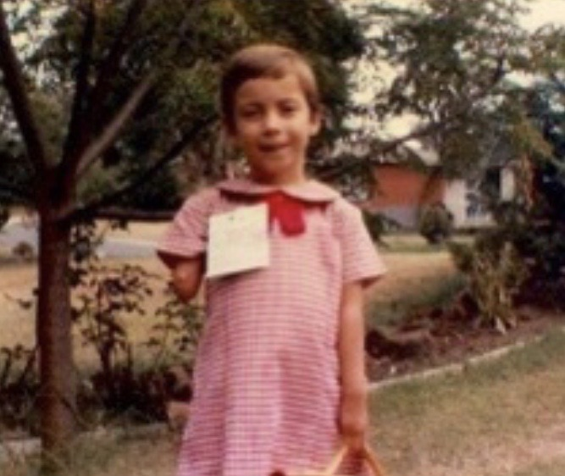

Slide 3
Barriers.

Slide 4
Barriers I faced at School:
Physical accessibility: there were a lot of steps at both my primary and high school. There were also issues in certain classrooms, i.e., science had tall benches and stools to sit on that were extremely difficult for me to get on.
Negative attitudes from teachers: not all teachers, most were supportive, but some teachers held me back because of beliefs they had about disability. This included the careers counsellor in high school.
Attitudes from peers: most of me peers were inclusive, but some weren’t, and some took inclusivity over the top!
Not understanding what supports were available: I didn’t find out until year 11 that I could have support in exams.

Slide 5
Solutions.

Slide 6
Solutions that would help avoid these barriers…
Open, good relationships with parents/carers and students with great communication.
Open minded teachers who are willing to learn and grow on their disability allyship journey.
A clear understanding of what supports are out there for students, including support in school and also during exam time.
Also a clear understanding of what supports there are for students to go into university and/or work.
Career counsellors that are aware of pathways and alternative pathways into university and/or work, there is no “one way” into life post school i.e., I didn’t go to university until I was a mature age student.
Auditing of the physical environment of the school/university, where are you doing it well and where can there be improvements.
Understand the law around disability, accessibility and discrimination. A lot of people are not aware of what their legal requirements are.

Slide 7
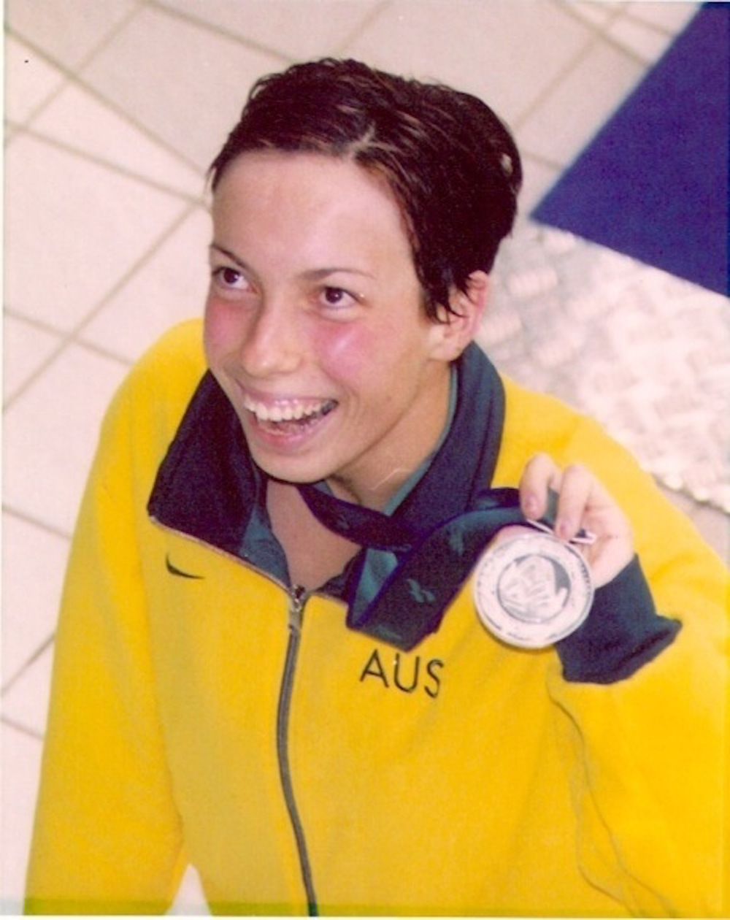
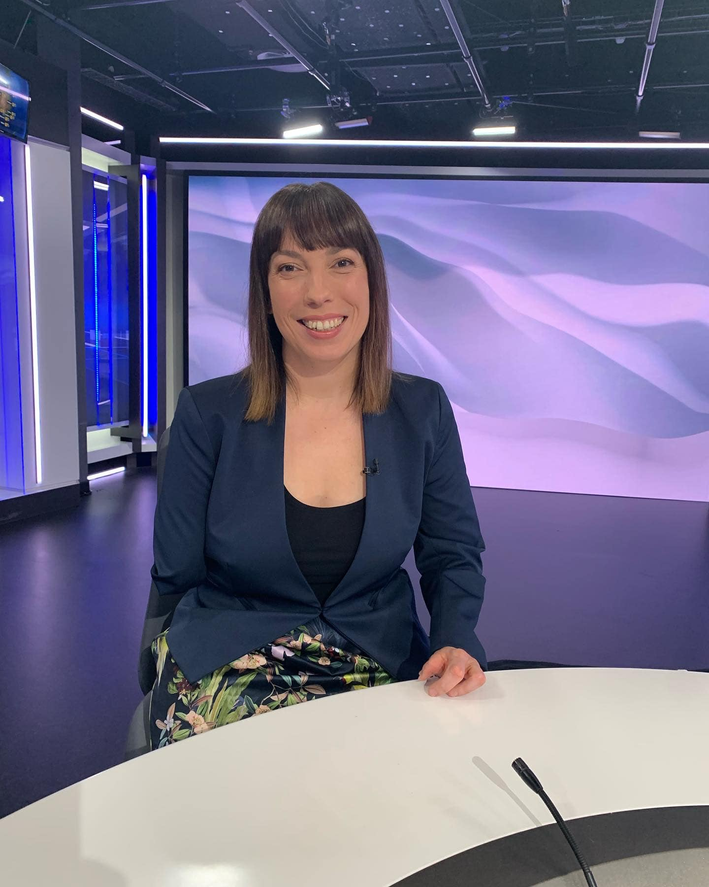
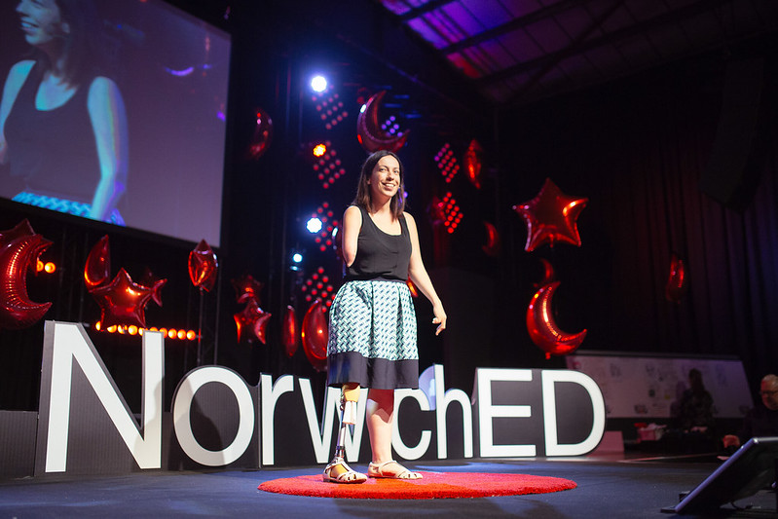

Slide 8
My advice to you…

Slide 9
Disability and the Education Journey
Elizabeth Wright
Paralympic Medalist, speaker,
ABC disability affairs reporter.
www.elizabethwright.net
elizabeth@elizabethwright.net

