Slide 1
Guidance for facilitator
Approx. 45–60-minute session depending how long you spend on activities.
The activities could always be set as an independent homework task.
This session will cover intro to FE and choosing a FE course
Some activities in this session require a computer/internet

Slide 2
An introduction to further education:
Part 2

Slide 3
Choosing a Further Education course
Notes:
We are now going to look at the courses on offer - There are 4 main learning styles/
We all learn in different ways and knowing which style works best for you can be really helpful. Knowing your learning style can make study and revision easier as well as help you choose a course.
Easy to remember as the acronym ‘VARK’

Slide 4
Activity: Page 32
Type ‘Arden University Learning Styles’ into your search engine to find the quiz, which is called ‘What type of learner are you?’
(What type of learner are you? (arden.ac.uk))
Notes:
Hard copy page 39
Arden University have created a short online quiz that can help you work out your learning style - We all use a combination of styles and nobody is 100% one or the other! However, you will probably have a favourite.
Type ‘Arden University Learning Styles’ into your search engine to find the quiz, which is called ‘What type of learner are you?’ What type of learner are you? (arden.ac.uk)
After completing the quiz, make some notes in the boxes on p.33
Ask students what type of learners they are? Were they surprised by the result?

Slide 5
Activity: Page 33
Now head over to the UCAS website (www.ucas.com). In the search box, type ‘Post 16 qualifications you can take’. Click on the heading of the same name, and this will give you the chance to read about the different options in more detail.
Notes:
Hard copy page 40
Now head over to the UCAS website (www.ucas.com). In the search box, type ‘Post 16 qualifications you can take’. Click on the heading of the same name, and this will give you the chance to read about the different options in more detail.
Read the info and note down anything new you learned about a type of course that interests you/that you think you will study.
Ask students to answer the question: DID YOU LEARN ANYTHING NEW?

Slide 6
A Levels
T-Levels
Types of Courses
BTECs
Apprenticeships

Slide 7
A Levels
What are A Levels?
A Levels are academic subject-based qualifications that can lead to university, an apprenticeship or work. Students normally study three or four A Levels and are assessed using exams.
You’ll find A Levels in traditional subjects such as English or Biology, but also courses you may not have studied at GCSE, like Psychology or Law.
What grades to I need to achieve A Levels?
To be able to study A Levels, you normally need five GCSEs at Grades 9 to 4, including English and Maths. Some subjects will require GCSE grades in specific subjects and these might be different at different providers.
If you’re thinking about going to university, some higher education courses also ask for specific A Levels or combinations of A Levels.
Notes:
Its worth noting to students that its worth checking entry requirements of different schools, sixth forms or colleges they’re interested in. A Levels can also be a good way to keep options open if students are not sure what job/career they would like in the future.
Its worth noting to students that more information about A Levels is available in the workbook

Slide 8
Vocational Subjects
What are Vocational Qualifications?
Vocational courses are designed to help you learn in a practical way about a specific job area. They can help you get the skills you need to kickstart your career or progress into higher education.
BTECs and other Level 3 vocational qualifications prepare students and allow them to progress onto a range of courses in higher education
Types of vocational qualifications:
BTECs
Apprenticeships
T-Levels
Notes:
IT’s IMPORTANT TO NOTE:
CAN VOCATIONAL QUALIFICATIONS LEAD ONTO HIGHER EDUCATION?
There are many myths around vocational qualifications and not being able to progress onto higher education. In fact, BTECs and other Level 3 vocational qualifications prepare students and allow them to progress onto a range of courses in higher education. However, some courses and higher education institutions do request A Levels and, in some circumstances, specific A Levels.
Check in advance whether a vocational qualification will allow students to progress onto the higher education course of their choice.

Slide 9
BTECs
What are BTECs?
BTECs offer practical skills, as well as relevant work experience in some circumstances.
There are usually less exams and a wider variety of assessment methods than you might find with A Levels. If you study BTECs, you may be assessed using practical tasks, observations and work-based assessments. You may also have to write some essays during a BTEC course.
Some schools, sixth forms and colleges let students study BTECs alongside A Levels.
There are lots of subjects available from Health and Social Care to Motor Vehicle Technology.
Notes:
If students are thinking of ‘mixing’ qualifications and studying A Levels and BTECs, they can visit the BBC Bitesize page to find out more: Can I mix A-levels and vocational qualifications? - BBC Bitesize

Slide 10
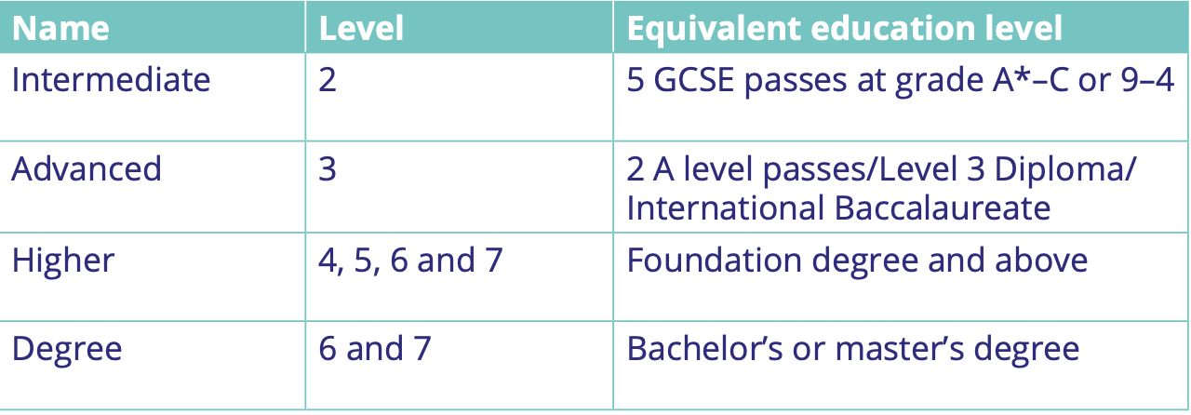
Apprenticeships
Notes:
This slide shows the different apprenticeship levels.

Slide 11
Apprenticeships
What is an Apprenticeship?
Apprenticeships combine practical training in a job with study. As an apprentice you’ll, be an employee earning a wage and work alongside experienced staff.
Most apprentices spend around 80% of their time in the workplace and 20% studying. Completing studies alongside work mean that being able to manage your time well is a must!
Colleges and Universities treat apprentices the same as other part-time students. They have access to services such as student support, library and social activities.
There is a wide variety of apprenticeships from nursing to zoology.
Check entry requirements carefully as they can often depend on the level and sector.

Slide 12
Activity: Page 39
You can find out what apprenticeships are on offer in your local area by searching ‘find an apprenticeship Gov.uk’
You don’t have to include a ‘key word’, just put your postcode in and how far you’d realistically want/be able to travel
Notes:
Hard copy page 46
Ask students to type in find an apprenticeship Gov.uk in a search engine.
Then ask students to complete the questions on page 39.

Slide 13
T-Level
What are T Levels?
T-Levels are a new and exciting type of qualifications.
They aim to give students the knowledge and practical experience to get jobs that require specific skills.
T-Levels are designed in partnership with businesses and offer students the chance to undertake work placements as part of their course. This could be a good option for you if you know what job or industry you want to work in.
T-Levels are still very new and offered in the subject areas below:
Education and childcare
Digital Production, design and development
Design, surveying and planning for construction
T-Levels will be recognised by higher education providers!

Slide 14
Final thoughts...
Do your research and make sure your chosen path is the right one for you!
It can be hard to put 100% effort into something you don’t enjoy, so try and think of subjects you really enjoy and explore where they could take you.
Remember to think about how you like to learn and does this suit you, this could influence what course and careers are right for you.
Everyone is different, what’s right for your friend may not be right for you. Ask yourself these 3 questions:
What do I enjoy doing?
What would I like to do?
What do I want from MY life?

Slide 15
Applying to Further Education
The FE application process
Find a 6th form, college, or training provider
Research your course options
Research your travel options
Attend an open event
Additional costs
Complete your application form
Attend an interview
Wait to hear whether you’ve been offered a place

Slide 16
Activity: Page 46
Using Careerpilot or Google Maps, find two FE providers in your area
Find out how far away the providers are
What methods of transport are available to you?
How long would it take you to get to them?
Write down 3 questions you could ask at an open day…
Notes:
Hard copy page 54
Ask students to type in find an apprenticeship Gov.uk in a search engine.
Then ask students to complete the questions on page 39.

Slide 17
College interviews
You’ll attend interviews for lots of different things throughout your life! Different types of interviews need different skills
We often think of interviews as being for the benefit of the interviewer. But interviews are also a great opportunity for you to talk about yourself and your future ambitions, and to find out more about the course and college life.
Preparation is key for interviews. The best way to prepare is to answer some practice questions!

Slide 18
Activity: Page 48
Have a think about a college and course you might be interested in, and answer the following questions…
Why have you decided to apply to us?
What do you want to gain from the course?
Where do you see yourself in five years?
What do you think your strengths and weaknesses are?
Do you have any questions for me?
Notes:
Hard copy page 56 & 57
Ask students to type in find an apprenticeship Gov.uk in a search engine.
Then ask students to complete the questions on page 39.

