Slide 1
Guidance for facilitator
Approx. 45-minute session
This session will cover intro to HE, school vs HE, routes to HE, choosing a course and choosing a university
Answers to the jargon buster activity are at the back of the workbook
Some activities in the second part of this session require a computer/internet OR university prospectuses from at least two institutions
For the interview activity on p. 81, the facilitator can be the interviewee OR students can be set homework to speak to someone they know who has been to university.

Slide 2
An introduction to Higher Education:
Part 1

Slide 3
What is higher education?
HE for short
Typically what you study after you finish Year 13/Year 2, if you decide to continue in education.
Higher education includes:
Getting a degree at a university
Getting a degree at an FE college
Higher National Certificates (HNC) and Higher National Diplomas (HND)
Foundation degrees
You don’t have to study HE but there are lots of benefits…

Slide 4
Activity: Page 55
Draw lines to match the words on the left hand to the definitions in the right hand side!
Notes:
Hard copy 66

Slide 5
Benefits of higher education
Can be a fantastic opportunity to boost your career options
Can also improve your chances of getting a well-paid job - graduates are likely to earn more money over their lifetime than non-graduates
You can study your very favourite subject
Meet loads of new people
Take part in a huge range of extra-curricular activities
Volunteering opportunities
Earn money
Live away from home if you want to
…the list is endless!
It’s also important to remember that HE isn’t for everybody and it’s certainly
not the only way to be successful. Make sure you do what’s right for you!

Slide 6
Activity: Page 58
Use the two spider diagrams to note down words or phrases that come to mind about school and college, and then higher education. Can you spot any key similarities or differences?
Don’t worry about getting anything ‘wrong’ – we’ll go through it together soon!
Notes:
Hard copy page 69

Slide 7
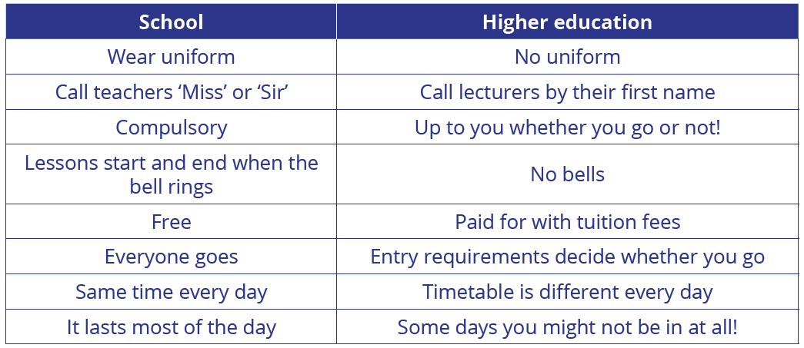
School vs HE

Slide 8
Lectures and seminars
Lessons at HE are usually called lectures and seminars:
Lectures
Seminars
When a tutor delivers a presentation on a topic and students listen and take notes. They are an opportunity to gather information for projects and assignments.
Usually smaller group gatherings, where students have the opportunity to discuss the information they have found. Seminars are fairly similar in style to lessons at school.
Depending on your chosen course, you might also have tutorials (smaller catch ups with staff), workshops/labs (practical, hands-on sessions) or other types of lessons.

Slide 9
Alternative Routes to HE

Slide 10
Alternative routes to HE
Many students choose to go to university to study higher education, but this isn’t the only way to get a degree! More and more students are studying at colleges, with more than 240 in the UK offering HE courses.
What are the benefits of studying HE at a college?
Smaller class sizes and more personal study support
Local providers
Lower tuition fees (usually)
Flexible study options

Slide 11
Alternative routes to HE
As well as traditional degrees, there’s also a wide range of other HE qualifications:
Foundation year
Foundation degree
HNCs & HNDs
A two year course, equivalent to the first 2 years of a full degree. Can be ‘topped-up’ with a final year to achieve a full degree.
Higher National Certificate (HNC): One-year work-related course equivalent to first year of degree
Higher National Diploma (HND): Two-year course equivalent to first two years of degree.
A one year course which allows students to develop the knowledge and skills they need to move onto a full degree.

Slide 12
Higher level & degree apprenticeships
Higher level apprenticeships provide an opportunity to gain high level qualifications with workplace input
Degree apprenticeships are similar, but allow you to gain a full degree or even a master’s degree!
What subjects can you study?
Construction
Agriculture
Animal care
Arts & media
Science & maths
Health
Public Services
Care
Digital
Creative & design
… and lots more!

Slide 13
Degree apprenticeships
To do a degree apprenticeship, you first need to find a job with an employer who offers an apprenticeship
Once you have the job, you can then apply for the course
You won’t have to pay for tuition or training, as these costs will be covered by your employer
You will receive at least the apprentice National Minimum Wage
If you’d like to find out more about degree apprenticeships, search ‘UCAS degree apprenticeships’ in your search engine!

Slide 14
Choosing a university and course

Slide 15
Choosing a course
Choosing what to study is a big decision that can affect your career for the rest of your life!
You can apply for up to five courses, and these can be at different universities. Some people choose to apply for five different courses, whilst others choose to apply for the same course at all five universities
There are more than 65,000 courses available in the UK, at more than 395 providers!

Slide 16
Different types of course
A lot of standard degrees take three years to complete.
Some courses, such as Architecture or Medicine, can take up to 10 years to complete training in!
Most people choose just one subject to study at Higher Education.
However, there are also different ways of studying…
Part-time/distance
Sandwich course
Some courses are available to be studied more flexibly, on a part-time or distance-learning basis.
Joint honours
These offer work placement years, ‘sandwiched’ between your other years of study!
Depending on your interests, you might be able to take what is called a ‘joint honours’ course, e.g. History and Politics.

Slide 17
HE courses
You’ll have heard of the more ‘traditional’ HE courses, such as English Literature, Biology, Business or Nursing, but did you know you can also study degrees in…
Air Transport with Helicopter Training
Surf Science
Ethical Hacking
Brewing and Distilling
Circus and Physical Performance
Floral Design
Prop Making
… and loads more!
The courses you choose at A Level/BTEC may affect the courses you can choose at HE. If you have a particular HE course in mind, do some research nice and early to make sure your FE choices support this!

Slide 18
Turn to page 65 in your workbook
Make a note of any courses you think you might be interested in studying at HE.
If you’re struggling, ask yourself: if you could get a degree in ANYTHING, what would it be?! You might be surprised what you can study…
Notes:
Hard copy page 76

Slide 19
Move onto page 77 in your workbook
Choose a course that you might want to study and look at the websites of two different universities that offer it. Can you see any differences between the two courses?
Make lists comparing the two courses using the table provided.
Notes:
Hard copy page 80

Slide 20
Choosing a university
Choosing where to study is a big decision!
You can apply for up to five courses, and these can be at different universities
Some questions you might want to ask yourself…
Do you already have any institutions in mind?
Close to home or far away?
Does it offer the course you want?
Big city, small town or countryside?
What is the accommodation like?
What facilities does it have?

Slide 21
Different types of universities
University centres/colleges
Colleges and university centres can also offer HE courses
Usually some in your local area
Russell Group universities
24 in the UK
Specialise in research
Highly competitive
Specialist institutions
Some subjects have entire universities or colleges dedicated to them!
E.g. conservatoires (performing and visual arts)

Slide 22
Factors to consider
City or countryside?
Likely to have different ‘feels’ or facilities
Campus or non-campus?
Campus = all buildings on one site, close together (sometimes accommodation too!)
Non-campus = buildings and facilities spread out across a town or city
Facilities
Libraries
IT facilities
Subject-specific
Hobbies

Slide 23
Turn to page 69 in your workbook
Using either university websites (you can find universities and colleges on UCAS.com) or prospectuses, fill in the table to compare two institutions.
Does one institution stand out to you more than the other? Why?
Notes:
Hard copy page 77

Slide 24
Page 70: Do your research
Do you know anyone who has been to university? Maybe a family member or teacher? Use the questions to ask them about their experiences. You also have space to make up your own questions!
Note their answers in the space provided.
If you’re doing this activity with your teacher in class, take it in turns to ask questions as a group.
Notes:
Hard copy page 81

Slide 25
Turn to page 71 in your workbook
Let’s do a bit more thinking about degree apprenticeships. Using what you’ve learned this morning, consider the similarities and differences between traditional degrees and degree apprenticeships.
You might want to do some online research to help with this…
Notes:
Hard copy page 82

