Slide 1
Guidance for facilitator
Approx. 45-minute session
This session will cover UCAS, personal statements, interviews, student finance and accommodation
No additional resources required (other than the workbook!)

Slide 2
An introduction to Higher Education:
Part 2

Slide 3
HE sounds great! So what now?
Last time we talked about routes into HE, choosing a course and choosing a university. But what happens next?
Submit an application
Applications are submitted in Year 13/Year 2 of your FE studies
Applications for university/college degrees are submitted through UCAS
Applications for degree apprenticeships are managed differently – we’ll discuss this in a later session!

Slide 4
UCAS stands for ‘Universities and Colleges Admissions Service’
Allows you to create one application which is then sent to all of your college/university choices
You can choose up to 5 universities and courses. These can be different courses at different universities, the same course at different universities or different courses at one university.
The application asks about things like your personal details and grades, as well as asking you to write a personal statement.

Slide 5
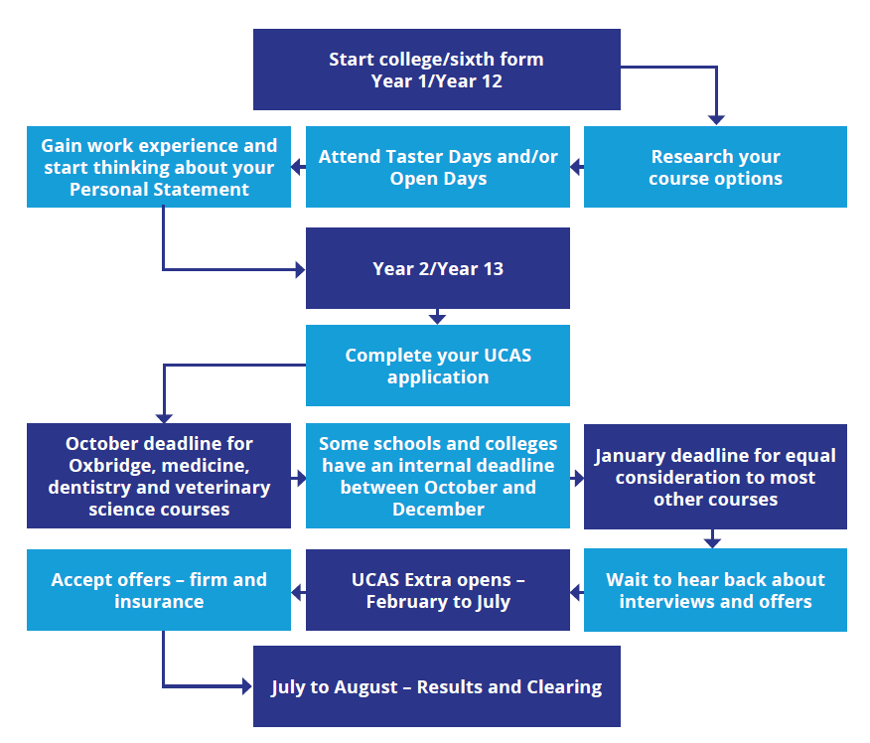

Slide 6
Personal Statements

Slide 7
Personal statements
This is the most important part of your UCAS application
It’s your chance to tell universities and colleges why you’re so fantastic!
You may also have to write personal statements for your FE courses and for job applications later on in life.
What do you need to talk about?
Why you’re applying for the course, job or opportunity
What you’re good at
Work experience (if you have any)
Career aspirations
Skills and abilities
Other interests

Slide 8
Turn to page 75 in your workbook
Use the prompts provided to think about why you might want to apply to HE, and the skills and experience you already have.
You might find inspiration in things you’ve done at school, at home, work experience/job or in your social life! Can you remember some of the things you thought of in session one?
Notes:
Hard copy page 86

Slide 9
What happens after you’ve applied?
Universities will look at all the applications they receive and begin to make offers.
Different types of offers:
Conditional – This is when you are made an offer based on you achieving specific entry requirements, e.g. grades.
Unconditional – This type of offer guarantees you a place on the course based on the qualifications or experience you already have.
Once you have received your offers and chosen your course and university, you enroll onto your course in late September.

Slide 10
UCAS Extra and Clearing
For students who don’t have an offer of place at the end of their application process, there are two functions designed to help get a place on a course:
UCAS Extra – This allows you to apply for additional courses once you’ve used up all of your places. This is for students who have either not been offered a place or have declined all of their offers.
Clearing – This is how universities and colleges fill remaining places on their courses. You can apply for a course through clearing if you’re not already holding an offer from a university or college, and the course still has places. Clearing usually takes place from Results Day onwards.

Slide 11
Interviews

Slide 12
Interviews
Interviews are when you have a face-to-face (in-person or virtually) meeting to talk about why you would be a good fit for the opportunity on offer. You may have done a bit of work around interviews already in the ‘Intro to FE’ section.
You could have an interview for:
Once you’ve submitted your application, some HE courses will ask you to attend an interview or audition before they offer you a place.
A place at college
A place at university
A job
Other paid and recreational opportunities e.g. volunteering

Slide 13
Quick activity
Turn to the person next to you and tell them one of your biggest strengths as a person. Then swap over.
You have two minutes…

Slide 14
Turn to page 78 in your workbook
Have a go at this activity to practice talking about yourself. These are some of the most common questions asked during interviews.
Notes:
Hard copy page 89

Slide 15
Preparing for interviews
You’re likely to hear about interview for courses or jobs via email or through the post. You might be asked to prepare a presentation on a relevant topic or a portfolio showcasing your work.
How to prepare:
Read the instructions you have received carefully
Check whether you need to prepare any materials or presentations for your interview
Practice interview questions
Make sure you have all of the contact and location details that you need for the day
Interviewing online? Make sure you know which platform you’re using and do a trial run
Interviewing in person? Familiarise yourself with the location and how you’re getting there.

Slide 16
Types of interview
There are a few different types of interview:
One-to-one: Where it’s just you and the interviewer in the room
Panel: Where you’re interviewed by more than one person
Group: Where you’re interviewed alongside other people applying for the same opportunity. This might involve you takin part in an activity with other applicants to showcase your skills.

Slide 17
Auditions and portfolios
If you’re applying to a specialist institution, you might be asked to attend an audition or produce a portfolio.
Auditions: An opportunity to showcase your talents! Prepare a short piece that is relevant to your course and perform it for members of staff from the course.
Portfolios: A collection of your best work, designed to show admissions tutors your style and skill. These are often required for creative courses.

Slide 18
Student Finance

Slide 19
Student Finance
What word – just one word – comes into your head when you hear…
Let’s talk about it
“student finance”?
Be ready to feed back with your answers!
For the most up-to-date information a good starting point is the government's student finance website: https://www.gov.uk/student-finance
Notes:
The discussion could go in various directions. Try to ensure that overall the students get two key points:
1. For up-to-date reliable information they should visit the government website as a start point.
2. Debates on the value for money of Higher Education will always be based on opinion. But it should be remembered that on financial terms you will only ever repay if you have benefited from studying in Higher Education. Often it’s the non-financial benefits which people cite as the most valuable from having studied at a higher level, such as: meeting new people; travel; time to think about what you want to do; discover new interests and talents; etc.

Slide 20
Student Finance
Student finance is a big topic that you’ll hear loads more about in the coming years. For now, we’ll just have a look at a brief overview.
Student finance is the money that students can borrow from the government to help them pay for their course, accommodation and general living costs whilst studying.
What is student finance?

Slide 21
Student Finance - loans
There are two key parts of a student finance loan:
Tuition fee loan: This is paid to the university or college to cover the cost of the course. As of September 26th 2022, universities can charge up to £9,250 per years for their courses. The tuition fee loan is paid directly to the university or college by the government.
Maintenance loan: This loan is paid directly to you, the student, once per term to help cover living costs such as accommodation, bills, food and travel.

Slide 22
Student Finance – additional support
There are also grants, bursaries and scholarships available across the UK. The might be available to students with additional support needs, those who achieve highly in particular subjects or who are from low income backgrounds.
Students with extra support needs may be eligible for Disabled Students’ Allowance (DSA). This can help to pay for specialist equipment and other expenses.

Slide 23
Student Finance – repayments
The idea of repaying a loan can seem scary and overwhelming! However, there are lots of things in place to make sure that people can afford to repay their loans in a safe and worry-free way.
Some key facts to remember about student loan repayments are:
You won’t start repaying your loan until the April after you graduate
You will not make any repayments until you are earning over £27,295
If you are earning this minimum figure, repayments generally cost less than a cup of coffee per week
If you ever drop below this salary amount, your repayments stop.

Slide 24
Tuition fees – Question 1
What is the maximum tuition fee a university or college can charge per year?
£5,500
£9,250
£15,350
£7,750
£12,800
£20,150
Notes:
For the most up-to-date information see: https://www.gov.uk/student-finance

Slide 25
Tuition fees – Question 2
How much tuition fee do you pay straight away?
0%
15%
50%
100%
10%
30%
80%
Notes:
Repayments will be discussed later but suffice to say that no repayments will ever be made until after you finish your studies and after you start financially benefiting from your studies which means earning over £25,725 per year.

Slide 26
How to find out how much you can apply for…
Use the Student Finance England calculator to see the size of loan you can apply for: https://www.gov.uk/student-finance-calculator

Slide 27
Top tips
If in full-time study
Take some money with you.
You normally get your Maintenance
Loan 3 – 5 days after you enroll.
Open a student bank account
Different banks have different offers, e.g. free 16 – 25 railcard. Many also give you an interest free overdraft.
Part-time work
It is advised that students work a maximum of 10 – 12 hours per week.
Plan and budget!
Maintenance Loans are paid in three instalments during the year.
Apprentice salaries may be paid monthly.
So you need to budget to make it last!
Make the most of student discounts
The National Union of Students (NUS) / TOTUM card gives you discounts in many shops, restaurants, and cinemas.
There are often reductions in travel costs for young people.

Slide 28
Accommodation

Slide 29
Accommodation
Choosing where to live whilst you study is a big decision! Your accommodation will be your home away from home.
One of the first decisions students need to make about accommodation is whether to live at home or move into student accommodation. This is a personal choice for each student, and there’s no right or wrong answer!
Have a chat with the person next to you about where you might choose to live at university or college. Make some notes in the space provided on p. 82.

Slide 30
Home vs away
Why live at home?
Why live away from home?
Home comforts
Existing support nextworks (e.g. friends and family)
Saving money
Existing responsibilities (e.g. a job, caring responsibilities)
Meet new people
Your chosen institution is close to home
Gain independence
Excitement of living somewhere new
Learn new life skills (e.g. cooking, paying bills, etc.)

Slide 31
Wellbeing check-in Page 85-86
Take a few moments to check in with yourself about how you're feeling today. You don't need to share this with anyone else!
Notes:
Hard copy page 97 & 98

