Slide 1

Student Finance
Notes:
All information is correct for 2023 entry

Slide 2


Snap Thought…
What word – just one word – comes into your head when you hear…
“student finance”?
Let’s talk about it
Where do you get information
on student finance?
Are these reliable sources?
Who could you ask for information?
Notes:
Allow students an opportunity to answer the following question. Answer any misconceptions and discuss reliable/ unreliable sources. It will be useful to ensure to have the names of specific UCAS/ Careers contacts in the school to refer student on to post the presentation.

Slide 3

What we’ll cover
1) What support is available?
2) How do you access it?
3) How and when to repay?
4) How to manage your money?
Student Finance England provides financial support to students entering higher education in the UK, on behalf of the UK government.
https://www.gov.uk/student-finance
Notes:
Ensure students are aware that questions about their personal circumstances will not be answered today and instead they should ask SFE.

Slide 4
Who can access Student Finance England?
UK nationals (also known as a home students)
Those living in the UK, Channel Islands or Isle of Man for 3 years before the start date of their course
Students who have not have studied any Higher Education course in the past in any county
European Students starting a course on or after 1st August 2021, who have settled or pre-settled status under the EU Settlement Scheme
Students who came to the UK from the EU after 1st January 2021, may need to apply for a visa to study here. Visit https://www.gov.uk/student-finance/eu-students for advice on how Brexit has affected Student Finance.
Notes:
It could be useful to send links directly to students who have altering circumstances to home students.

Slide 5
What support is available?
Tuition Fee Loan
Maintenance Fee
Loan
Additional Funding

Slide 6
Question: What are Tuition Fees?
A
The cost of day to day living as a student
B
The fee the government charges a provider to run a course
C
The amount it costs a provider to put a student through a higher education course
D
The Fees a Higher Education provider charges to study a course

Slide 7
Question: What are Tuition Fees?
D
The Fees a Higher Education provider charges to study a course

Slide 8
Tuition Fees
What is the maximum tuition fee a university or college can charge per year?
£7,750
£9,250
£15,350
£7,750
£12,800
£20,150
Notes:
For the most up-to-date information see: https://www.gov.uk/student-finance

Slide 9
Tuition Fees
How much tuition fee do you pay straight away?
0%
15%
50%
100%
10%
30%
80%
Notes:
Repayments will be discussed later but suffice to say that no repayments will ever be made until after you finish your studies and after you start financially benefiting from your studies which currently means earning over £25,000 per year.
Ensure students are aware that unlike regular loans this can be subject to change.

Slide 10
Tuition Fee Loan
Public higher education providers can charge up to £9,250 per year for their course
You DO NOT have to pay this up front
A Tuition Fee Loan is available from Student Finance to cover the fee charged by your higher education provider
Your Tuition Fee Loan is paid directly to your higher education provider at the start of the academic year
Notes:
Ensure students are aware that they will not physically ‘see’ this money and they do not have to worry about ensuring it gets sent to their HE provider. However, what students MUST ensure they do is attend registration events at the University as it is only once they are registered that the correct university will be paid and they will begin receiving their maintenance loans.
Ensure students are aware that at the point they apply for student finance they will be putting the university they hope to attend, but depending on what happens between May and Results day they may change where they end up going! In which case they just log on to SFE and update their uni choice- simple!

Slide 11
Question: What does a maintenance loan cover?
A
Holidays
B
Day to day living costs
C
Transport
D
Repairs to the property you are living in

Slide 12
Question: What does a maintenance loan cover?
B
Day to day living costs
C
Transport

Slide 13
Maintenance Loan
A loan paid directly to your bank account in 3 instalments across the year, to help with living costs while at university.
The amount of Maintenance Loan you can get depends on where you live as well as your household income
Notes:
Discuss the types of things their maintenance loan will have to cover and how this will change depending on whether they are living at home or in rented accommodation. Ensure students are aware that not all rented accommodation is all inclusive of bills; however, many first year halls will include this. You could also mention the differences between catered and uncatered accommodation.

Slide 14
Maintenance Loan
How much can I get?
Household Income | Living at Home | Living Elsewhere | Living in London
£25,000 & under | £8,400 | £9,978 | £13,022
£30,000
£35,000
£40,000
£45,000
£50,000
£55,000
£65,000 + | £3,698 | £4,651 | £6,485
Figures correct as of 2023-2024. Check the Student Finance website for the latest changes.
Notes:
Ensure students are aware they will need to open conversations at home about household income BUT make parents aware they will NOT have the share their financial information with their student at any point. They receive a separate log on to student finance to add this information.

Slide 15


Maintenance Loan
Use the Student Finance England calculator to see the size of loan you can apply for:
https://www.gov.uk/student-finance-calculator
Notes:
You could click the link and show students how this would work.

Slide 16



What is additional funding?
Additional funding is any financial support that students can apply for outside of tuition and maintenance loans.
Not everyone will be eligible for additional funding.
The funding can be based on multiple factors.

Slide 17
Additional Funding
The additional funding you could receive will vary depending on:
Where you’re applying
The course that you want to do
Your grades
Your personal circumstances
Any additional needs you may have
Some examples…
NHS Courses
Bursaries and Scholarships
Care-experienced or estranged
Disability Support
Notes:
Explain to students that while additional funding can mean university support, it can also mean parental support or money from a part time job. As well as looking for grants and bursaries from their university they should also look in their local area, sometimes some areas advertise these in the newspaper or online.
Some NHS courses are fully or partially funded- if students are particularly interested in these you could search for examples.

Slide 18
Additional Funding
Bursaries and Scholarships
Extra sources of financial support are available that are usually called bursary schemes, scholarships or grants.
These are separate to Student Finance and you need to apply to these directly through your chosen university or college
Unlike Student Loans, you don’t need to pay these back, so it’s essentially free money
Not everyone is eligible, you need to meet certain criteria, so make sure you do your research!
Try going to your HE provider’s website and look for any ‘Financial Support’
pages
Notes:
Each university will offer a range of grants and bursaries HOWEVER these usually have strict deadlines for applications so make sure to have a look early to see what support you can get,

Slide 19
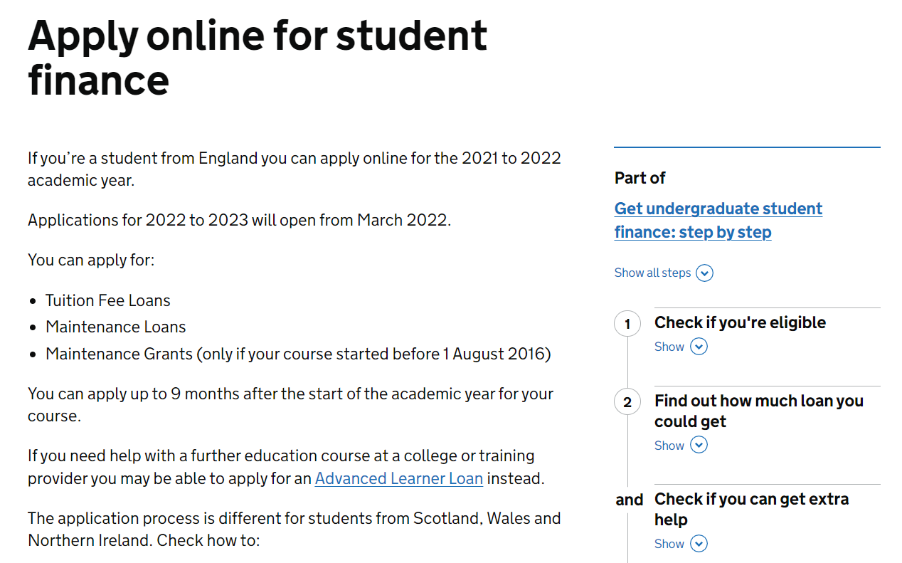
How do you access StudentFinanceEngland?
Apply online between March and May – don’t miss the deadline (end of May)!
Student Finance will ask for your household income,
so be prepared to get this from your parents/carers
Students don’t need a confirmed place at university to apply for student finance – simply state preferred course choice. This can be changed later.

Slide 20
Question: What is the income threshold that you start repaying your loan?
A
£27,500
B
£15,000
C
£25,000
D
£20,000

Slide 21
Question: What is the income threshold that you start repaying your loan?
C
£25,000

Slide 22
How and when to repay
When you will start repaying…
The April after you finish
your course
The government will write-off any unpaid balance after 40 years
When you’re earning over £25,000
per year
Notes:
Ask questions such as:
If you earn £25,000 in the April after you finish your course will you have to repay? YES
If you earn £60,000 as soon as you finish your course will you have to repay? NOT TILL APRIL.
If you finish your course at 21 will you still have to repay when you are 70? NO

Slide 23

How and when to repay
How you will start repaying…
You need to pay back BOTH your Tuition Fee Loan and your Maintenance Loan
You still have to repay your student loans if you leave your course early
You only start paying your Student Loans back once you’re earning over a certain amount per year. (Subject to change.)
Your repayments will come off your pay slip just like tax, national insurance, or your pension so you don’t even notice!
If your income falls to £25,000 or below your repayments will stop. Any outstanding loan balance will be cancelled 40 years after entering repayment.
Notes:
Also worth noting that you still have to repay if you leave the country! There is often an incorrect rumour that this is not the case.
Once again remind students than unlike a regular loan this can be subject to change.

Slide 24
How and when to repay
When you will start repaying…
£5000 over Repayment Threshold
Repayment Threshold £25,000
You repay
£37.50 per month
Your Income
£30,000
per year
You repay 9% of £5000
=
Income each year before tax | 9 % will be deducted from | Monthly repayment (Approx)
£25,000 | £0 | £0
£30,000 | £5,000 | £37.50
£35,000 | £10,000 | £75
£40,000 | £15,000 | £112.50
£50,000 | £25,000 | £187.50

Slide 25

GAME
Higher or lower?

Slide 26

Higher or Lower
Text book
Student accommodation
Washing powder
Term bus pass
Baked beans
£40
£4,500*
£3.50
£135
£0.60
£30
£6,000
£10
£100
£0.80
What word – just one word – comes into your head when you hear “student finance”?
Lightbulb
80 tea bags
TV Licence
Max Maintenance Loan
Hourly minimum wage for 18 year old
£4
£2.50
£159
£13,022
£7.49
£2.90
£3.00
£170
£10,350
£8.30
Notes:
A typical textbook
Example of one year of student accommodation in halls – Catered* around £6,500
Washing powder (22 washes)
Term bus pass (3 months)
One can of baked beans
Energy saving light bulb
80 tea bags
Colour TV licence (one year)
Maximum Maintenance Loan for one year in England (2022)
Minimum hourly wage for 18-21 year old

Slide 27
Budgeting

Slide 28
Can you balance the budget?
In 2022 the average first year student in Leeds spent £282 per week
Using the handout, with the below table on, can you decide how much you think you need to spend on each item?
Spending | First Year
Accommodation
Food and Bills
Travel
Course Costs
Leisure
Toiletries, clothing, misc.
Total | £282.00 per week
Notes:
On average for a student in Leeds, they spend £282 per week on living costs
Students need to use the blank table (handout) to decide how they would budget their costs
The total amount they have is £282, they need to decide how much they think their accommodation will cost, how much they’d spend on leisure, what are their priorities
The table below shows a realistic budget

Slide 29
Can you balance the budget?
The below is a realistic example of a budget
Spending | First Year
Accommodation | £145
Food and Bills | £56
Travel | £21
Course Costs | £10
Leisure | £30
Toiletries, clothing, misc. | £20
Total | £282.00 per week

Slide 30
How to manage your money
What would that need to cover?
Full-time student example (age 18+)
Maximum Maintenance Loan £13,022
Divided by 52 weeks =
£250.42 per week.
Rent
Food
Bills
Entertainment
Travel
Social Life
Hobbies
Toiletries
Uni Equipment
Clothes
Did you know?
Even if you qualify you don’t have
to apply for the full Maintenance Loan.
Notes:
Have pupils answer what it would need to cover and discuss that rent in London – where you could get the absolute max student loan is expensive. Again, open the discussion to how additional money could be sought.

Slide 31
How to manage your money
Many students may need to supplement their income with money from savings, a part time job, contributions from parents or carer.
Student Job Examples:
Part time Retail | Student Ambassador
Bar/Hospitality | Student Union
Resident Assistant | Restaurant/Cafe
If in full-time study
Take some
money with you.
You normally get
your Maintenance
Loan 3 – 5 days after you enroll.
Open a student
bank account
Different banks
have different offers, e.g. free 16 – 25 railcard. Many also give
you an interest
free overdraft.
Part-time
work
It is advised that students work
a maximum of
10 – 12 hours
per week.
Plan and
budget!
Maintenance Loans
are paid in three instalments during
the year.
Apprentice salaries may be paid monthly.
So you need to
budget to make
it last!
Make the most of student discounts
The National Union
of Students (NUS) / TOTUM
card gives you discounts in many shops, restaurants,
and cinemas.
There are often reductions in travel costs for young people.

Slide 32


