Slide 1
Student life

Slide 2
Why studying Higher Education could change your future

Slide 3
Question: What does HE stand for?

Slide 4
Answer:
HE stands for Higher Education.
You can access HE at universities and colleges up and down the country.

Slide 5
What is Higher Education?
Higher education is the name for qualifications and courses you can take after 18. It includes diplomas, foundation years, bachelor degrees and more.
Higher Education is Level 4 education and takes place after you leave school (GCSEs are Level 2 and A Levels are Level 3).
It takes places at Universities and Further Education colleges.

Slide 6
“
So why should I consider Higher Education at a University or College?

Slide 7
To get a degree
To get a job
To earn good money.

Slide 8
“
What other opportunities might there be?

Slide 9
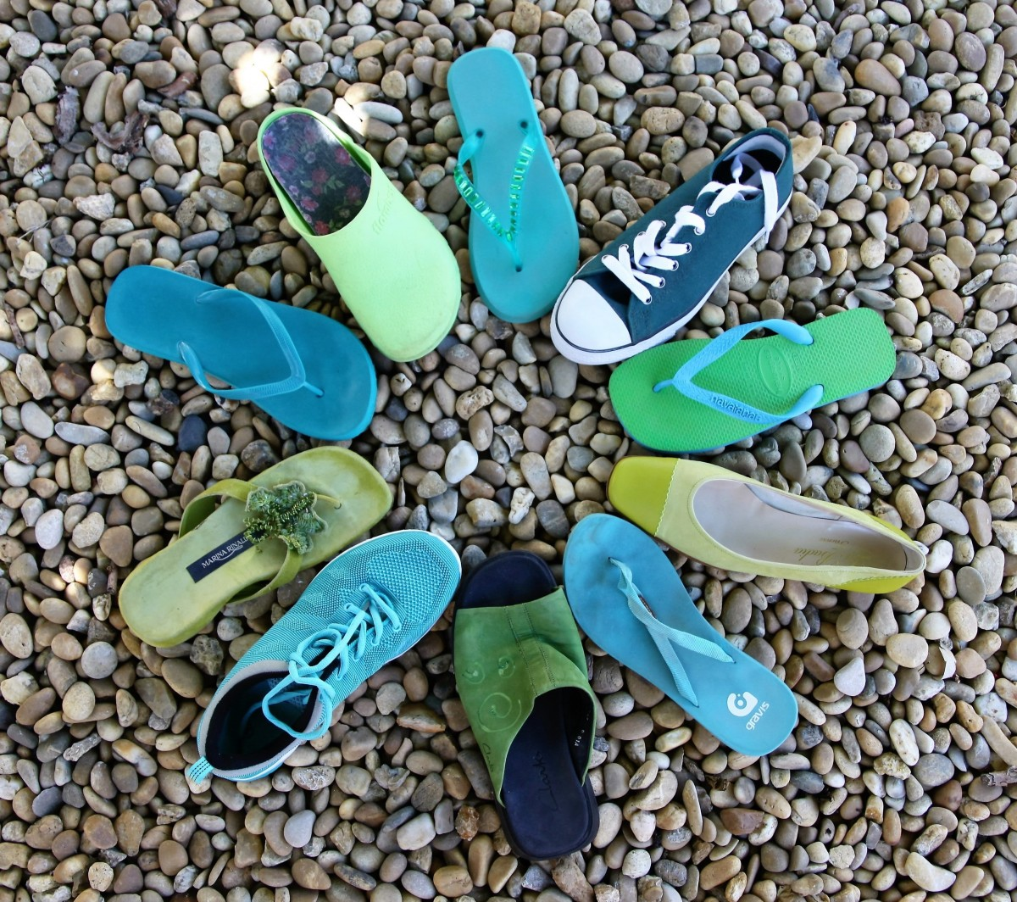
Meeting different people
If you choose to study HE in a University or College setting you’re likely to encounter people from many different walks of life
Most importantly, you will build a useful network and you could make friends for life.

Slide 10
You could meet people who…
…have the same interests as you
…have a different background to you
…inspire you
…change your view of things
…make you laugh and cry
The people you meet will play a big part in your educational and personal journey
This Photo by Unknown Author is licensed under CC BY-ND

Slide 11
Moving away from home
You don’t have to move away from home to study Higher Education, staying at home can have many benefits too. Such as being close to family, additional responsibilities, different financial considerations or maybe you already have a part-time job at home.
However, others prefer to move away from home to embrace student life.

Slide 12
University student halls are a great way to meet new people; or once you’ve made some friends you might decide to move into a shared house together (usually after a year or two of study).
It brings both responsibility and fun with it
You’ll always have company
You might be on the same course and can work together
You can explore a new city
Maybe even share the washing up
There are plenty of choices when it comes to accommodation out there, whether you’d like a single bed, double bed or an en suite, there’s usually something to suit every budget!

Slide 13
Trying new things
Universities (and some colleges) offer a wide range of clubs and societies.
The options are vast, you can get involved in pretty much anything
Question: Do you know any society names?

Slide 14
Here’s some you may not know about…
Bollywood dance
Film making
Quidditch Society
Improvisational theatre
Mario Kart Society
Public Speaking
Kpop
There was once even a society for chicken nugget enthusiasts…
Plus, if there isn’t a club or society for your interest, you can create one! All you need is a few like-minded people
This Photo by Unknown Author is licensed under CC BY-NC

Slide 15
Study a subject you feel passionate about
At school you have lots of compulsory subjects, some you might not particularly enjoy.
At university or college, you can make an active choice of what you want to study.
Not just by choosing the course you want, but some courses allow you to choose from a number of specific modules (which usually last a term each).
Did you know you have approximately 50,000 courses to choose from in HE?

Slide 16
You have thousands of courses to choose from, some you may never have heard of before like a degree in Baking Technology Management, Ethical Hacking, or Circus Performance?
Look at university websites, UCAS e.g. “science degrees”…You’ll be surprised to see what’s out there.
On the next slide are a list of potential degree courses – you must decide if they are real or not…
T

Slide 17
Uni of Central Lancashire
FOOTBALL STUDIES
STOP MOTION ANIMATION AND PUPPET-MAKING
Uni of Brighton
Reaseheath College (Uni of Chester)
X
DAIRY FARM MANAGEMENT
TIKTOK MANAGEMENT
MEDIA MAKE-UP AND SPECIAL EFFECTS
X
Manchester College
HORROR LITERATURE
Birmingham City Uni
HOROLOGY
University College London
VIKING STUDIES
X
Uni of Plymouth
YACHT OPERATIONS
PERFUMOLOGY
Notes:
This is designed to introduce students to the range of courses available in HE.
Horror Literature is a module of a Literature degree (use this to explain what modules are)
TikTok Management isn’t a degree… but Social Media Management is at the University of Sunderland
Someone interested in perfumes could study Chemistry.

Slide 18
Be in control
Studying Higher Education is likely to make you a lot more independent
You might live in student halls or a shared house
You might need to do your own food shopping, cleaning, washing up, laundry
You might have to pay some bills (e.g. electricity or broadband)
You might have to find a part-time job (and organise your workload around it)
You will have to be self-motivated to make sure you get your work done on time
You might have to deal with some challenging situations
These things are not always fun – but are an important part of becoming an adult and preparing you for your future
You’ll be your own boss and largely make your own decisions.

Slide 19
Study abroad
Many university courses offer a year abroad, this is usually between your 3rd and 4th year of study.
Study abroad is a fantastic opportunity to experience a different culture and make new friends from other countries.
You could choose to study in Norway, China, New Zealand, Portugal, Chile, Kazakhstan, or Canada – this will allow you a once in a lifetime experience.
You might even get to learn a new language!

Slide 20
Get your first job
Many students choose to work part-time alongside their studies.
This could be pulling drinks in a pub, handing out flyers, working in a call centre, doing admin work in an office, selling clothes in a shop, becoming a student ambassador…

Slide 21
If your timetable and workload allow it, a part-time job is a great way to gain relevant work experience, earn some extra cash and upgrade your CV.
A part-time job might also help you find out early on which type and area of work you enjoy (and which you don’t) while adding great value to your personal attributes.

Slide 22
You think you know yourself…
University will teach you a lot of new things about yourself
Your likes and dislikes, your strengths and weaknesses, your hopes and worries…
It may sound cheesy, but it can play a big part in helping you learn more about yourself and shaping your decisions for the future.

Slide 23
Student experiences
What do the actual students have to say about their time at Higher Education?
Notes:
Click the ‘What do HE students say?’ heading, then watch the ‘Social Sciences at the University of Leeds A student perspective’ video

Slide 24
Useful Links
Student life podcast series: https://open.spotify.com/episode/1eupLIFBhrkWpQmGukpRwJ?si=874cda6ce9924080
Student life podcast series: https://open.spotify.com/episode/2uGvgkUdweEhxFu4J9t2SX?si=oqEb_kRhRci_2qu2XHIO3A
Social experience: https://open.spotify.com/episode/4mmloiIrHiAP11statutsp?si=in2HU2dvTqC2HMA7i-JTQQ
UCAS: https://open.spotify.com/episode/0LMeBmORnY3OuT1Qga9QGK?si=0Cy_F7XtThK6z3Q0MzqT3g
Preparing for university: https://open.spotify.com/episode/2uGvgkUdweEhxFu4J9t2SX?si=277d92af0def444b
Student Insight: https://open.spotify.com/episode/2VhdNFgop8hRRP1FdxkUrJ?si=1fee4008aa164ccd

Slide 26
Any questions?

Slide 28
Thank you

