Slide 1
Programme objectives + content + outcomes

Slide 2
What we will cover…
Programme overview
Deep dive into three core programme objectives:
Outline and key indicators
Content designed to achieve desired outcome
Relevant outcomes from evaluation
Summary of evaluation findings
Learning from the evaluation
Notes:
Natalie

Slide 3
Programme overview

Slide 4
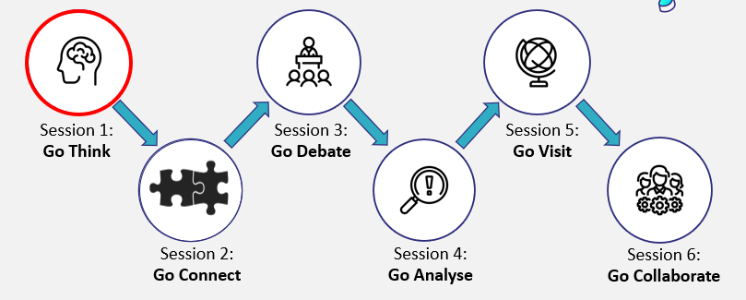
Programme structure
Comprises of 6 sessions, 5 in school and 1 campus visit
Each session has its own focus whilst building from previous activities
Campus visit usually took place at a university for Year 9 and 10 and at a University center in a college for Year 8. Visits were full days and the 5th session that took place.
Notes:
Hannah

Slide 5
Delivery model
Sessions between 50 minutes and 1 hour
Delivered by an Outreach Officer supported by student ambassadors
Use limited resources- paper pens, shared printed materials
Session Structure
Focus of the day
60 second words (the same starter activity for each session)
1-2 main activities
Reflection
Notes:
Hannah

Slide 6
Learner journey
Session | How skills build
Go Think! | Organising info
Go Connect! | Linking info
Go Debate! | Discussing ideas
Go Analyse! | Analysing own and others' ideas
Go Collaborate! | Applying skills developed together
Notes:
Hannah

Slide 7
Learner objectives
Learning abilities
Approaches to learning
Communication of ideas
Identifying, organising and connecting knowledge
Discussing, debating and analysing ideas
Embedding new strategies, skills and techniques
Notes:
Natalie

Slide 8
Objective 1: Learning abilities

Slide 9
Outline of objective: learning abilities
As a result of this programme, learners should be able to:
Organise and monitor information
Use appropriate study skills
Improve their revision techniques
Leading to:​
More effective learning​
Increased confidence to succeed in tests​
Notes:
Natalie

Slide 10
Key indicators: learning abilities
I have control over my ability to learn well.
I am good at remembering information.
I am good at organising information
(for example, I can see how parts of my learning link together).
I know when I have understood a new concept or idea.
Notes:
Natalie

Slide 11
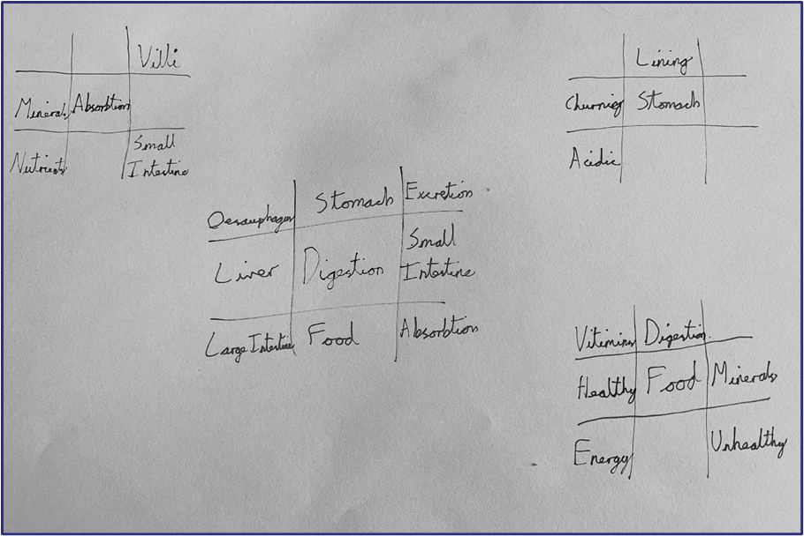
Headline content: learning abilities
Lotus Blossom
Notes:
Hannah

Slide 12
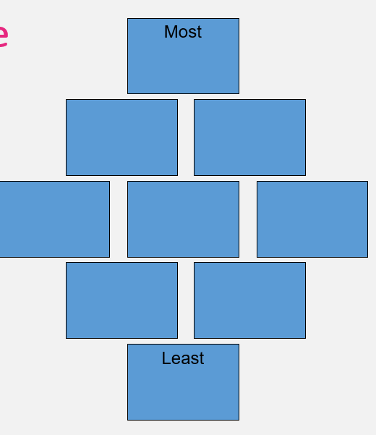
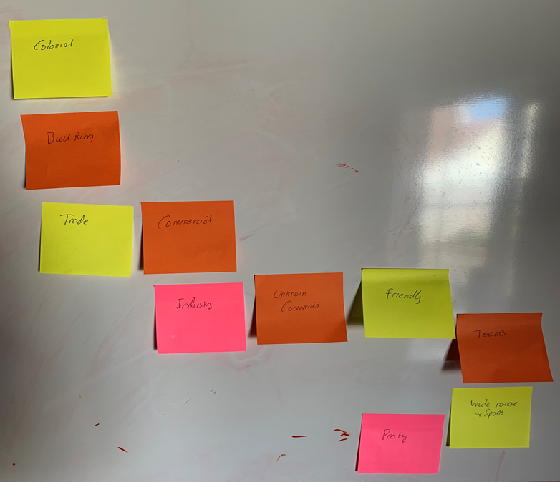
Supplementary content: learning abilities
Post-it note dominoes
Diamond Nine
The aim of this activity is to make connections between pieces of information and justify how they are connected.
Organise the items/characters from most to least important.
Be prepared to justify your answers
Notes:
Hannah

Slide 13
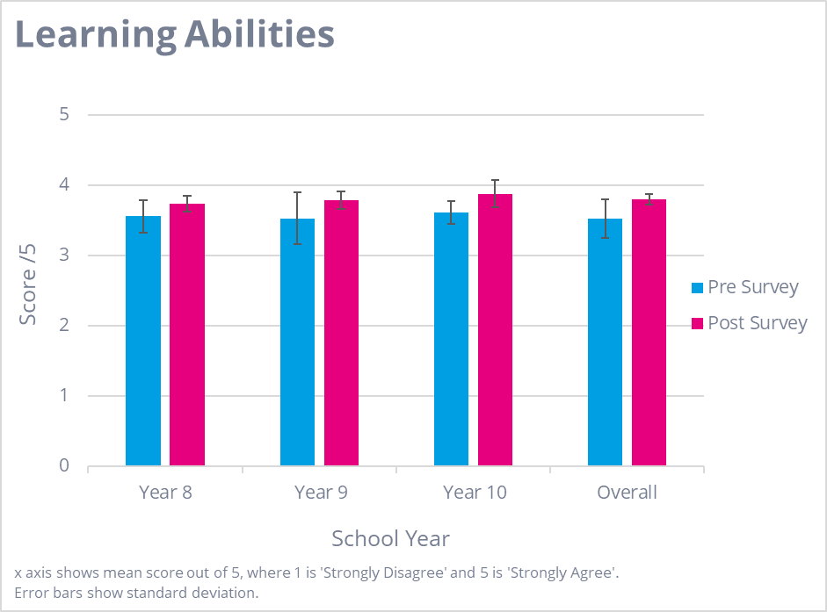
Outcomes & findings: learning abilities
Most impact on: Year 10
Biggest indicator of improvement: I know when I have understood a new concept or idea.
Headline insight:
Learners identified skill development in organising and linking information, mostly via the lotus blossom activity.
However, their understanding of how to apply these skills to specific subjects was limited.
Notes:
Natalie

Slide 14
Objective 2: Communication of ideas

Slide 15
Outline of objective: communication of ideas
As a result of this programme, learners should be able to:
Communicate effectively in the classroom
Construct an argument and challenge ideas
Think critically and apply logical reasoning
Leading to:​
Learners engaging more in their education
Increased confidence to succeed in tests
Notes:
Natalie

Slide 16
Key indicators: communication of ideas
I can express myself easily and explain my ideas in group discussions
I am comfortable asking questions when I need more help to understand something, or I want to improve my knowledge
I know how to construct and communicate an argument, using evidence to support my ideas.
I can build on and/or challenge other people’s ideas in a thoughtful way
Notes:
Natalie

Slide 17
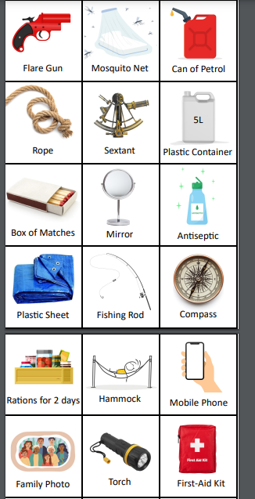
Headline content

Slide 18
Supplementary content
'Yes, but' Group Activity
One person begins a discussion around a topic, e.g. where we should go on holiday. The other person answers, but this must begin with the words, ‘yes but’.
E.g.
•I think we should go somewhere with lots of rivers this year.
•Yes, but remember the dangers of open water.
•Yes, but think of all the health benefits by being out in the countryside.
•Yes, but remember there are some dangerous animals.
Etc…

Slide 19
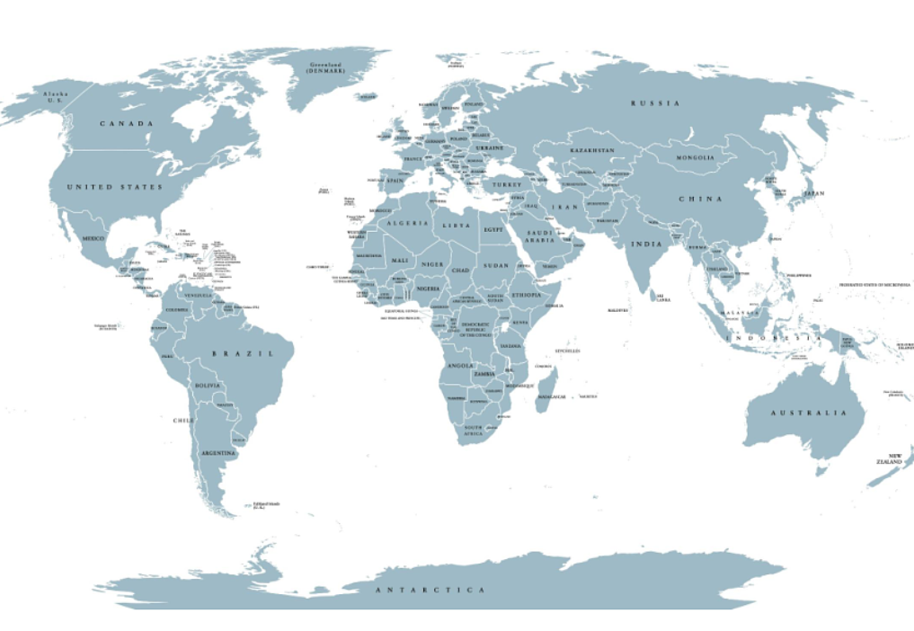
Supplementary content
Paired Debate
Geo Guesser
Using the skills you have developed today, you should now be able to effectively discuss and debate a topic with one another.
You will have 5 minutes to discuss the given topic with your partner, then you will join another pair to debate this topic.
You will either be for or against the topic.

Slide 20
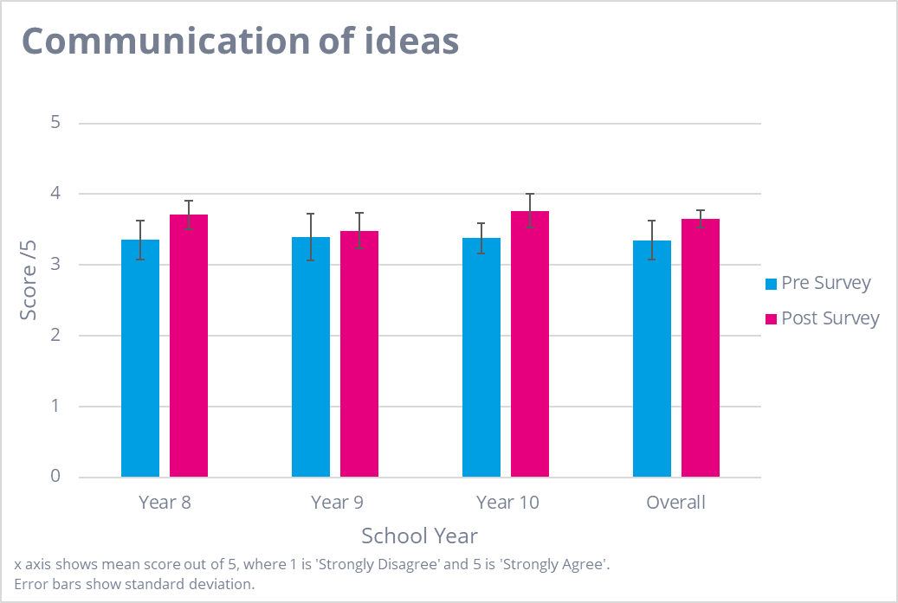
Outcomes & findings: communication of ideas
Most impact on: Year 8
Biggest indicator of improvement: I can build on and/or challenge other people’s ideas in a thoughtful way.
Headline insight:
Learners identified the value of developing their debating skills for their learning in school and outside of school, incl. being more confident to ask questions
Learners made connections between oral debating skills and improved analytical thinking in their written work
Notes:
Natalie

Slide 21
Objective 3: Approaches to learning

Slide 22
Outline of objective: approaches to learning
As a result of this programme, learners should be able to:
Apply learning strategies across different subject areas
Demonstrate academic self-efficacy - improved confidence in academic ability and skills
Demonstrate the link between metacognitive strategies and their use in HE
Leading to:​
Better access to subjects which learners find more difficult by using these strategies
Improved attitude to learning
Notes:
Natalie

Slide 23
Key indicators: approaches to learning
I know which techniques work best for me when I am learning and studying
I reuse learning methods and study skills if I know they have worked before
I feel prepared to handle new and challenging tasks
I am comfortable using feedback to improve my work
Notes:
Natalie

Slide 24
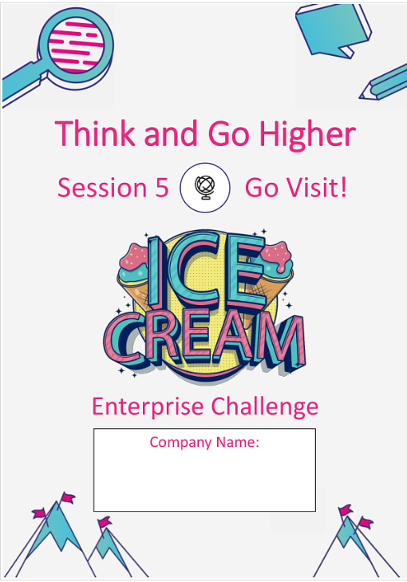
Headline content
Enterprise challenge
Required to analysis, justify and explain how the choices they have made will meet the chosen criteria set for them
Learners are deciding on the learning style that suits them to achieve the desired outcome. A task has been set but they need to choose how it will be achieved.
Activity uses resources and concepts from in school sessions i.e., Lotus Blossoms, debating and critical thinking skills.

Slide 25
Supplementary content
Reflective Activities and resources
Lotus blossom
Repeated and refined throughout the program

Slide 26
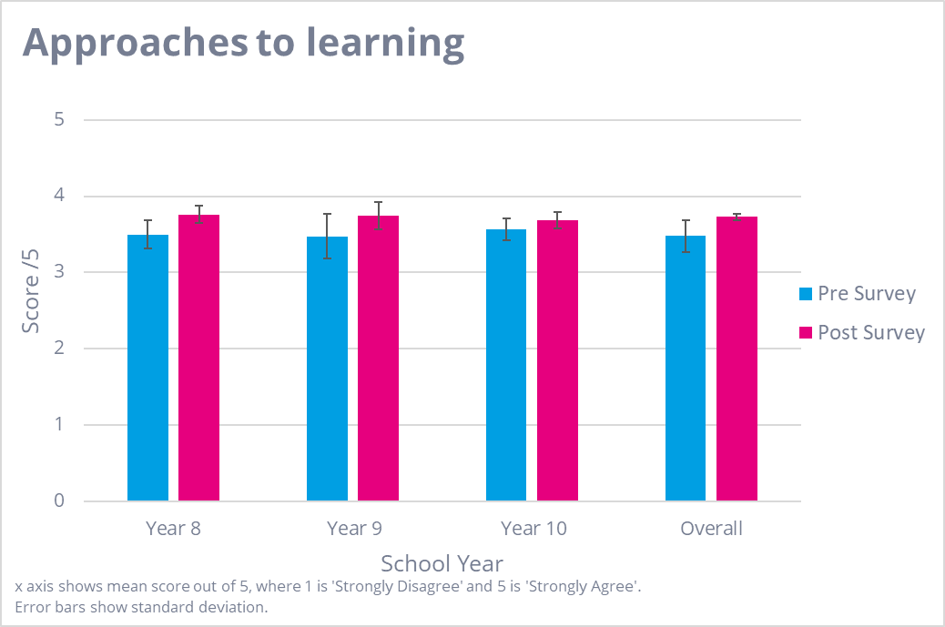
Outcomes & findings: approaches to learning
Most impact on: Year 8
Biggest indicator of improvement: I feel prepared to handle new and challenging tasks.
Headline insight(s):
Learners self-reported an improvement in their grades and revision skills since participating in the programme.
Learners also highlighted that collaborating with other pupils outside of the typical classroom environment enhanced their communication skills.
Notes:
Natalie

Slide 27
Summary and learning
Notes:
Natalie

Slide 28
Key insights
Modest gains were seen across the programme for all year groups, but most notably for the Year 8 cohorts
Most impact can be seen in outcomes related to learners' communication of ideas
Learners self-report improved grades and revision skills, however we don’t currently have attainment data to verify this
Collaborating with other peers and applying their new skills outside of the classroom setting was considered valuable by learners, alongside the added benefits of experiencing an HE campus
Notes:
Natalie

Slide 29
Learning
Baseline self-scoring was typically fairly high, limiting 'distance travelled' and suggesting a need for greater reflection and/or refined targeting of learners​
While learners reported developing their skills and finding this helpful, adaptions are needed to help learners apply these skills to specific subjects and assessments​
Important to be explicit with learners about how all activities can support and develop skills related to learning, revision and communication
Potential to have the biggest impact with younger year groups and build on this as they get older.
FINALLY... WE HAVE THREE EXTRA SCHOOLS TAKING PART IN 2023/24!

