Slide 1

Student Finance
Notes:
This Presentation will cover a the basics of student finance. We recommend making it clear from the outset that you – and GHWY – cannot answer questions about an individuals personal circumstances should be sent to Student Finance directly.

Slide 2


Snap Thought…
What word – just one word – comes into your head when you hear…
“student finance”?
Let’s talk about it
Where do you get information
on student finance?
Are these reliable sources?
Who could you ask for information?
Notes:
Allow students an opportunity to answer the following question. Answer any misconceptions and discuss reliable/ unreliable sources. It will be useful to ensure to have the names of specific UCAS/ Careers contacts in the school to refer student on to post the presentation.

Slide 3

What we’ll cover
1) What support is available?
2) How do you access it?
3) How and when to repay?
4) How to manage your money?
Student Finance England provides financial support to students entering higher education in the UK, on behalf of the UK government.
https://www.gov.uk/student-finance
Notes:
Ensure students are aware that questions about their personal circumstances will not be answered today and instead they should ask SFE.

Slide 4
Who can access Student Finance England?
UK nationals (also known as a home students)
Those living in the UK, Channel Islands or Isle of Man for 3 years before the start date of their course
Students who have not have studied any Higher Education course in the past in any county
European Students starting a course on or after 1st August 2021, who have settled or pre-settled status under the EU Settlement Scheme
Students who came to the UK from the EU after 1st January 2021, may need to apply for a visa to study here. Visit https://www.gov.uk/student-finance/eu-students for advice on how Brexit has affected Student Finance.
Notes:
It could be useful to send links directly to students who have altering circumstances to home students.

Slide 5
What support is available?
Tuition Fee Loan
Maintenance Fee
Loan
Additional Funding

Slide 6
Tuition Fees
What is the maximum tuition fee a university or college can charge per year?
£7,750
£9,250
£15,350
£7,750
£12,800
£20,150
Notes:
For the most up-to-date information see: https://www.gov.uk/student-finance

Slide 7
Tuition Fees
How much tuition fee do you pay straight away?
0%
15%
50%
100%
10%
30%
80%
Notes:
Repayments will be discussed later but suffice to say that no repayments will ever be made until after you finish your studies and after you start financially benefiting from your studies which currently means earning over £25,725 per year.
Ensure students are aware that unlike regular loans this can be subject to change.

Slide 8
Tuition Fee Loan
Public higher education providers can charge up to £9,250 per year for their course
You DO NOT have to pay this up front
A Tuition Fee Loan is available from Student Finance to cover the fee charged by your higher education provider
Your Tuition Fee Loan is paid directly to your higher education provider at the start of the academic year
Notes:
Ensure students are aware that they will not physically ‘see’ this money and they do not have to worry about ensuring it gets sent to their HE provider. However, what students MUST ensure they do is attend registration events at the University as it is only once they are registered that the correct university will be paid and they will begin receiving their maintenance loans.
Ensure students are aware that at the point they apply for student finance they will be putting the university they hope to attend, but depending on what happens between May and Results day they may change where they end up going! In which case they just log on to SFE and update their uni choice- simple!

Slide 9
Maintenance Loan
A loan paid directly to your bank account in 3 instalments across the year, to help with living costs while at university.
The amount of Maintenance Loan you can get depends on where you live as well as your household income
Notes:
Discuss the types of things their maintenance loan will have to cover and how this will change depending on whether they are living at home or in rented accommodation. Ensure students are aware that not all rented accommodation is all inclusive of bills; however, many first year halls will include this. You could also mention the differences between catered and uncatered accommodation.

Slide 10
Maintenance Loan
How much can I get?
Household Income | Living at Home | Living Elsewhere | Living in London
£25,000 & under | £8,400 | £9,978 | £13,022
£30,000
£35,000
£40,000
£45,000
£50,000
£55,000
£65,000 + | £3,698 | £4,651 | £7,052
Figures correct as of 202-2024. Check the Student Finance website for the latest changes.
Notes:
Ensure students are aware they will need to open conversations at home about household income BUT make parents aware they will NOT have the share their financial information with their student at any point. They receive a separate log on to student finance to add this information.

Slide 11


Maintenance Loan
Use the Student Finance England calculator to see the size of loan you can apply for:
https://www.gov.uk/student-finance-calculator
Notes:
You could click the link and show students how this would work.

Slide 12
Additional Funding
The additional funding you could receive will vary depending on:
Where you’re applying
The course that you want to do
Your grades
Your personal circumstances
Any additional needs you may have
Some examples…
NHS Courses
Bursaries and Scholarships
Care-experienced or estranged
Disability Support
Notes:
Explain to students that while additional funding can mean university support, it can also mean parental support or money from a part time job. As well as looking for grants and bursaries from their university they should also look in their local area, sometimes some areas advertise these in the newspaper or online.
Some NHS courses are fully or partially funded- if students are particularly interested in these you could search for examples.

Slide 13

Additional Funding
Disability Student Allowance
This is based on your individual needs and is support to cover the
study-related costs you have because of a mental health problem, long term illness, or any other disability.
Special Equipment Allowance
Non-Medical Helper Support
General Allowance – Stationery, photocopying, or fridges for storing medication
Travel – Private taxi transport or accessible transport
For extra information go to:
www.gov.uk/disabled-students-allowances-dsas
Study Assistants, Notetakers, Communication Support Workers, British Sign Language Interpreters, or Assistive Technology Trainers
Notes:
Students with disabilities will need to register their disability with the university. This will usually mean providing evidence. A wide range of disabilities are covered, from physical disabilities that would require accessible transport to learning disabilities which mean you find it easier to read things that are printed as opposed to on a screen – you could gain a printing budget for this.
DSAS money does not have to be paid back! So if you think you are eligible it is definitely worth having a look.

Slide 14
Additional Funding
Bursaries and Scholarships
Extra sources of financial support are available that are usually called bursary schemes, scholarships or grants.
These are separate to Student Finance and you need to apply to these directly through your chosen university or college
Unlike Student Loans, you don’t need to pay these back, so it’s essentially free money
Not everyone is eligible, you need to meet certain criteria, so make sure you do your research!
Try going to your HE provider’s website and look for any ‘Financial Support’
pages
Notes:
Each university will offer a range of grants and bursaries HOWEVER these usually have strict deadlines for applications so make sure to have a look early to see what support you can get,

Slide 15
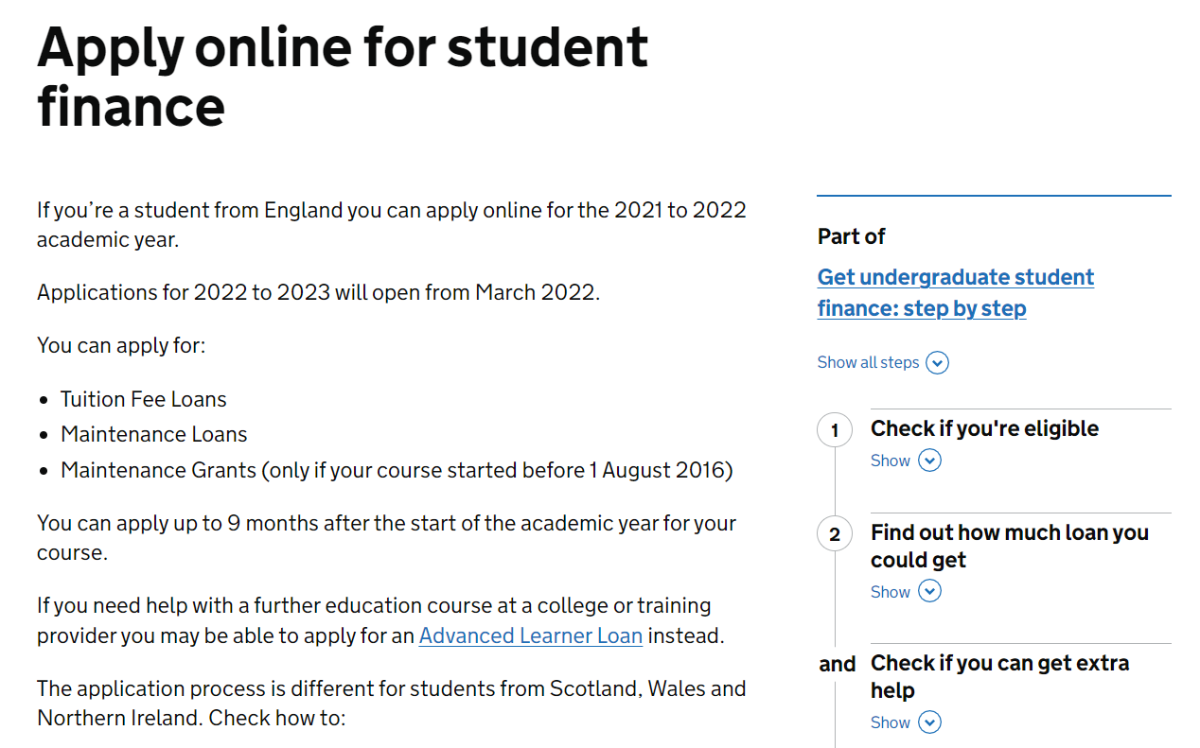
How do you access StudentFinanceEngland?
Apply online between March and May – don’t miss the deadline (end of May)!
Student Finance will ask for your household income,
so be prepared to get this from your parents/carers
Students don’t need a confirmed place at university to apply for student finance – simply state preferred course choice. This can be changed later.

Slide 16

How and when to repay
How you will start repaying…
You need to pay back BOTH your Tuition Fee Loan and your Maintenance Loan
You still have to repay your student loans if you leave your course early
You only start paying your Student Loans back once you’re earning over a certain amount per year. (Subject to change.)
Your repayments will come off your pay slip just like tax, national insurance, or your pension so you don’t even notice!
If your income falls to £27,295 or below your repayments will stop. Any outstanding loan balance will be cancelled 30 years after entering repayment.
Notes:
Also worth noting that you still have to repay if you leave the country! There is often an incorrect rumour that this is not the case.
Once again remind students than unlike a regular loan this can be subject to change.

Slide 17
How and when to repay
When you will start repaying…
The April after you finish
your course
The government will write-off any unpaid balance after 30 years
When you’re earning over £27,295
per year (from April 2022)
Notes:
Ask questions such as:
If you earn £25,000 in the April after you finish your course will you have to repay? NO
If you earn £60,000 as soon as you finish your course will you have to repay? NOT TILL APRIL.
If you finish your course at 21 will you still have to repay when you are 70? NO

Slide 18
How and when to repay
When you will start repaying…
£705 over Repayment Threshold
Repayment Threshold £27,295
Your Income
£28,000
per year
You repay 9% of £705
=
You repay
£5 per month
Income each year before tax | 9 % will be deducted from | Monthly repayment (Approx)
£27,295 | £0 | £0
£30,000 | £2,705 | £20
£35,000 | £7,705 | £58
£40,000 | £12,705 | £95
£50,000 | £22,705 | £170

Slide 19

GAME
Higher or lower?

Slide 20

Higher or Lower
Text book
Student accommodation
Washing powder
Term bus pass
Baked beans
£40
£4,500*
£3.50
£250
£0.60
£30
£7,374
£19.97
£320
£1.39
What word – just one word – comes into your head when you hear “student finance”?
Lightbulb
80 tea bags
TV Licence
Max Maintenance Loan
Hourly minimum wage for 18 year old
£4
£2.50
£175
£10,667
£7.49
£2.90
£2.85
£159
£9,978
£6.49
Notes:
A typical textbook
Example of one year of student accommodation in halls – Catered* around £6,500
Washing powder (97 washes)
Term bus pass (3 months)
One can of baked beans
Energy saving light bulb
80 tea bags
Colour TV licence (one year)
Maximum Maintenance Loan for one year in England (2022)
Minimum hourly wage for 18-21 year old

Slide 21
How to manage your money
What would that need to cover?
Full-time student example (age 18+)
Maximum Maintenance Loan £13,022
Divided by 52 weeks =
£250.42 per week.
Rent
Food
Bills
Entertainment
Travel
Social Life
Hobbies
Toiletries
Uni Equipment
Clothes
Did you know?
Even if you qualify you don’t have
to apply for the full Maintenance Loan.
Notes:
Have pupils answer what it would need to cover and discuss that rent in London – where you could get the absolute max student loan is expensive. Again, open the discussion to how additional money could be sought.

Slide 22
How to manage your money
Many students may need to supplement their income with money from savings, a part time job, contributions from parents or carer.
Student Job Examples:
Part time Retail | Student Ambassador
Bar/Hospitality | Student Union
Resident Assistant | Restaurant/Cafe
If in full-time study
Take some
money with you.
You normally get
your Maintenance
Loan 3 – 5 days after you enroll.
Open a student
bank account
Different banks
have different offers, e.g. free 16 – 25 railcard. Many also give
you an interest
free overdraft.
Part-time
work
It is advised that students work
a maximum of
10 – 12 hours
per week.
Plan and
budget!
Maintenance Loans
are paid in three instalments during
the year.
Apprentice salaries may be paid monthly.
So you need to
budget to make
it last!
Make the most of student discounts
The National Union
of Students (NUS) / TOTUM
card gives you discounts in many shops, restaurants,
and cinemas.
There are often reductions in travel costs for young people.

Slide 23

Any Questions?

Slide 24


