Slide 1
Think and Go Higher
Session 1 – Go Connect

Slide 2
Ice Breaker
As you enter the room, you will be directed to sit on a table in groups of three/four.
On the name card/sticker in front of you, please write your first name.
With the other people on your table, talk about the following questions:
What is your favourite subject?
An interesting fact about you…
If you could travel to anywhere in the world, where would you go and why?
Notes:
Students should be directed to sit in groups of 3 or 4
On the tables will be cards/sticker – ask the students to write their first names on them
Start off by explaining what the questions are then use this opportunity to start the activity by answering the questions yourself e.g.- my name is … my favourite subject is/was.. and a fun fact about me is and where you would travel, if you could go anywhere
The SA should go next
Then go around the room and have the students answer, you could stand up, line up or go around in groups. It might be useful to assess the group beforehand for how comfortable they will be doing this and adapt if necessary.
Feel free to change the fun fact to another question if you think it would work better.

Slide 3
Who are we?
Name
Job Role
Institution
Name
Job Role
Institution
Notes:
Introduce yourself to students.

Slide 4
Who are Go Higher West Yorkshire?
As a team, we bring together the thirteen higher education providers in West Yorkshire. We have members of staff at each institution, providing a central place to find information, and providing help with accessing and preparing for higher education.
You might find us in a school or college, online or at a local community event. We can help you with any questions or concerns you might have about higher education, and point you in the right direction with all things degree-related.
Notes:
In this first session, make sure that you take the time to introduce yourself as facilitator, introduce them to GHWY and the student ambassador (SA)

Slide 5
Notes:
A list of our partner institutions. Some students may have visited/heard of these places before.

Slide 6
What is HE?
Level 8
Doctorate
Doctorate
Level 7
Degree Apprenticeship L7
Master’s Degree
Degree Apprenticeship L7
Master’s Degree
Level 6
Degree Apprenticeship L6
Honours Degree
Honour’s Degree
Level 5
Foundation Degree
Dip in HE Yr2
Higher Apprenticeship
Dip in HE Yr2
Higher Apprenticeship
Level 4
HNC
Dip in HE
Dip in HE Yr2
Level 3
Advanced Apprenticeship
BTEC
A Levels
Level 2
Apprenticeship
BTEC
GCSE 9 - 4
Level 1
Traineeship
GCSE 3 - 2
Entry Level
Entry Level Qualifications
Work based learning
Vocationally based learning
Academic Learning
Notes:
Give a general overview of the levels and pathways
They are currently studying for entry level qualifications (Y8 and some Y9) and Level 1/2 qualifications (Some Y9 and Y10)
Explain that HE is level 4 and above.

Slide 7
What is Think and Go Higher?
Session 1: Go Connect
Connecting knowledge
Making justifications
Explaining your decisions
Session 4: Go Collaborate
Working as a team
Using critical thinking and debating skills in a group setting.
Session 5: Go Present
Do’s and don’ts of presenting
Top 5 presenting tips
Practicing presentation skills
Session 2: Go Analyse
Critical thinking
Asking interrogating questions
Session 3: Go Debate
Do’s and don’ts of debating
Forming an argument
Practicing your debating skills
Session 6: Go Visit
Experience Higher Education
Take on the Technology Research Challenge
Use skills from the last 5 sessions
Notes:
Outline the project in weeks, the objectives of each session and the campus visit at the end.
Take the time to speak about why the skills we cover will be useful.
Highlight the slides that have top tips included on them.
Highlight each session and how all the sessions will build up and lead to the campus visit (session 6).
Encourage the use of the SA each session.
The bullet points on the slides provide detail for each session, go through these in order.

Slide 8
Pre-Session Survey
On your table, you will find some papers containing a list of questions.
Please write your first and last name at the top of the paper.
We will read through the questions one at a time and you will answer these as we go through them.
It is important to be as honest and realistic as possible when answering these questions and we will be doing a similar questionnaire at the end of the programme.
This will help us see how effective the programme has been in developing your critical thinking, teamwork, debating and presenting skills.
Notes:
These should be ready on the tables at the start of the session with students names and HEAT IDs already printed.
Instruct the students to complete confidentially, there is no right or wrong answer but it is important for them to be honest and realistic.
Reiterate that this is just to gauge their thoughts about their own ability in week one to compare at the end of the 6 week programme. Explain that it does not matter if they are scoring themselves low in this session.
Tell the students we will complete the same survey at the end of the last session to see how much they think they have improved.
Guide them through the questions one at a time, explaining what each question is asking them.

Slide 9
Session 1 – Go Connect
This first session will help you make connections between your knowledge and think creatively. Additionally, you will need to justify the connections you make.
This will help you to organise your knowledge so that you can remember more and do more with this.
Being able to connect pieces of knowledge and justify why you have made these connections is vital for success in all areas of life, both in and out of school.
In the next session, Go Analyse, we will use the skills you develop in this session as a basis to start thinking critically about information.
Notes:
Introduce the session, the objectives (what they should gain from it) and briefly outline the activities.
Discuss each point with the students.

Slide 10
The Lotus Blossom Diagram
Draw a noughts and crosses grid in the middle of the sheet of paper. This is your Lotus blossom. as a guide this should be about 15cm by 15cm.
Now put the topic you have chosen in the centre.
Topic
Notes:
Introduce the lotus blossom by example. Use the SA to help complete the model..
Explain how this structure is allowing them to expand their knowledge of a certain topic
Ask students to draw their own model and complete using a word of your choice
If the concept is easily grasped within the group, move on to the extension, taking one word from the original diagram and creating a second one
Suggested words to use for activity:
Y8: Ice Cream,
Y9: Earthquake,
Y10: Technology

Slide 11
The Lotus Blossom Diagram
In the eight open boxes around the outside of the topic, write down eight different things you associate with that topic or anything that comes to mind. You have one minute.
Idea 1
?
Idea 4
?
Topic
Idea 2
Idea 3
?

Slide 12
The Lotus Blossom Diagram
Having completed the eight ideas, choose one of those ideas to put in the centre of a new lotus blossom to be drawn elsewhere on the paper.
Idea 1
?
Idea 4
?
Topic
Idea 4
Idea 2
Idea 3
?

Slide 13
The Lotus Blossom Diagram
Now try and fill in as many ideas you can about your new word or your new idea. You are now going into greater depth.
Idea 1
?
Idea 4
A
?
C
?
Topic
?
Idea 4
Idea 2
D
Idea 3
?
?
B
?
?

Slide 14
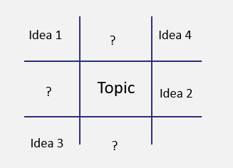
Top Tip! - The Lotus Blossom Diagram
This can be used to help you with revision and answering exam questions:
When writing an essay or an answer to a question, use the lotus blossom to organise your knowledge.
Then you can use the words you have generated as the basis for your answer.
Notes:
Share this top tip with students to highlight the lotus blossom as a useful resources when revising and answering exam questions.

Slide 15
Post-It Note Dominoes
Think of four words which are related to the topic we’ve just spoken about write each one on a separate post-it note.
Try to pick four words that you think no one else will have.
The aim of this activity is to make connections between pieces of information and justify how they are connected.
Notes:
To begin the activity one group chooses a post it note and hands it to the trainer to put up on a board for all to see. If necessary, the group can be asked to explain their idea and their reason for choosing whatever they put on the post it note
The next group in turn has to choose one of their post it notes that links in some way to the first groups posted note. in other words, the same as if you would play Domino's except we are not asking for matches just justifications for a link
See next slide for a demonstration.

Slide 16
Post-It Note Dominoes
etc…
Homework
Teachers
School
Buildings

Slide 17
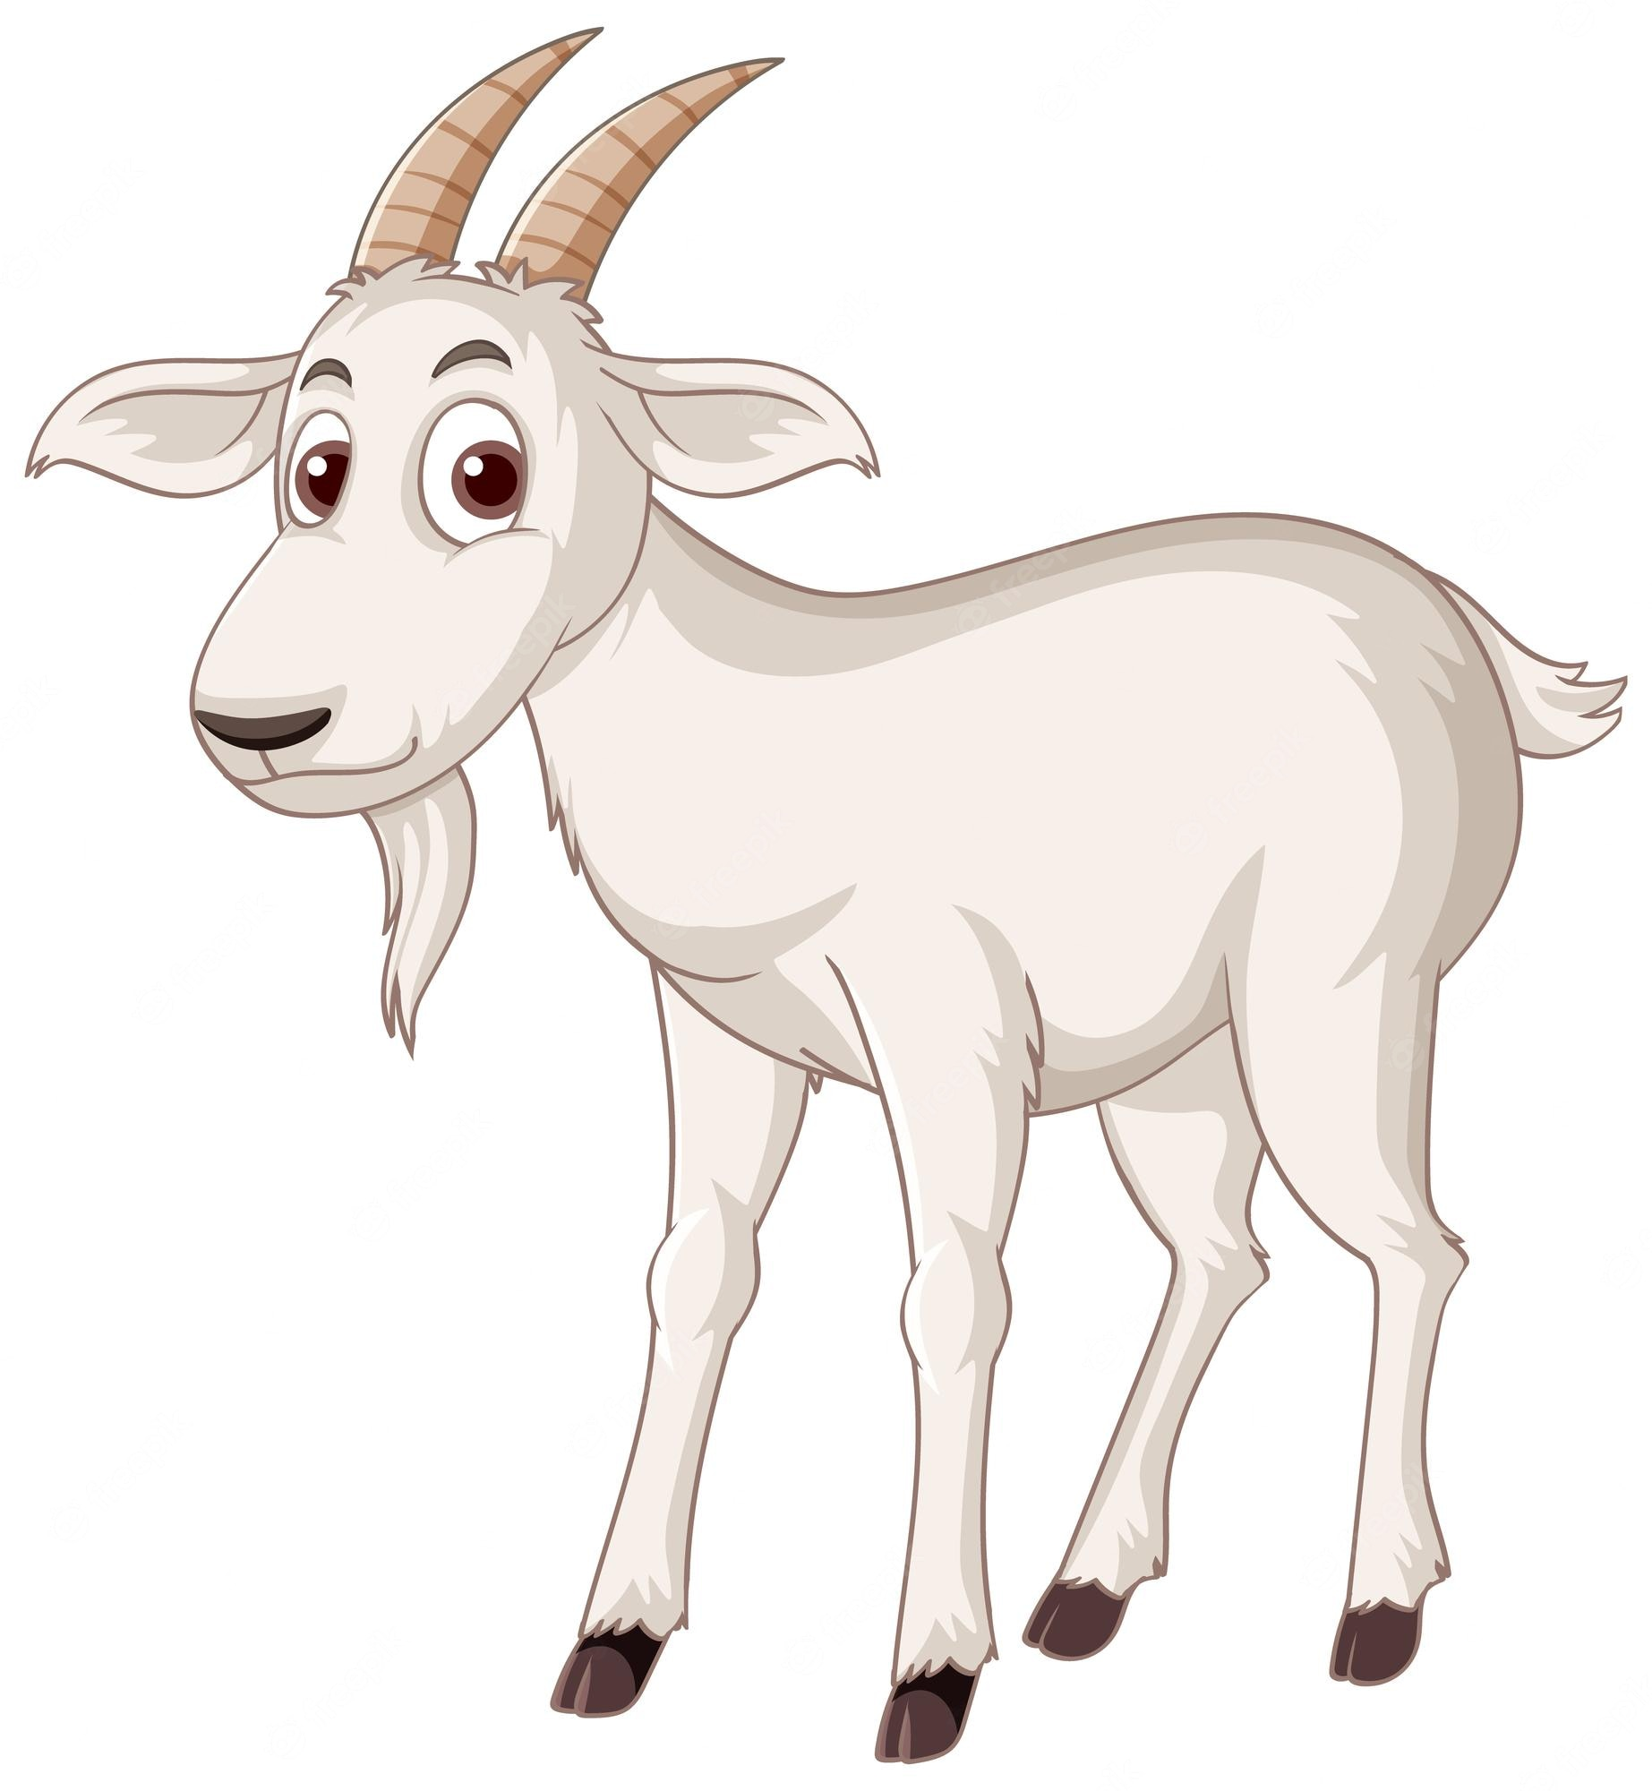
Card Sort Activity
On your tables you have a selection of images. You need to put the images in order by making connections and justifying your reasons why.
For example:
Cheese is made from milk, which can be produced by goats.
The sun is yellow, the same colour as many cheeses.
This sandwich contains lettuce, which wouldn’t grow without light from the sun.
Starting with hair
Goats are covered in hair.
Notes:
The images for this activity should be laid out on each group’s tables
Year 8, 9 and 10 each have a separate pack of 8 images.
Students need to put their images in order, by creating a link between the fist image and the next.
They should write down their links and justifications so that they don’t forget them.
Use the example on the slide to explain how this would work.
Allow all students a few minutes to familiarise themselves with the images on their tables
Ensure it is highlighted that there is no right or wrong answer as long as they can justify the link.
Allow the groups around 5-10 minutes to begin their discussions while the OO and SA circulate the room
Optional extension: give each group one or two card from the ‘wild cards’ pack and ask them to include them in their card sequence.

Slide 18
Card Sort Activity
Now you have a series of connected images, switch tables with another group.
What were the connections they made between each image. Write down what you think they were.
Finally, speak with the group to group you switched with and see if you were right.
Notes:
Optional extension: Students switch tables with another group and try to work out what reasons/justifications the groups used to order their cards in this way. Give them around 5 minutes to do this, then ask the groups to come together and see how accurate they were.

Slide 19
Post-it reflection…
And finally…
Each take 3 post-it notes and on them, write:
When you’ve finished, stick on the board at the front in the relevant section.
One thing that you enjoyed about today’s session
One piece information or a skill you learnt in today’s session
One question you have or something you’re still not sure about
Notes:
Three post-it notes should be given to each student
Ask the students to write on one coloured post-it something they enjoyed about the session, on another a piece of information or a skill they have learned and on the final post-it, a question or something they are unsure about.
Finally ask students to stick the post-it on the board under the relevant section, or in a designated space in the room, e.g. separate table for each heading.

Slide 20
Thank you

