Slide 1
Think and Go Higher
Session 4 – Go Collaborate

Slide 2
What did we do last session?
As you enter the room, discuss this with the people on your table. Use the images below to help you. We will ask you to feed back on your discussions when everyone arrives.
What was the session called?
What activities did we do?
What skills did we develop?
Why did we do this?
Notes:
Allow students time to enter and get comfortable
Have this slide displayed
Use the images displayed as prompts to facilitate a discussion on learner’s tables about what they did last session, the activities they took part in, why they did it etc.

Slide 3
Who are we?
Name
Job Role
Institution
Name
Job Role
Institution
Notes:
Introduce yourself

Slide 4
What is Think and Go Higher?
Session 1: Go Connect
Connecting knowledge
Making justifications
Explaining your decisions
Session 4: Go Collaborate
Working as a team
Using critical thinking and debating skills in a group setting.
Session 5: Go Present
Do’s and don’ts of presenting
Top 5 presenting tips
Practicing presentation skills
Session 2: Go Analyse
Critical thinking
Asking interrogating questions
Session 3: Go Debate
Do’s and don’ts of debating
Forming an argument
Practicing your debating skills
Session 6: Go Visit
Experience Higher Education
Take on the Technology Research Challenge
Use skills from the last 5 sessions
Notes:
Outline the project in weeks, the objectives of each session and the campus visit at the end.
Take time to speak about why these skills we will cover will be useful and highlight various slides will have top tips included on them.
Highlight each session and how all the sessions will build up to the campus visit (session 6).
Encourage the use of the SA each session.
Bullet points on the slides provide detail for each session, go through these in order.
Mention that there is a prize at the end of session 6 for the winning group (£10 voucher per student in winning group)

Slide 5
Session 4 – Go Collaborate
This fourth session will help you to collaborate effectively with your peers, share your ideas and opinions, and reciprocate to reach a mutual conclusion.
This builds on the skills we developed in the previous session, Go Debate, as you will need to analyse other’s views and articulate a debate to reach a consensus as a group.
In the next session, Go Present, you will use the skills you develop in this session to plan and present on a topic with your peers.
Notes:
Introduce the session, the objectives (what they should gain from it) and briefly outline the activities.
Discuss each point with the students.

Slide 6
Starter – Hot Air Balloon Challenge
Imagine you are on a hot air balloon which is slowly descending. It is too heavy and is about to crash into a mountain…
Each of you will be assigned a character, and it will be your job to justify why you think your character should stay in the balloon and not get thrown out!
This will involve using the debating skills we developed in the previous session.
In order to convince the rest of your group, think about:
What does your character do?
Who might be affected (family members etc.)?
How could the group benefit by keeping them on board?
Notes:
Guide time for activity – 10-15 minutes:
Each learner selects one of four characters (on following slide) to pretend to be for this activity.
They must argue as to why their character should stay in the hot air balloon and not be thrown out.
Remind students of the debating skills they learned last session, including the suggested debate structure.
Give students a few minutes to decide on their characters as a group, then a further 10 minutes to debate with their group.
At the end of the activity, ask each group to nominate one person who will be thrown out of the balloon. Remember, they need to justify their decision!

Slide 7
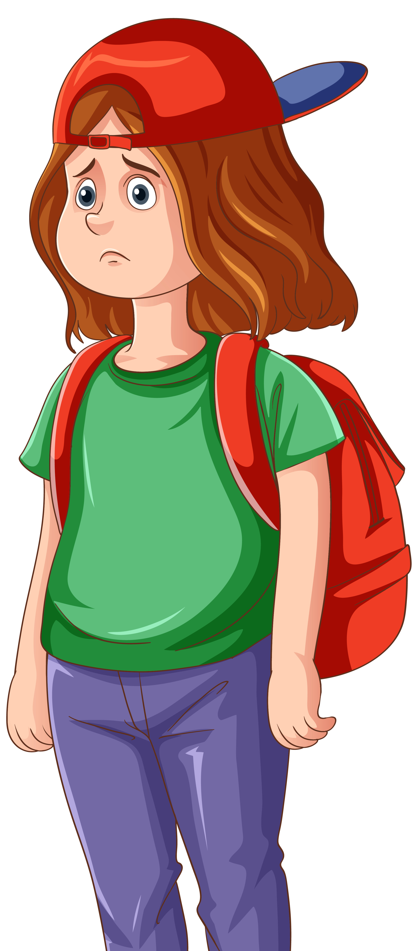
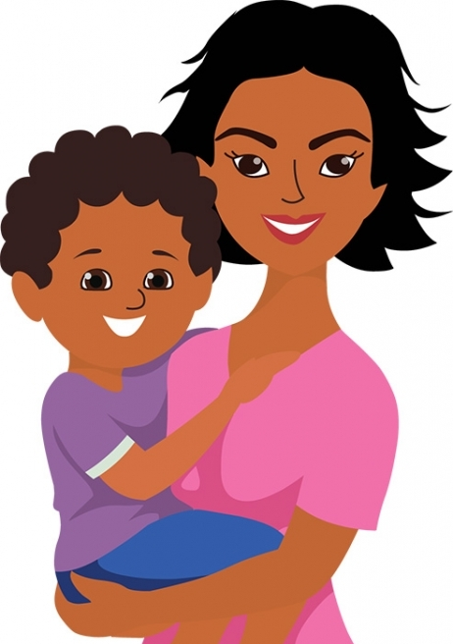
Starter – Hot Air Balloon Challenge
The Doctor:
58 years old
Qualified doctor
Treats 20 patients every day
Has no immediate family
Planning to retire in 2 years to go on a 6 month cruise
The Celebrity:
21 years old
TikTok sensation (over 100 million followers)
Advocate for social causes e.g. Black Lives Matter and ending police brutality
The Student:
16 years old
Lives at home with parents and three siblings
Just left school after failing GCSEs and is looking for a college place
Attends Scouts on a weekly basis and enjoys camping/survival activities
The Parent:
28 years old
No partner
Has a 3-year-old son and a 6-month-old daughter
Currently has no job
Worked in a shop before having children
Notes:
Character profiles for Hot Air Balloon Task:
Display this slide during the activity

Slide 8
Debate Structure: PEEL
Structure | Explanation
Yes | Acknowledge your opponent’s point and the argument they have made for or against the statement.
Point | State your own point.
Evidence | Give evidence to support your point.
Explain | Explain how this evidence supports your point.
Link | Link this back to your initial point (or to the next point).
Notes:
Share debate structure with students, as a recap from last week’s session.

Slide 9
Collaboration – What does it mean?
Collaboration is the action of working with other people to produce something or achieve a common goal.
Notes:
Give students 30 seconds to discuss with their group, then ask one group/learner to feed back before revealing the answer.

Slide 10
Collaboration – What does it mean?
Collaboration is the action of working with other people to produce something or achieve a common goal.
Do’s | Don’ts
Notes:
Give students another minute to discuss the do’s and don’ts of collaboration, before sharing the answers on the board.

Slide 11
Collaboration – What does it mean?
Collaboration is the action of working with other people to produce something or achieve a common goal.
Do’s | Don’ts
Listen to other people’s ideas | Ignore other people’s ideas
Contribute your own ideas | Be afraid to put forward your own ideas
Be willing to learn from others | Assume that your ideas are always right
Accept when others don’t agree with you | Take it personally if others don’t agree with you
Notes:
This table is the toolkit entry for students to takeaway at the end of the session.

Slide 12
Survival Activity
Imagine you have woken up to find that a zombies have taken over your town. You need to quickly gather some supplies and escape before the zombies find you.
If you could take 10 items with you to survive the apocalypse, what would they be?
Discuss this with your group and come up with a final list.
Use your debating skills and critical thinking skills to decide.
Remember to justify your decisions.
Notes:
Give students approximately 3-5 minutes to think freely about what they would need with them in the event of a zombie apocalypse.
Explain that they have woken up in their home in a small rural town, to find that it has been taken over by hordes of zombies.
They have a few minutes to decide on 10 items to grab before running into the wild.
They should write down their items, but need to make sure they have no more than 10.
Afterwards, ask each group to feed back, making sure they can justify their decisions.

Slide 13
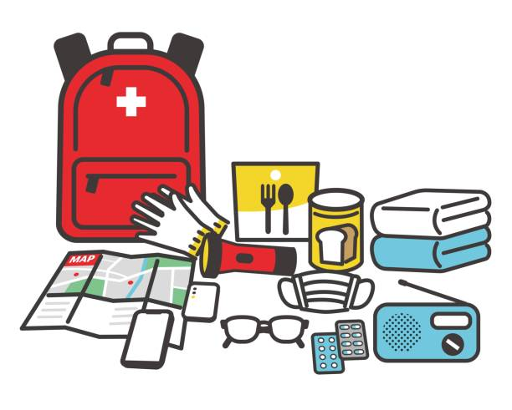
Survival Activity
Now you need to choose the top 10 items from the survival pack on your tables.
Discuss this with your group and decide on the 10 items you would want to have with you.
Use your debating skills and critical thinking skills to decide.
Remember to justify your decisions.
Notes:
Now hand out the survival activity pack to students.
Give students five minutes to debate with each other, to decide on the 10 items they would choose from the pack.
Explain that they can choose any item, regardless of price, but they can’t choose any more than 10.

Slide 14
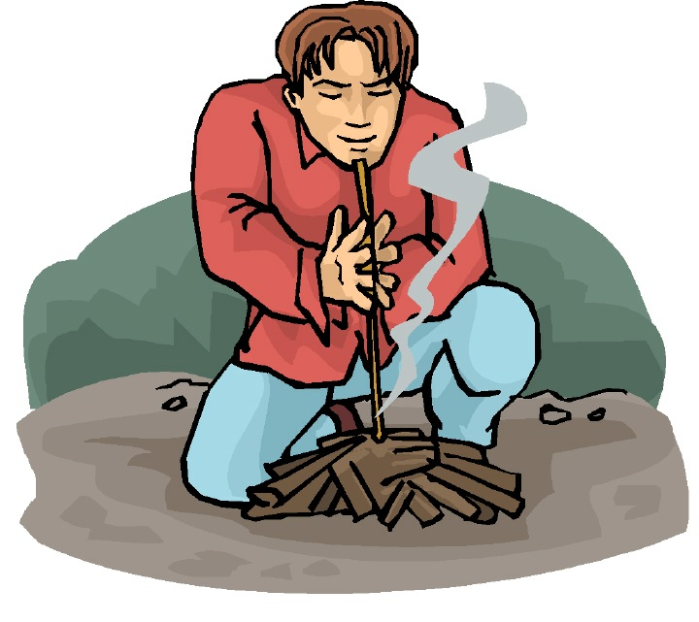
Survival Activity
Oh no! Another survivor has stolen your 10 items and is asking you to buy them back from him, but you only have £75 to spend on them.
Use the prices on the item cards to decide which items you are going to buy back.
Remember, you can’t spend more than the £75 limit
Notes:
Now students need to decide which of their items they need to buy back, without exceeding the £75 limit.
Give them 5-10 minutes to do this.

Slide 15
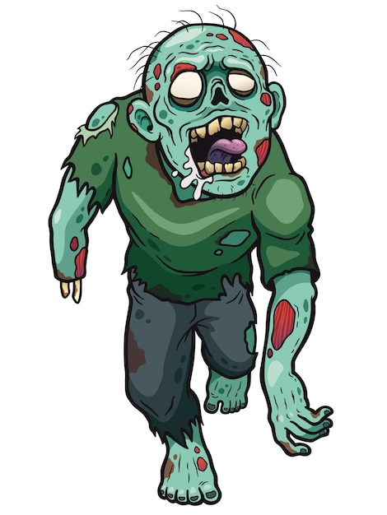
Survival Activity
Oh no! You’ve just walked straight into a zombie and dropped all of your items on the ground. You need to get away quickly and only have time to pick up 3 items.
Discuss this with your group and decide on the 3 items you would want to have with you.
Use your debating skills and critical thinking skills to decide.
Remember to justify your decisions.
Notes:
Explain that now students need to reduce their number of items even further.
Give students five minutes to debate with each other, to decide on the 3 items they would choose from the items they have just purchased.

Slide 16
Survival Activity
Out of your remaining items, which one do you feel is the most important?
Discuss this with your group and decide on the 1 item you would want to have with you.
Use your debating skills and critical thinking skills to decide.
Remember to justify your decision.
Notes:
Finally, students must select the final item they wish to keep.
At the end of the task, ask students to feed back to the group, revealing what items they selected and why.
If you have time, ask students to mix groups, ensuring that each table has a mix of all the different groups on it.
Using the debate structure from the previous session, students must take it in turns to defend their chosen item.
You may want to ask students: ‘If you could go back to the beginning of the task and only select one item, would this have been the one you eventually chose?’ Why/why not?

Slide 17
Post-it reflection…
And finally…
Each take 3 post-it notes and on them, write:
When you’ve finished, stick on the board at the front in the relevant section.
One thing that you enjoyed about today’s session
One piece information or a skill you learnt in today’s session
One question you have or something you’re still not sure about
Notes:
Three post-it notes should be given to each student
Ask the students to write on one post-it something they enjoyed about the session, on another one piece of information or a skill they have learned and on the final post-it, a question or something they are unsure about.
Finally ask students to stick the post-it on the board under the relevant section, or in a designated space in the room, e.g. separate table for each heading.

Slide 18
Summary - Go Collaborate
In this session you have practiced collaborating with your peers by using critical analysis and debating skills in a group setting. This has allowed you to share your ideas and opinions, and reach a mutual conclusion.
In the next session, Go Present, you will use the skills you developed in this session to plan and present on a topic with your peers.
Session 1:
Go Connect
Session 2:
Go Analyse
Session 3:
Go Debate
Session 4:
Go Collaborate
Session 5:
Go Present
Session 6:
Go Visit
Notes:
Summarise the skills that students have practiced in today’s session, including how this fits into the remaining sessions.
Also hand out the ‘toolkit’ sheet for students to take away with them, highlighting the do’s and don’ts of effective collaboration.

Slide 19
Thank you

