Slide 1
Why do we need study skills?
Notes:
Put this slide up whilst learners are coming into the classroom and getting settled – they don’t need to answer the question.

Slide 2
Study Skills
Notes:
Short introduction:
GHWY - ‘GHWY is a partnership of 13 HEP’s across West Yorkshire. Our aim is to work together to make sure young people and their parents/carers have the right information to be able to make informed decisions around Higher Education’.
Today we’ll be looking at Study Skills.

Slide 3
Mind Map Time
You have 3 minutes to create a Mind Map all about studying – try to make connections where you can!
Feelings and thoughts about studying
How you like to study
Need inspiration?
Your favourite subjects to study
Study/revision techniques
Why?
How do you like to learn
Study resources

Slide 4
Mind Map Time
Now pick one concept on your Mind Map.
In pairs, take it in turns to explain that concept to the other person.
You each have one minute.
Notes:
After students have done the task – ask how they found it.
Explain that through the task they’ve used techniques – mind mapping, memory recall, and teaching others.

Slide 5
Why are we here?
To develop our understanding of study skills.
To develop our awareness of different study techniques and methods.
To try out some study techniques and so you can discover what might work best for you.
Notes:
Explain the objectives of the session.

Slide 6
What are study skills?
Study skills are skills that you need in order to be able to study and learn effectively. These skills are useful in your daily life too, so it’s important you work on developing them! They include:
Note taking and condensing information
Time management and organisation
Critical thinking
Academic writing and referencing
Researching and evaluating information
Notes:
Explain what study skills are using the slide.
Optional:
Give example of where they already use each skill. E.g. Looking for reviews of a product on Tiktok then deciding if they should by it = Researching and evaluating information. If they watch sports they might debate why a player made a certain pass or tackle = critical thinking.
Ask where they think they do/could use these skills outside of school/college – either now or in the future.

Slide 7
Getting Organised
Time Management
Do you have a plan for the term/year? Are your deadlines written out?
How much time do you have to study? What else do you have planned for the day/week?
Workspace
Where do you concentrate best?
A desk, good lighting and minimal distractions!
Resources and Materials
Do you have the essentials – paper, pens, USB Stick?
Are your files organised – Laptop or physical.
Local Library, Café, College/school?
Do you have access to any printouts, slides, books you might need?
Prioritisation
Write a list of everything.
What’s most important? When’s the soonest deadline?
Goal Setting
Divide your study session into smaller chunks.
Pomodoro technique
Self-Awareness
What time of day do you concentrate best? What distracts you?
What other responsibilities do you have? Looking after siblings? A job?
What’s realistic and achievable?
What’s your form of self-care?
Notes:
Explain that being organised sets the foundation for effective study.
Explain what each box is/means.

Slide 8
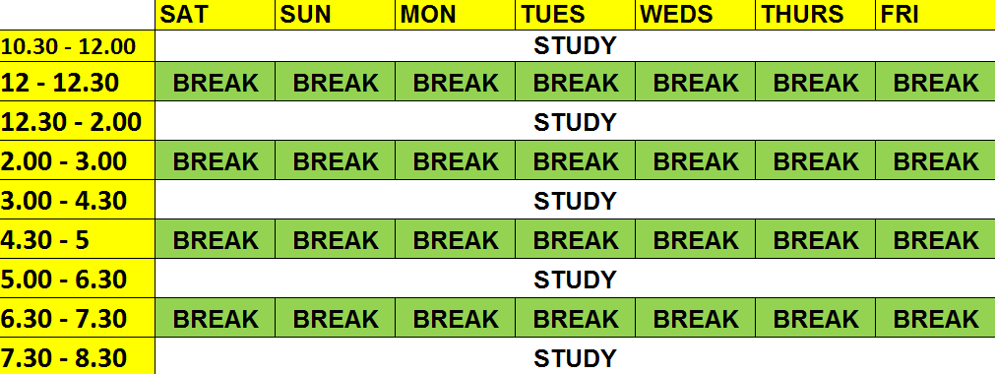
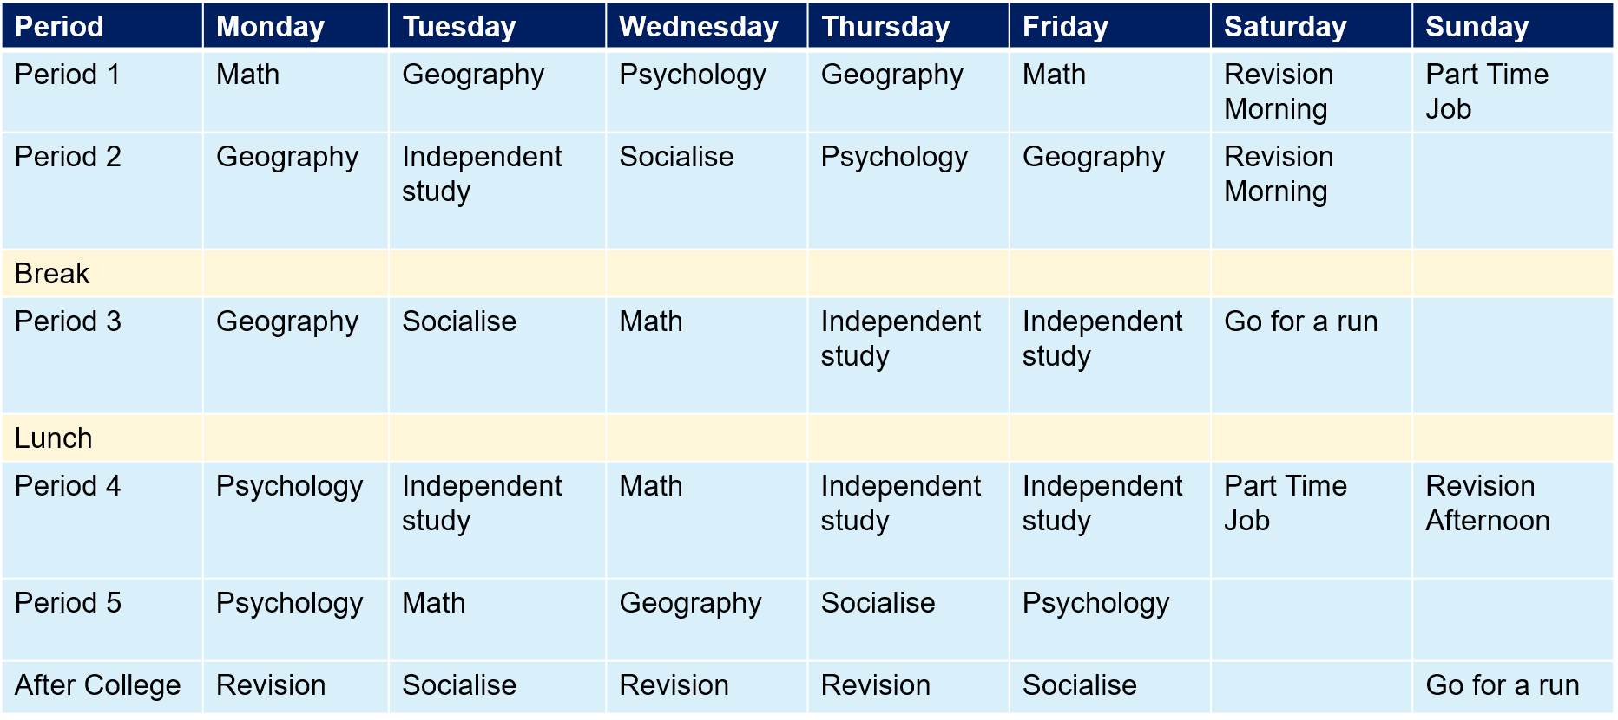
Study Timetable
You have 2 minutes to discuss these two timetables – What’s good? What’s bad? Which is better? Why?
Rowan’s Timetable
Charlie’s Timetable
Notes:
Give students a couple of minutes to discuss the two timetables then draw them back into a group discussion.
Comments might include:
Charlie has written her full schedule.
Rowan’s is unrealistic – there’s no breaks
Charlie includes things like going for a run and socialisation – life outside of study

Slide 9
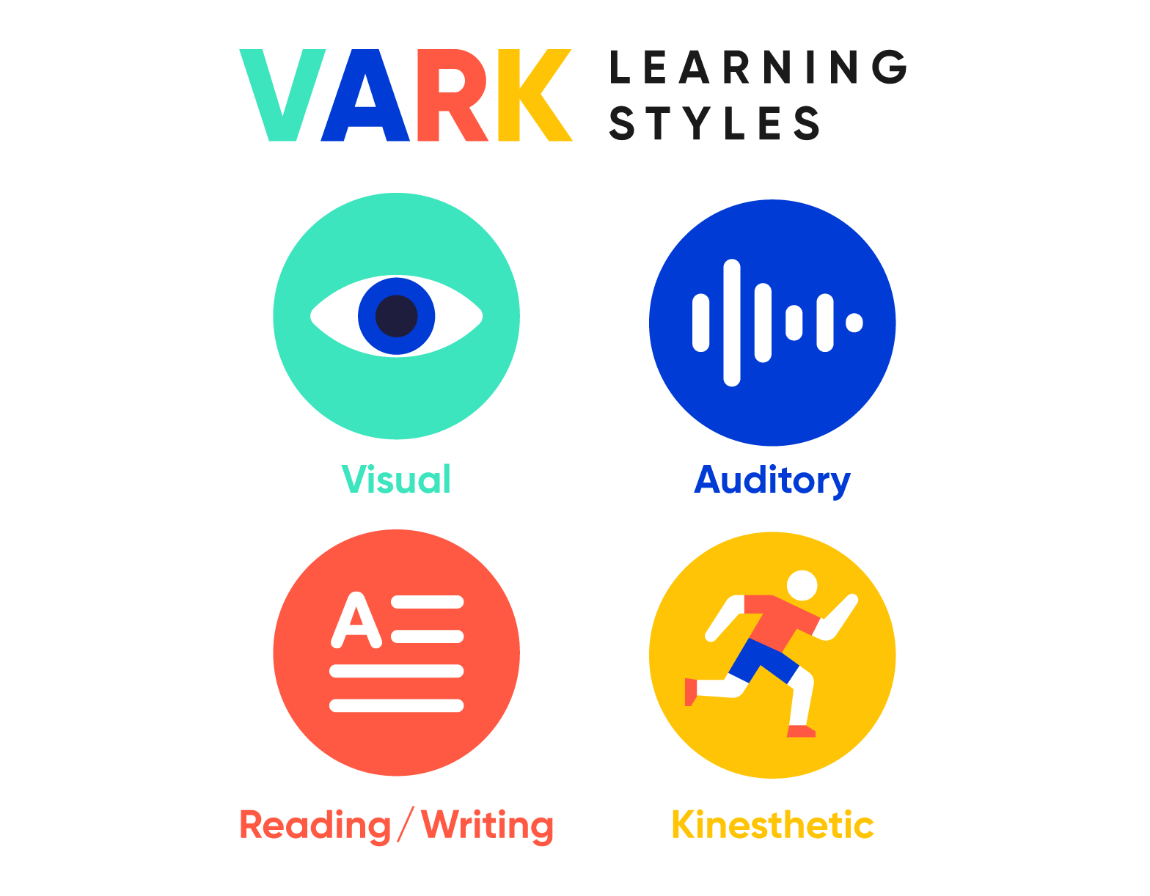
Learning Styles
As humans, we’re all unique, which means we all learn in different ways!
Understanding your personal learning style is a great way to get the most out of your studies.
There are 4 main learning styles – VARK.
You could lean towards one learning style, or you could you have a flexible/combination learning style.
How you like to learn might change depending on the subject and the information you’re being given, so be open to try out new things!
Notes:
Introduce learners to the concert of learning styles - important self-awareness so they can tailor their studying/revision.
VARK is one of the most popular models (you will explain each style in depth in the next slide):
Visual
Auditory
Reading/Writing
Kinaesthetic
Ask students if they already know their style OR ask them to have a minute to think about what their styles could be and why – feedback to the group if they’re comfortable.

Slide 10
Learning Styles - Visual
You learn effectively when:
Seeing information.
Visual images and cues.
Best Study Techniques:
Top Tip:
When reading and making notes, colour code and draw relevant doodles!
Flash Cards
Videos
Infographics
Posters
Mind maps

Slide 11
Learning Styles - Auditory
You learn effectively when:
Listening and hearing information.
Talking through topics.
Best Study Techniques:
Top Tip:
Try to have group discussions and debates as a way of studying/revising!
Reading out loud
Recording yourself explaining topics
Podcasts
Audiobooks
Creating a song or jingle

Slide 12
Learning Styles – Reading and Writing
You learn effectively when:
Information is written down.
Best Study Techniques:
Top Tip:
Try using written memory recall – after reading a text, write down as many things as you can remember.
Write notes – re-read and re-write them.
Print out text – highlight and annotate it.
Read articles, journals, textbooks etc.
You’re reading text.

Slide 13
Learning Styles – Kinesthetic
You learn effectively when:
You're doing practical/’hands on’ tasks.
Best Study Techniques:
Top Tip:
Have regular movement breaks whilst you’re studying – it’ll keep your mind engaged!
Simulations
Role-play
Making interactive resources – flashcards
Practical demonstrations
Teach others
Notes:
After explaining all 4 learning styles, reiterate that they might find that they fit into multiple/change depending on the subject.
There’s questionnaires they can do to help then get a better idea (google search or using the link on resource slide).
Show of hands – who has a clearer idea of what their learning style might be?

Slide 14
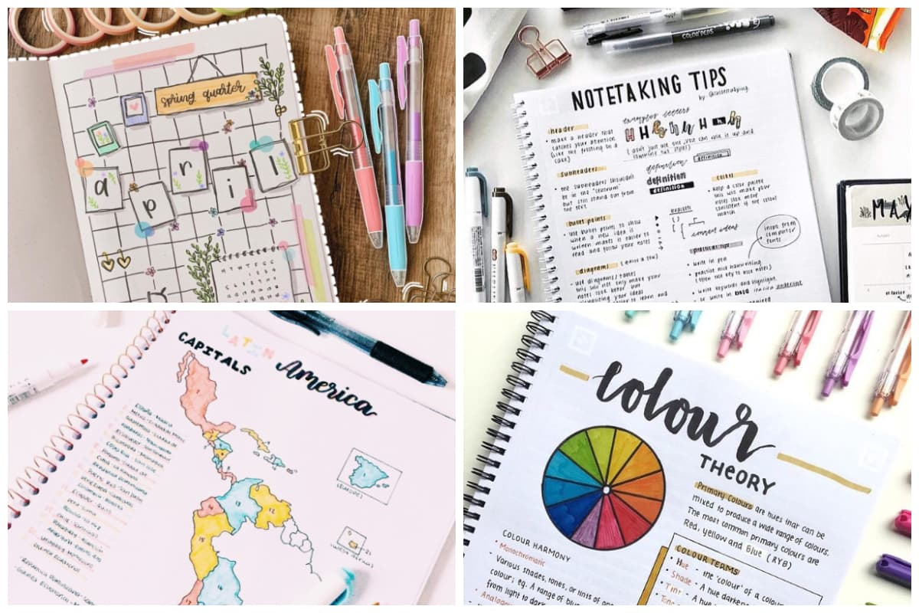
Note Taking
Good notes:
Clarifying your thoughts and understanding.
Support critical thinking.
Help you to memorise important information.
Remember to:
Always use your own words – helps with information retention and understanding.
Use key words, phrases, doodles and abbreviations (you can even make up your own).
Note down the key points - look for what’s relevant.

Slide 15
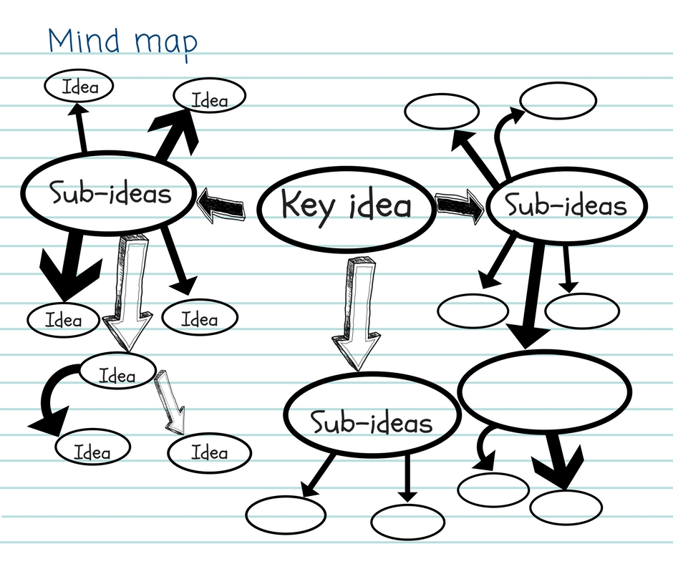
Note Taking Methods
Mind Map
Cornell Method
Notes:
Mind Map
Put the keyword, main point or learning outcome in the centre of the page.
Make branches that go from this main point to sub-points, details etc.
Leave enough room for all your points and to use a separate mind-map for each main point.
Colour-code, add drawings and highlight.
Cornell Method
Two columns:
One for the main point, theory, learning outcome (done after main notes are completed).
Second for your notes, key-words or questions.
At the end of each page with this method, write a brief summary.

Slide 16
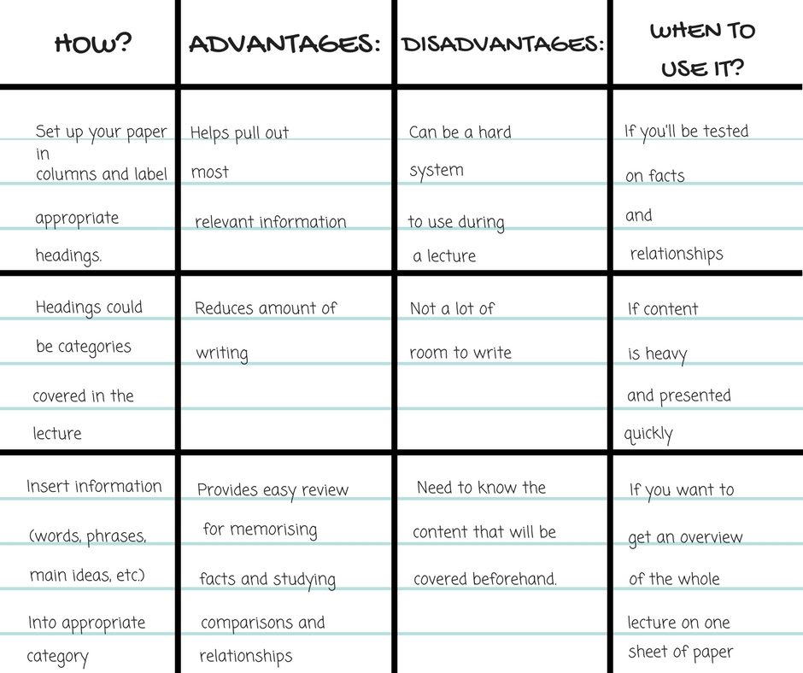
Note Taking Methods
Outline Method
Charting Method
Notes:
Outline Method
Using indentations, bullet points or numbers to visually distinguish the difference between main points, sub-points and details.
Using different coloured pens, capitalisation or highlighters helps to make it more effective
Closest to what they might already do.
Charting Method
Using a table to make your notes.
Separate columns for main points, questions, details, key dates etc.
About classifying your information so you can easily access it.

Slide 17
Note Taking – Your Turn!
Choose one of the note taking styles…
Using the note taking style you’ve chosen, make notes on the short clip we’re about to watch!
Notes:
See delivery notes for suggested videos.

Slide 18
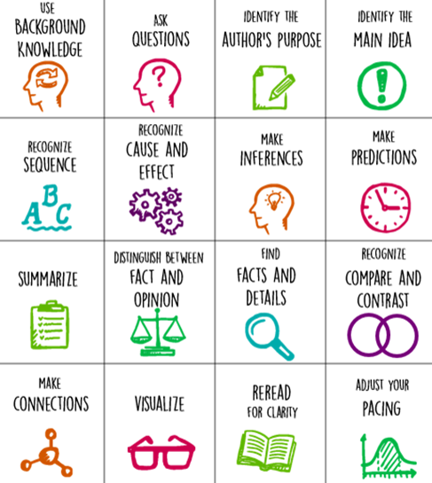
Reading Skills
As you read:
Highlight, annotate and make notes of any thoughts or questions.
Practice skimming (quickly looking over a text to get a general idea) and scanning (looking for key words).
Reflect on the body of text that you’ve just read – what made sense? What surprised you? What do you need to investigate further? What was the author’s point?
Notes:
Explain to learners that when they’re reading, it should be active.
Explain some of the skills in the image.
Active reading helps with processing and retaining information.

Slide 19
Bonus Task
Using the resources on the tables, make some study resources focused on everything you have learned today. This could be:
Flashcards
Notes
Annotating the slides
Script for a voice recording
Poster
Mind Map
Notes:
If you have time at the end of the session and the relevant resources (pens, paper, printouts of slides etc) then challenge learners to create a resource about study skills using their technique of choice.

Slide 20
A Final Note
Create your own study timetable (with breaks included)
Don’t cram your study or revision – use spaced repetition!
Have a look at some of the apps and resources mentioned.
Try out different techniques and methods for different subjects.
Research your learning style.
Use the support you have access to – teachers, study centre and the library.
Your lifestyle impacts your ability to learn – make sure you get enough sleep!
Remember – these are skills that will be useful throughout your life!
Notes:
A summary of the session in the form of what learners can do next/top tips.
Apps and resources are on the next slide.

Slide 21
Resources
Apps
My Study Life: Get organised by creating detailed timetables, to-do lists and tracking your progress.
AnkiApp: Turn your notes into colourful flashcards and test yourself.
Quizlet: Make your own quiz flashcards as well as using ones already made by others.
Websites
Seneca Learn: Free revision tool for GCSE & A Level exams across 250+ exam board specific courses.
Pomofocus: Focus on any task you are working on such as study or revision with this online time.
GetRevising: A one stop shop for creating study plan’s and accessing 1000’s of resources including past papers, quizzes and flashcards.
Learning styles quiz: The VARK Questionnaire for Younger People - VARK (vark-learn.com)

Slide 22
Any questions? ☺

