Slide 1
Exploring alternate pathways to medicine and other opportunities
Dr Pip Garner
Assistant Professor in Anatomy and Physiology & Admissions Tutor
Clinical Sciences
P.E.Garner@Bradford.ac.uk

Slide 2
What attracts people to a career in medicine and/or
healthcare?
Alternatives to Medicine
Notes:
Get the students to post in the comment section the aspects of medicine they want in terms of the career / as we can explore this with the alternate career choice

Slide 4
Biomed
Optometry
Pharmaceutical and Cosmetic Sciences
Pharmacy
Clinical Sciences
Alternatives to medicine
In Faculty of Life Sciences
Physician’s Associate
Alternatives to Medicine
Notes:
*9 programmes to be discussed today – Midwifery, Nursing and Paramedic Science are other options
**1.5 millions people employed by NHS, not all doctors
***will focus on Biomedical Science, Clinical Science FY + Programme, Clinical Technology, Forensic and Medical Science, Optometry, Pharmacy

Slide 5
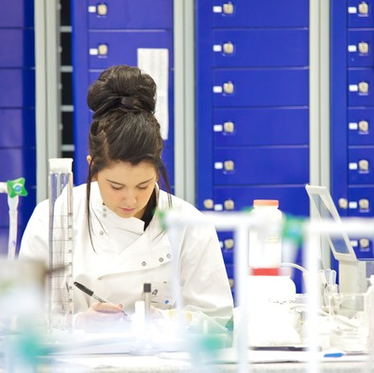
biomedical science
The Biomedical Science (Honours) degree requires an interest in science and technology.
In-depth study into human health and explore causes of disease that have a major global impact at systems, cellular and molecular level.
You will learn how biomedical research is helping researchers and clinicians develop novel therapeutic strategies and inform government health policy.
As part of our frontline medical team, biomedical scientists in healthcare laboratories are involved in over 70% of UK diagnoses and play vital roles in monitoring chronic diseases.
Studying biomedical science will also prepare you for a broad range of scientific careers beyond NHS and public laboratories, including research and development, pharmaceutical and biotech companies, the food and water industry, clinical trials, medical sales and teaching.
Typical offer = BBC with Bio or Chem at B or above, DDM BTEC Applied Science (may depend on units), T level merit with subject specific science requirement
Notes:
Human biology – with a focus on Genetics and biochemistry (chemistry in the body i.e. hormone levels)
Professional skills, biochemistry, cell and tissue, genetics, microbiology, immunology, haematology
Need Biology or Chemistry B or Applied Science BTEC
Tori Lacy - BSc Biomedical Science in 1995 - Weather forecaster on Radio 5 Live

Slide 6
Optometry and vision sciences
Our integrated 4-year Master of Optometry (MOptom) programme has been completely redesigned for 2024, modernising our course content and structure to enable you to proceed directly to registration as a fully-qualified optometrist with the General Optical Council (GOC) upon completion.
The course is clinically-focussed from the start. You will learn all the practical techniques, theoretical underpinnings, professionalism and communication skills required to qualify as an optometrist.
Typical offer = AAB (136 UCAS points) inc x2 science subjects (B, C, P, M), DDD in BTEC Applied Science but only in combination with a pure science A level. T levels are not accepted.

Slide 7
What do Pharmacists spend most of their time doing?
Making Medicines
Dispensing Medications
Checking Prescriptions
Talking to people
Problem Solving
Notes:
C is the correct answer.

Slide 8
different pharmacy roles
Community Pharmacy
GP
Practice
Hospital Pharmacy
Veterinary
Pharmaceutical Industry
Armed Forces
Management
Care Home Pharmacist
Academia
Publishing
Notes:
Also prison
Go through each one

Slide 9
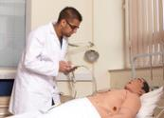
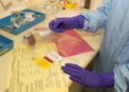
different pharmacy roles
Community
Safe supply of medicines
Managing conditions from minor to major
Consultations on medicines use
Preventative e.g. flu vaccines
Hospital
Safe supply
Wards
Wide range of activities eg:
Dispensing
Manufacture
Clinical Services
Specialist roles
Industrial
Part of a R&D team
Basic research
Drug development
Formulation
Manufacturing
Licensing
Clinical trials
Marketing/Sales
Notes:
Ask what they think the pictures represent (you have already given them a clue from a couple of charts ago)
Go through each one

Slide 10
how would I study?
Team-Based Learning
Active learning to develop problem solving skills
Collaborative learning to develop team-working skills
Higher-level learning to promote deep learning
Lab classes
Prescription processing classes
Developing Professional Practice
Student Support Seminars
Some Lectures
Work-based learning placements (Inter-professional Learning, Patient Public Involvement, GP visit with medical students).
Notes:
Mostly active learning, problem solving, fun way to learn
Combination of different learning methods

Slide 11
pharmacy
Typical Offer: ABB/128 with and A level in Chem or Bio plus another science subject. DDD BTEC in Applied Sci (4 units Bio and/or Chem at D). T levels are not accepted.

Slide 12
Build a strong understanding of formulation science, product and process development, manufacturing and quality assurance.
Safety
Efficacy
Regulations
Quality
Sustainable manufacturing
70% Pharmacy 30% Chemistry
Typical Offer: 112 UCAS points
BBC inc. Bio or Chem (B) + 1 other science. DMM BTEC in Applied Sci (4 units Bio and/or Chem at M). T levels are not accepted.
pharmaceutical and cosmetic sciences

Slide 13
careers
The course is linked to the following industries and specialisms:
pharmaceutical industry
cosmetics industry
food and nutrition industry
quality control
product development
manufacturing
Possible job roles for graduates include:
formulation scientist
manufacturing chemist
quality control chemist
technical business development officer
pharmaceutical analyst
After graduating, you may continue to study our Pharmaceutical Technology and Medicines Control MSc.

Slide 14
physician’s associate (PA) – an alternative route into medicine
“Physician associates support doctors in the diagnosis and management of patients.”
2 Year Professional-Masters Degree – need a BSc first
See patients with acute and chronic problems
Perform medical examinations and procedures
Interpret various investigations
Provide education and support
Refer patients to other organisations to admit to hospital
Independent prescribers

Slide 15
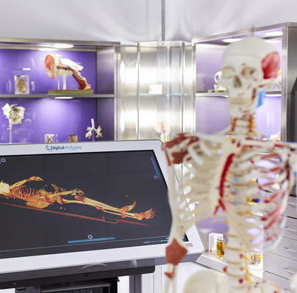
clinical science
Accepted and popular route into UK Medical Schools
Clinical focus – emphasis on anatomy, physiology, health and employability
Informed by research, clinical expertise and multi-professional teaching
Widening Participation to enter the MBChB at Sheffield Medical school
Entry via foundation year and year 1
Students at HYMS, Brighton & Sussex, Leeds, Lancaster
Facilities

Slide 16
BSc (Hons)
Clinical Sciences
Bradford
Medicine (30-50 %);
Physician Associate;
Postgraduate courses;
Graduate careers
Year 3
*NEW*
Industrial placement year or a year studying abroad
Year 2
BSc Access
Sheffield Partnership
Year 1
Transfer to other Bradford courses e.g.
Pharmacy
Biomedical Science
Progress to external courses - including Medicine
FY Access
Foundation
Integrated Foundation Year, standard offer is BCC/104 points with at least grade C in 2 A levels (or equivalents). Points must come from top 3 qualifications. Any subjects.
BSc in Clinical Sciences, standard offer is BBC/112 points with both A level Chem and Bio at Grade BC.
Notes:
“Points must come from top 3 qualifications”. If asked about this point, i.e. you cannot get in with CCDD or CCC+ an EPQ, it would have to be a BCC equivalent

Slide 17
sheffield partnership
Separate application process through UCAS at the end of the academic year
Meet academic criteria
Meet UCAT threshold
Must meet at least 2 of the Sheffield Widening Participation criteria
Foundation year: Average > 70 %
70% or above in Chemistry module
Stage 1 : Average > 70 %
Pass every element at 1st attempt

Slide 18
A. Doctor
B. Pharmacist
C. Accountant
What can you do with a Clinical Sciences Degree?
D. NHS Analyst
E. Clinical Trial Administrator
F. Clinical Scientist
G. Civil Servant
H. Physician’s Associate
I. Teacher
Notes:
Trick question, technically its all of them!

Slide 19
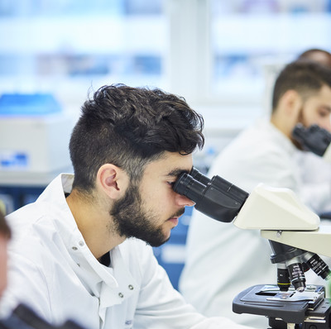
career opportunities
Further study
Medicine (30-50%)
Other Health related career:
Dentistry; Pharmacy; Optometry; Nursing; Physiotherapy; Physician Associate
Postgraduate Study (Teaching, MSc, PhD)
Notes:
The ones I’ve put in red over the next 2 slides are all the things that just my S3 PAT group (of 7 students) are applying to ready for next year, in fact my medical writer has already secured their job!

Slide 20
career opportunities
Graduate careers within the NHS (Managerial and Professional)
Health Service Management
Primary Care Groups
Private Care Homes
NHS Hospitals
Health Commission Associate
NHS Analysts
Clinical Audit Co-Ordinator
Clinical Scientist
Scientist Training Programme
Cardiac Safety Specialist
Healthcare Scientists
Research Coordinator
Pharmaceutical Industry / NHS
Clinical Trial Administrator
Medical Sales
Medical Writing
Marketing & Registration
Regulatory Affairs
Non-Healthcare Careers
Civil Service
Accountancy

Slide 21
Future Programmes
Series of webinar streams, x 4 webinars in each
8 UCAS points for qualifying courses
Link

Slide 22
Thank you
Any Questions?
Notes:
*Academics been in research always or come from Industry, Teaching staff on nursing at Bradfrod have been nurses
What did students put in their personal statements so they were successful on their course?
What skills are helping the students to succeed on their course?

