Slide 1

Career & Skills Based Resources
Go Higher West Yorkshire & West Yorkshire Combined Authority
22nd January 2024

Slide 2


Uni Connect Programme
Widening participation initiative funded by The Office for Students
29 partnerships across the UK- Go Higher West Yorkshire is one of the largest, made up of 13 Higher Education Providers
We focus our work on 30 partnership schools & colleges across the region, but our resources and CPD are open to all teachers, advisors and education practitioners
Focus on:
Post 16 and Post 18 progression options, allowing learners to make informed choices
Confidence building through exposure to HE and skills development
Underrepresented Groups- offering bespoke opportunities

Slide 3
West Yorkshire Careers Hub Resources

Slide 4
LMI
Jonathan Hopwood-Lewis

Slide 5
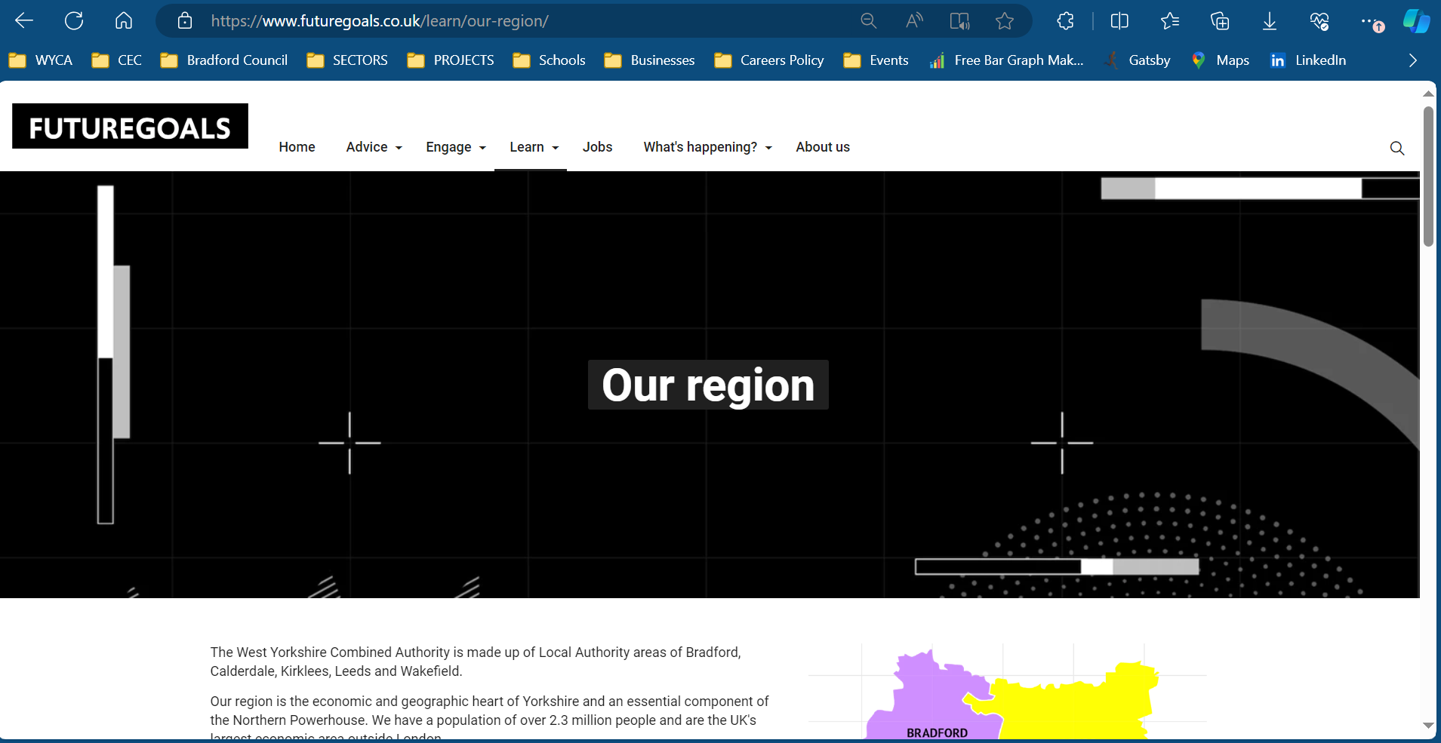

Slide 6
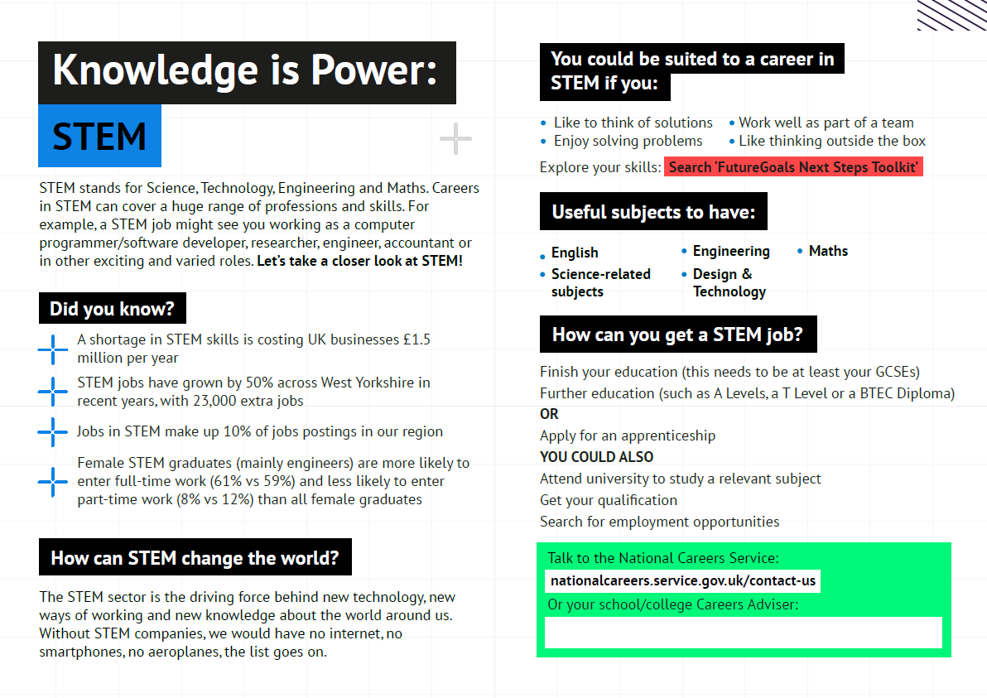

Current 6 Postcards
STEM, Construction, Culture, Media & Leisure, Green Economy, Health & Social Care, Manufacturing
Possible Future Postcards
Space Industry, Textiles, Digital Economy,
Creative Industry…

Slide 7
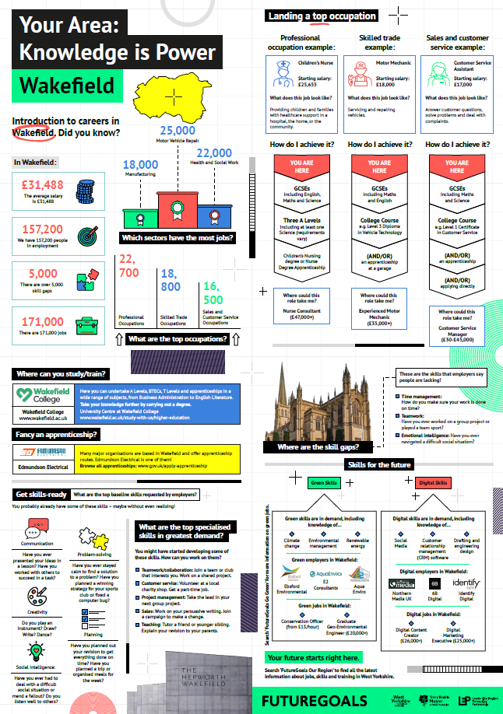
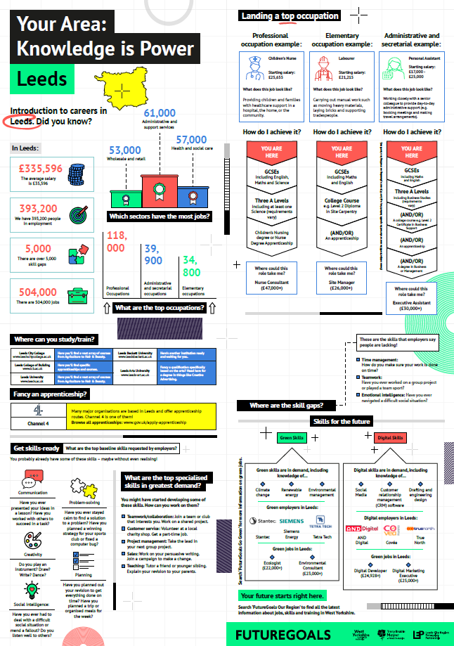
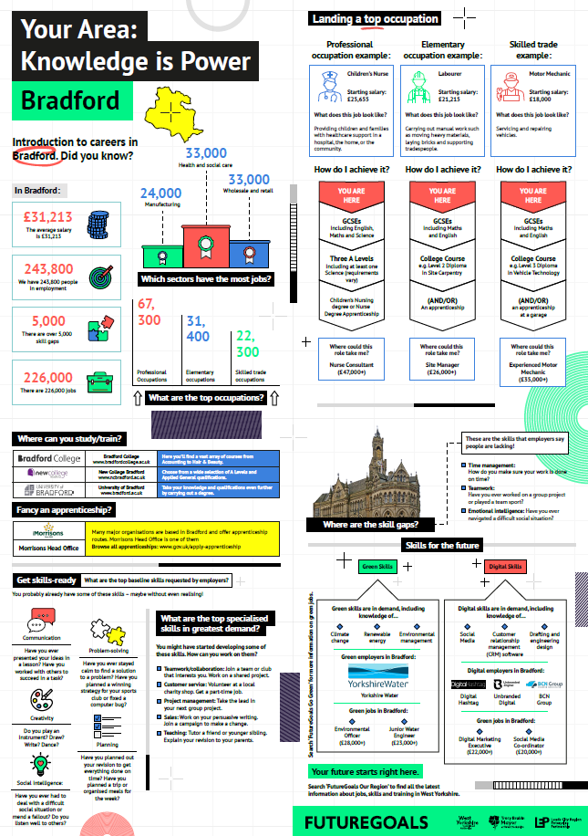
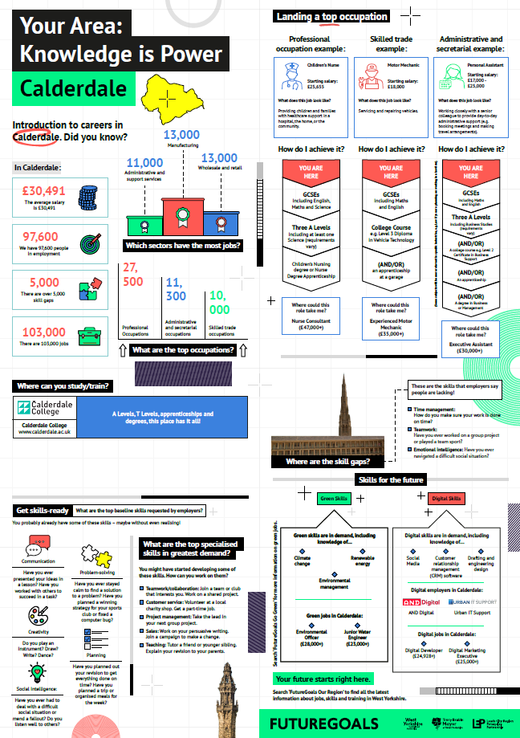
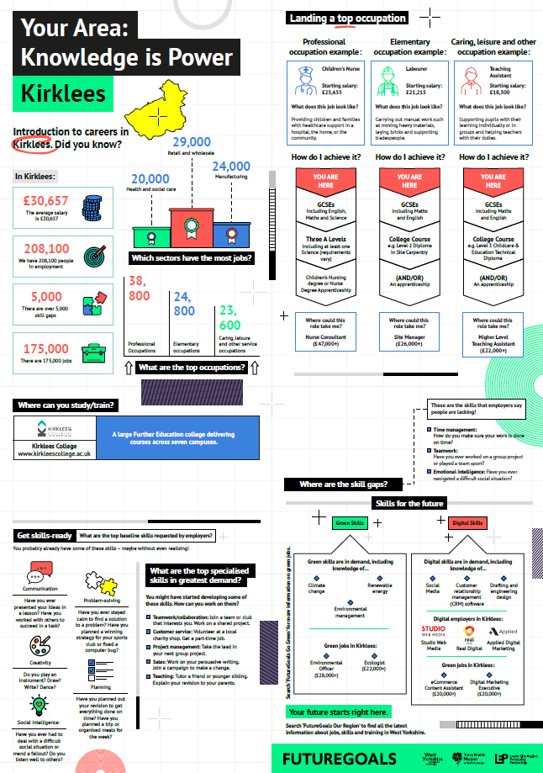

Slide 8
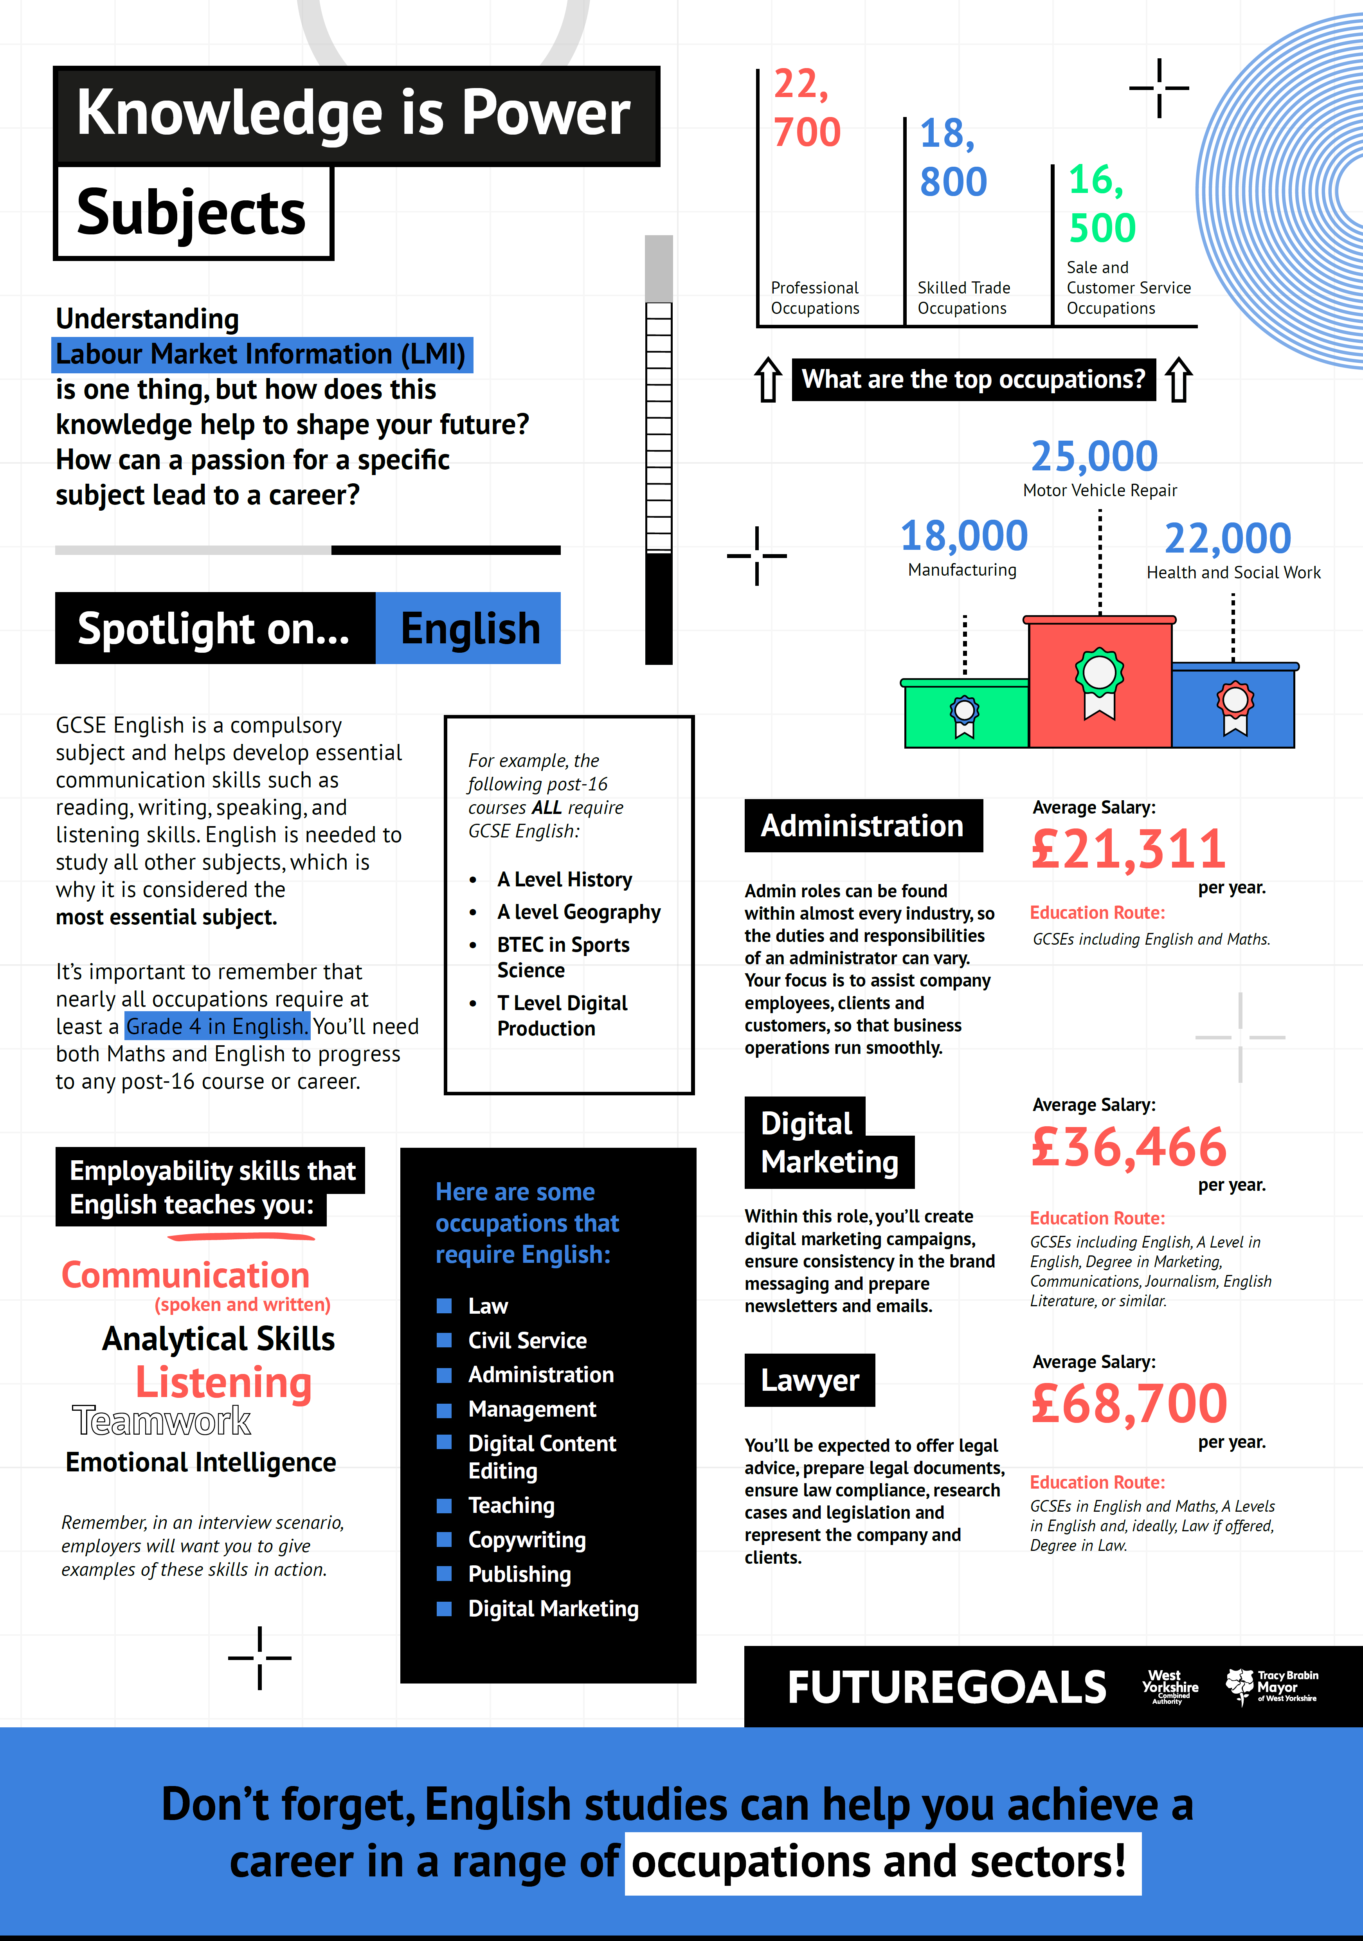
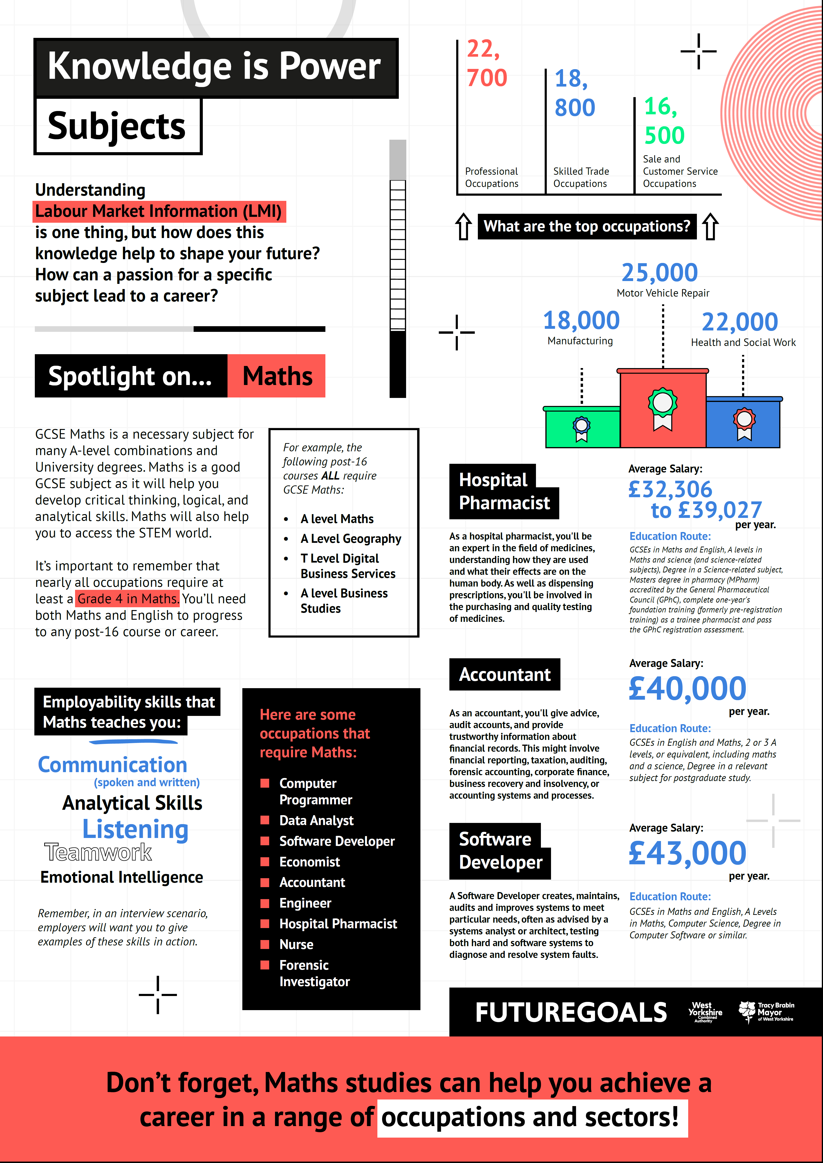
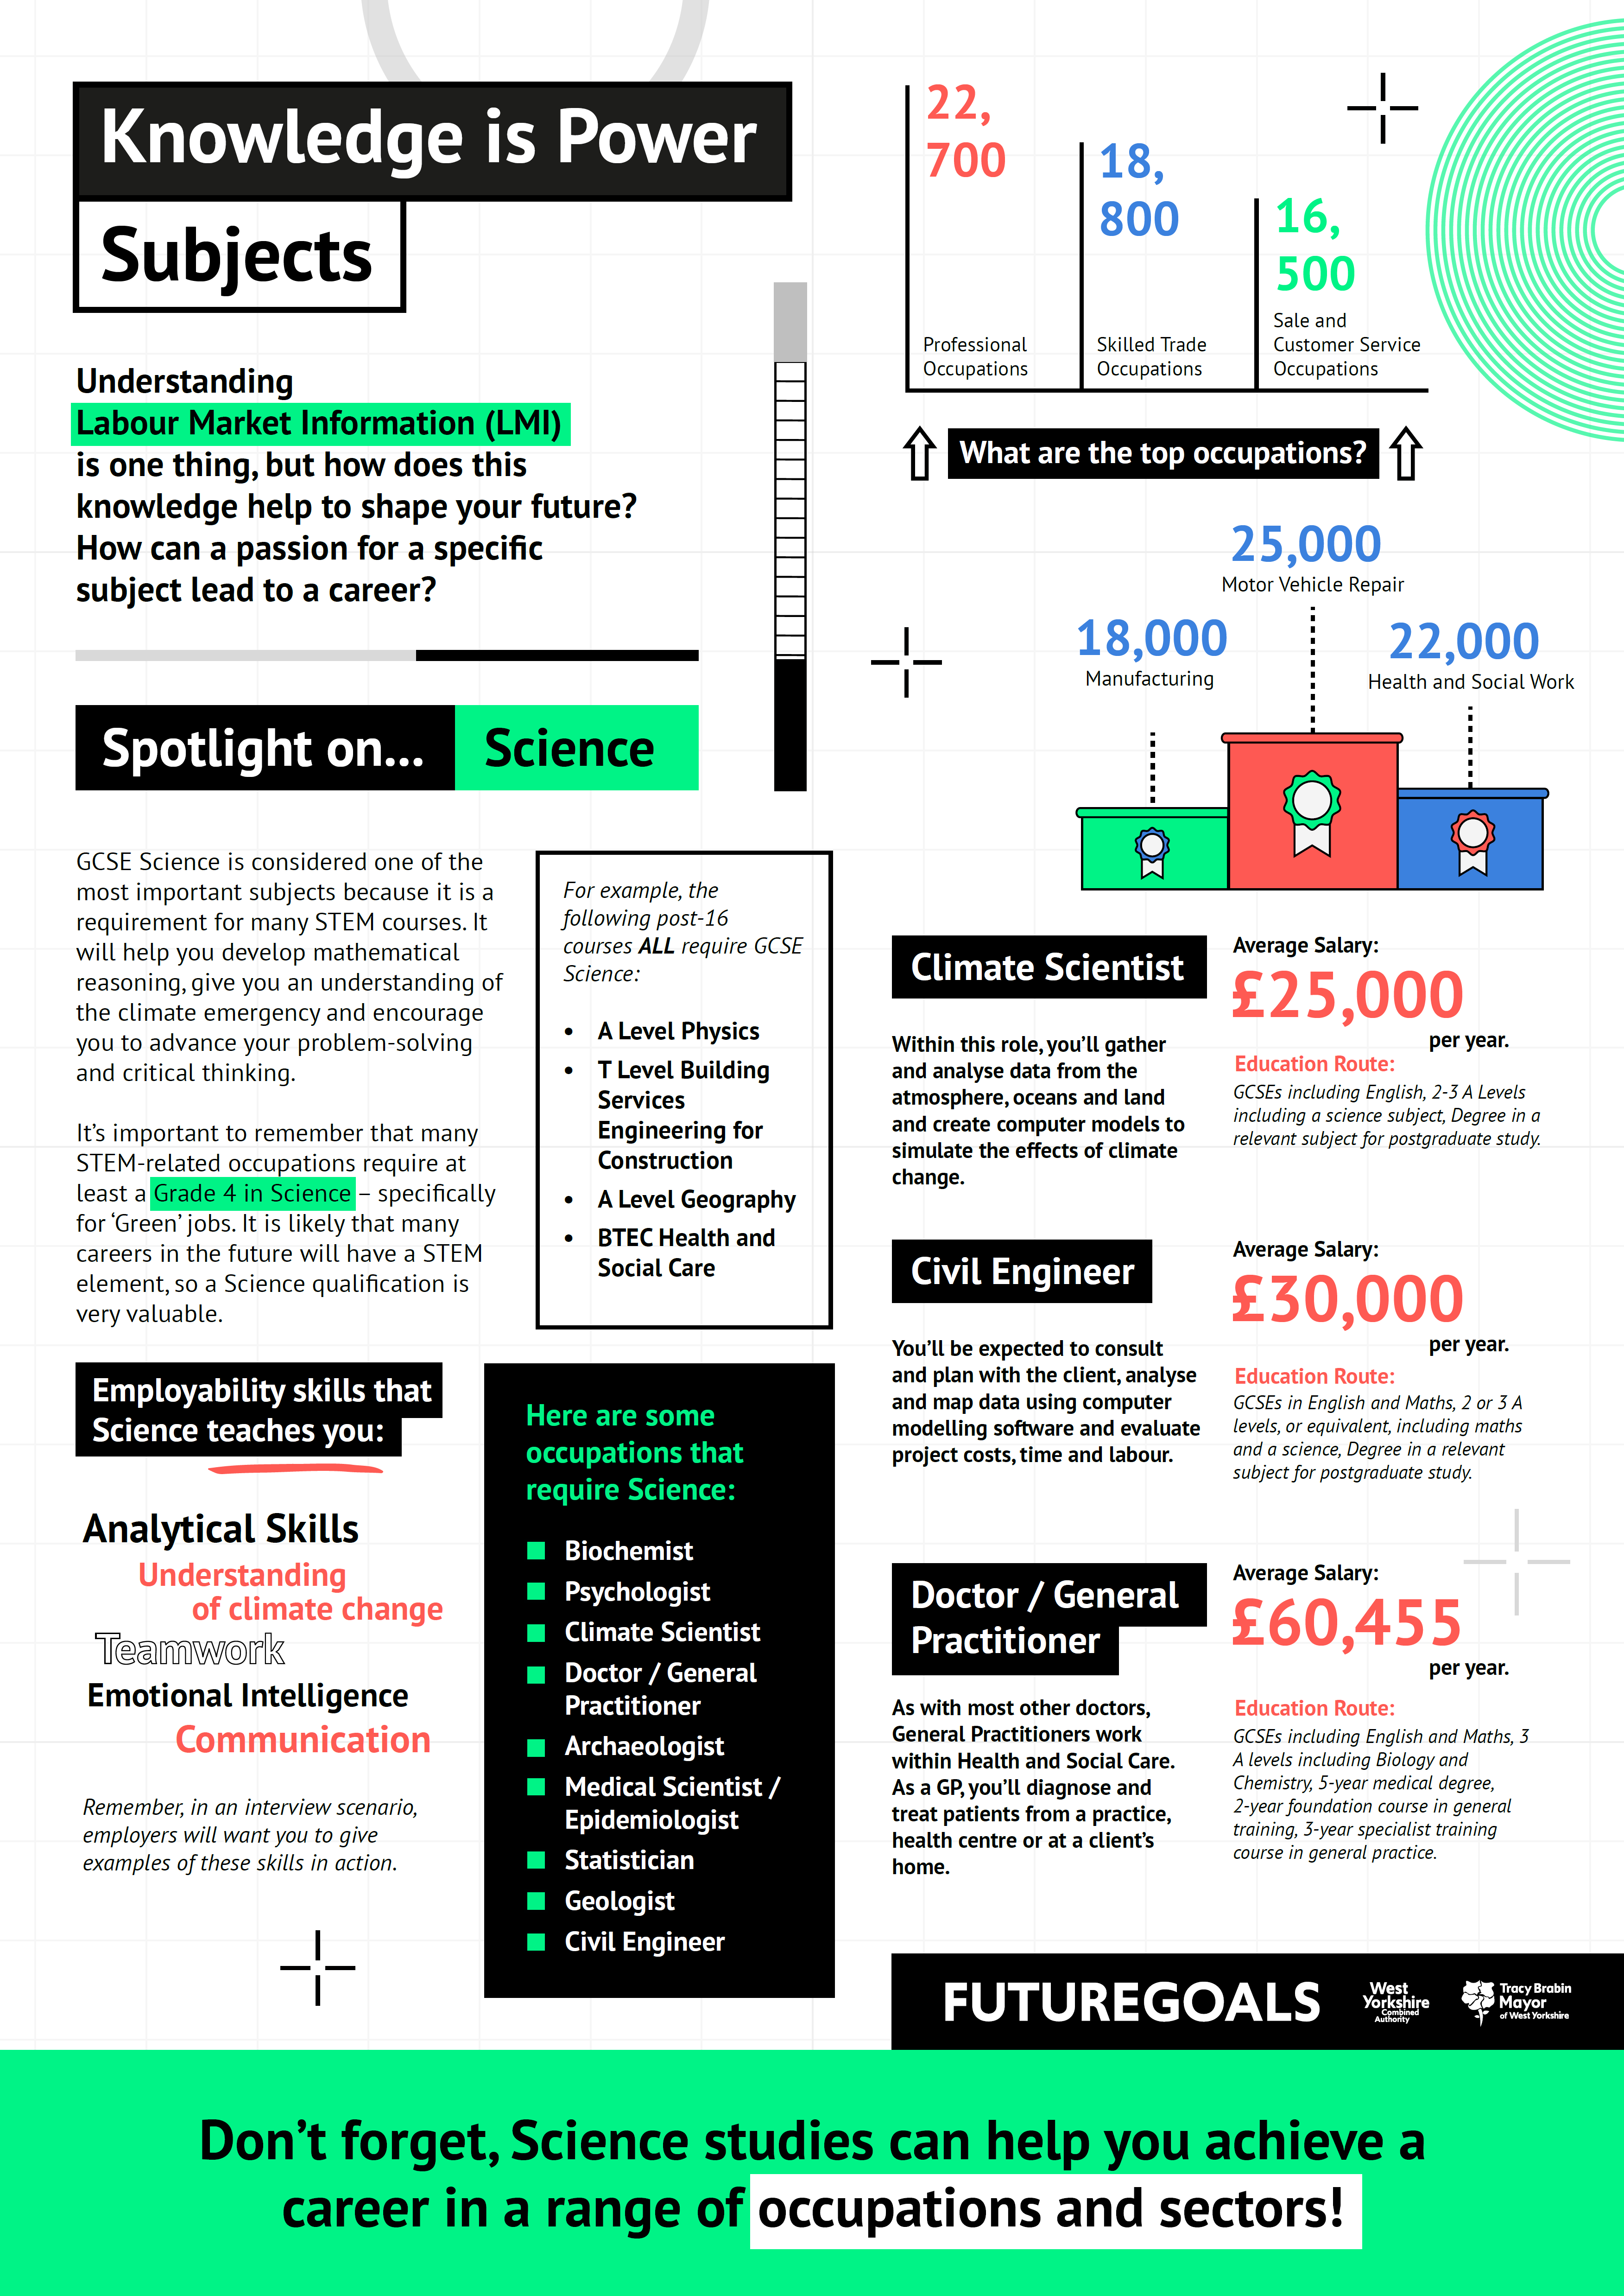
Subject Posters: Maths, English & Science

Slide 9


West Yorkshire: Useful information
Which sectors are growing?
Health and social care (141,000 jobs)
Business administration and support services (110,000 jobs)
Manufacturing (105,000 jobs)
Which occupations are in the greatest demand?
v
Administrative Assistant – 14,000+ vacancies
Software Developer – 10,000+ vacancies
Customer Service Representative – 9,000+ vacancies
Account Manager – 7,000+ vacancies

Slide 10
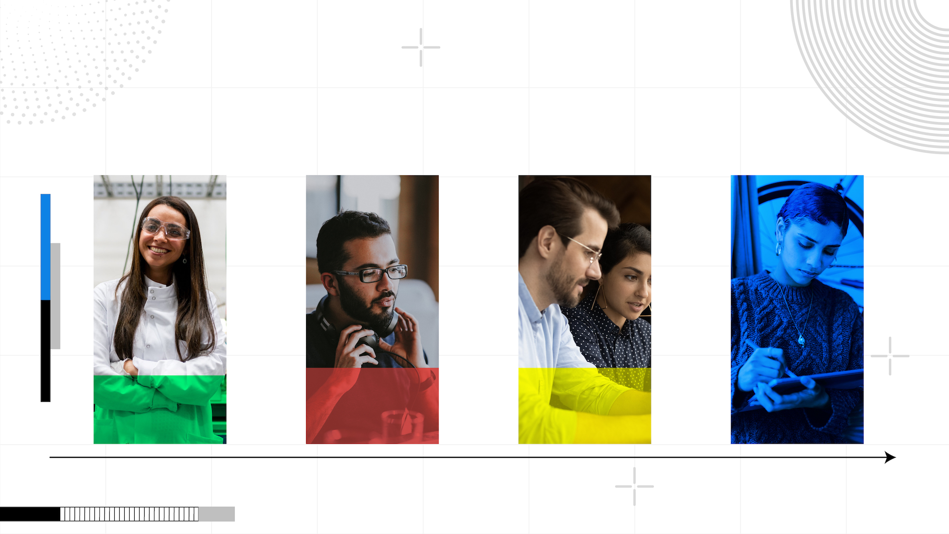
Apprenticeships across our region
Health, Public Services and Care (+940, +25%)
Information and Communication Technology (+182, +28%)
Business, Administration and Law (+52, +28%)
Arts, Media and Publishing (+44, +142%).
+25%
+28%
+28%
+142%

Slide 11
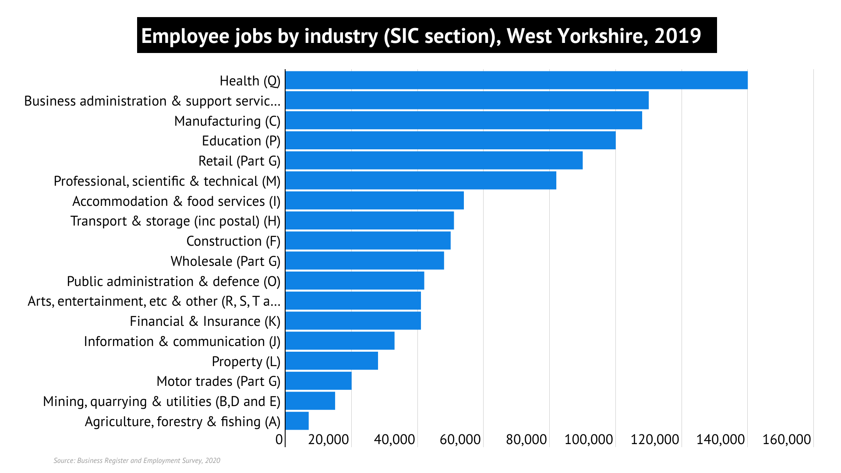
What are the largest sectors across West Yorkshire?

Slide 12

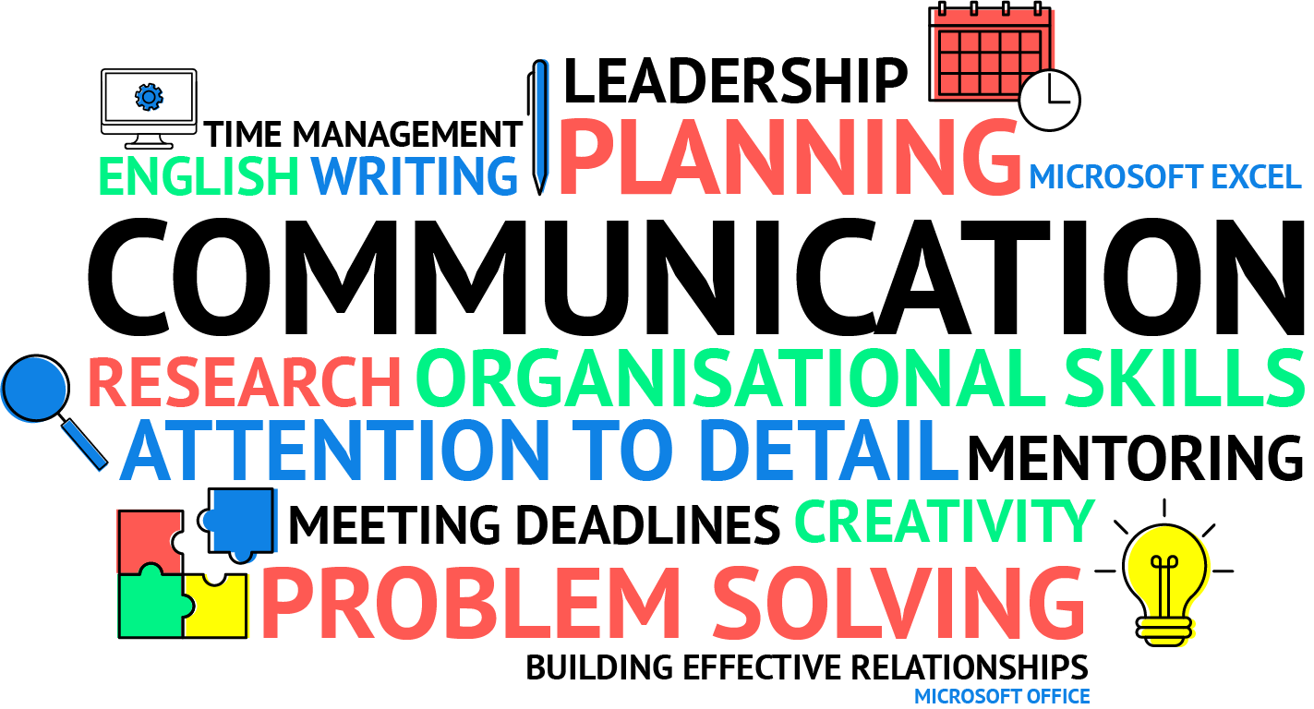
Skills in demand: Baseline
‘Baseline’ skills in greatest demand in West Yorkshire (between 2021 – 2022).
‘Baseline’ skills are the basic ones required for any job.

Slide 13
Skills in demand: Specialised
‘Specialised’ skills in greatest demand in West Yorkshire (between 2021 – 2022).
‘Specialised skills’ are those that make you particularly qualified for a specific position/role.

Slide 14

Skills in demand: Digital
Digital skills, particularly relating to Microsoft packages, are in strong demand amongst those companies looking to recruit.

Slide 15
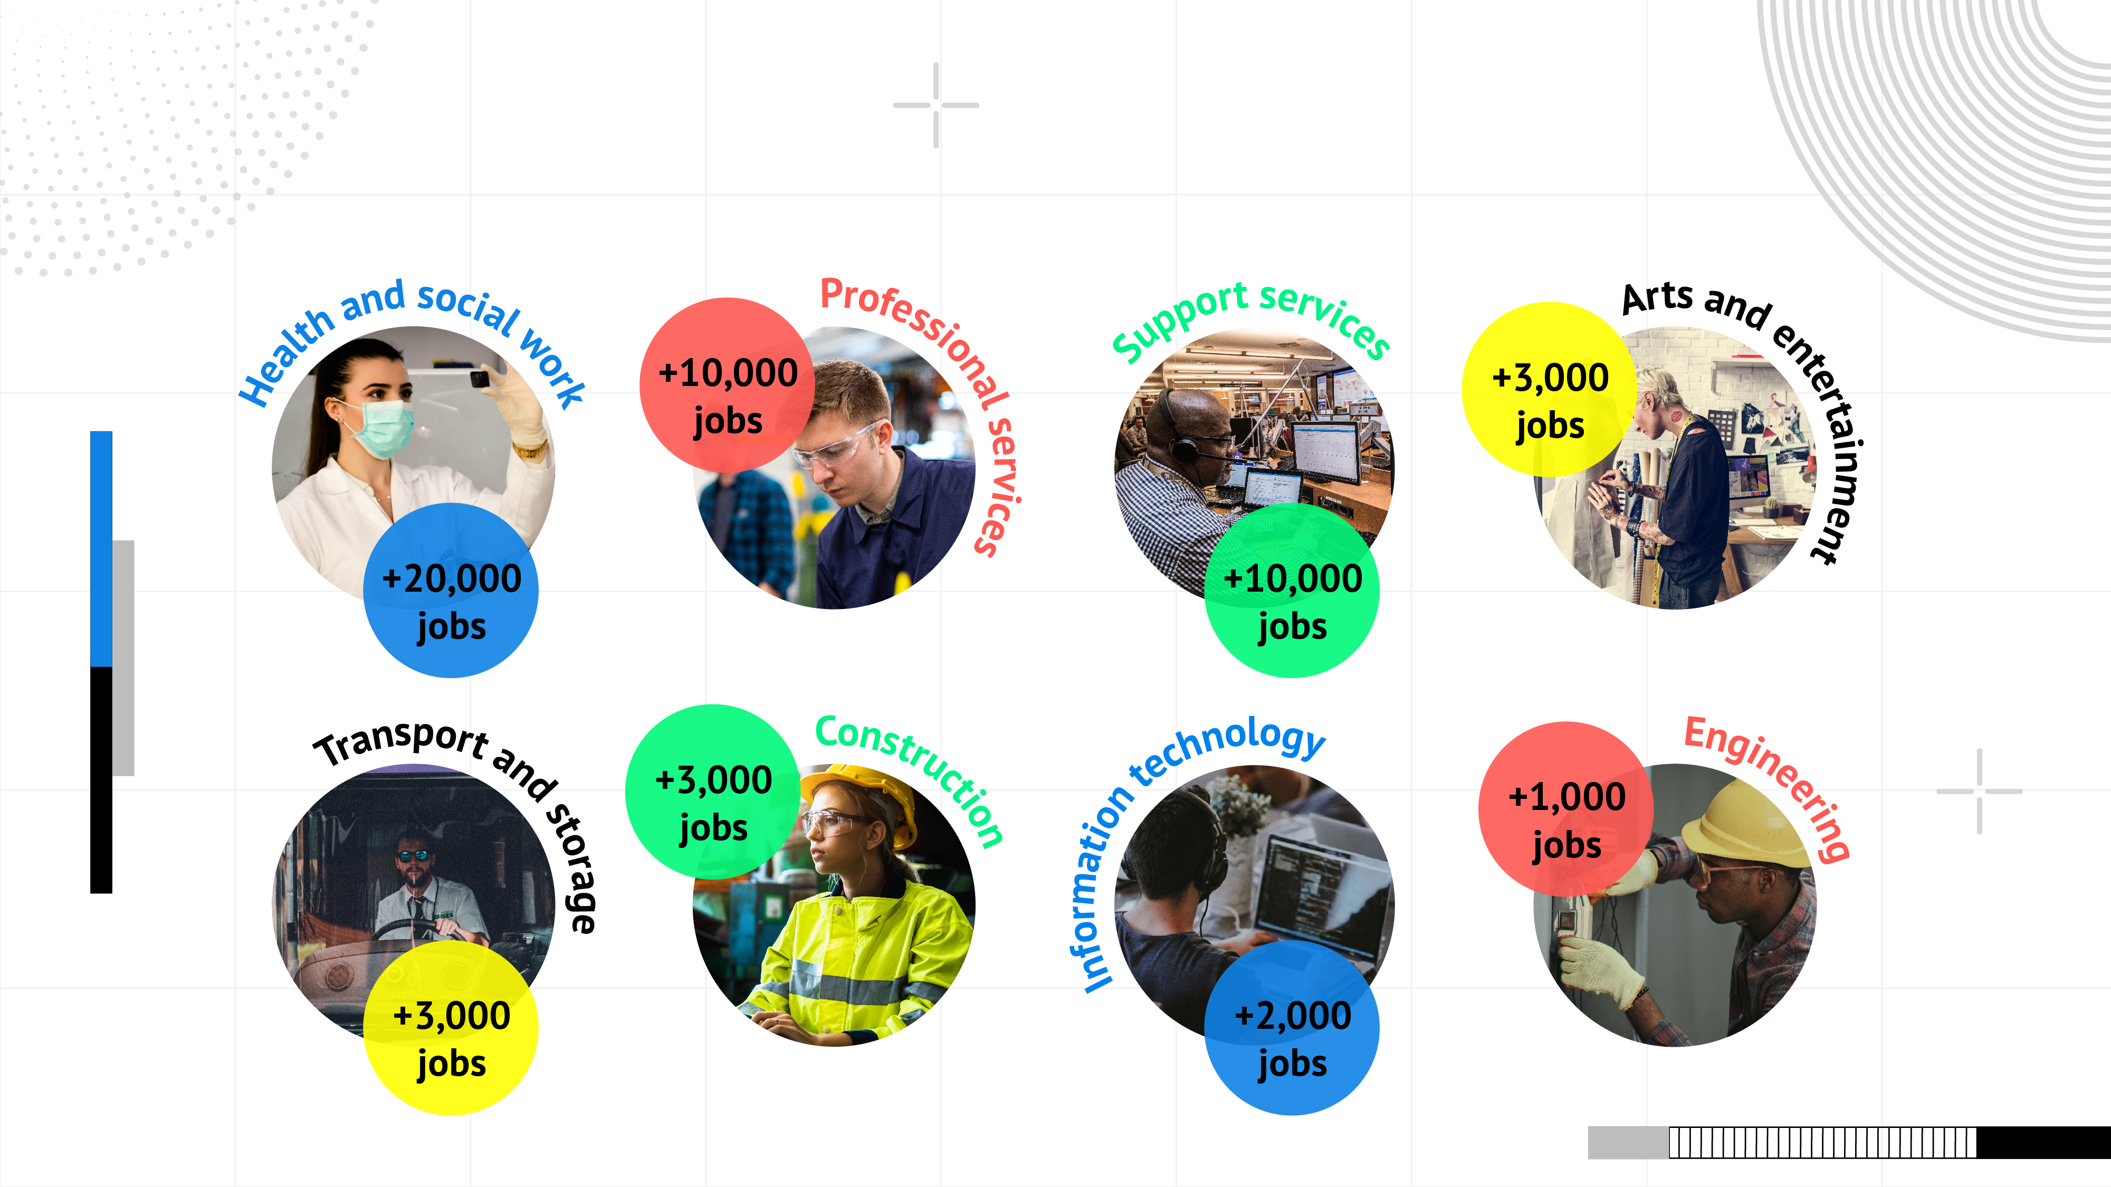
How will our occupations and sectors change in the future?
Notes:
It is likely that many IT professionals will work in other sectors such as professional services, e.g. a software developer working for an insurance firm. Construction also looks small because a lot of workers are self-employed in that sector and so fall into a different sector/category.

Slide 16
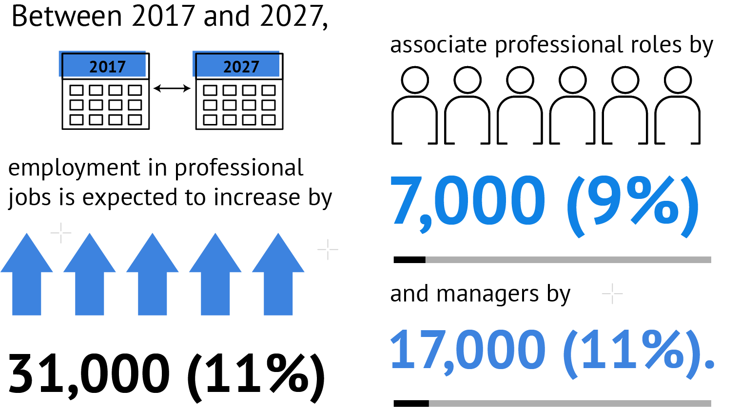
How will our jobs change in the future?
Due to the increase in automation, some sectors will see dramatic changes in their job roles.

Slide 17
How are things changing around you?
Think about the places you visit and things around you. Where have you noticed automation in action?
When we talk about automation and the impact it will have on various sectors, we’re referring to roles that will no longer require a human element or input.
For example…
Supermarkets
Food delivery services
NHS services
Banking
Notes:
A reflection slide asking students to think about/discuss what has changed in their local supermarket might help with this, e.g. self-checkout, click and collect, scan as you shop. Or takeaways such as McDonalds with Deliveroo and screens to order on.

Slide 18

The definition of
‘green skills’ includes skills linked to energy, and the environment, plus areas like heating and green marketing.
These are some of the green skills in greatest demand:
A knowledge of…
Climate change
Renewable energy
Energy efficiency
Energy management
Did you know that there was a strong increase in vacancies requiring green skills in 2020 and 2021?
Occupations like Project Manager and Civil Engineer are among those with the biggest demand for green skills. In addition, STEM jobs are also popular when it comes to green skills – like engineers, scientists and technicians of various kinds.

Slide 19

Green skills for the future!
These skills and knowledge are needed to successfully work within the Green sector.

Slide 20
Virtual Work Experience
Louise Graham

Slide 21

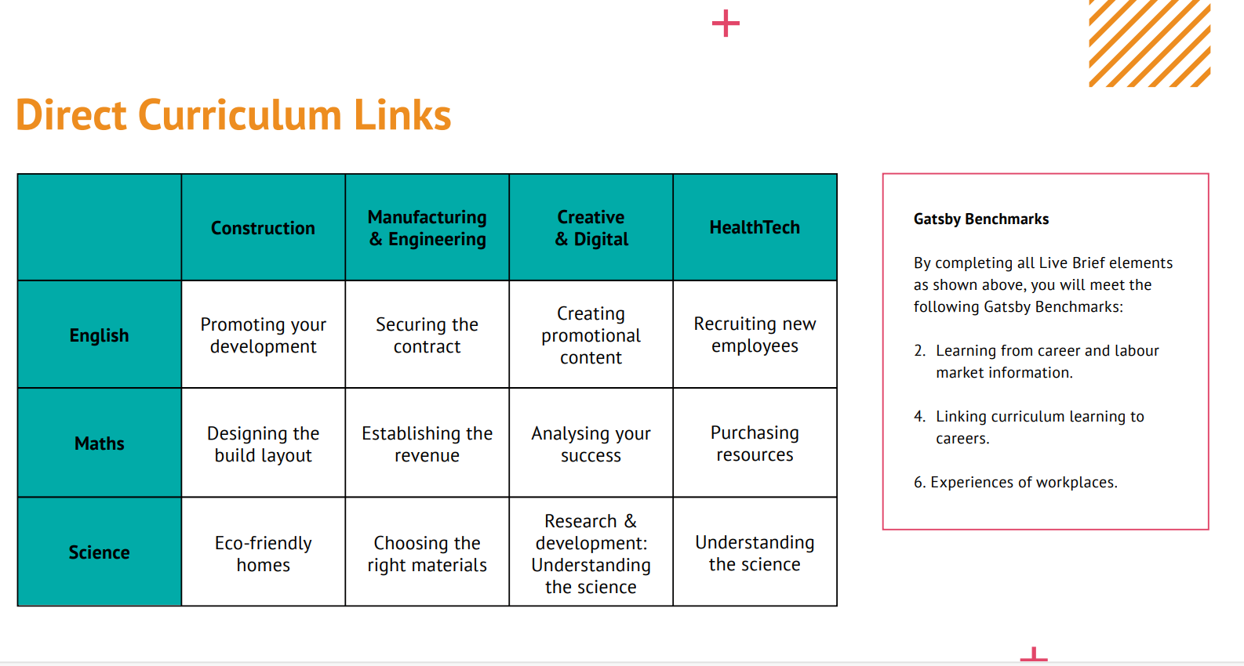
Virtual/In School Work Experience offer – Future Goals
Notes:
Louise

Slide 22
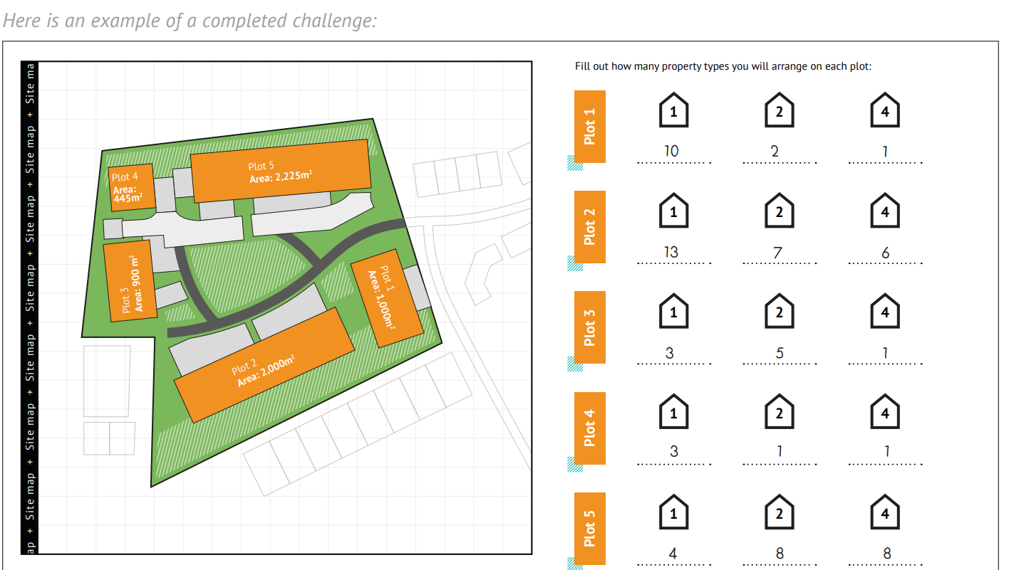
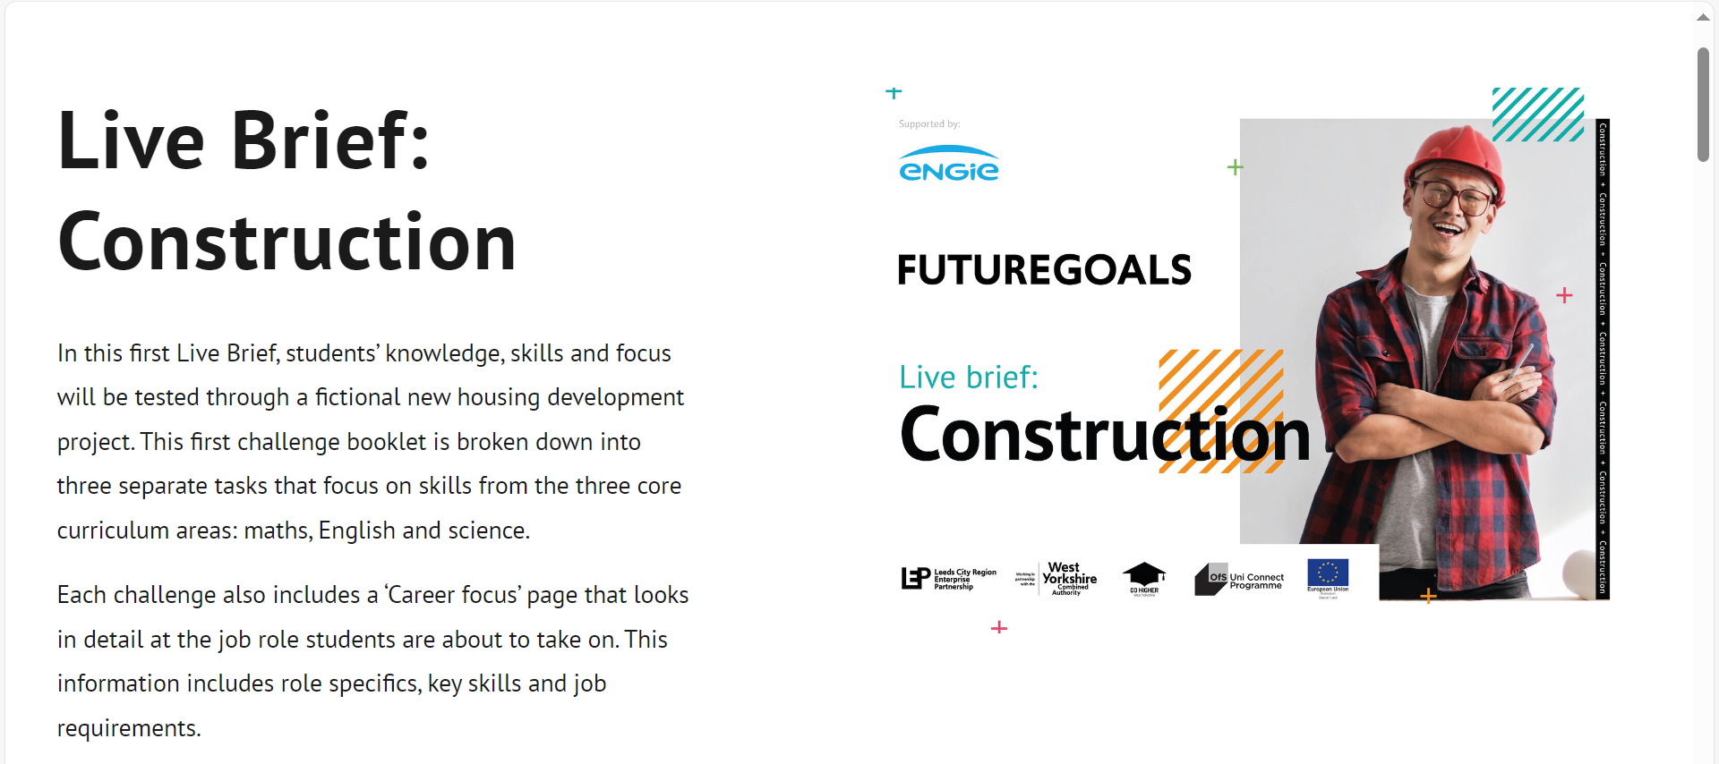
Virtual Work Experience offer – Future Goals
Notes:
Louise

Slide 23

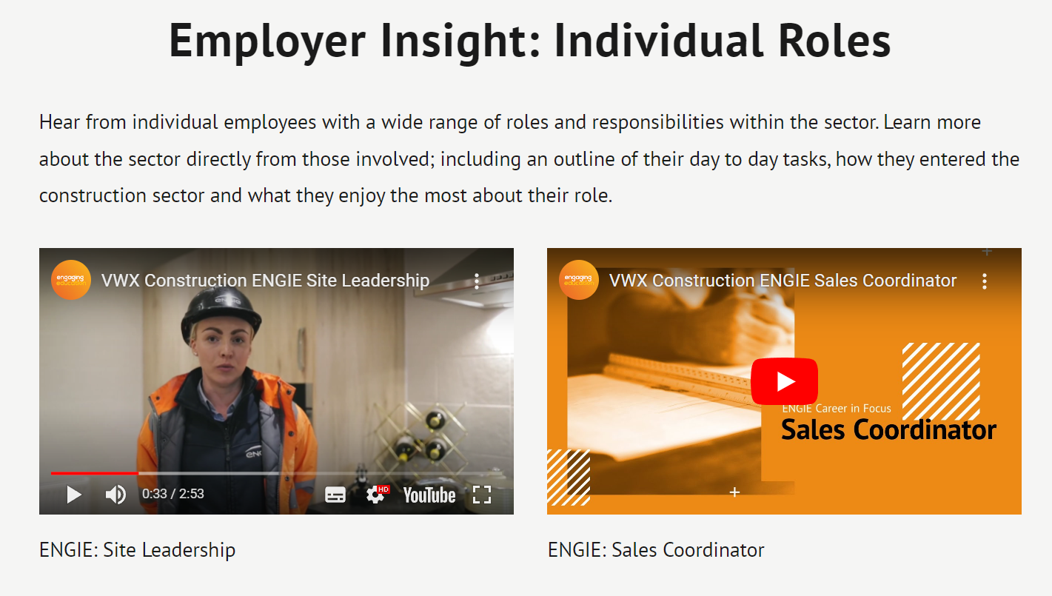
Videos
Notes:
Louise

Slide 24
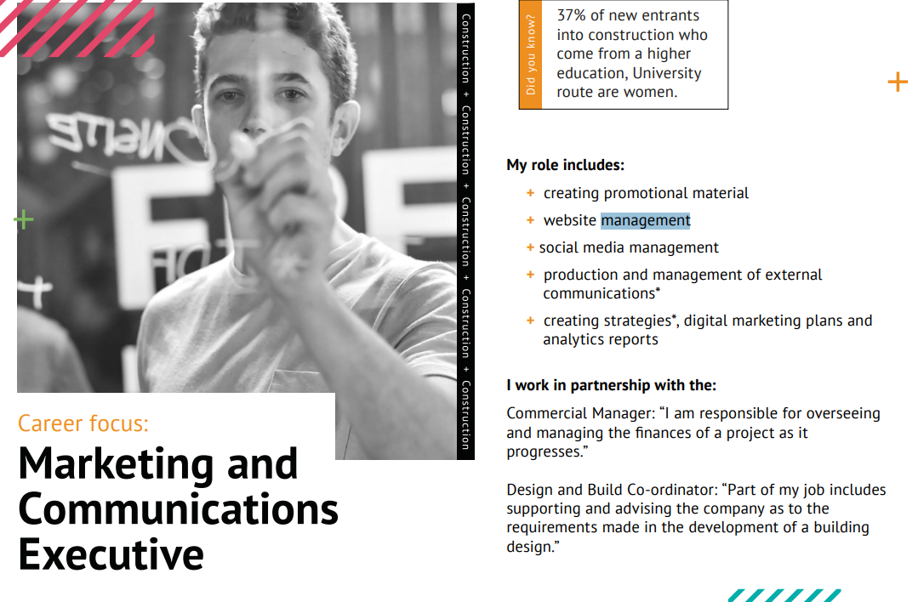
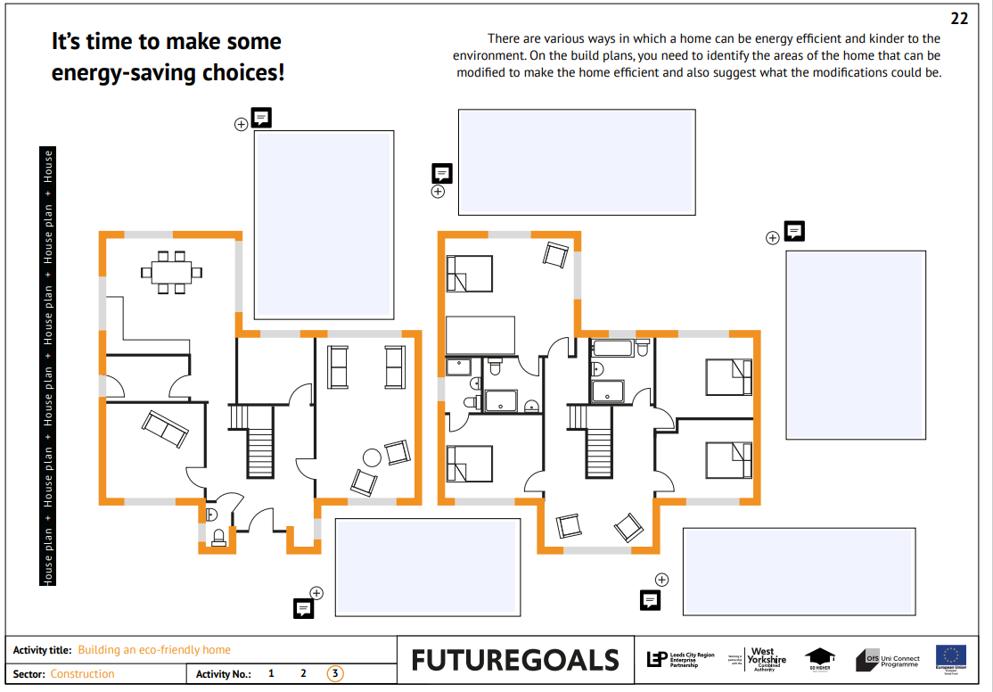
Workbook
Notes:
Louise

Slide 25
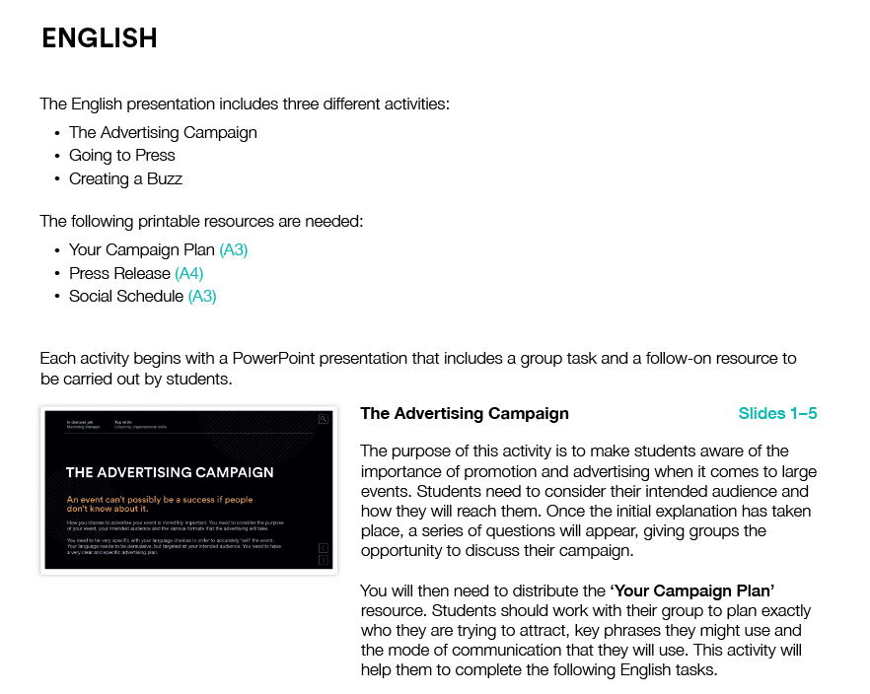

Future Goals Spotlight
Notes:
Louise

Slide 26
SEND Resources
Marie Locker

Slide 27

SEND Alumni Toolkit
The SEND Alumni Toolkit has been designed to support school to develop an effective Alumni network.
Notes:
Why develop this toolkit:
A specific SEND alumni would help raise the aspirations of other students with SEND within thir context, creating opportunities for students to met relatable role models.
Young people with SEND would like to hear from people they can relate to and hear more about their pathway and journey.
Support and encourage parents
Research showed that schools would welcome useful and easy to use resources to hel build an effective Alumni

Slide 28
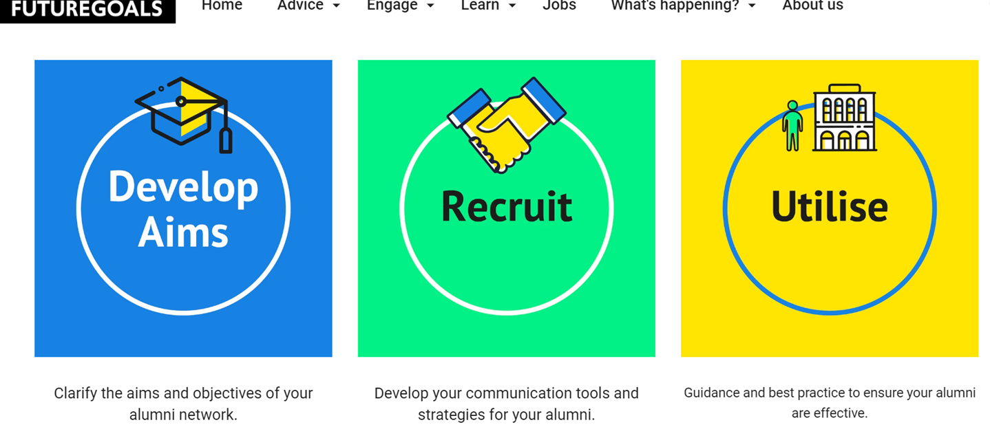
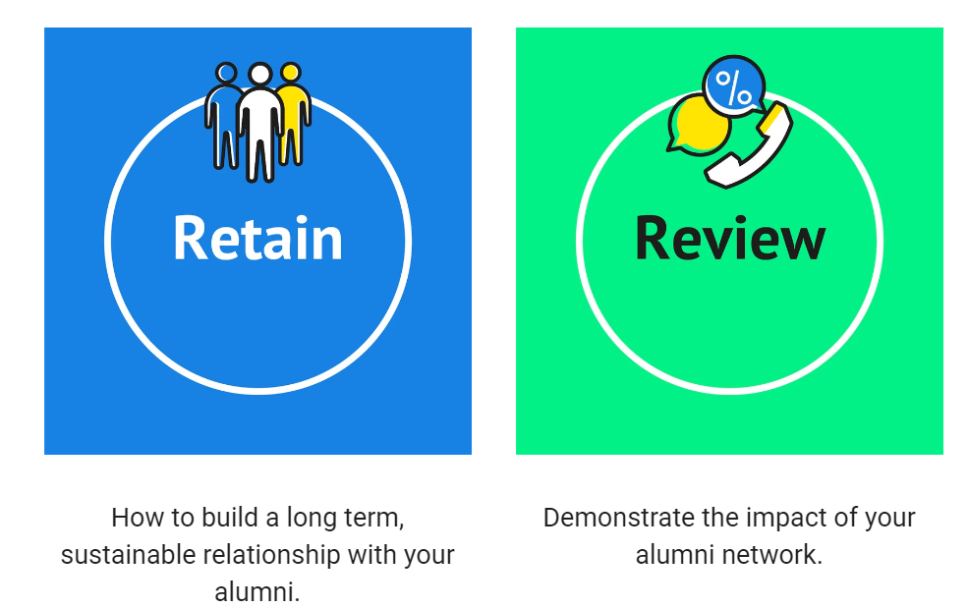

Slide 29

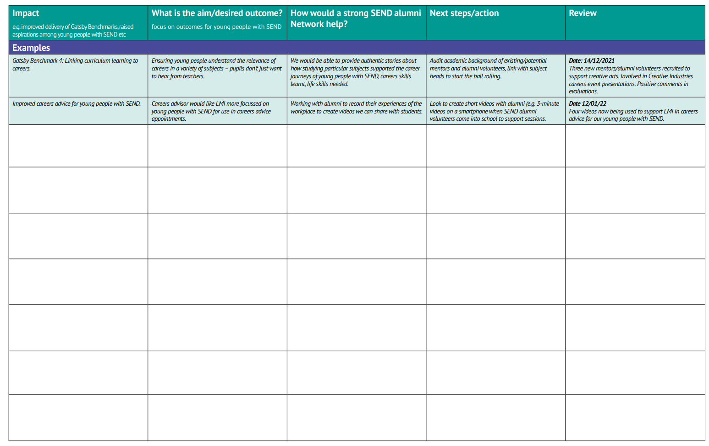
Useful Templates

Slide 30


Handy hints and tips

Slide 31
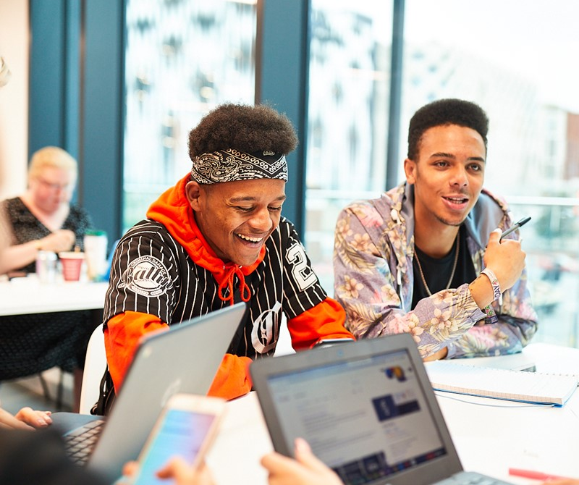
SEND Employer Engagement Toolkit
The SEND Employer Engagement Toolkit is designed to provide you with resources and examples to support employer engagement.
Notes:
Why develop this toolkit:
A specific SEND alumni would help raise the aspirations of other students with SEND within thir context, creating opportunities for students to met relatable role models.
Young people with SEND would like to hear from people they can relate to and hear more about their pathway and journey.
Support and encourage parents
Research showed that schools would welcome useful and easy to use resources to hel build an effective Alumni

Slide 32


Slide 33
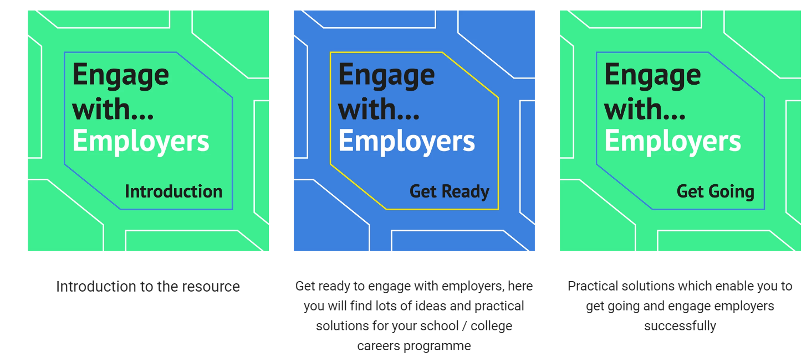
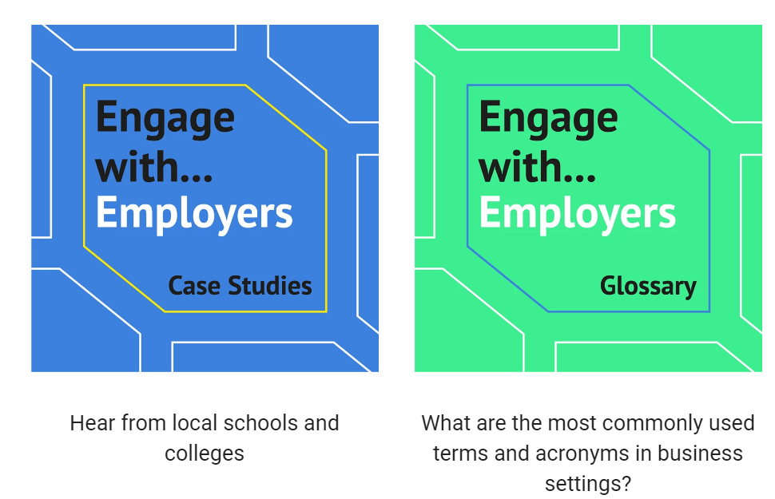

Slide 34
SEND Virtual Work Experience
The SEND Virtual Work Experience offers a series of short films and activities, which have been designed to inspire your students about work opportunities in our region.
Notes:
Why develop this toolkit:
A specific SEND alumni would help raise the aspirations of other students with SEND within thir context, creating opportunities for students to met relatable role models.
Young people with SEND would like to hear from people they can relate to and hear more about their pathway and journey.
Support and encourage parents
Research showed that schools would welcome useful and easy to use resources to hel build an effective Alumni

Slide 35
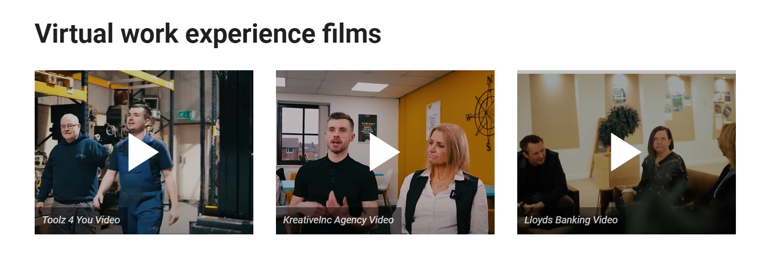
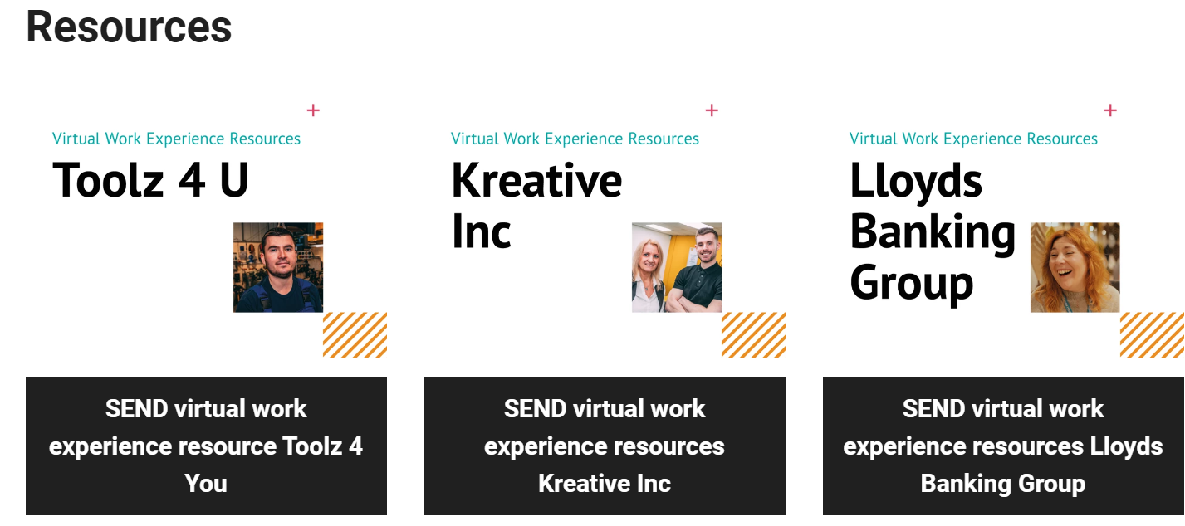

Slide 36
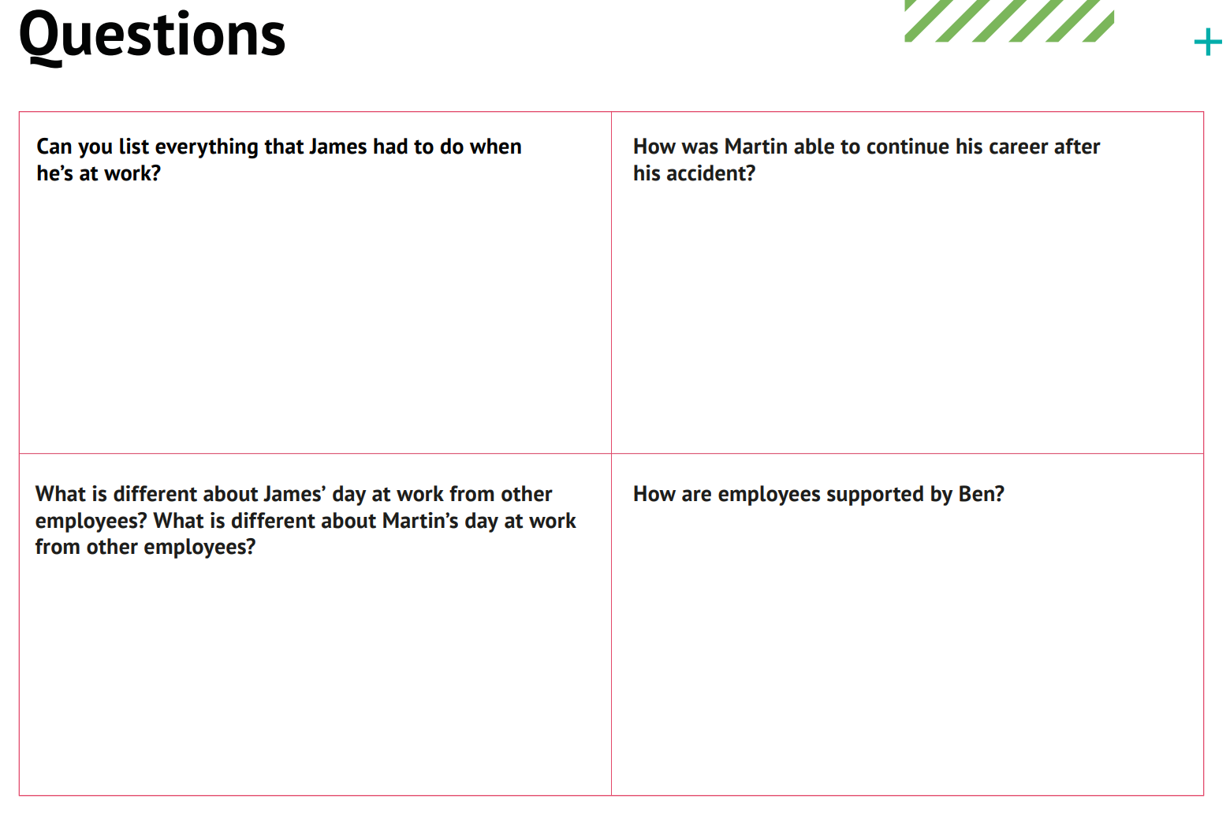
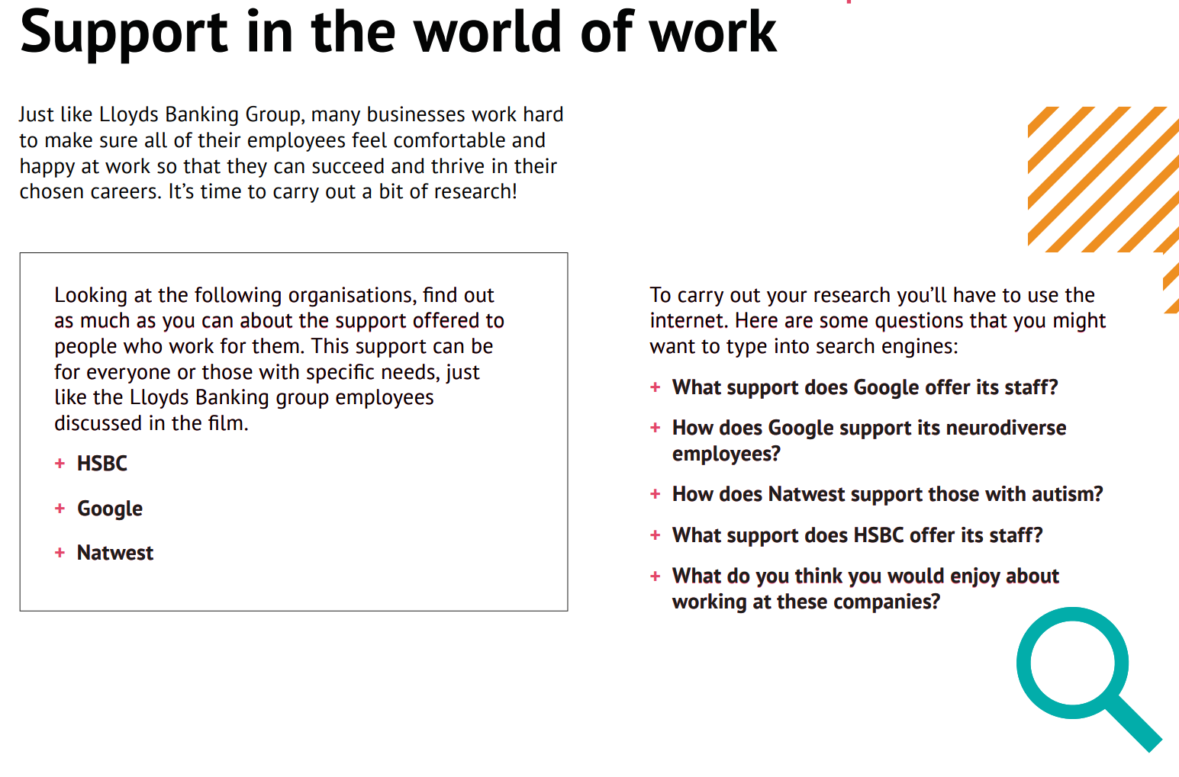
Activities available

Slide 37
Digital Skills Resources

Slide 38

Charlotte Keyworth, GHWY Project Officer c.e.keyworth@leeds.ac.uk

Slide 39
Why focus on digital skills?
Over 80% of all jobs in West Yorkshire currently require the minimum of basic digital skills.
Lack of confidence or ability to use digital skills can hinder a young persons chance of entering employment or progressing long term.
A survey completed at Leeds City College (2020), showed digital skills to be the skill set students felt least confident about – is it a lack of awareness on what digital skills are or a lack of confidence with using them?
This challenged our own misconceptions about young people and digital skill sets.

Slide 40
The five ‘basic’ Digital Skills
Outlined in the governments Essential Digital Skills Framework, 2018, the report outlines the 5 essential digital skills which are ‘skills for life’.
Communicating
2. Handling Information & Content
3. Transacting
4. Problem solving
5. Being Safe & Legal Online

Slide 41
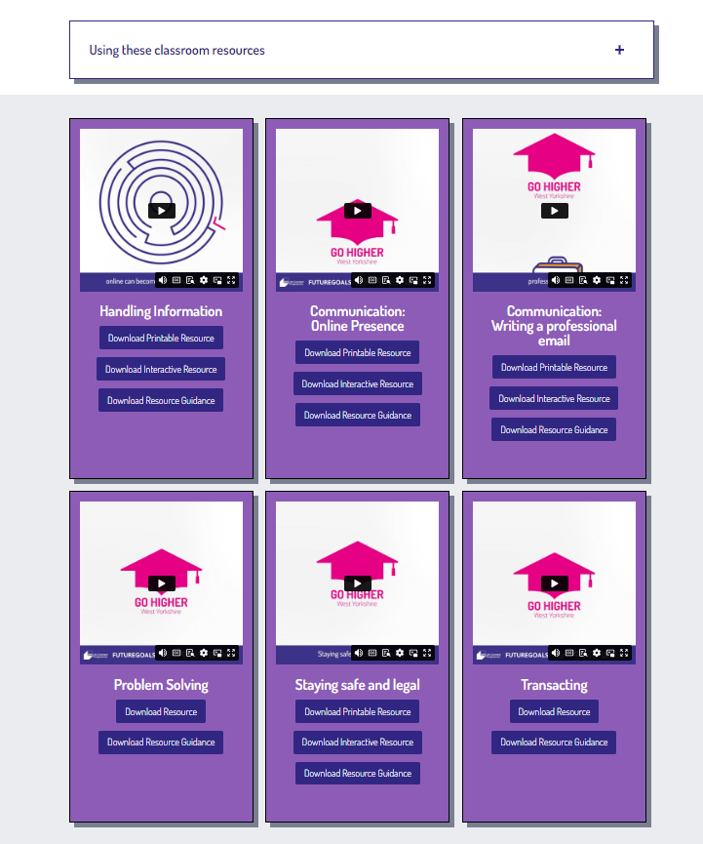
Link to access online
https://gohigherwestyorks.ac.uk/resources/teachers-carers-advisors/key-downloads-workbooks-and-tools/digital-skills/

Slide 42
Overview of the resources
Resources aimed at 15- 17 year olds (year 10- 13 or FE Level 2/ 3)
Each session has an:
Animated video (2- 3 mins)
Interactive activity (suggested time for delivery: 20- 40 mins)
Guidance notes for delivery
6 sessions focusing on each of the essential digital skills (communication has been split into two sessions)
Each video begins with an ‘employability connection’
Accessibility: Each video is subtitled and each activity is printable
Flexible delivery time between 10 and 60 minutes

Slide 43
Key areas of focus
Topic Area | Content
Communication: Writing a professional email
Communication: Online Presence
Handling information and content: Reliable Research
Transacting: How do you spot a phishing email?
Being safe and legal online: How do you keep your personal information secure?
Problem Solving: Using the internet to help solve problems
Using an interactive template, learners will write a professional email to apply for an employer opportunity
Learners create a Linked In profile, encouraging reflection on skills and experience
Learners research a university course or apprenticeship, considering how to fact check information using the internet
Learners are presented with several emails, they need to analyse which ones are trustworthy and consider the signs to look out for
Learners are presented with different scenarios and they need to decide what risks come with these and any advice they would give and/ or take on board
Utilising the internet, learners are asked to create a budgeting spreadsheet on Microsoft Excel

Slide 44
Discussion Points
Topic Area | Suggested areas for discussion
Communication: Writing a professional email
Communication: Online Presence
Handling information and content: Reliable Research
Transacting: How do you spot a phishing email?
Being safe and legal online: How do you keep your personal information secure?
Problem Solving: Using the internet to help solve problems
When and why would you need to write a professional email? When have learners sent an email before?
When and why would you benefit from a Linked In profile? This can lead to discussions around future choices
This can lead to discussions about post 16 & 18 choices, how can research inform their choices?
What could the potential harms be both personally, but also for your employer or place of study?
How safe do learners currently feel when using the internet? Were learners already aware of any of the risk covered in the activity?
How did learners find the task, was it easy or hard using the internet to solve problems? When might Excel be of benefit in their lives?

Slide 45
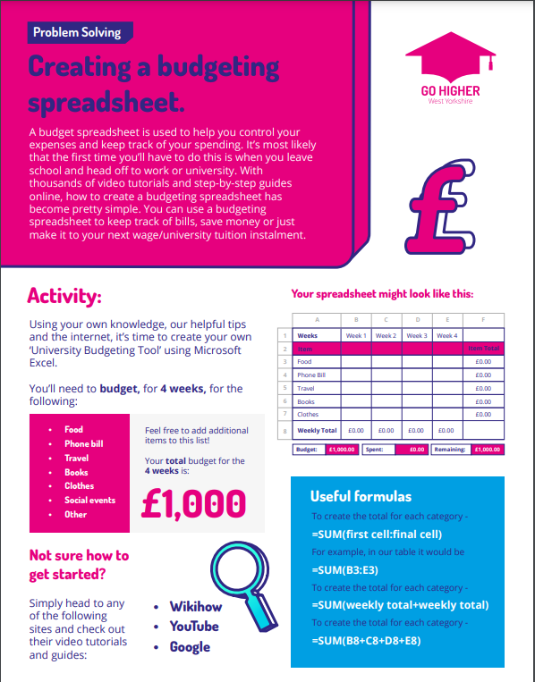
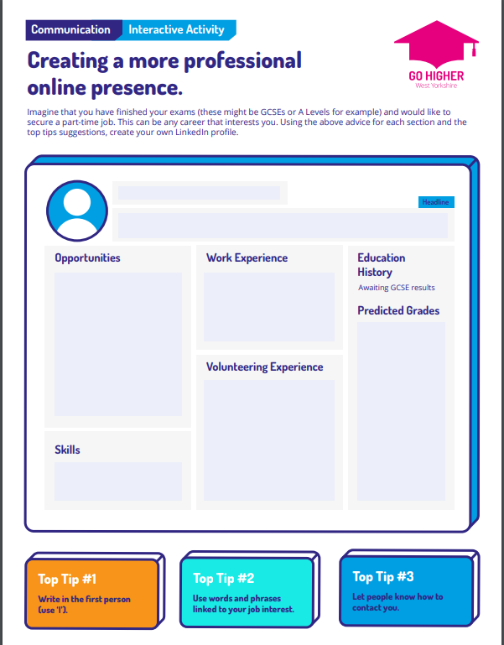
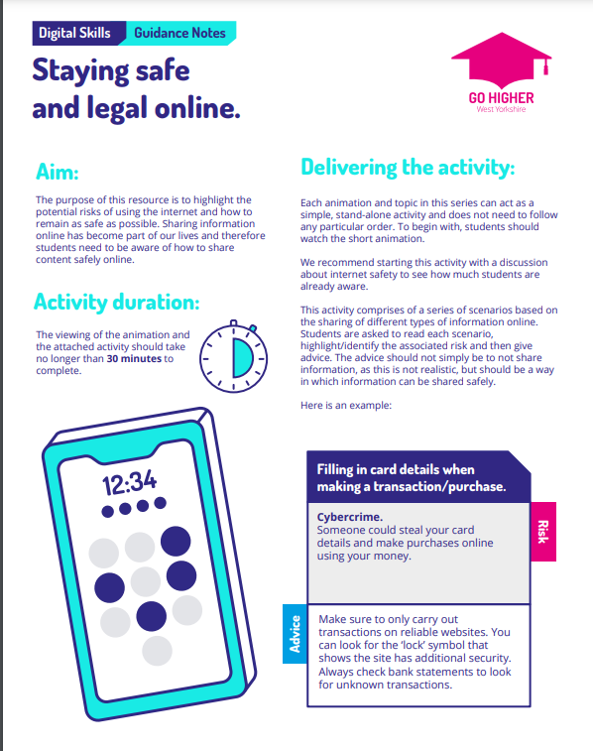
Instructions sheet for each activity
Interactive and printable activity sheet
Delivery Guidance notes

Slide 46
Where do you see these resources fitting in with and/ or enhancing current curriculum in your setting?
Which year groups would these resources best support?
Do any topic areas stand out as being more valuable to cover and why?

Slide 47
Go Higher West Yorkshire Activity Menu
The team at GHWY have created a range of presentations to support delivery with:
Raising awareness of Further and Higher Education
Educating on finance and budgeting
Developing confidence with study skills and self care
All of these resources are available and free to download.
Link to access online
https://gohigherwestyorks.ac.uk/resources/teachers-carers-advisors/key-downloads-workbooks-and-tools/

Slide 48


Slide 49
Thank you

