Slide 1
Digital / IT Careers
Kurtis Lamb – CCP Games

Slide 2
Kurtis LamB
Senior Backend Engineer
Cloud Technologies
Golang / Bash
DevOps Practices
Agile Methodology
Banking
Senior Business Partner
Fintech/Insurtech
Senior DevOps Engineer
Video Games
Senior Backend Engineer

Slide 3
Agenda
Common IT/Digital Roles
Brands In WY
Self Teaching
Self Teaching – Hiring Best Practices

Slide 4
Common Roles
IT Service Desk – Keeping peoples IT devices Working
Web/Software/Database/Network/Cloud/Data Engineers – Maintain/Build the products and services
Project Managers/Product Owners – Delivering projects of varying scale for organisations

Slide 5
Brands With IT and Digital Presence In West Yorkshire

Slide 6
Digital Agencies In West Yorkshire

Slide 7
Self Teaching - Cloud Certs

Slide 8
Cloud Providers
Provide remote compute and digital capabilities
Low cost entry, pay for what you use
89% of business use a cloud provider of some kind
90% Fortune 500 companies use a cloud provider
Support remote roles more readily
Certificates are qualifiers for roles

Slide 9
Cloud Providers – Certificates
Each Cloud Provider maintains accreditations which show someone's ability to use their platforms
These accreditations are a direct requirement for roles

Slide 10
Cloud Providers – Entry Certs
AWS Certified Cloud Practitioner
Microsoft Certified Azure Fundamentals
Google Associate Cloud Engineer
These represent the entry level certs for each cloud, giving enough info on what, why and how.
Cloud Providers off free training on their websites
6 hours of self studying
Does not require setting up a cloud provider account

Slide 11
Cloud Providers – Next Steps
Amazon Web Services (AWS) Solutions Architect – Associate
This example Certification is a requirement for AWS Cloud Engineer roles
25-80 hours of studying
AWS Provide free resources to study
Does not require setting up an AWS account but is recommended

Slide 12
Self Learning – HOW?
- £30 Per month
- £45 Per month
- Free*
Tests - £100

Slide 13
Other Self Teaching Certs
Coding languages
Terraform, Golang, Rust, Java
Operating System Admins
Linux/Windows
Project Management
Prince2
Scrum/Agile

Slide 14
Hiring Strengths
Self-Accreditation is useful when applying for technical roles
Practical application of accreditations is useful, personal or professional
Accreditations enable internal promotions
Self-teaching a skill shows drive and initiative

Slide 15
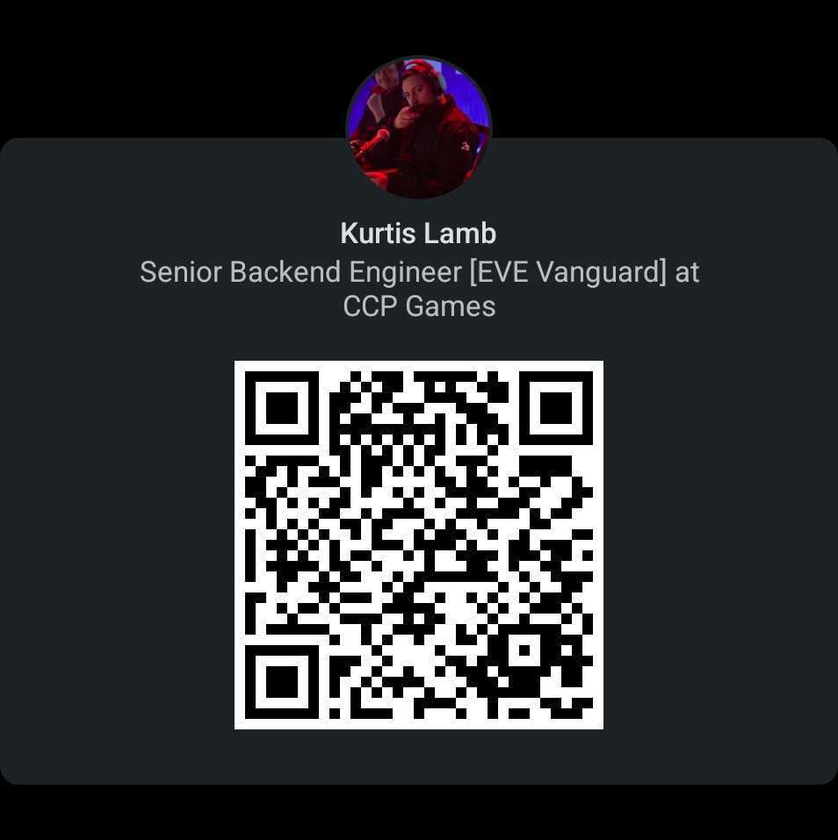
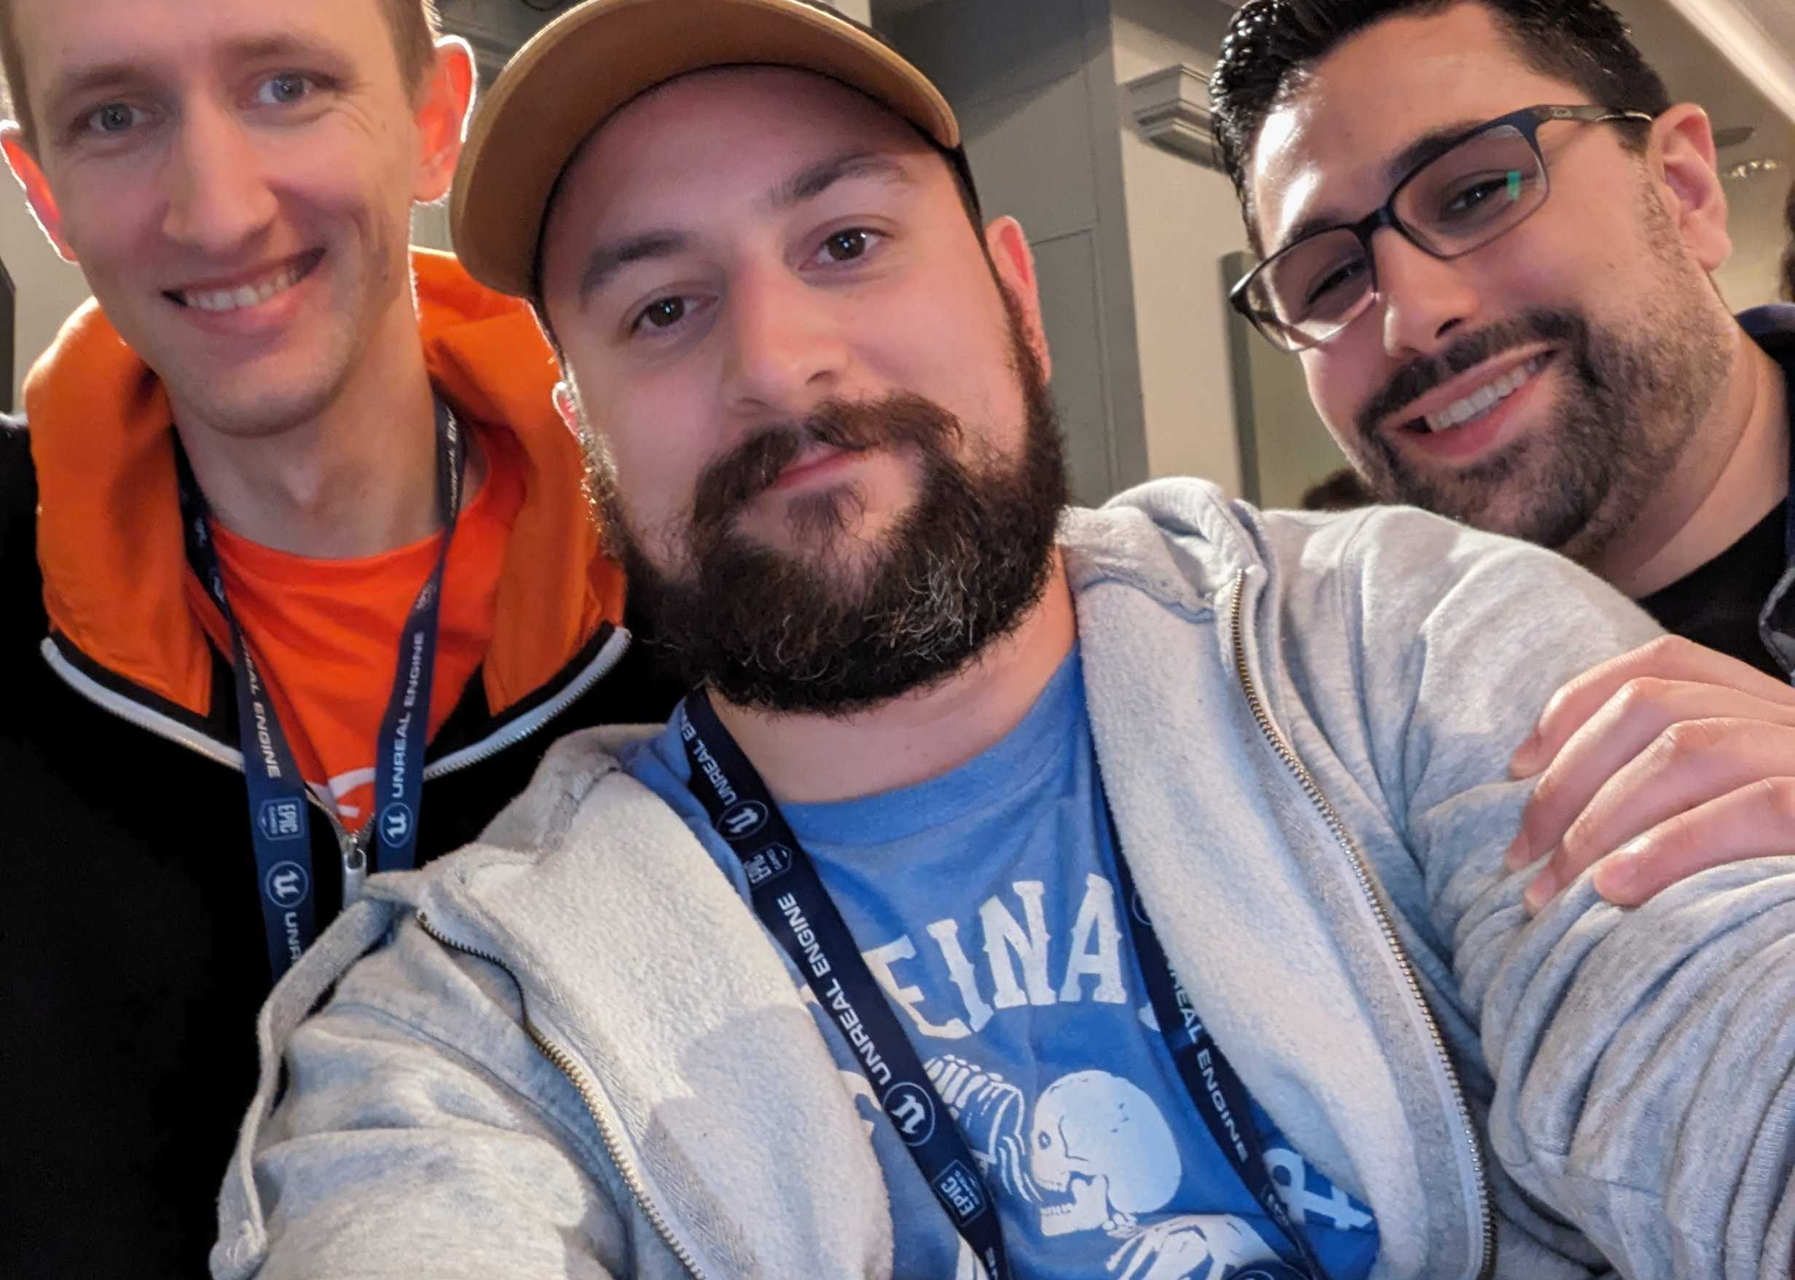
Thank You!
Kurtis Lamb www.linkedin.com/in/kurtis-lamb/

