Slide 1
Student Finance Update for Academic Year 2024/25
By Stephen Jones
Funding Information Services Team
Student Loans Company

Slide 2
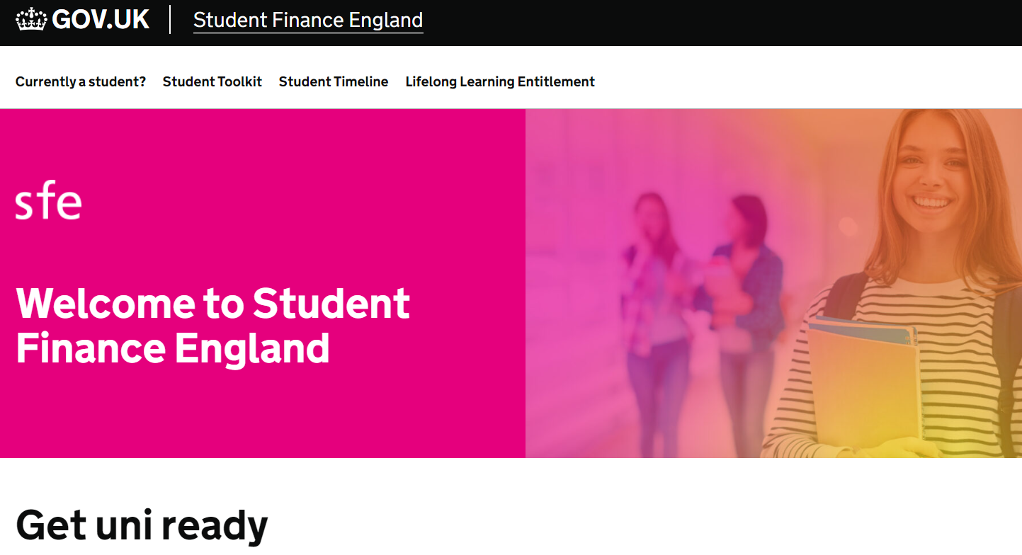
Contents
Eligibility Update
New Figures for 2024/25 (What You Can Get and What You Repay)
Tuition Fee Loans
Maintenance Loans
Disabled Students Allowance
DSA Reforms
Grants for Dependants
Postgraduate Loans
Repayment Plan 5

Slide 3
General Eligibility Update

Slide 4
Student Finance Eligibility
General Eligibility - Residency
Students need to meet certain residency criteria in order to be eligible for financial support from
SLC:
Settled status – can live in the UK without any Home Office restriction
Ordinarily resident in UK on the first day of the first academic year of their course
Been living in the UK for the three years immediately prior to this date (UK ‘Home’ and RoW students)
EU, EEA and Swiss nationals with EUSS Settled or Pre-Settled status may be entitled to support depending on the status awarded and their residency
Students may also be eligible for support if they hold a status such as Refugee, Humanitarian Protection, Stateless, or Ukraine Scheme Leave
Go to www.gov.uk/student-finance/who-qualifies for more information
Notes:
October 2016
The following statement applies to EU nationals who are currently in receipt of student loans from the Student Finance England (SFE), and to EU nationals who intend to begin studying from this autumn, and to EU nationals applying to study from autumn 2017.
Existing students
EU nationals or their family members, currently in higher or further education, and who are eligible to receive loans and/or grants from SFE will continue to receive these loans and grants until they finish their course. This applies to all student finance provided to eligible EU students by SFE. This includes loans to cover tuition fees (for those resident in the EEA for at least three years), loans and grants for maintenance (for those resident in the UK for at least three years or who are EEA migrant workers), and some other grants and allowances. These students are also entitled to home fee status.
Students beginning study in the 2016/17 Academic Year
The rules applying to EU nationals, or their family members, who have applied to study a course which started or starts in the 2016/17 Academic Year and which attracts student support, are unchanged. The SFE will assess these applications against existing eligibility criteria, and will provide loans and/or grants in the normal way. EU nationals, or their family members, who are assessed as eligible to receive grants and/or loans from the SFE in the 2016/17 Academic Year will be eligible for this support and for home fee status for the duration of their study. The eligibility criteria set out that for students beginning study from August 2016, EU nationals must have been resident in the UK for at least five years or be EEA migrant workers in order to apply for a maintenance loan.
Students beginning study in the 2017/18 Academic Year
The rules applying to EU nationals, or their family members, who are applying to study a course which starts in the 2017/18 Academic Year and which attracts student support, are also unchanged. The SFE will assess these applications against existing eligibility criteria, and will provide loans and/or grants in the normal way. EU nationals, or their family members, who are assessed as eligible to receive grants and/or loans by the SFE in the 2017/18 Academic Year will be eligible for this support and for home fee status for the duration of their study. These eligibility criteria set out that for students beginning study from August 2017, EU nationals must have been resident in the UK for at least five years or be EEA migrant workers in order to apply for a maintenance loan.
Exceptions
If the student, their spouse, civil partner, parent/stepparent are recognised by the Government as a refugee and lived in this country since this status was awarded.
If the student, their spouse, civil partner, parent/stepparent, have been granted Humanitarian Protection to stay in the UK by the Home Office, resulting from a failed asylum application.
If student is the child of a Swiss national or Turkish worker, and been ordinarily resident in the EEA and Switzerland/Turkey for the three year period immediately before the first day of the first academic year of their course

Slide 5
Student Finance Eligibility
General Eligibility
Individuals in protection-based categories who start or continue HE courses:
Refugee
Humanitarian Protection
Calais Leave, Section 67
Stateless Leave
Indefinite Leave to Remain as a Bereaved Partner
Indefinite Leave to Remain as a victim of domestic violence,
Afghan Relocation and Assistance Policy (ARAP) and Afghan Citizen’s Resettlement Scheme (ACRS), Operation Pitting
Applicants holding a status under the Home Office Ukraine schemes.
Individuals in these categories are not required to demonstrate three years’ ordinary UK residence before the start of a course to qualify for student support and home fee status
Go to www.gov.uk/student-finance/who-qualifies for more information

Slide 6
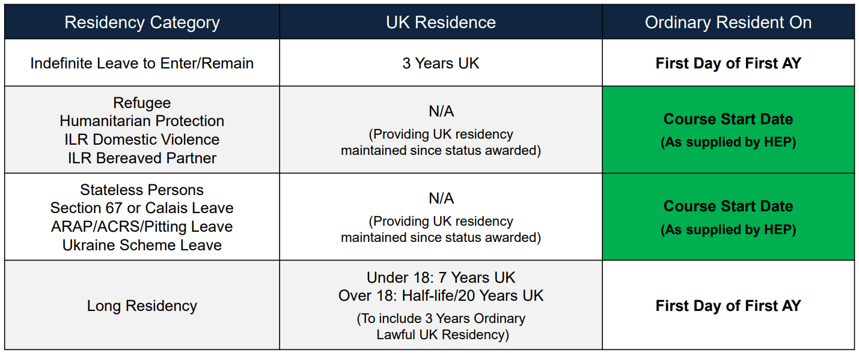
SFE – ROW Policy Enhancements
High level SFE support summary based on first day of first AY residency:
Notes:
A number of other changes will be made to eligibility rules for student support and home-fee status that will benefit certain vulnerable groups of students.
Students who have been granted indefinite leave to enter (ILE) as a victim of domestic abuse and their children who are granted ILE will also qualify for student support and home fee status.
I am also confirming today that home fee status and tuition fee support is being extended to British citizens born in the Chagos Islands, and their direct descendants who are also British citizens.
In addition, students gaining settled status part-way through their course will qualify for student support and home-fee status for the remainder of their course.

Slide 7
SFE Policy Enhancements - AY 2024/25
SETTLED AS AN EVENT
From AY 24/25, students who are granted settled status for any reason during the course, not just under the EUSS, can become eligible for funding as an event (subject to satisfying other eligibility requirements)
Students who acquire a settled status after the first day of the first academic year of their course (or course start date where applicable) will qualify for support:
as applicable to the category they are eligible under, and
provided they apply within the relevant regulatory deadlines for applying for support when eligible as an event
Examples of settled status:
British citizen
Irish citizen
Exempt from immigration control under the Immigration Act 1971
Indefinite leave to enter (ILE)
Indefinite leave to remain (ILR)

Slide 8
What is available?

Slide 9
Tuition Fee Loans
Maximum tuition fees for 2024/25 in England will be maintained at the levels that applied in 2023/24
academic year. The seventh year in succession that fees have been frozen.
Maximum tuition fee for standard full-time courses offered will remain at £9,250
Maximum tuition fee for standard part-time courses offered will remain at £6,935
Key Points to Note :
Tuition Fee Loans are non means tested (we don’t need parent’s income for this bit!)
Loans are paid directly to the university on behalf of the student
Most of the 1.6m students every year apply for the maximum loan available
It is the easy part of the application – just tell us which university you are going to and how much you want to borrow (usually students tick ‘max’)

Slide 10
Maintenance Loans – Which Tier?
Maximum (Maintenance) loan for living costs for new full-time students and eligible continuing full
time 2016 cohort students:
Loan Rate | 2016 Cohort Full-Time Students | Entitled to Benefits | Aged Over 60 First Day of First AY
Parental Home | £8,610 | £10,158 | £4,327
Elsewhere | £10,227 | £11,658
London | £13,348 | £14,557
Overseas | £11,713 | £13,038

Slide 11
Maintenance Loans
The ‘eligible for benefits’ Maintenance Loan rate is available to students who fall into a specified category (full list on an application form) including if they:
Are a lone parent responsible for a child or a lone foster parent of a child or young person aged under 20
Have a partner who is also a full-time student and are responsible for a child or young person aged under 20 who is in full-time non-advanced education
Are deaf and qualify for Disabled Students' Allowance
Have a disability and qualify to receive income related Employment Support Allowance or are eligible to receive Disability/Severe Disability Premium
If unsure, students should always ask Jobcentre Plus/Department for Work and Pensions (DWP) for clarification on their on-going benefit entitlement
Notes:
The student is a lone parent who is responsible for a child or a young person aged under 20 who is a member of the student's household, and who is in full-time education
The student is a lone foster parent of a child or young person aged under 20
The student has a partner who is also a full-time student and one or both of them are responsible for a child or young person aged under 20 who is in full-time non-advanced education
The student has been treated as incapable of work for a continuous period of at least 28 weeks (two or more periods of incapacity separated by a break of no more than 8 weeks count as one continuous period)
The student is deaf and qualifies for Disabled Students' Allowances
The student is waiting to go back to a course having taken approved time out because of an illness or caring responsibility, that has now come to an end, for a period not exceeding one year
The student is entitled to Personal Independence Payment, Armed Forces Independence Payment or Disability Living Allowance
The student has a disability and qualifies for income related Employment Support Allowance

Slide 12
Maintenance Loans
The ‘eligible for benefits’ Maintenance Loan rate is made up of two main elements of support:
A Maintenance Element and
A Special Support Element
The Special Support Element of the loan is designed to be a contribution towards the cost of books, travel, equipment and childcare:
The Special Support Element will be disregarded by the Department for Work and Pensions as student income when calculating benefits
Any Special Support Element funding that students are eligible to receive will be clearly marked on their Notification of Entitlement letters
Notes:
Maintenance and Special Support Element of the Loan for Living Costs.
For 2016 cohort students entitled to benefits, the loan for living costs has a maintenance element and a special support element, the latter being a contribution towards the costs of books, travel, equipment and childcare.
The special support element is disregarded by the Department for Work and Pensions as student income when calculating benefits. Students whose entitlement to loan for living costs exceeds the maximum maintenance element will receive additional loan as a special support element.

Slide 13
Maintenance Loans – Household Contribution
2016 cohort FT students, not eligible for benefits or aged over 60
Household Income | Home | Elsewhere | London
£25,000 & under | £8,610 | £10,227 | £13,348
£30,000 | £7,887 | £9,497 | £12,606
£35,000 | £7,163 | £8,766 | £11,863
£40,000 | £6,440 | £8,035 | £11,120
£45,000 | £5,716 | £7,304 | £10,377
£50,000 | £4,993 | £6,573 | £9,634
£55,000 | £4,269 | £5,842 | £8,891
£60,000 | £3,790 | £5,111 | £8,148
£65,000 | £3,790 | £4,767 | £7,405
£70,040 & over | £3,790 | £4,767 | £6,647
i
You can get an estimate of your loan entitlement using the calculator on:
www.gov.uk/student-finance-calculator
Notes:
Students on household incomes of £25,000 or less qualify for the maximum loan for living costs at the respective Home, Elsewhere or London rate of loan.
The income assessment for full year and final year rates of loans for living costs is calculated as follows:
Parental Home Rate: £1 reduction in loan for every complete £7.08 increase in income above £25,000.
London Rate: £1 reduction in loan for every complete £6.89 increase in income above £25,000.
Elsewhere Rate: £1 reduction in loan for every complete £7.01 increase in income above £25,000.
Overseas Rate: £1 reduction in loan for every complete £6.94 increase in income above £25,000.
The income threshold for the minimum non-income assessed full rate of overseas loan is: £65,967.
The income thresholds for the minimum non-income assessed final year rates of loans are: £56,910 (Home), £67,422 (London), £60,836 (Elsewhere), and £62,678 (Overseas).

Slide 14
Postgraduate Loans
Maximum loans for new students starting postgraduate master’s or doctoral degree courses in AY
2024/25 will be to:
Maximum Postgraduate Master’s Loan
£12,471
Maximum Postgraduate Doctoral Loan
£29,390
Maximum Postgraduate Disabled Students’ Allowance
£26,948
Notes:
Loans for students undertaking postgraduate master’s degree courses.
Maximum loans for new students starting postgraduate master’s degree courses in 2023/24 will be increased by 2.8% to £12,167.
Loans for students undertaking postgraduate doctoral degree courses.
Maximum loans for new students starting postgraduate doctoral degree courses in 2023/24 will be increased by 1.8% to £28,673.
Disabled Students’ Allowance.
The maximum Disabled Students’ Allowance for postgraduate students will be increased by 2.8% to £26,291 in 2022/23, in line with the changes to the undergraduate Disabled Students’ Allowance.

Slide 15
Additional Support

Slide 16
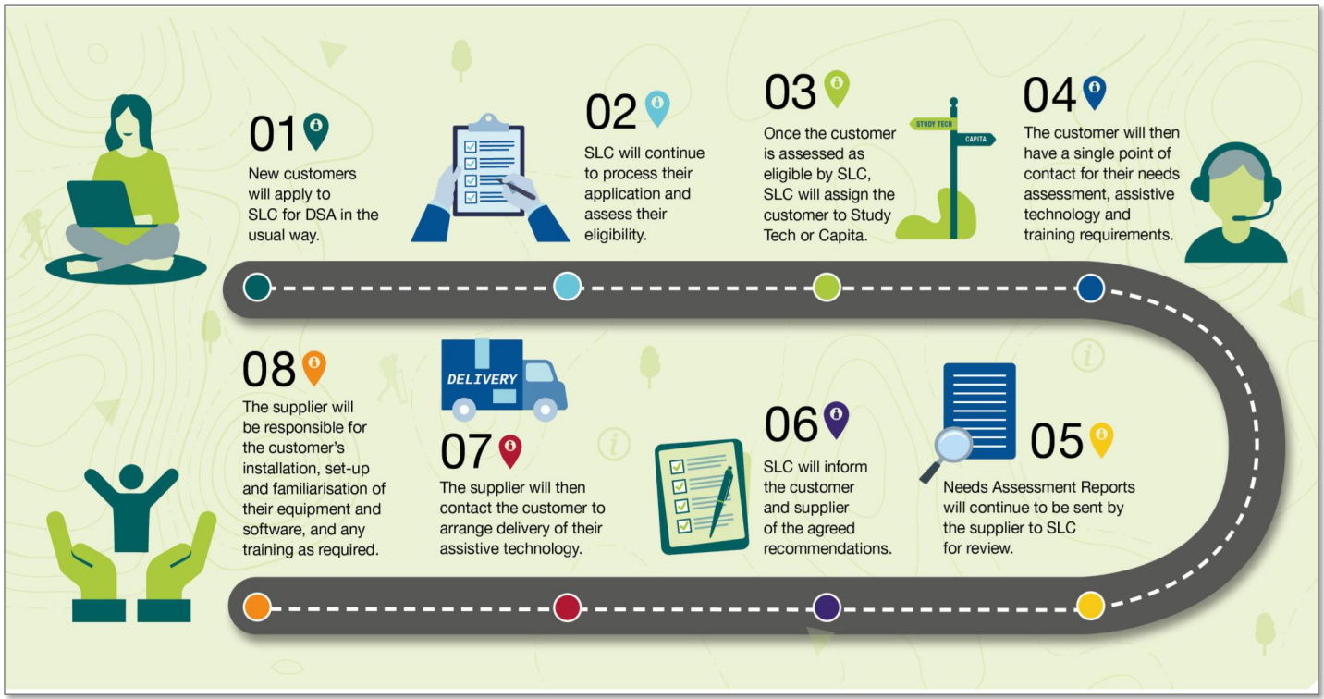
Disabled Students Allowance
New Suppliers: Study Tech and Capita
What they will supply:
Needs assessments, assistive technology and assistive technology training for students in receipt of DSA. Students will have one supplier who has ownership of their end-to-end support for the services above.

Slide 17
Disabled Students Allowance
The maximum allowance £26,947 applies to both full-time and part-time undergraduate and postgraduate DSA recipients in 2024/25.
Disabled Students’ Allowances provide help towards the additional costs a student may face as result of their disability, long-term health condition, mental-health condition or specific learning difficulty:
DSA Support:
Is available in addition to the standard student finance package,
Does not have to be repaid,
Is not affected by household income,
Looks at the specific needs of the individual student
Notes:
DISABLED STUDENTS ALLOWANCE FOR FULL-TIME UNDERGRADUATE STUDENTS (Not means-tested).
The undergraduate DSA allowance was simplified into one allowance for 2021/22. The same maximum allowance - £26,291 - will apply to both full-time and part-time undergraduate and postgraduate DSA recipients in 2023/24.
This will apply for both new and continuing students. An exception for travel costs will be made to this maximum cap, which means that travel costs will in effect be uncapped.

Slide 18
Dependants Grants
GFD AY 24/25 Income Assessments | PLA | ADG | CCG (*52 Week Rate)
 |  |  | 1 Child | 2+ Children
Maximum entitlement | £1,963 | £3,438 | £10,068.24* | £17,261.40*
Minimum payable | £50 | £0.01 | £0.01 | £0.01
Lower income threshold for maximum grant | £14,910 | £8,746 | £9,727 | £11,118
Upper income threshold for minimum grant | £18,835.98 | £15,621.98 | £19,795.23 | £28,379.39
i
*Weekly maximum CCG amount for one child: £193.62
*Weekly maximum CCG amount for two or more children: £331.95
Notes:
Where dependants’ incomes are from £18,640 to £18,739.98 students qualify for a minimum £50 PLA.
Weekly maximum CCG for one child is £188.90.
Weekly maximum CCG for two or more children is £323.85.

Slide 19
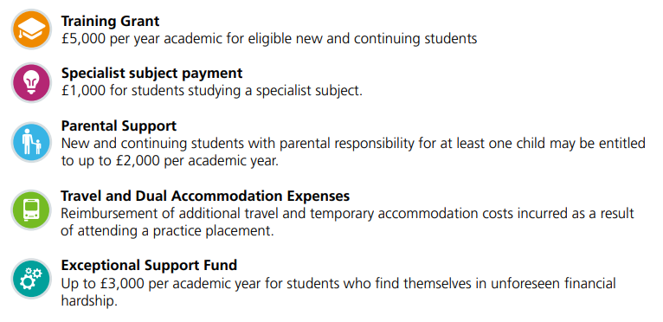
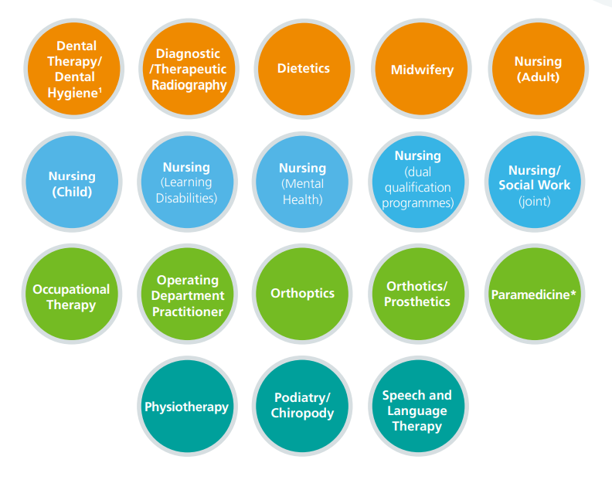
Additional NHS Support in England
Other Key Points
Previous Study Exemption for 2nd degree (if NHS)
Maximum NHS and SFE funding available
Applications SFE usually Jan/Feb
Applications NHS usually April
Students eligible for the long course loan
Students must be eligible for tuition fees and maintenance support in each AY to be able to access NHS LSF
Visit NHS BSA / Student Services for more information

Slide 20
Repayments

Slide 21
Student Loan Repayment SFE
From academic year 2023/24, loan repayment policies for undergraduate students in England undertook a
change.
Key facts about how repayments now work, include;
Students won’t have to make repayments until their income is over a set threshold, which will be £25,000 a year until April 2027
From April 2027 the threshold is set to rise annually with inflation (RPI)
If students study a full-time course, they will be due to start repaying from the April after completing their course or leaving/withdrawing from higher education
A 2026 graduate who starts a job with a salary of £28,000 a year, would expect to repay around £17 per month over financial year 2027-28
If a student’s income drops below the threshold, their repayments will stop, and any outstanding balance will be written-off 40 years after entering repayment
Information: educationhub.blog.gov.uk/2022/02/24/get-the-facts-about-student-loan-reform
Notes:
https://educationhub.blog.gov.uk/2022/02/24/get-the-facts-about-student-loan-reform/
New borrowers commencing study from academic year 2023-24 onwards
There will be a new loan plan type for students who start courses from academic year 2023/24. The new loans will have:
o In-and-post-study interest rates of RPI+0%.
o A repayment threshold of £25,000, maintained at this level up to and including financial year 2026-27, and uprated by inflation (RPI) from April 2027 onwards.
o A repayment term length of 40 years.
Key messages
The new loan plan does ask graduates to repay for longer and from an income threshold of £25,000, but it also increases certainty for borrowers by reducing interest rates to match inflation only.
This ensures that, under these new terms, borrowers will not have to repay more than they have borrowed in real terms.
A student who completes their degree in summer 2026 with a loan on the new terms, and who commences a job with a salary of £28,000 a year, would expect to repay around £17 per month towards the cost of their higher education over financial year 2027-28.
Compared with borrowers on Plan 2 loan terms, borrowers with a loan on the new terms will repay – at most – up to £30 per month more in financial year 2027-28.
The Government will be keeping these new loan terms under review.

Slide 22
Repayment as of AY 2024/25 - SFE
Government Rationale for £25,000 Threshold:
How much per month? (projected figures)
Gross Annual Income | Approx Monthly (2023/24) @ £25,000 | Approx Monthly (2027/28) @ £25,710
£25,000 | £0 | £0
£28,000 | £22 | £17
£30,000 | £37 | £32
£35,000 | £75 | £69
£40,000 | £112 | £107
£45,000 | £150 | £144
£50,000 | £187 | £182
Notes:
Plan 2
The thresholds are £524 a week or £2,274 a month (before tax and other deductions). They change on 6 April every year.
Example
You’re paid weekly and your income changes each week. This week your income was £600, which is over the Plan 2 weekly threshold of £524.
Your income was £76 over the threshold (£600 minus £524). You will pay back £6 (9% of £76) this week.
Example
Your annual income is £28,800 and you are paid a regular monthly wage. This means that each month your income is £2,400 (£28,800 divided by 12). This is over the Plan 2 monthly threshold of £2,274.
Your income is £126 over the threshold (£2,400 minus £2,274). You will pay back £11 (9% of £126) each month.

Slide 23
Many thanks for attending.
If you want to discuss any Student Finance issues, ask questions or arrange a visit, please don’t hesitate to contact me using the details below.
Stephen Jones
Account Manager – Northwest England & North Wales
stephen_jones@slc.co.uk

