Slide 1
Law
Apprenticeship

Slide 2
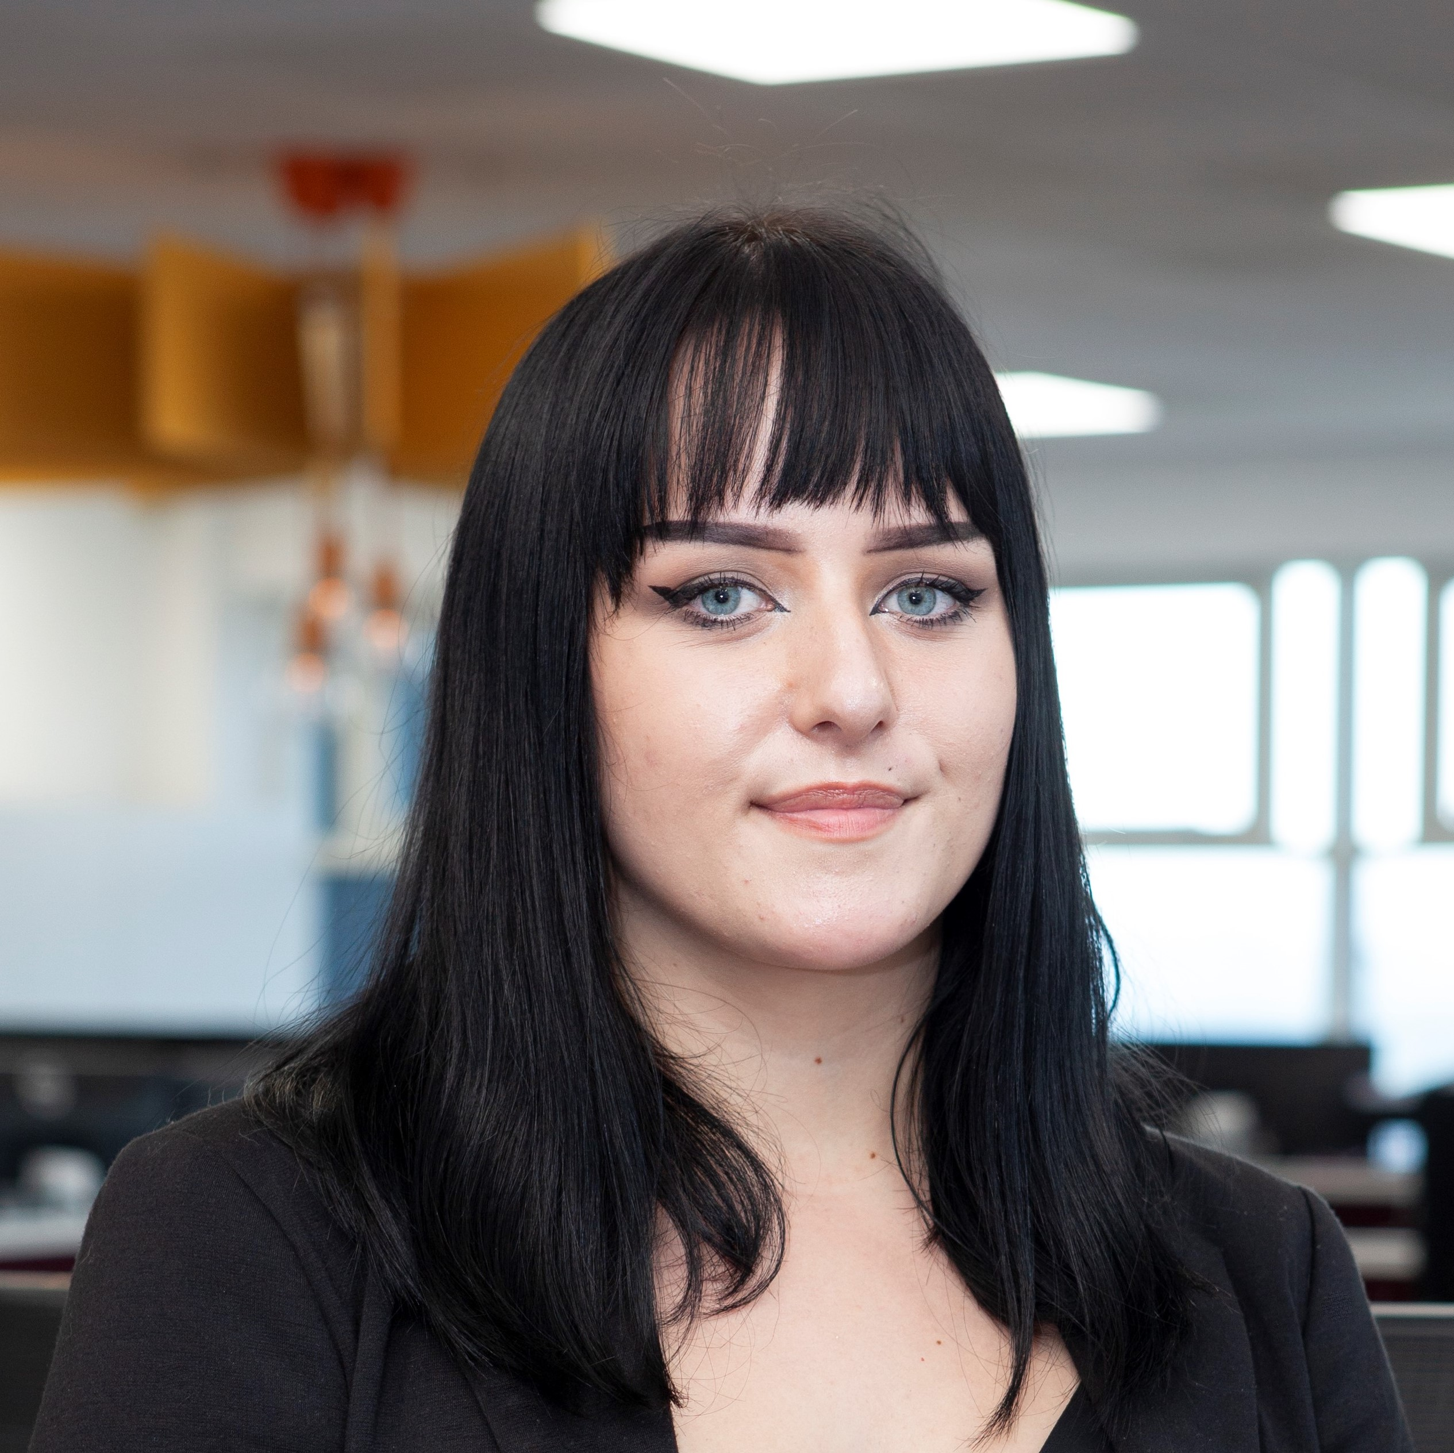
A bit about us…
I am a legal apprentice, having started at Gordons in 2021. I am currently studying with our law provider BPP. I work closely with Megan in the Private Client department.
Sophie Wilton
Apprentice Lawyer
I joined Gordons 12 years ago and was one of the first apprentices. I completed the scheme in 2017 when I became a fully qualified Chartered Legal Executive Lawyer. I advise my clients on Wills, Probate and Succession Planning
Megan Stocks
Chartered Legal Executive Lawyer

Slide 3
Who is Gordons llp?
Gordons is one of Yorkshire’s leading independent law firms with offices in Leeds & Bradford. We have around 180 colleagues.
We provide legal advice to both individuals and businesses that range from small family businesses to national and international companies such as Morrisons, B&M and Evri.
Traditionally there has only been one route to qualification; go to university, complete the Legal Practice Course, obtain a training contract at a firm and qualify from there.
We started our apprentice scheme as our former Managing Partner, having come from humble beginnings himself, is passionate that all bright, ambitious individuals should be able to access and succeed in a career in law – not just those who can afford to go to university.

Slide 4
Various professions have embraced the apprenticeship route in the last 10/15 years and apprenticeships, particularly in law, are now a respected and alternative option for students entering the profession
At Gordons we still offer the traditional training contract route for those students who have been to university, but our apprenticeship route is becoming more and more popular each year.
The levels of applications between our two training routes have begun to equalise, and last year we received over 130 applicants for our apprenticeship scheme. We are expecting numbers to be higher this year.

Slide 5
What we do
Corporate / M&A
Residential Conveyancing
Commercial Property
Commercial Contracts
Wills & Trusts & Inheritance Tax Planning
Employment & HR
Dispute Resolution
Power of Attorney
Construction
Property Disputes
Probate & Estate Administration
Regulatory
Defendant Personal Injury

Slide 6
Gordons Apprenticeship
Launched in 2011 our apprenticeship was the first of its kind in the legal sector and has won many awards
The apprenticeship is open to bright and determined school leavers who have a passion to work in the legal profession
We welcome applications from candidates from a wide range of backgrounds and in particular students who have shown determination to overcome challenges
There is no expectation of prior legal knowledge or experience, candidates do not need to have studied A-Level law or have gained any legal work experience.
We look for candidates who have a “can do” attitude and are ready to enter the workplace and gain a practical experience.

Slide 7
BPP apprenticeship
Our legal apprenticeship is a level 7 degree apprenticeship.
The apprenticeship is split into two parts:
- Years 1-2 Paralegal Apprenticeship (includes BPP Level 4 Certificate in Higher Education)
- Years 3-6 Solicitor Apprenticeship (includes LLB law degree and Solicitors Qualifying Exams)
On completion of all stages and passing all examinations and end point assessments you will qualify as Solicitor at the firm, gain a degree and hold a Level 7 qualification.
Our apprentices are employed by the firm full-time whilst studying one day a week with BPP University. Our apprentices receive a starting salary of £17,000 which is reviewed each year, 25 days annual leave plus bank holidays, paid study leave, all training fees are paid by the firm and support is provided throughout the apprenticeship by qualified lawyers and staff.
Candidates apply in their final year of sixth form. Applications open in the January and are accessed via our website, applications close in the April and the first part of the interview process begins in May. Candidates who are successful at the interview stage are invited back to a work experience week at the firm in the summer. During this week we provide case studies and various tasks relating to different areas of law. The candidates are assessed on these tasks. We make offers at the end of this experience week, conditional on the candidates achieving the required grades.

Slide 8
Gordons Law apprenticeship
Requirements:
Three or more A Levels (or equivalent) grade B or above
Five GCSEs including Maths and English
Be available to attend the work experience placement week
Be hardworking and determined

Slide 9
Apprentice applications
Applications to be made in Year 13
Key Dates
January – online application opens
End of April – application closing date
May Half-Term – interviews, part 1 selection process
End of July – one week work experience placement, part 2 selection process
August – apprenticeship offered (conditional on grades)
September – apprenticeship programme starts

Slide 10
Our experience
Why did you choose an apprenticeship scheme over university?
What has been the hardest part of the transition from school/college to the workplace?
What tasks do you undertake as an apprentice and how was your level of responsible changed as you’ve progressed?
Do you feel like you have missed out on the social side of university?
How did you hear about the scheme, and what support did you receive from college/sixth form?
Tell me how you found the application/interview process.

Slide 11
QUESTIONS?
If you have any questions please do not hesitate to contact us.
apprenticeships@gordonsllp.com

