Slide 1
The Professional Services Sector in West Yorkshire
Louise Graham

Slide 2

What are Professional Services?
Occupations that provide support to businesses in the form of advice or performing tertiary roles such as:
  Banking and finance: managing money, providing loans and investments
  Law: advising clients on legal matters, representing them in court
  Consultancy: providing expert advice and support on business issues

Slide 3

Economic Powerhouse
Employs over 149,000 people in Yorkshire and Humber
Contributes over £11.8 billion to the regional economy
A significant driver of high quality job creation and economic growth
Leeds is the UK's second largest financial services centre outside of London
Home to major banks, building societies, consultancies, and legal firms
A growth area. Reports suggest continued expansion and opportunity in areas like financial exports

Slide 4

Opportunities
Training & Progression: Many professional services firms invest heavily in training their staff.
Global Exposure: Major international business centre. There are opportunities to work with clients from around the world, gaining a broader perspective.
Impactful Roles: Depending on the field, there are opportunities to contribute to important projects that shape the region's economic landscape.

Slide 5

Early Career Opportunities
Graduate schemes: tailored training programs for recent graduates
Apprenticeships: earn while you learn, combining on-the-job experience with academic qualifications
Education Outreach: gain valuable work experience and build knowledge of the sector.

Slide 6

Skills in High Demand
Strong analytical and problem-solving skills
Excellent communication and interpersonal skills
Digital literacy
Ability to work independently and as part of a team
Curiosity and keen to learn and develop
This Photo by Unknown Author is licensed under CC BY-NC-ND

Slide 7
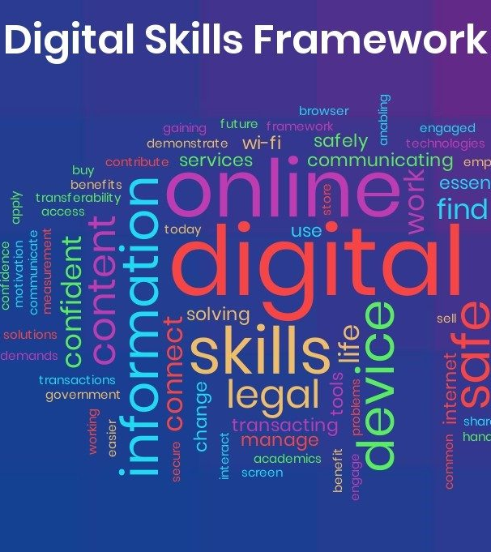
Basic Digital Skills in High Demand
We face a significant gap in basic digital skills for both life and work.
As of 2021, 25% of adults in Yorkshire and Humber lack essential digital life skills, and only 59% of employed individuals possess essential work skills (https://www.westyorks-ca.gov.uk/media/9492/digital-skills-plan.pdf).
All young people need proficiency in tasks like using email functionalities, video conferencing tools, and handling document formats such as PDFs.

Slide 8

Barriers to Entry for Disadvantaged Young People
Limited social capital:
Those from better off backgrounds were almost 80 per cent more likely to be in a professional job than their working-class peers.
Limited social capital restricting access to work experience, networking opportunities and career insights
Financial barriers: tuition fees, unpaid internships.
Lower self-belief and career awareness: self-confidence, self-awareness in terms of skills, and lack of market knowledge.

Slide 9

What we can do:
Parental engagement
Mentoring and role models
Experiences of the workplace
Career talks & presentations
Teacher CPD
Self-efficacy boosting activities
Early intervention
Transition support

