Slide 1





Careers Talk with
Lloyds Banking Group
Imagine
what’s next
January 2024

Slide 2







Who we are
The UK’s largest retail and commercial financial services provider
An organisation with a 325+ year history
A Group with 20 digitally active users
58,000 colleagues working to deliver
the right outcome for customers, communities and colleagues
A company driven by a core purpose
to Help Britain Prosper
Home to some of the UK’s most
well-known banking brands. Can
you name them?
Our family of brands

Slide 3
What we offer
We’re transforming financial services and we want you to join us.
These are our Early Careers entry routes.
At school or college
From online sessions
to potential industry placements for T-Levels, we can help
you start exploring
your future.
From school or college
Apprenticeships
give you a chance
to develop skills, gain qualifications, and
get paid a salary as you do.
Entry-level roles
we recruit into
roles throughout the business that will give you a professional 'foot in the door’. No prior experience needed.
At university
We offer industrial placements, summer internships and virtual insights programmes.
After university
From learning to lead, to creating innovative banking products, we’ve got a range of graduate schemes.

Slide 4

Get into…
Technology
As part of our tech transformation we’re:
Enhancing our online services and resilience
to cyber threats
Exploring latest innovations in robotics and machine learning
Putting cloud technology at the heart of everything we do
Making the most of the vast wealth of data
we have
Using industry standard tools including GitHub, Kubernetes and Terraform to develop and deliver software, and the list is constantly evolving
Be part of it. Explore opportunities in Data Management and Strategy, Data Science and Analytics, and Technology Engineering.
Be part of a new digital future.
We’re the UK’s biggest digital bank with over
18 million online customers.
There’s so much more we want to achieve — that’s why we've invested more than £3bn into our people, technology and data.
We’re delivering the largest transformation ever in financial services.

Slide 5

Get into…
Group Functions
They work across our brands and business to:
Manage our finances and ensure we’re
up-to-date on laws and regulations
Assess and protect ourselves and our customers against risks
Review and enhance the ways we work
Attract talented people and support them
to be at their best
Interested? Explore opportunities in Actuarial, Finance, Human Resources, Occupational, Psychology and Risk.
Be at the beating heart of
our business.
There’s a wide range of teams who ensure our business runs smoothly
and we can serve our customers in
the best way possible.

Slide 6
Get into…
Consumer Relationships
The focuses of this area include:
Offering quality banking products including current and savings accounts
Staying in-step with customers as their needs change throughout their lives
Offering a unique multi-service, multi-brand
offer to help our brands grow and succeed with inspiring collaboration
Thinking about how we can provide as much value to our customers as possible, with hands-on collaboration and care
Investing in the future by fixing and improving processes more quickly for better customer results
Want to know more? Explore our apprenticeship in Customer Service.
Be someone who strengthens and supports real people.
At the end of the day, everything we do is for the benefit of our customers, and we act and think accordingly. The customer comes first, which is why it’s crucial we forge close and meaningful relationships with customers at all levels.

Slide 7

Get into…
Consumer
Lending
Core focuses in Consumer Lending include:
Offering quality lending products including credit cards, loans and mortgages
Ensuring a seamless customer experience,
from digital to in-person services
Keeping inclusivity and sustainability at the forefront of our operations, financing an affordable, achievable journey to Net Zero for everyone
Having a strong focus on helping customers spend and borrow in a safe and responsible way, making key life moments as smooth as possible
Embracing an integrated, data-led approach
to lending which helps customers feel heard
and supported as we both respond to and anticipate their needs
Upholding our strong values and sense of purpose to power ahead in times of instability – being there for customers when they need us the most
Want to know more? Explore opportunities in Sustainable Consumer Banking.
Be in an exciting space where you can make real changes.
When it comes to Consumer Lending
in Lloyds Banking Group, understanding the customer on many different levels helps us go the extra mile.

Slide 8
Get into…
Business and Corporate
Banking
Teams and specialists in this part of the Group work to:
Advise businesses on how to manage risks and become more sustainable
Help them invest in the UK as well as trade internationally
Develop products and services that meet their specific needs and build a better future
Manage and assess the risks around our business lending
Become the best digital bank for businesses
Diversify our offer to customers so they can access more products in more ways
Transform how we operate to continuously improve our services
Support our customers as we reduce the carbon emissions we finance
Want to know more? Explore opportunities in
Business and Commercial Banking or Corporate Banking and Markets.
Be on a team that’s a trusted partner to UK businesses.
It’s not only the public who use our services. From small start-ups to huge global corporations, we look after the financial needs of millions of businesses. We’re always looking to broaden our offering so more customers can access more products in more ways.

Slide 9
Get into…
Corporate and Institutional
Banking
A variety of teams in this part of the Group include :
A stand alone legal entity, the Lloyds Bank Corporate Markets (LBCM) is a UK Financial & Capital Markets specialist,
an international lender and a customer-centric Islands bank with colleagues based in the UK and internationally
The Institutional Coverage team comprises Financial Services and Financial Sponsors teams who work with clients on purpose-led activities to help them invest, grow and protect their assets through varying solutions
Debt, Risk and Balance Sheet Management plays a key role in underpinning the sustainable growth of the CIB franchise, providing clients with optimised, market-leading financing solutions
Want to know more? Explore opportunities in Corporate and Institutional Banking.
Be at the forefront
of capital markets.
Corporate and Institutional Banking serves the financial needs of large clients (generally more than a £100m turnover) who have a strong link to the UK. Currently growing our presence in capital markers, we have a new and innovative focus on ESG (Environment, Social and Governance) advisory.

Slide 10
Get into…
Insurance,
Pensions and Investments
In this area, we’re focused on:
Offering a range of home, vehicle and life insurance products, workplace and personal pensions, plus support and services to help customers invest
Delivering a seamless service to customers across all channels
Using data and insights to pre-empt customer needs and develop new insurance, pension and investment propositions
Deepening relationships with our customers and intermediary partners to sustainably grow this part of our business further
Investing in the future with large-scale technology programmes to improve services for customers
Want to know more? Explore opportunities in Sustainable Financial Wellbeing.
Be someone who improves people’s financial resilience.
In an uncertain world, our customers need us more than ever. To help protect them against the unexpected and prepare for the future. In this growing part of our business, we’re supporting them in even more, ever better ways.
Notes:
Want to know more? Explore opportunities in Sustainable Consumer Banking.

Slide 11

Imagine What’s Next

Slide 12
What route is right for me?
Want to earn, learn
and make a real difference?
Find an Apprenticeship
Our programmes are designed to help you take the first step into a rewarding new career. We offer:
A wide range of opportunities, from finance to tech to customer service
Time and support to study towards industry-recognised qualifications
A range of levels so there is something for everyone, regardless of your qualifications
Ready to kick-start your career while studying?
Discover Undergraduate opportunities
Providing a great introduction to work and our Graduate Schemes, we offer:
12-month industrial placements in Technology Engineering, Risk, and Data and Analytics
Virtual Work Insights Summer programmes
Eight-week Summer Internships available
Nine-week T Level placement (available through partner colleges in regional locations of Halifax, Manchester, Bristol and London)
Want to make an impact, straight out of university?
Explore our Graduate Schemes
Two+ year programmes designed to:
Help you explore your talents and interests
Experience different teams within your
chosen business area
Develop your skills and gain professional qualifications or valuable certifications
Or look at our Entry
Level roles
Get the same support, learning and development to help you build a career, in a fixed, permanent role.

Slide 13

Why choose an Apprenticeship?
“The Apprenticeship Programme has
had a massive impact on my personal development. It has given me the opportunity to learn so many fundamental skills that I will carry throughout my career.”
”Hands on training has given me a real chance to hone my skills and put them to use in a live work environment. It has given me a springboard to aspire for other roles within
the Group as well.”
Get work experience
Learn and earn a salary
Future career prospects
Gain a recognised qualification'

Slide 14



What’s being an Apprentice like?
Opportunities from day one
You’ll get lots of support to develop
and build your career
You’ll learn to network, use different technologies, and join community volunteering activities
You’ll work with experienced leaders who’ll inspire you to develop as a person and a professional
You’ll help make an impact on millions of customers

Slide 15
Our Apprenticeship Programmes
HR
Develop a wide range of skills
as you work with expert teams, who empower everyone at Lloyds Banking Group to perform their best whilst achieving their career goals.
Closing date for our Apprenticeship
Programmes
Varies
With programmes in a variety
of business areas, across a range
of levels, there’s something to
suit almost everyone.
Audit
If you’ve got an eye for detail and a drive to make an impact, help us ensure the ongoing security, transparency, and success of our business.
Risk
Use your curiosity and natural problem-solving ability to help us lead the way in keeping our customers and business safe.
Customer Services
Help us show our commitment to customers and use your people skills to help the individuals, businesses, and communities we’re here to serve.
Finance
Build a career helping colleagues and customers navigate the changes that
are shaping the future of financial services.

Slide 16
Our Apprenticeship Programmes
With programmes in a variety
of business areas, across a range
of levels, there’s something to
suit almost everyone.
Quality Engineer
Data
Use your love of numbers and eye for detail to help us use data in even smarter ways.
Cyber
Work with advanced technologies and expert teams as you help build and maintain the systems that protect us.
Technology Engineering
Use your love for technology
to help Britain’s biggest digital bank keep delivering the best digital solutions.
Software Engineer
DevOps Engineer

Slide 17

What’s the process?
Visit our Assessment Practice zone
Apprenticeships
Apply online
Tell us about yourself and
your potential – no CV required
If you meet our minimum
entry criteria, you’ll be invited to the next stage
Online assessment
Approx. 60-minute of tests
Designed to assess your motivation, strengths, values and behaviours
Tip: Visit our Assessment
Practice Zone to prepare
Assessment day or interview
Depending on the programme you applied to this could be an interview or assessment day
These take place virtually via Microsoft Teams or face to face
Tip: We can help with technology
if needed
And then?
Make it through the final stage and we’ll make you an offer
Accept and there are a few official checks to complete before joining
Talk to us about any support or adjustments you need

Slide 18

Prepare for what’s next
How we help

Slide 19


Learn more about future roles
Wondering what to do when you leave school?
Join our Lloyds ‘careers
live’ stream
At these monthly virtual events you can hear about exciting careers that could start you on your own path. Plus, meet industry experts, apprentices and graduates starting their career journeys. Visit our Early Talent YouTube channel to find past streams.

Slide 20
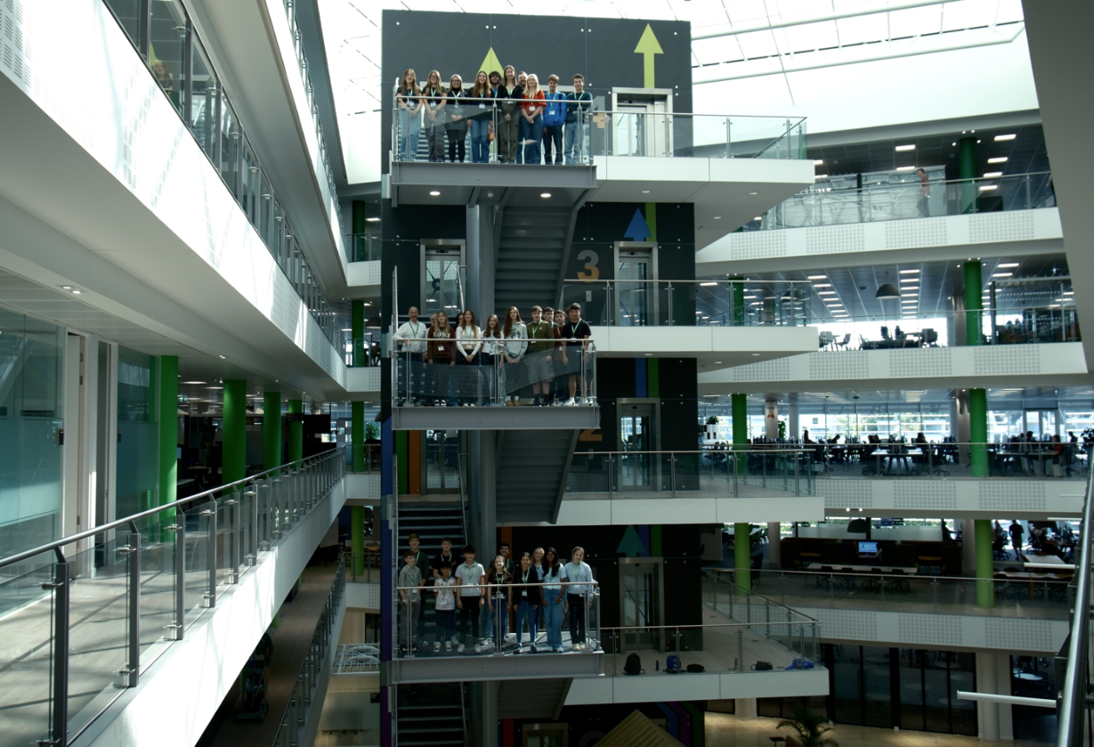
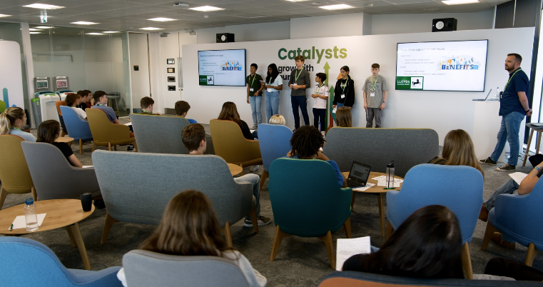

Gather experience
Want experience that could kick-start your career?
Experiences of the workplace
Virtual, at school and on our campus sites
From 2 hours to 5 days, structured experiences of the workplace to give you the skills and confidence for transitioning into the world of work

Slide 21
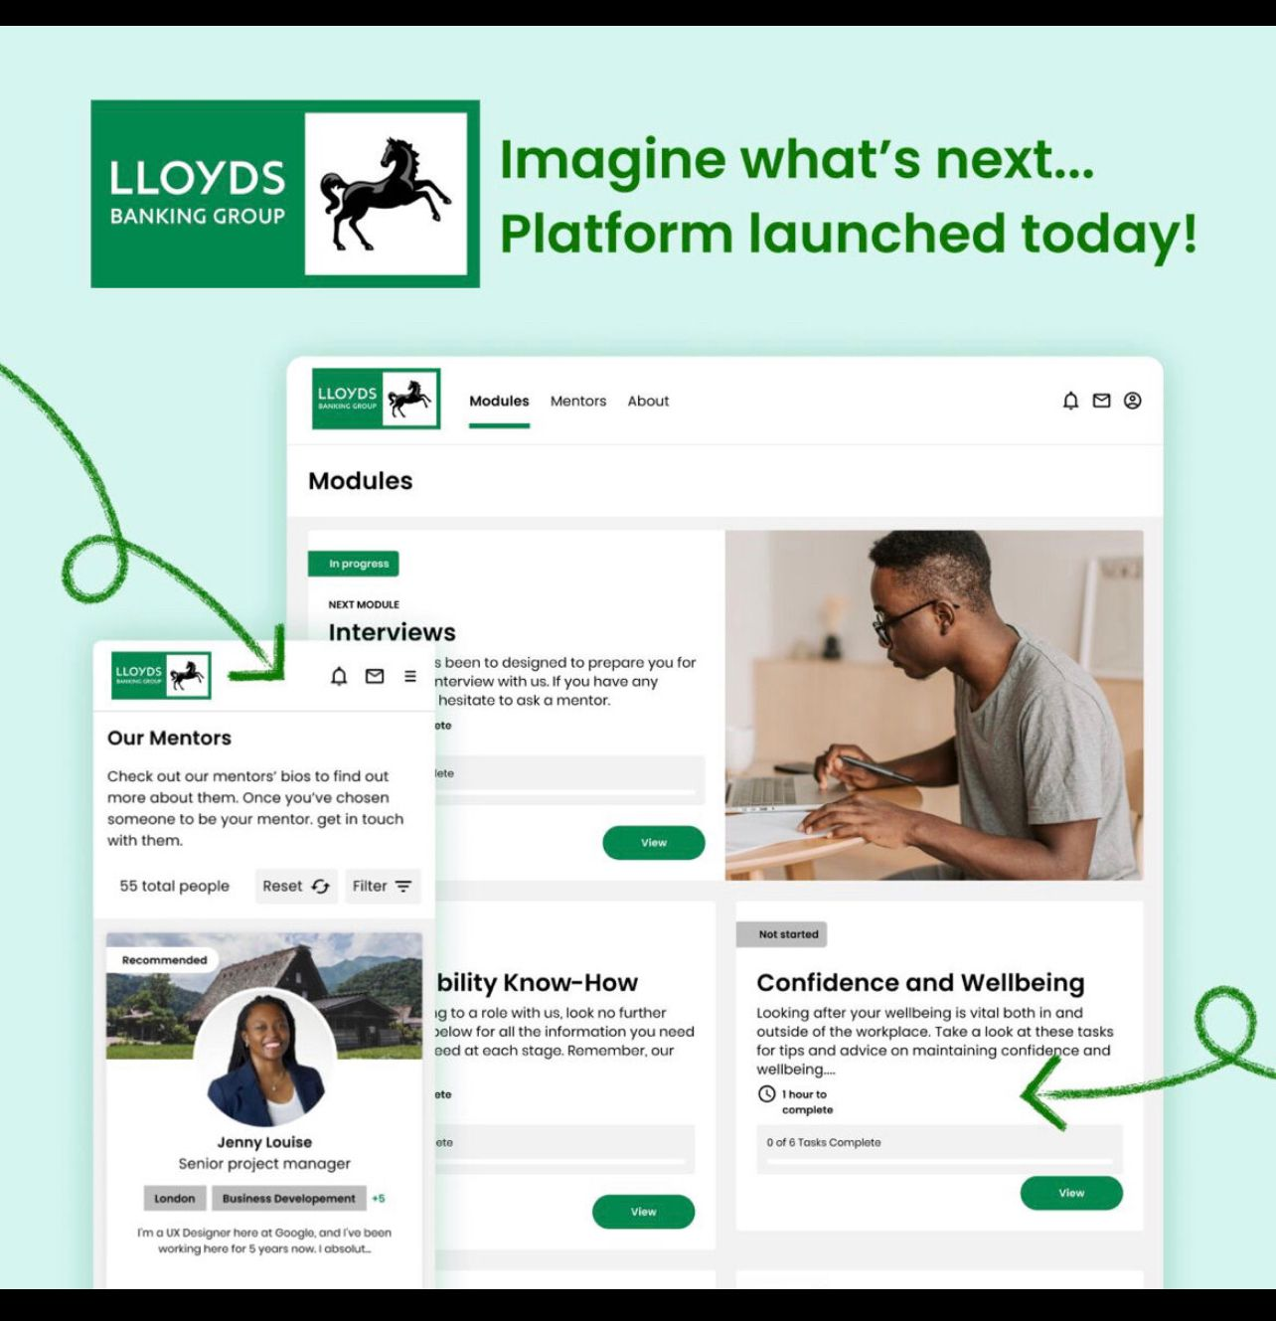
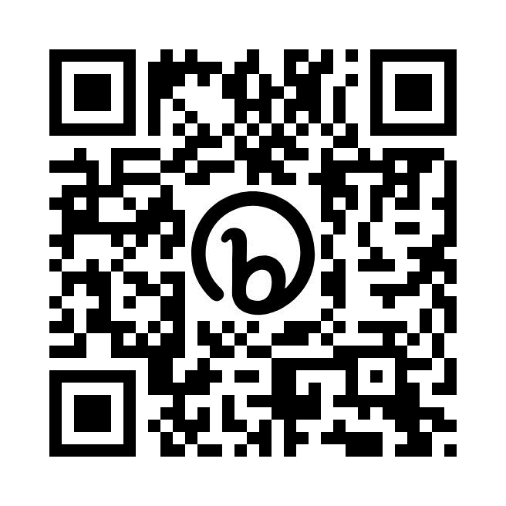
Connectr: Imagine What’s Next

Slide 22
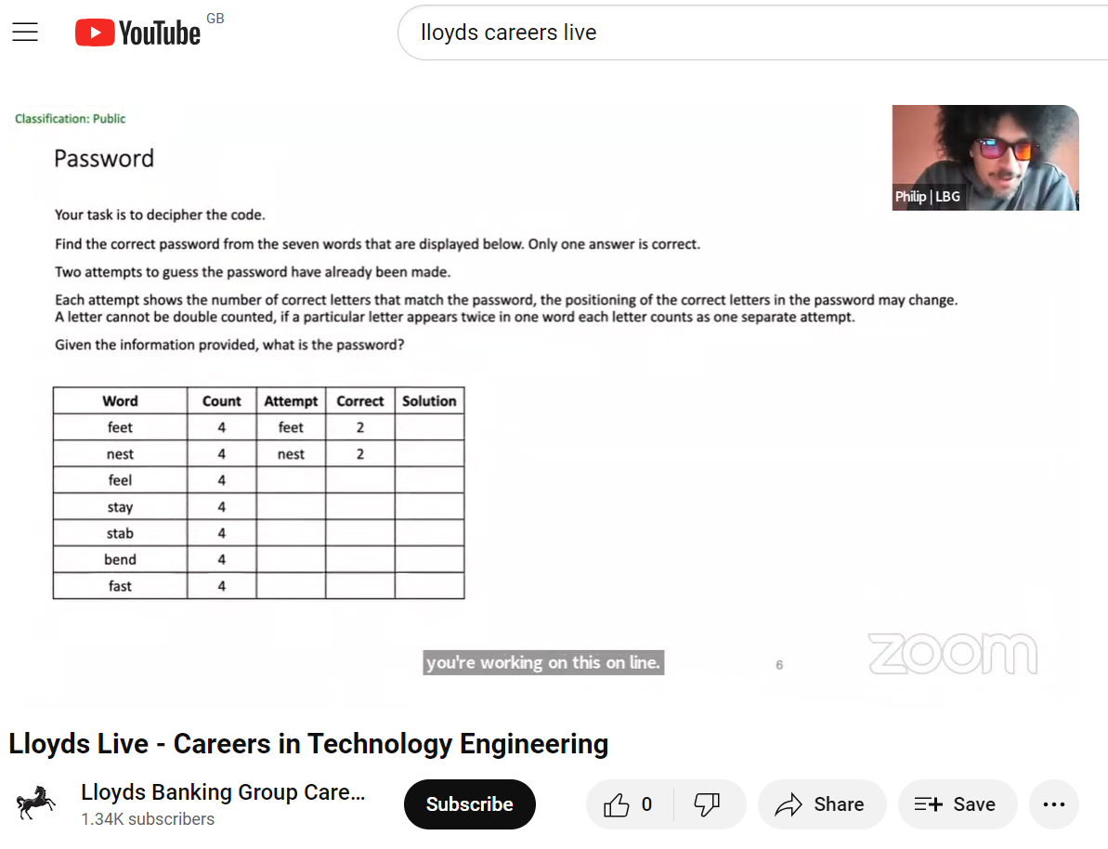
Application support

Slide 23
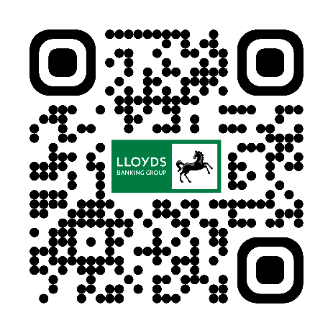
Careers website
https://www.lloydsbankinggrouptalent.com
Instagram
https://www.instagram.com/lbgearlytalent/
Connect with us
Follow Lloyds Banking Group
online for latest new,
opportunities and stories
Facebook
https://www.facebook.com/LBGEarlyTalent/
LinkedIn
https://www.linkedin.com/company/lloyds-banking-group/

Slide 24


Thank you

