Slide 1
How to…Open Days

Slide 2
Who we are
As a team, we bring together the thirteen Higher Education providers in West Yorkshire.
We have members of staff at each institution, providing a central place to find information, and providing help with accessing and preparing for Higher Education.
You might find us in a school or college, online or at a local community event.

Slide 3

What is an open day?
Higher Education Providers organise open days for prospective students.
Look around the campus, view facilities and find out about courses.
Help you make decisions on what and where to study.
Ask questions to course leaders and student ambassadors.
Find out what support is available.

Slide 4

What happens at an open day?
Talk to Lecturers and student ambassadors
General Talks – ‘Welcome to the University’, Student Finance, Student Life
Subject/course talks and workshops
Explore the city
Accommodation Tours
Services – disability, study abroad, student union, sport and active lifestyle
Campus Tours – campus and facilities

Slide 5
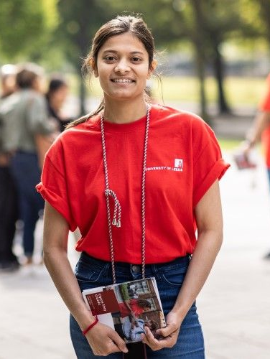
When do open days happen?
Dates vary between the different providers.
Open Days (both in person and virtual) can take place throughout the year.
Most commonly held between June and November.
Advertised on Higher Education Provider’s website.

Slide 6

How to prepare for an open day
Book a place
Note down important session times
Check travel arrangements
Prepare questions to ask
Think, what do you want to see?

Slide 7
Scenarios
Pick one of the following scenarios. Who would the students benefit from talking to? What information do they need to help them?
Scenario One
Student A is trying to decide whether they should commute or live at university.
Scenario Two
Student B does not know whether to study a sports or a business course.
Scenario Three
Student C does not want to do all their studying in the UK.
Scenario Four
Student D is dyslexic and has received support with this at college, they are nervous about how they will cope in higher education.
Notes:
Student A: Would benefit from talking to accommodation, commuting students, course team to gain insight into contact team. They would look at questions around transport links in the area of the university, how many students commute, any cost saving suggestions and support for students who commute in meeting new people and societies students can join.
Student B: Would benefit from talking to both of the course teams, student ambassadors from both areas and the careers team. They would look at questions around the different courses available, what modules are involved, any placement opportunities, the careers prospects of both and how they are assessed.
Student C: Would benefit from talking to the course team and the study abroad team. They would look at questions around placement opportunities, study abroad, financial support, careers prospects and courses that would allow them to study in this way.
Student D: Would benefit from talking to the disability support team, course team, wellbeing team and student ambassadors. They would look at questions around the support that is available, how to access any support, how their course is structured and assessed as well as any current students with dyslexia experience.

Slide 8

Open Day Action Plan
What do you want to get out of an open day?
Which talks do you want to attend?
What questions do you need to ask?
Who do you want to speak to?
What do you want to see?

Slide 10
Any questions?
www.gohigherwestyorks.ac.uk

Slide 11
Thank you
www.gohigherwestyorks.ac.uk

