Slide 1
Why do we need study skills?
Notes:
Put this slide up whilst learners are coming into the classroom and getting settled – they don’t need to answer the question.

Slide 2
Who we are
As a team, we bring together the thirteen Higher Education providers in West Yorkshire.
We have members of staff at each institution, providing a central place to find information, and providing help with accessing and preparing for Higher Education.
You might find us in a school or college, online or at a local community event.

Slide 3

Study Skills

Slide 4

Study Skills mind-map
Create a mind map all about studying – write down everything you can think of.
Notes:
Give them 3 minutes
Learners create a clearing mind map – adjust time on slide as needed.
Encourage group discussion after the activity, i.e. what did people write down.

Slide 5

Study Skills mind-map
Pick one concept on your Mindmap.
In pairs, take it in turns to explain that concept to the other person.
You have one minute each.
Notes:
In pairs, learners need to take turns explaining one of the concepts on their mind map to the other person e.g. Flashcards - what a flashcard is, how it works, why it’s useful etc.
After students have done the task – ask how they found it.
Explain that through the task they’ve used techniques – mind mapping, memory recall, and teaching others.

Slide 6

Purpose
Developing your understanding of different ways to study.
Practicing study techniques.
Learning what works best for you.
Notes:
Explain the purpose of the session.

Slide 7





What are study skills?
Skills for learning.
Useful for education and daily life.
Critical thinking
Note taking
Condensing information
Researching
Evaluating information
Time management
Organisation
Academic writing
Referencing
Notes:
Study skills are skills you need to study and learn effectively, they’re useful in daily life too, so it’s important you work on developing them!
Ask for examples of where each skill is already used.
Give relevant examples:
Looking for reviews of a product on TikTok then deciding if they should by it = researching and evaluating information.
Debates about why a football player made certain pass = critical thinking.
Ask where they think they do/could use these skills outside of school/college – either now or in the future.

Slide 8





Getting Organised
Time Management
Plan for the term/year.
Workspace
Where do you concentrate best?
A desk, good lighting and minimal distractions!
Resources and Materials
Do you have the essentials – paper, pens, USB Stick?
Are your files organised – Laptop or physical.
Local Library, Café, College/school?
Do you have access to any printouts, slides, books you might need?
Deadlines written out.
Realistic
How much time do you have to study? What else do you have planned for the day/week?
Prioritisation
Write a list of everything.
What’s most important? When’s the soonest deadline?
Goal Setting
Divide your study session into smaller chunks.
Pomodoro technique
Self-Awareness
What time of day do you concentrate best? What distracts you?
What other responsibilities do you have? Looking after siblings? A job?
What’s realistic and achievable?
What’s your form of self-care?
Notes:
Being organised sets the foundation for effective study.
Explain what term
Time Management:
Planning for the term/ year.
Knowing when deadlines and exams are.
Thinking about what your week looks like – how much time do you have to study?
Prioritisation
Deciding what’s most important.
What’s the soonest deadline? What’s urgent?
Could use a prioritisation matrix.
Workspace
Studying somewhere that you won’t get distracted.
Where do you concentrate best? Library, café, college/school?
Goal Setting
Dividing study sessions into smaller chunks.
What’s realistic and achievable in that time? E.g. one mock exam, making notes on two topics.
Techniques e.g. pomodoro.
Resources & Materials
Make sure you’ve got the things you need before studying – e.g. books, pens, paper, slides etc.
Make sure all your files are organised – physical and digital.
Self-Awareness
Understanding how you work best & how to look after yourself.
Think about what time of day you work best, what distracts you, how to balance your responsibilies and what you do for self-care.

Slide 9
Getting Organised
Time Management
Workspace
Resources & Materials
Prioritisation
Goal Setting
Self-Awareness
Notes:
Being organised sets the foundation for effective study.
Explain what term
Time Management:
Planning for the term/ year.
Knowing when deadlines and exams are.
Thinking about what your week looks like – how much time do you have to study?
Prioritisation
Deciding what’s most important.
What’s the soonest deadline? What’s urgent?
Could use a prioritisation matrix.
Workspace
Studying somewhere that you won’t get distracted.
Where do you concentrate best? Library, café, college/school?
Goal Setting
Dividing study sessions into smaller chunks.
What’s realistic and achievable in that time? E.g. one mock exam, making notes on two topics.
Techniques e.g. pomodoro.
Resources & Materials
Make sure you’ve got the things you need before studying – e.g. books, pens, paper, slides etc.
Make sure all your files are organised – physical and digital.
Self-Awareness
Understanding how you work best & how to look after yourself.
Think about what time of day you work best, what distracts you, how to balance your responsibilies and what you do for self-care.

Slide 10
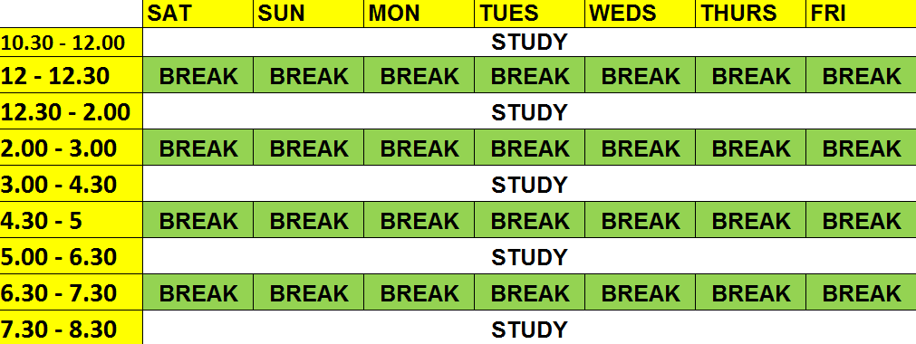
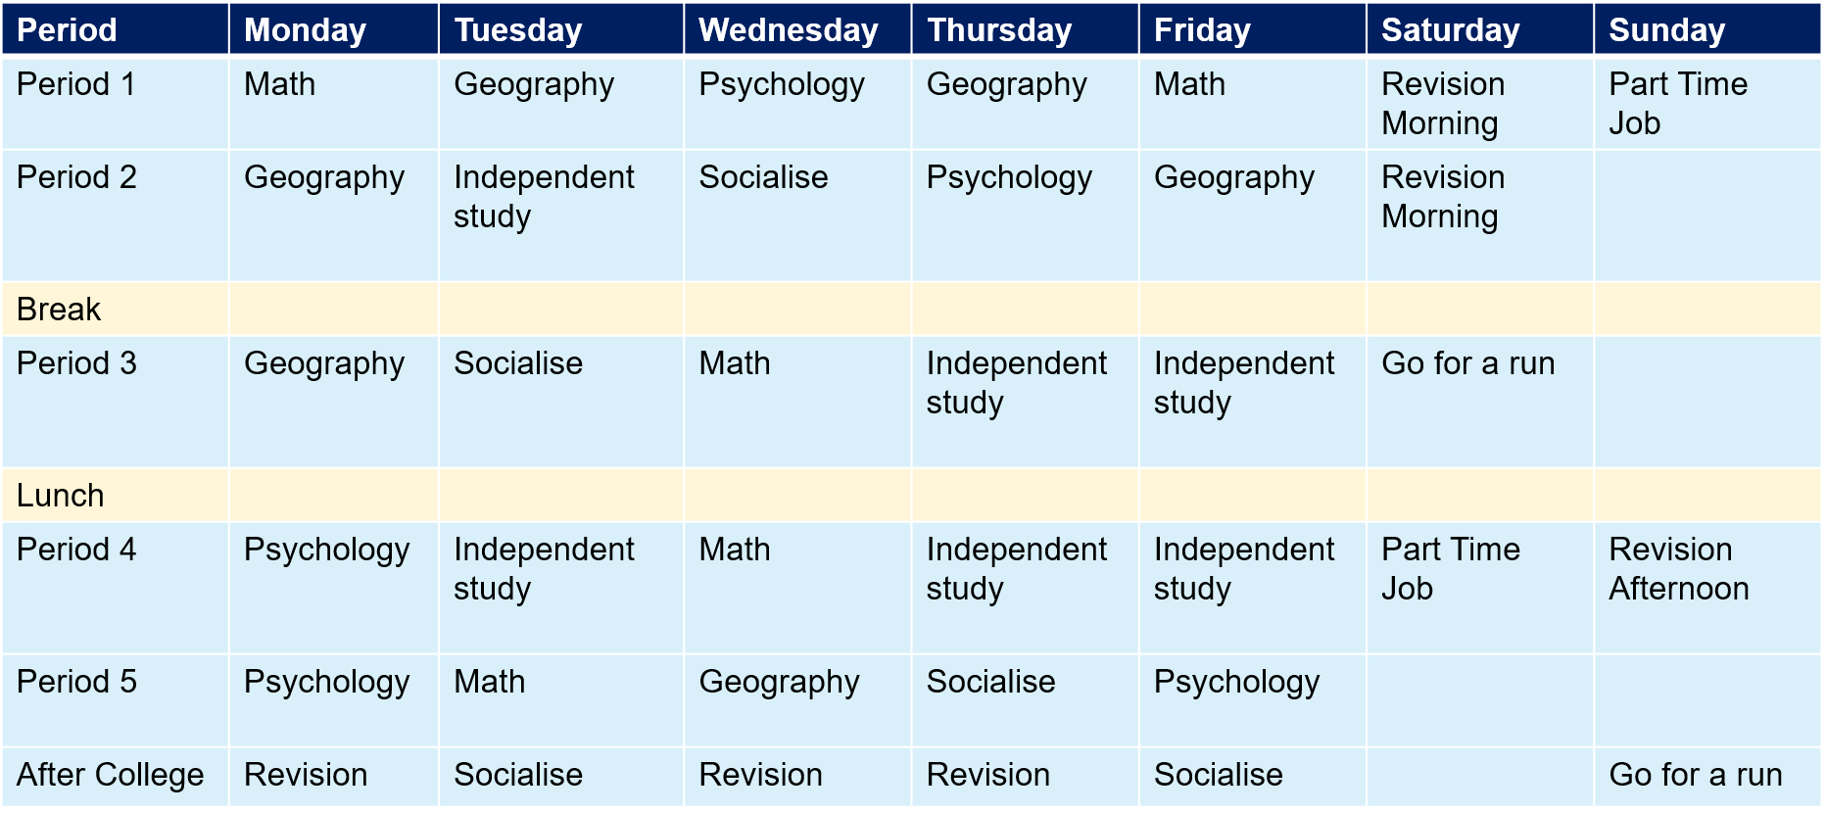
Study Timetable
Discuss these two timetables – What’s good? What’s bad? Which is better? Why?
Rowan’s Timetable
Charlie’s Timetable
Notes:
Give students a couple of minutes to discuss the two timetables then draw them back into a group discussion.
Comments might include:
Charlie has written her full schedule.
Rowan’s is unrealistic – there’s no breaks
Charlie includes things like going for a run and socialisation – life outside of study

Slide 11
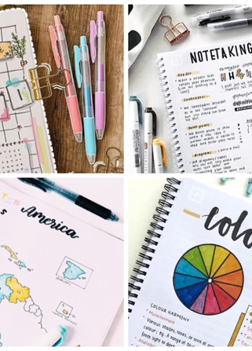
Good note-taking
Clarifying your thoughts and understanding.
Supporting critical thinking.
Memorising important information.
Remember to focus on:
Using your own words – helps with understanding and remembering.
Using key words, phrases, doodles and abbreviations (make up your own).
Noting key points - relevance.
Notes:
Talk through the slide.
Explain that there are several note taking methods, you’ll be going through some of the most popular methods in the next couple of slides

Slide 12
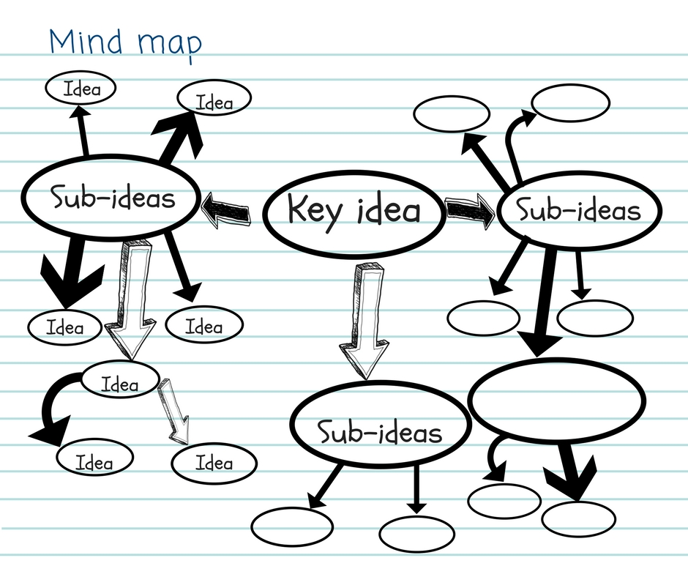
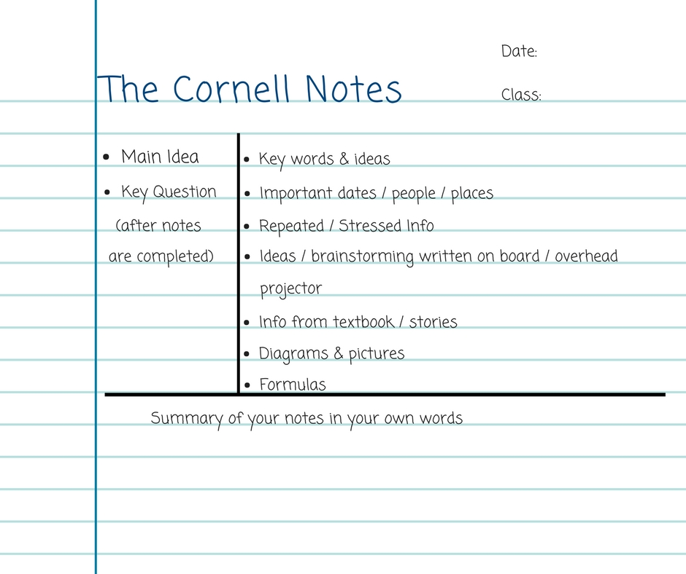
Note-taking methods
Notes:
Mind Map
Put the keyword, main point or learning outcome in the centre of the page.
Make branches that go from this main point to sub-points, details etc.
Leave enough room for all your points and to use a separate mind-map for each main point.
Colour-code, add drawings and highlight.
Cornell Method
Two columns:
One for the main point, theory, learning outcome (done after main notes are completed).
Second for your notes, key-words or questions.
At the end of each page with this method, write a brief summary.

Slide 13
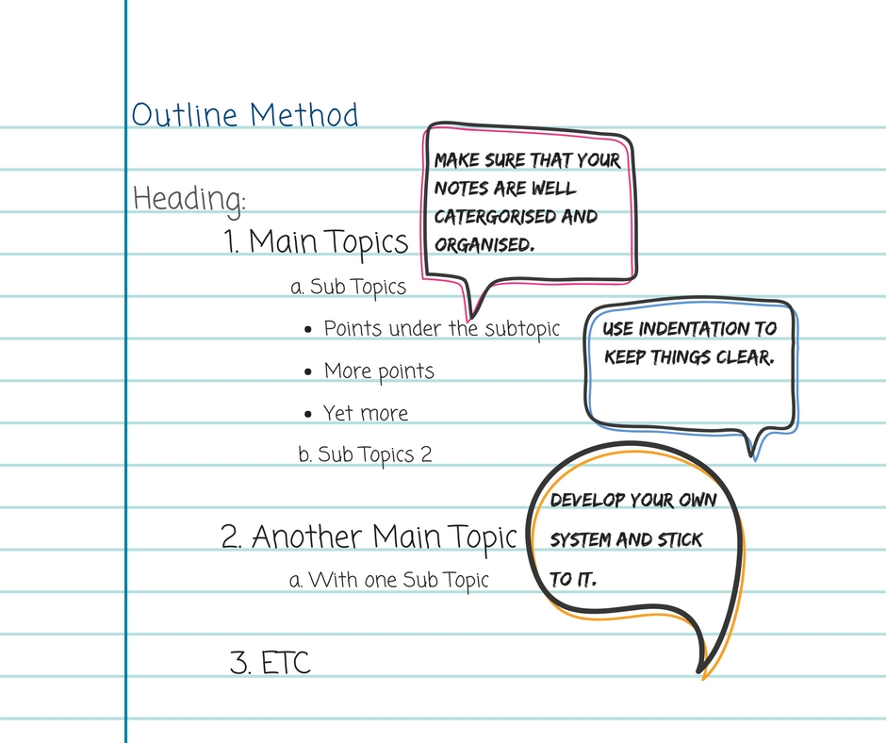
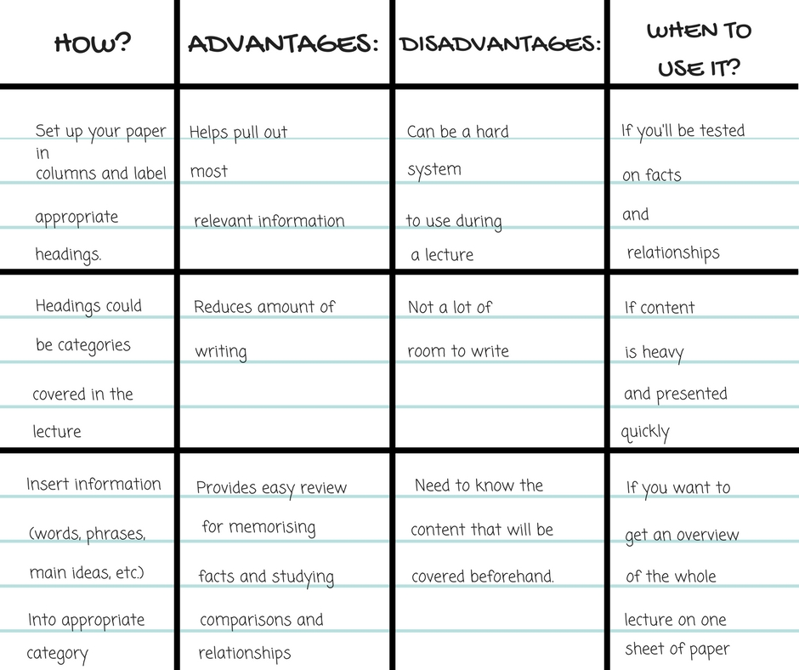
Note-taking methods
Notes:
Outline Method
Using indentations, bullet points or numbers to visually distinguish the difference between main points, sub-points and details.
Using different coloured pens, capitalisation or highlighters helps to make it more effective
Closest to what they might already do.
Charting Method
Using a table to make your notes.
Separate columns for main points, questions, details, key dates etc.
About classifying your information so you can easily access it.

Slide 14

Note taking – your turn!
Choose one of the note taking styles…
Using the note taking style you’ve chosen, make notes on the short clip we’re about to watch.
Notes:
Learners pick one of the 4 note-taking methods and write notes a short clip.
Suggested clips
TED-Ed: 4 things all great listeners know | TED Talk
Jen Gunter: Do you really need 8 hours of sleep every night? | TED Talk
Jen Gunter: How your sense of smell helps you savor flavor | TED Talk
Elizabeth Cox: The benefits of daydreaming | TED Talk
You can choose an alternative clip, based on your learners interests or curriculum, but ideally the clip should be no longer than 5 minutes: TED: Ideas change everything.
Check in with learners to see how they found the task – try to hear from learners who used different methods.

Slide 15
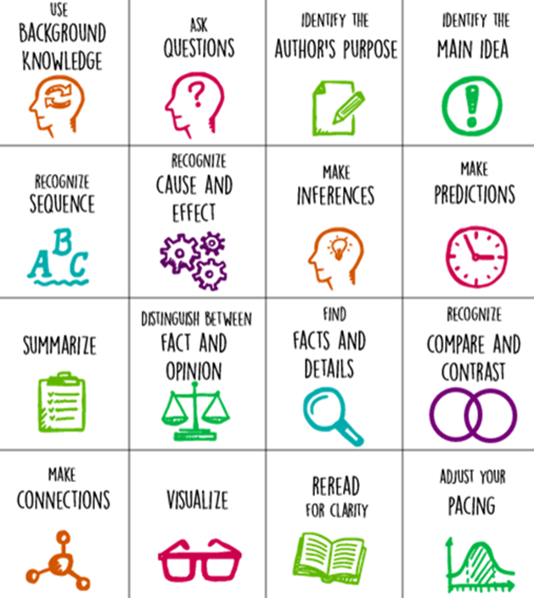
Active Reading
As you read:
Highlight, annotate and make notes of thoughts or questions.
Practice skimming (quickly looking over a text to get a general idea) and scanning (looking for key words).
Reflect on what you’ve just read:
  What was the main point?
  Any surprises?
  Possible further reading?
Notes:
Explain to learners that when they’re reading, it should be active.
Explain some of the skills in the image.
Active reading helps with processing and retaining information.

Slide 16

Bonus Task
Create a resource about what you have learned today.
You could create:
  Flashcards
  A Poster
  A mind-map
  A script for a voice recording
  Notes
Notes:
If you have time at the end of the session and the relevant resources (pens, paper, printouts of slides etc) then challenge learners to create a resource about study skills using their technique of choice.

Slide 17
Resources
My Study Life: Timetables, to-do lists and tracking your progress.
AnkiApp: Flashcards to test yourself.
Quizlet: Quiz flashcards (make your own and use other peoples).
Seneca Learn: Free revision tool for GCSE & A Level exams.
Pomofocus: Online timer.
GetRevision: Creating study plan’s and accessing resources including past papers, quizzes and flashcards.
Notes:
Talk through slide and any in college/school support.
Circulate to learners if possible/encourage them to make a note of some of the websites/apps.

Slide 18
A Final Note
Create a study timetable (include breaks).
Look at some of the apps and resources mentioned.
Try different techniques and methods for different subjects.
Don’t cram – use spaced repetition!
Get support – teachers, study centre and the library.
Lifestyle impacts learning – get enough sleep and stay hydrated!
These skills are useful in all areas of life!
Notes:
A summary of the session in the form of what learners can do next/top tips.

Slide 19
Any questions?
www.gohigherwestyorks.ac.uk

