Slide 1
Speak Up, Your Voice Matters
Session 1

Slide 2
Ice Breaker
Notes:
Have the students all stood in the room (if space allows)
Direct them to either the left of the right side of the room depending on the choice they make
Ideally discuss the different choices with the students – helps to build the engagement and gives the deliverer some background knowledge of the students

Slide 3
Notes:
Have the students all stood in the room (if space allows)
Direct them to either the left of the right side of the room depending on the choice they make
Ideally discuss the different choices with the students – helps to build the engagement and gives the deliverer some background knowledge of the students

Slide 4
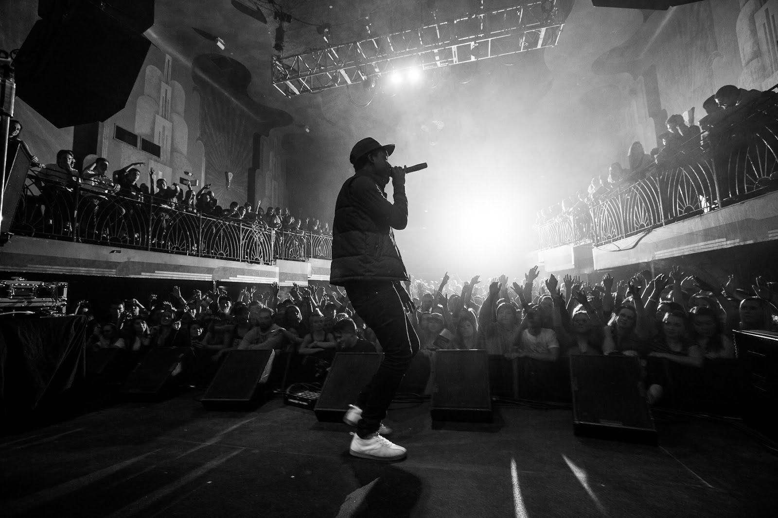
Notes:
Have the students all stood in the room (if space allows)
Direct them to either the left of the right side of the room depending on the choice they make
Ideally discuss the different choices with the students – helps to build the engagement and gives the deliverer some background knowledge of the students

Slide 5
Notes:
Have the students all stood in the room (if space allows)
Direct them to either the left of the right side of the room depending on the choice they make
Ideally discuss the different choices with the students – helps to build the engagement and gives the deliverer some background knowledge of the students

Slide 6
Notes:
Have the students all stood in the room (if space allows)
Direct them to either the left of the right side of the room depending on the choice they make
Ideally discuss the different choices with the students – helps to build the engagement and gives the deliverer some background knowledge of the students

Slide 7
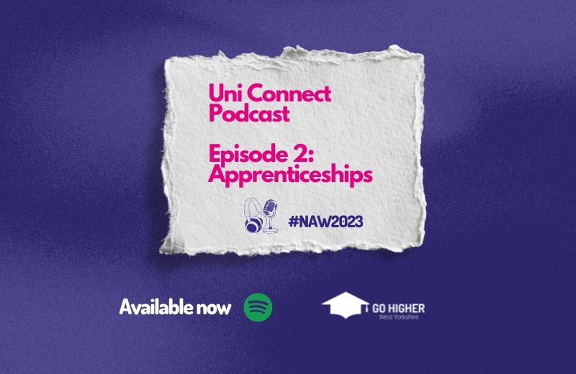
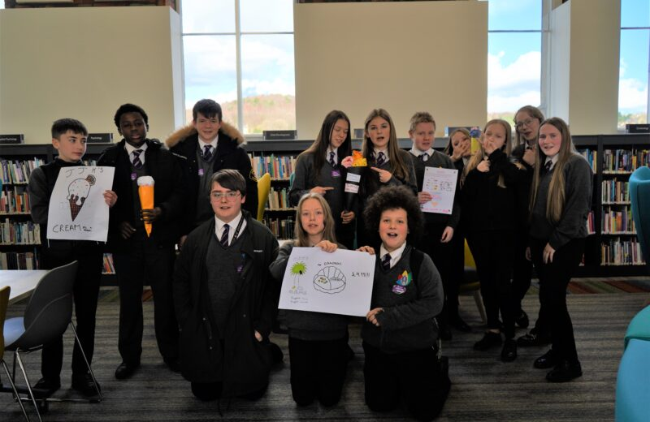
Who are Go Higher West Yorkshire
Go Higher West Yorkshire (GHWY) created these sessions.
GHWY, we bring together the thirteen Higher Education providers in West Yorkshire.
We have members of staff at each institution, providing a central place to find information, and providing help with accessing and preparing for Higher Education.
You might find us in a school or college, online or at a local community event.

Slide 8
Speak Up, Your Voice Matters
This programme has been created and designed by GHWY, for male learners across West Yorkshire.
There will be 3 sessions, and we’re going to be developing some key skills in the process. We will think about:
Who you are, what interests you and what you would like to do in the future?
What options you have and what Further and Higher Education mean
Notes:
Intro to programme

Slide 9
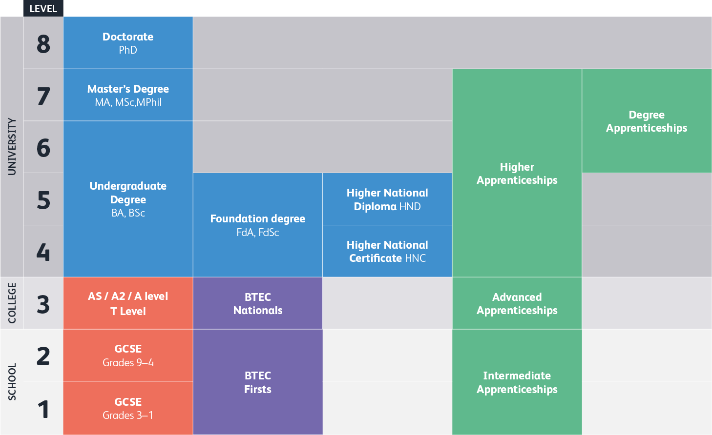
Notes:
(Put this wherever it makes most sense)

Slide 10
Further Education (FE) – at a glance
What is FE:
The next step after secondary school (usually between the ages of 16-18).
What can you study:
A Level: You'll usually study at least 3 subjects in one go, and these can range from Maths and English Literature to Film Studies, Politics, Psychology and Sports Science. They usually take 2 years to complete, and are assessed via a series of exams and/or coursework.
BTEC: These are slightly different in that theory is combined with regular practical work so you can directly apply what you learn. At Level 3, there any many options, including law, childcare; construction; health and social care, and sport. They are assessed via regular coursework and projects throughout the course, as well as some externally-marked tests.
Apprenticeships and T-Levels (more on these two later…)
Notes:
FE signposting (Y10)
If you struggle in exam conditions, Btecs can relieve this pressure by spreading out the work that makes your final grade. In previous years, some students doubted Btecs because of their more vocational and less academic nature. But this narrative has shifted, as more and more young people see Btecs as the right fit for their interests and aspirations. As a result, universities have adapted their entry requirements and will widely communicate Btec requirements alongside those for A-levels.

Slide 11
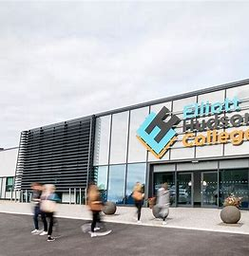
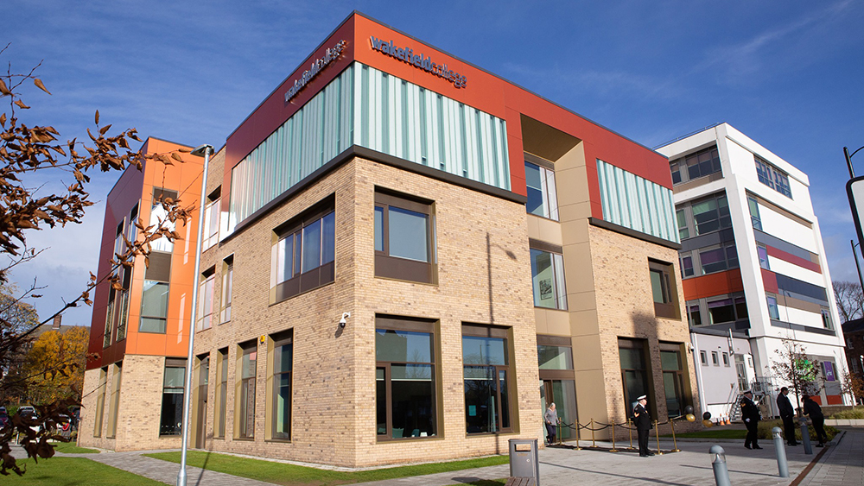
Further Education – at a glance
Where can you study:
Sixth Form College; most offer A Levels and some vocational qualifications too. Some are independent, some are attached to schools.
FE College; some offer A Levels but focus on a wide range of vocational qualifications in different subjects.
Notes:
FE signposting (Y10) Give local examples?

Slide 12
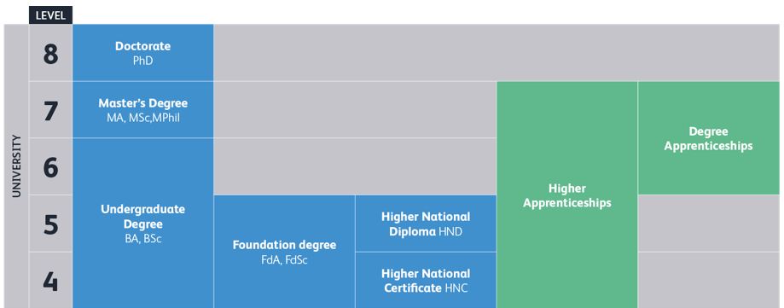
Higher Education – at a glance
What is HE:
Higher Education is the optional, final stage of formal education
What can you study:
There are 100s of courses to choose from, from subjects you may already have studied like Maths and English, to something completely new like Animal Behaviour and Welfare and 2D Animation.
Where can you study:
You can search and apply for most HE courses online.
You usually have to be 18 or older to take a higher education course. They’re usually taught in: universities, colleges, specialist institutions like art schools or agricultural colleges.
Notes:
HE signposting (Y10) Not sure what else to add…

Slide 13
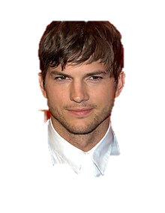
Higher Education – at a glance, how to get there
Degree in Biochemical Engineering at Uni of Iowa
Degree in Economics at University of the West of England
Alton College: Business, English Language, Computing, Media Studies
Washington High School
Perins School
Notes:
HE signposting (Y10) Use OO’s as other examples to show diversity of pathways?

Slide 14
Higher Education – at a glance
How to get there…
Degree in Economic at University of the West of England
Alton College: Business, English Language, Computing, Media Studies
Perins School
Notes:
HE signposting (Y10) Use OO’s as other examples to show diversity of pathways?

Slide 15
Current/Future Self Photography Project
A reflective exercise at who we are as people and what we want our futures to look like.
We’ll take two selfies and use them to build a picture that can help us understand more about ourselves and where we want to end up.
The pictures need to look different
Notes:
The aim of this project is to look at ourselves now, and start to think about what we might look like in the future.

Slide 16
Current Self
This picture has to represent you as you are NOW
Get in Pairs
Try to find a plain background

Slide 17
Future Self
This picture has to represent you as you see yourself in the future
Same rules apply!

Slide 18
That’s a wrap!
What we'll be doing next time:
Discovering Apprenticeships
Revealing the photos
Making our current-self word cloud

