Slide 1
Speak Up, Your Voice Matters
Session 3

Slide 2
Session 3 – Human Bingo
Fill in the boxes with different statements, achievements, or skills a person might have
You then have 3 minutes to go round the room and find someone that fits each of your statements
The first person to fill in a whole line wins
Ideas for bingo statements
Has xxx pets
Can play an instrument/ makes music
Has a brother/sister
Lives in xxx
Is good at xxx
Likes listening to xxx
Likes playing xxx
Favourite teacher is xxx
Notes:
Ice breaker

Slide 3
Recap – Session 2
Apprenticeships
Selfie
Current self
Word cloud
Notes:
Image?

Slide 4
T-Levels – At a glance
Growing each year:
Since the beginning of 2020 more that 20 T-Level qualifications have been introduced
A great balance:
80% of time in the Classroom, 20% of the time completing a 45 day work placement
Relevant skills:
Gives a potential advantage over others who have studied at A-Level that might be applying for similar jobs
High Pass Rate:
In 2024 91% of students achieved a 'pass' or above
Limited:
Not all subjects are available to study.
A great balance:
A T-Level qualification is equivalent to 3 A-Levels and can lead to a place a University.
Notes:
Year 8 & 10

Slide 5
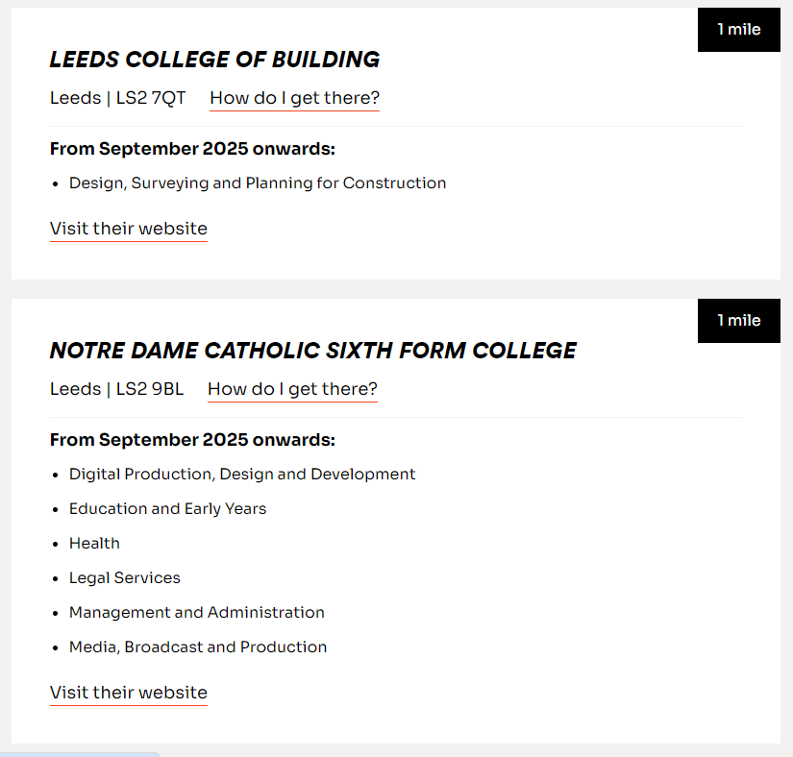
T-Levels – Starting Point
tlevels.gov.uk
Enter your postcode
This will show you all of the local collages or University centres that offer T-Levels
Select your choice and it will take you to the relevant website for the provider
Applications for the course can then be made
Notes:
Year 10

Slide 6
Future Self wordcloud
This is similar to the previous wordcloud, but now you are going to use the information on next steps from each session
Think about which paths you are interested in taking, or even just knowing more about; consider what steps you would need to take to get there
Using the one-pagers on your desks, come up with some statements about what you will do to start your journey to achieve those next steps

Slide 7
Future Self
Can I do an apprenticeship in a school?
What other jobs in schools are there?
Can I teach without a degree?
A-Levels???
Do I need a degree?
I’m going to search for Jobs in teaching
How much will I get paid?
How many GCSEs do I need to attend college?
Where is my local college?
What are T-Levels

Slide 8
Future Self
Can I do an apprenticeship in a school?
Do I need a degree?
What other jobs in schools are there?
What are T-Levels
Where is my local college?
Can I teach without a degree?
I’m going to search for Jobs in teaching
A-Levels???
How much will I get paid?
How many GCSEs do I need to attend college?
Notes:
Come up with my own?

Slide 9
Over to you!
Look at the sheets provided which discuss the types of future pathways you could choose
What questions do you have for your future self
Feel free to write down and ideas that you have
This can include, what you want to study – where you want to study – why you want to do a certain job/course
You can use interesting design/ colours

Slide 10
That’s a wrap!
Summary…
What have we learned over the sessions?
Courses/FE/HE
Where we are now
What we need to find out
Next steps- think about how you can get closer to your future self- what you need to do

