Slide 1
Go Higher Presents- What’s HE to me?
Notes:
Explain who GHWY UC are

Slide 2
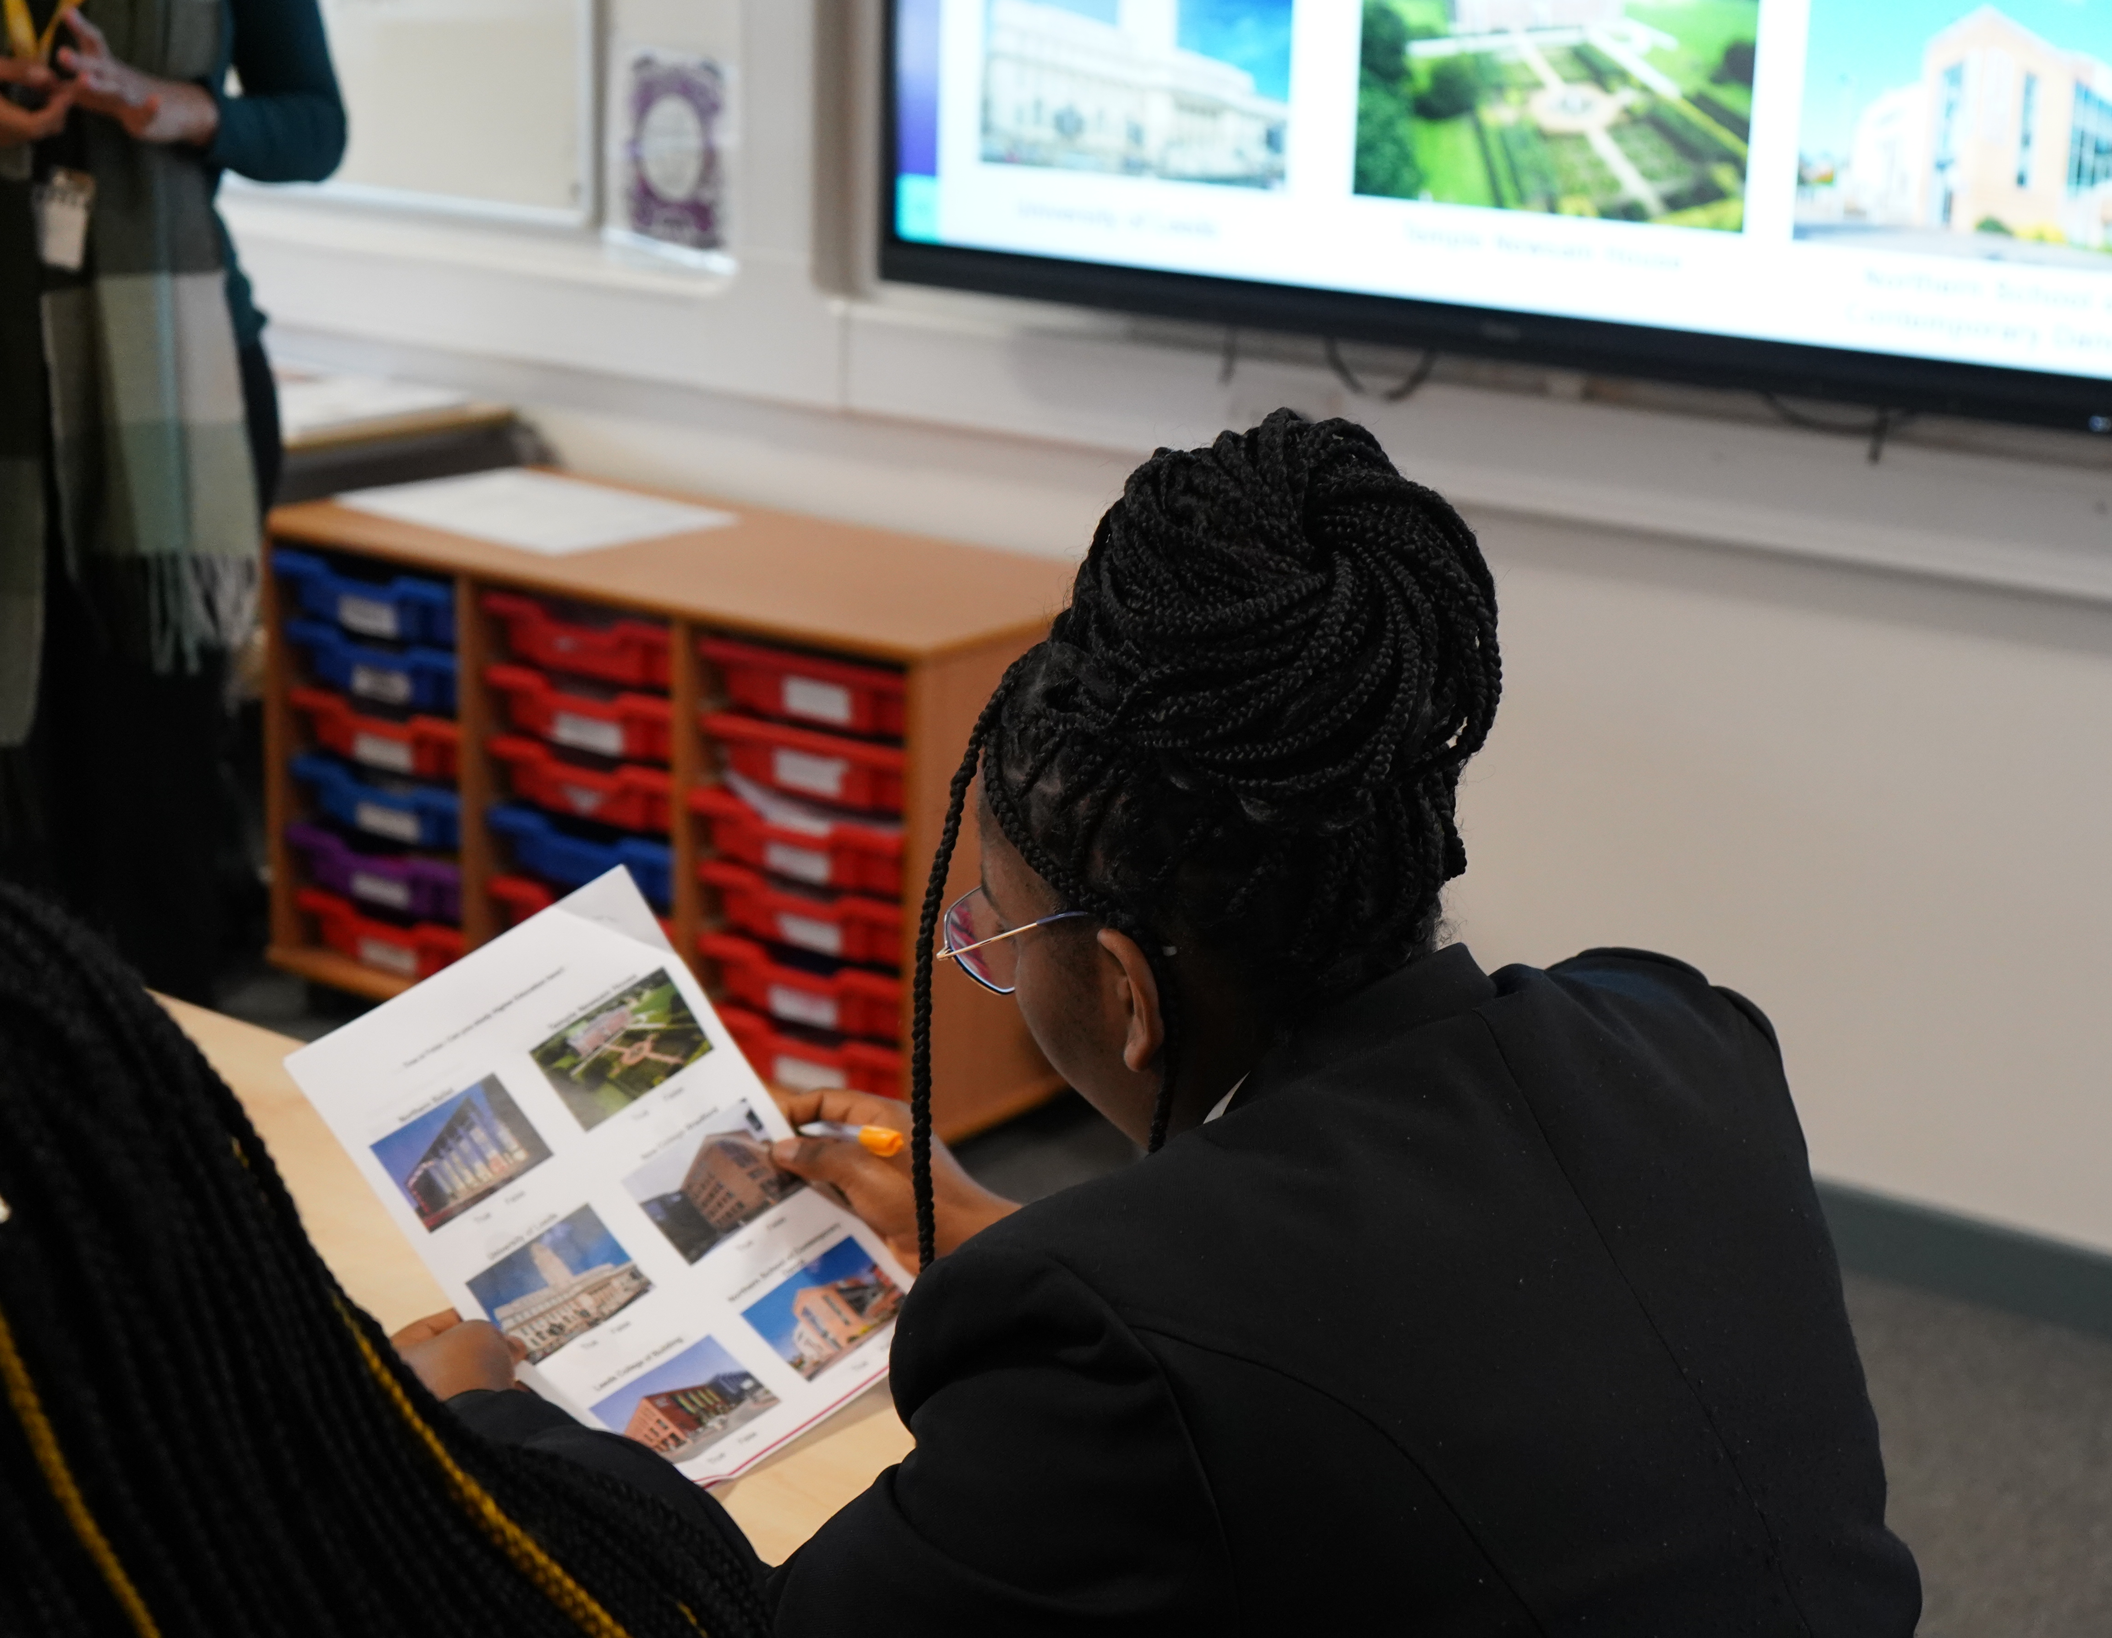
Session 1

Slide 3
Why are we doing this?
Black, Asian and Minoritised ethnic learners are:
We know that society isn’t fair. Learners from certain backgrounds are unable to progress on their educational journey to reach their potential for many reasons.
We want to know your thoughts and feelings about this, and if you could what message would you give to Higher Education providers about what you need and want from HE?
Less likely to be offered a place at a uni even if they have the correct grades
Less likely to be achieve a higher outcome in their degree (2:1 and above)
Less likely to complete their degree once at university

Slide 4
Aims of What is HE to me?
To understand key issues in relation to ethnicity/ cultural background
To be able to understand more about your identity
To learn about what Higher Education is
To understand how identity relates to Higher Education
By the end of the project you will have made a podcast called ‘What is HE to me’ sharing what you have learned

Slide 5
In this session we will
Get to know one another
Understand the aims of the project
Think about key topics and issues around race, identity and ethnicity in relation to education
Consider your own characteristics of your identity
Notes:
Do icebreaker- I am but I am not

Slide 6
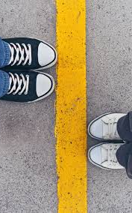
Boundaries
We will be expressing our personal opinions and sharing our experiences.
We want this to feel safe so we will create our ‘rules’ for the sessions together now.
Taken from mindful.org
Notes:
Add here and save, or save on to flipchart paper and bring to all sessions

Slide 7
Glossary and workbook
Let’s think about some important words for today
Bias
Identity
Culture
Race
Power
Representation
HE
There is a glossary in your workbook
Use your workbook to record your thoughts and learning
Notes:
Work in pairs to define these words

Slide 8
Gallery Walk
Spend some time looking at the posters
Use your post it notes to record your thoughts about them.
Notes:
break

Slide 9
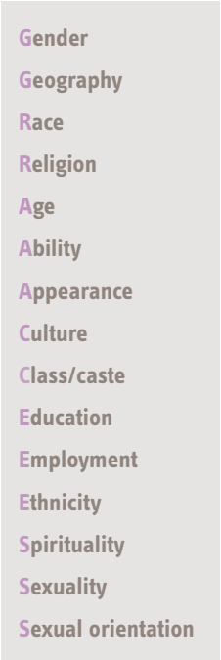
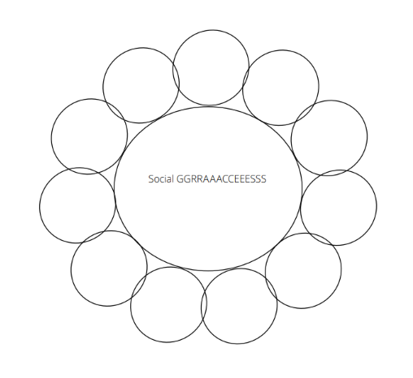
Social GGRRAAACCEESSS framework
Academics developed this framework to help individuals explore issues of social difference, power, diversity and bias
Use the framework to make notes about yourself in your workbook.
Taken from https://practice-supervisors.rip.org.uk/wp-content/uploads/2019/11/Social-GGRRAAACCEEESSS-and-the-LUUUTT-model.pdf

Slide 10
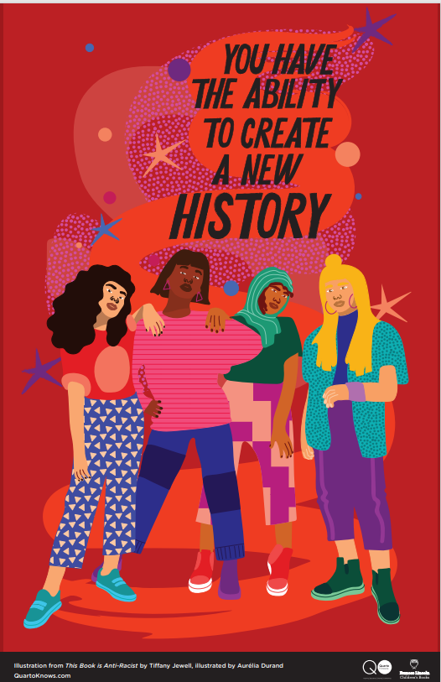
Next Session
We will think about who we are, and how that relates to how we make choices
We will learn more about Higher Education
Notes:
Take in work books

