Slide 1
Go Higher Presents… Faye

Slide 2
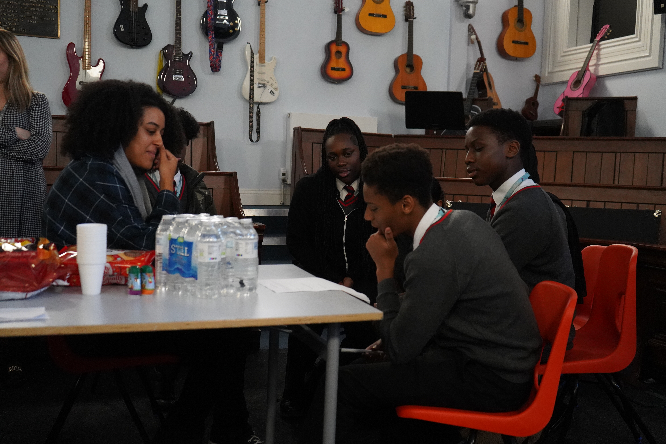
In this session we will:
Learn about what Higher Education (HE) is
Listen to a podcast and think about what an HE student says about their experiences
Review our HE knowledge with a quiz
Notes:
We will listen to three podcasts over the three sessions as part of this project, all of them have been recorded between learners and students who are from global majority, or black, Asian and Minoritised ethnic backgrounds. The learners wrote the questions themselves and produced the podcasts. We did this because we know that role models and ‘safe conversations’ are helpful for learners from BAME to make choices about their future. We hope they are useful for you!

Slide 3
Activity 1: Higher Education Brainstorm

Slide 4
Activity 1- What is Higher Education?
How old will you be when you progress to HE?
What do you know about HE?
Try answering these questions with a partner….
Which careers can HE lead on to?
Why would people study HE?
Do you know anybody who has studied at HE?
Notes:
Try answering these questions- don’t worry if you are not too sure, just give it a go!!

Slide 5
Higher Education Introduction

Slide 6
Higher Education
Higher education is the name for qualifications and courses you can take after 18. It includes diplomas, foundation years, bachelor degrees and more.
Higher education is Level 4 education and takes place after you leave school or college
There are lots of different places you can study higher education including at universities, further education colleges, university centres and specialist providers.
Often referred to as HE
Notes:
There are HE providers all over the country. Some people choose to go to a HE provider near to home whereas others move far away to study.

Slide 7
What will you learn?
At school you have lots of compulsory subjects, some you might not particularly enjoy.
At HE, you can make an active choice of what you want to study and specialise
Some courses allow you to choose from a number of different modules
Did you know you have approximately 50,000 courses to choose from in HE?
Notes:
This specialisation can help you to get the skills and knowledge to get a career

Slide 8
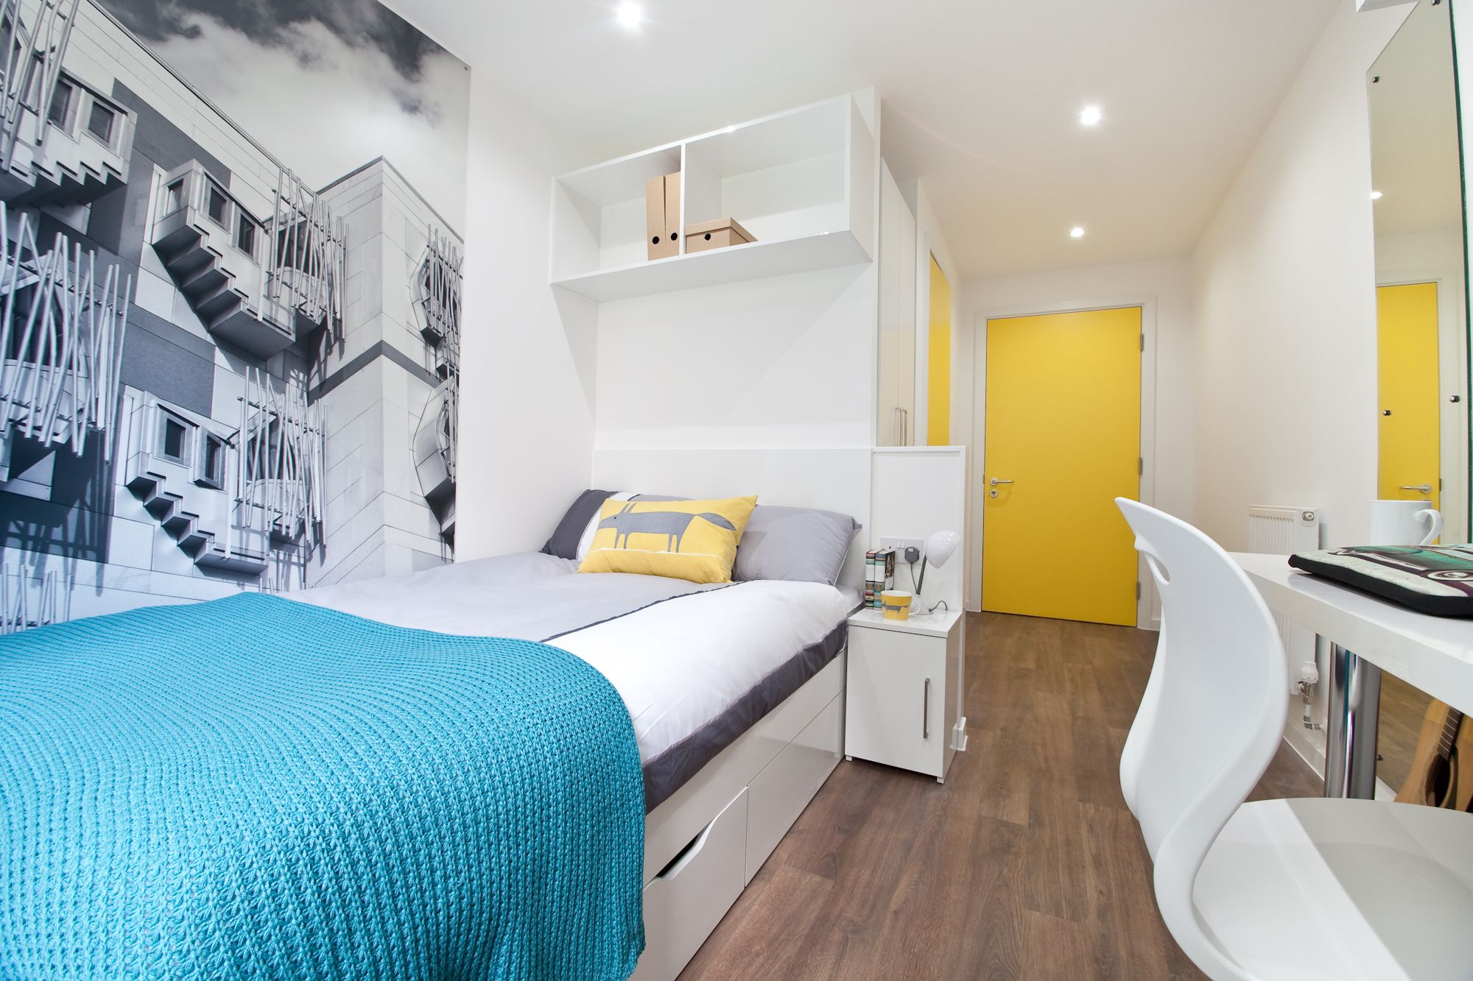
Where will you live?
At home
Benefits
Being close to family
Different financial considerations
Part-time job at home
At Higher Education accommodation
You’ll always have company
You might be on the same course and can work together
You can explore a new city
Maybe even share the washing up

Slide 9
What about hobbies?
Societies and Clubs
Bollywood dance
Film making
Quidditch Society
Improvisational theatre
Mario Kart Society
Public Speaking
Kpop
Plus, if there isn’t a club or society for your interest, you can create one! All you need is a few like-minded people
Notes:
There will also be faith centres and sports opportunities, well-being activities, mentoring and buddy schemes.

Slide 10
Activity 2: Podcast

Slide 11
Who’s in the podcast?
Faye, 3rd Year Landscape Architecture Student
Originally from Bristol
From an African family
Studying at Leeds Beckett University

Slide 12
Activity 2- Podcast
1. What made Faye choose the course which she studies?
2. What has Faye’s journey been from year 10 to now?
3. When she is at Uni does she have any hobbies?
4. Who did Faye live with at Uni?
Your turn
Listen to the podcast with Faye, each time the teacher stops the podcast, discuss the questions with a partner

Slide 13
Activity 2- Podcast continued
5. Did she miss her parents?
6. How was uni for Faye?
7. If she could ask year 10 Faye anything, what would it be?
8. What do you think about their discussion?
Notes:
At the end have a reflective conversation with the group about what they have learned.

Slide 14
Activity 3: Higher Education Quiz

Slide 15
How many HE courses are there in the UK?
a) 20,000
50,000
b) 100,000
100,000
c) 50,000
Notes:
Answer will turn pink if you click the next button – c) 50,000

Slide 16
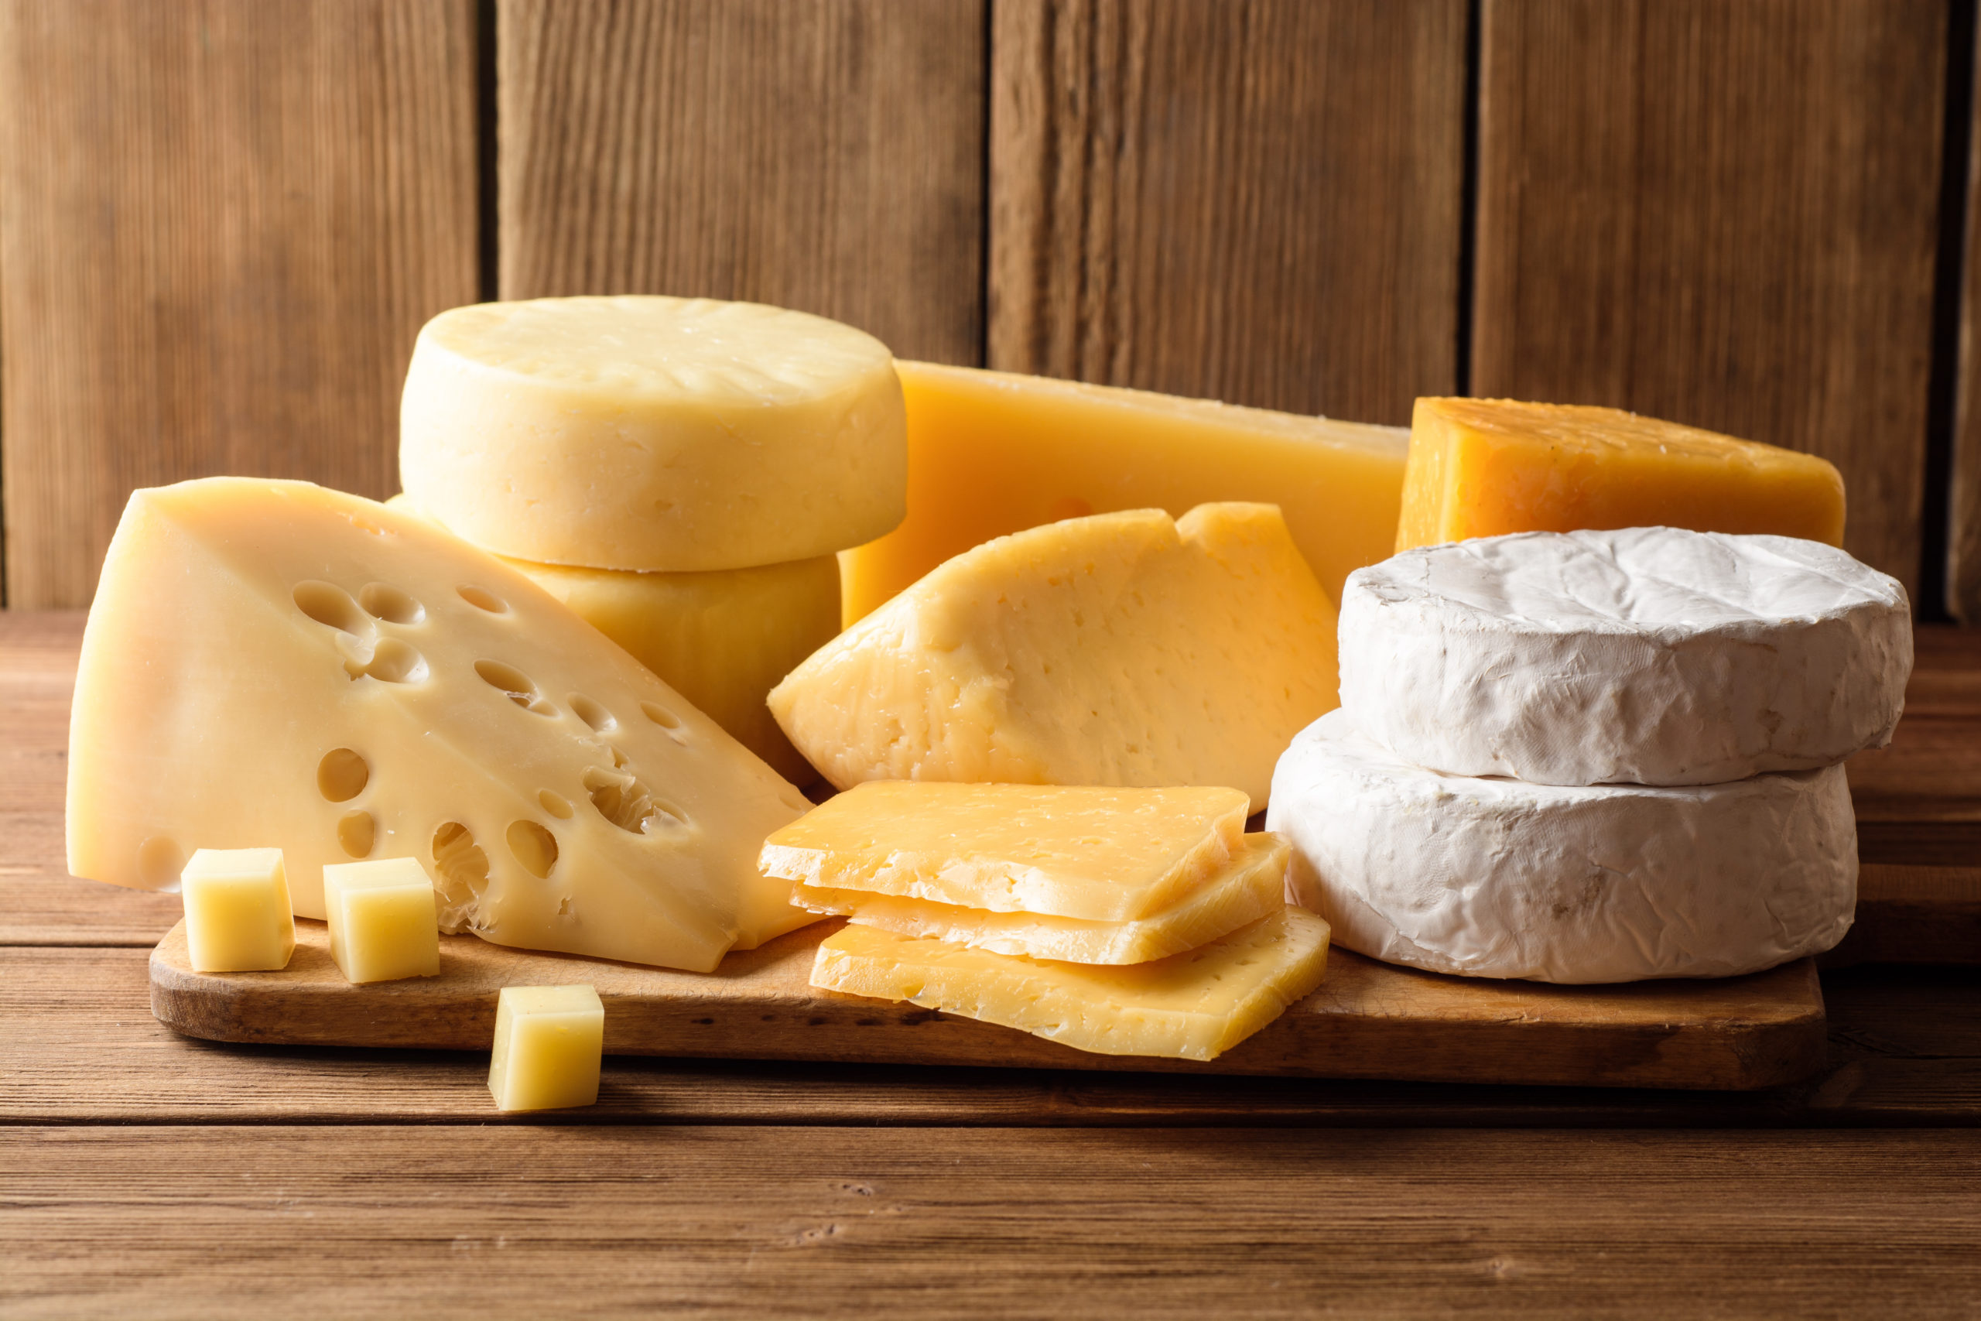
Which of these is NOT a society at Leeds Beckett University?
a) African Caribbean Society (ACS)
b) Cheese Society
c) Hacking Society
Notes:
Answer will turn pink if you click the next button – b) Cheese Society

Slide 17
How many students were studying in the UK in 21/22?
Over 1 million
b) Over 2 million
c) Over 3 million
Notes:
Answer will turn pink if you click the next button – b) Over 2 Million

Slide 18
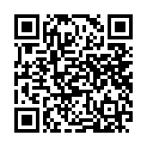
Next steps
In our next session we will be thinking more about Higher Education and meeting a new ambassador!
If you want to find out more about HE in the meantime, you can listen to our other podcasts about HE here
https://gohigherwestyorks.ac.uk/resource/uni-connect-podcast/
Scan to listen to more GHWY HE podcasts

