Slide 1
Go Higher Presents Linda-Ray

Slide 2
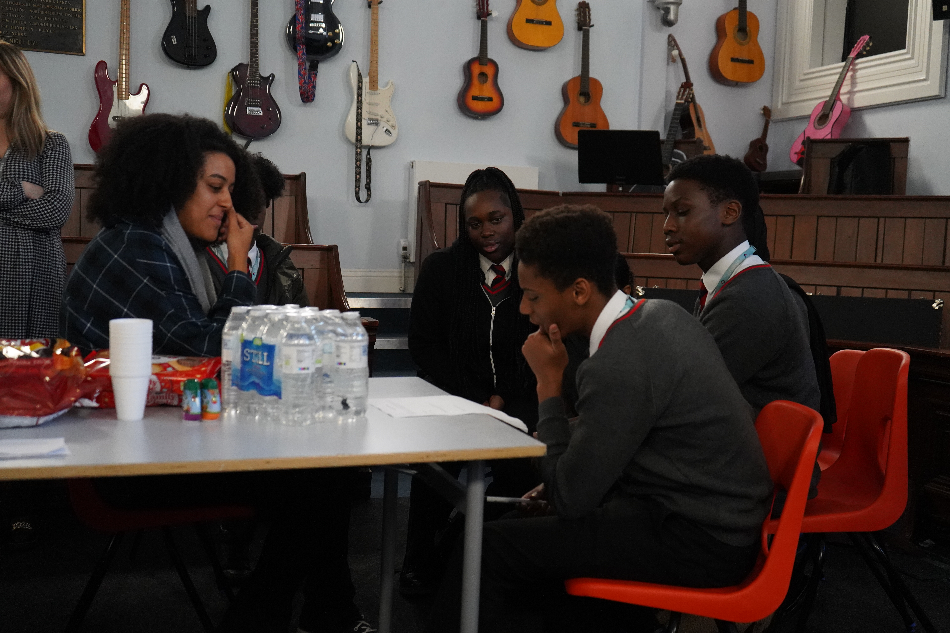
In this session we will:
Reflect about ourselves- interests, skills and ambitions
Listen to and think about what a HE student says about their experiences
Create an action plan about educational next steps

Slide 3
Activity 1- Self reflection
What does self-reflection mean to you?

Slide 4
Activity 1 – What makes you, you?
Think about the things that make up your personality, what interests you, what are you good at and what matters to you.
Jot down a few ideas to start with.
Think about your:
Hobbies
Interests
Goals
Aspirations
Skills
Priorities
Experiences
Interests

Slide 5
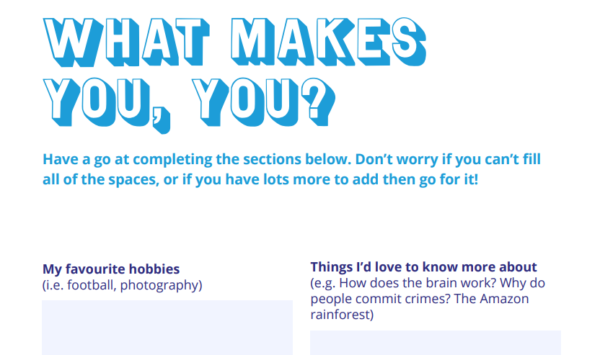
Activity 1- Self reflection
It is useful to know more about yourself before you think about decisions for the future
Chat with a partner, but write about yourself on the ‘what makes you, you’ worksheets
Notes:
Feedback to the whole group.
Pages 16-17

Slide 6
Who’s in the podcast?
Linda-ray Ndlovu
(Image courtesy of YEP)

Slide 7
Activity 2- Podcast
What is Linda-Ray learning at HE? Think of 3 things
What inspired her to study this?
What did Linda-Ray explain about her background?
Your turn
Listen to the podcast, each time the teacher stops the podcast, discuss the questions with a partner

Slide 8
Activity 2- Podcast continued
4. How did moving around help Linda-Ray become the person she is today?
5. Why did you think playing sports helped her?
6. How did she describe her music?
7. What advice did Linda-Ray give?
Notes:
At the end have a reflective conversation with the group about what they have learned ( see delivery notes)

Slide 9
Mind mapping
1. What is important to you on this journey
2. Who should you talk to?
4. Anything you’re unsure of?
3. What do you need to do next?

Slide 10
The STAR method
The STAR method is a useful tool to help you set and manage your goals
Specific.
Make it simple and focused
Time-bound
When will you do it by?
Attainable
Is it realistic?
Relevant
What is the point of your goal?

Slide 11
Activity 3- HE Action Planning
Use the worksheets to do this thinking and set yourself goals
Notes:
Use pages 16 and 17 from shaping your future workbook worksheets

Slide 12
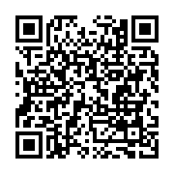
Next steps
Use more of the activities from the Shaping your Future Workbook, which you can download for free using the QR Code
Ask others what they studied and how they got the jobs they did- friends, family, teachers
Keep looking for other opportunities to build your skills and trying new things out.
Thank you!
You can download the Shaping your future workbook here

