Slide 1
GHWY Resources for Underrepresented Groups
Jenny Scannell

Slide 2
GHWY CPD: Changes to Personal Statements 25/26 Webinar
Access the webinar using the following link
Changes to UCAS Personal Statements (academic year 25-26) - Go Higher West Yorkshire
Advancing Access led a CPD session on the recent personal statement reform, outlining the new process and offering expert guidance.
This webinar recording is ideal for professionals assisting post-16 learners with higher education applications in the UK.

Slide 3
GHWY CPD: Upcoming sessions related to UCAS
Sign up here
https://gohigherwestyorks.ac.uk/resources/teachers-carers-advisors/cpd/
24th June Understanding the UCAS Clearing Process
2nd July Spotlight on Access to HE and Foundation Year Courses

Slide 4
Degree and Higher Level Apprenticeships
Go Higher in Apprenticeships Resource
A learners’ guide to understanding and accessing higher-level and degree apprenticeships
Step by step application advice
Useful signposting
Download here:
https://gohigherwestyorks.ac.uk/resources/teachers-carers-advisors/go-higher-in-apprenticeships/

Slide 5
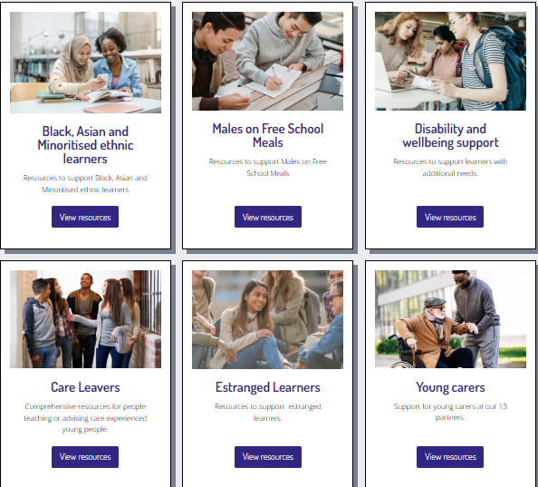
Underrepresented Groups Website Area
Aims to aid signposting to collated resources for specific under-represented groups
Previously resources in different areas of our website e.g. podcast, CPD, e-learning etc.
Now in one area

Slide 6
Disabled Learners Transition Pack
Collaborative output – input from Disabled Students Network​
Student voice is important​
Generic content: HE pathway, mythbusting, accommodation​
Specific content: Disabled Students Allowance, charities etc.​
Download here: https://gohigherwestyorks.ac.uk/resources/teachers-carers-advisors/underrepresented-groups/disability-and-wellbeing-support/

Slide 7
Care- Experienced Learners Transition Pack
Collaborative output – input from Care Experienced Students Network​ and Inspiring Choices Uni Connect
Student voice is important​
Generic content: HE pathway and mythbusting
Specific content: Named contacts, accommodation, care leaver covenant
Download here:
https://gohigherwestyorks.ac.uk/resources/teachers-carers-advisors/underrepresented-groups/care-leavers/

Slide 8
KS3-5 learning resources
Download Black, Asian and minoritised ethnic resources
https://gohigherwestyorks.ac.uk/resources/teachers-carers-advisors/underrepresented-groups/black-asian-and-minoritised-ethnic-learners/
Sustained programme focuses on:
working with learners to articulate their personal values
understand others’ influences on their decision making
identifying their own skills and strengths
develop a sense of belonging in HE through creative activity, building trust and working with role models
Resources for Males on Free School Meals AND Black, Asian and Minoritised Ethnic Learners
The sessions, are designed so they can be delivered independently by school and college staff.
Download Males on FSM Resources
https://gohigherwestyorks.ac.uk/resources/teachers-carers-advisors/underrepresented-groups/males-on-free-school-meals/

