Slide 1
Supporting Disabled Learners on their Higher Education journey
Carly Miller Disability Coordinator, University of Leeds
Please note information is accurate as of May 2025

Slide 2
Today’s Session
What do we mean by ‘Support Needs’
Documents and Paperwork
Support offered by Universities
Differences between School and University Support

Slide 3
School Terminology
SEND
Special Needs
Additional Needs
Support Needs
Special Educational Needs
SEN
Special Education Needs and Disabilities

Slide 4
University Terminology
Disability

Slide 5
What is a Disability?
The Equality Act 2010 defines a disability as a condition or impairment that:
has a significant impact on the ability to perform day to day tasks, which includes activities relating to education.
is long-term i.e. has lasted or is likely to last for 12 months or more.
For a student, 'normal day to day activities' might include taking notes, writing, researching, reading large amounts of text and moving between multiple locations.

Slide 6
Includes people who:
are D/deaf or hearing impaired
are blind or visually impaired
have a physical disability, and/or mobility difficulties
have a specific learning difficulty (for example, dyslexia or dyspraxia)
have a neurodevelopmental condition (for example, AD(H)D)
have a neurological condition (for example, MS, epilepsy, Tourette Syndrome, stammer)
are autistic
have a mental health condition
have a long-term medical condition (e.g. chronic fatigue syndrome, asthma, diabetes, cancer, HIV)
have a combination of these

Slide 7
You are not alone!
Every year, over 100,000 disabled students apply through UCAS to study at a university or college in the UK
It is estimated that 24% of the UK population is disabled
At the University of Leeds there are over 9000 students who have shared that they are disabled

Slide 8
Things to think about:
Some useful questions to think about:​
Are they on medication for a health issue?​
Do they have specific learning needs e.g. dyslexia?​
Have they been diagnosed with a medical condition?​
If the answer is yes to then we recommend they contact Disability Services at the relevant universities to discuss further. ​

Slide 9
How are disabled students identified?
UCAS Application
Online registration with University
Contacting Disability Team directly
Referral from other University departments
At university students are responsible for completing the process themselves.
None of the information about a student’s support or adjustments at school will automatically transfer to university.
At University of Leeds students can register with Disability Services at any point in their degree but to get the right support at the right time we recommend they disclose at application stage. If a student was concerned about how this information might be shared it is fine to contact the relevant universities for reassurance.

Slide 10
UCAS
If an applicant ticks the box on the UCAS form this will likely activate university processes.
At the University of Leeds this means we will send them useful information on how to register with our service.

Slide 11
Parents / Guardians
Due to data protection regulations (UK-GDPR), universities cannot legally discuss students or aspects of their support with family members or supporters.
Family members or supporters cannot arrange support for students, although they may be able to help them to complete forms and access the process.

Slide 12
Supporting Information
Different universities have different processes regarding “evidence” requirements
Students may need to provide a letter from their doctor, consultant or other medical practitioners. They may not have needed to provide this at school to receive support.

Slide 13
Supporting information ideally should be
be on official headed paper
be as up to date as possible
give a clear clinical diagnosis of a disability that is likely to affect ability to do every day, or academic, tasks
clearly state that your disability is long-term (e.g. has lasted for, or is likely to last for at least 12 months)
indicate the impact disability has on daily life and/or studies
be written in English

Slide 14
Form 8
Applicants may have Form 8 assessment for exam arrangements at school (such as extra time).
A Form 8 assessment might be completed if a pupil has difficulties with processing text, handwriting or reading speed that the school or college thinks might be related to a specific learning difficulty (e.g. dyslexia; dyspraxia).
At the University of Leeds we will accept Form 8s for exam arrangements but we do not put full recommendations in place as it does not confirm disability.

Slide 15
Why sign up?
At the University of Leeds -
If the applicant registers we will create a Support Summary Sheet for them which includes a list of recommended teaching and learning support, and create exam arrangements for them.
The applicant may not end up attending the University but we know how important having support in place at the beginning of their studies is.
Applicants may think they do not need support, or feel they are not ‘disabled enough’ to deserve this. It is really important the significant differences between school and university are considered, and that people are reassured that accessing support for themselves does not remove it from someone else.

Slide 16
Support
Common Adjustments at the University of Leeds include:
Additional guidance
Directed reading lists
Attendance flexibility
Submission flexibility
Access to Lecture Capture / Permission to Record
Lecture materials in advance

Slide 17
Exam Arrangements
Universities are able to offer a wider range of exam arrangements. Sometimes this can be confusing for students who are used to having, for example, extra time when they would benefit more from rest breaks and no exams before 10am.
Exam arrangements can include:
Extra time
Rest breaks
Permission to leave the room
Room number limit

Slide 18
Disabled Students’ Allowance (DSA)
If applicants are entitled to support from Student Finance, they should apply for DSA. They should do this even if they will not taking out a maintenance or tuition fee loan.
DSA a grant which is provided by the government to pay for any additional study-related costs you may have as a direct result of your disability.
It is not a loan and it is not means-tested.

Slide 19
Disabled Students’ Allowance (DSA) continued
Depending on need it can cover the cost of:
Specialist equipment and software
One-to-one support from a specialist support worker,
A travel allowance to help with any extra travel costs you may have to attend your university, college, or placement because of your disability.
Support with additional study-related costs such as photocopying or printing materials.

Slide 20
When to Apply
Completing the DSA process can take up to 15 weeks at busy times, so it is important that applicants apply early to make sure their support is in place when they start university. You can usually apply for DSA from the March in the year that you are due to commence your studies.
Applicants do not need to know which University they will be attending at this time.

Slide 21
DSA process
Complete an application form and supply evidence (see slide 27 for key links).
Eligibility will be assessed and confirmed.
Undertake a Study Needs Assessment which will make recommendations for equipment, support and adjustments.
Recommendations will be checked by Funding Body.
DSA will then send an ‘entitlement letter’ to the applicant / student which confirms what support will be in place.
Applicant / student will need to follow the steps in the letter for support to be in place.

Slide 22
Not eligible for DSA
If you work with / know anyone who is not eligible for Student Finance funding they should contact Disability Services at the universities they are applying to and ask if there are any alternative options for them.

Slide 23
Personal and Social Care
Universities are not able to provide social or personal care support. If students have received this support during their time at school or college, it is important that they talk with their Local Authority and/or adult social services department to investigate how this support will be transferred to assist them at university.
It is also important, where possible, for students to consider the informal support they receive from family or school staff that would not be replicated at university and may need a more formal solution.

Slide 24
Key Actions
Students should
Register with disability services at the university / universities they are considering attending
Apply for DSA as soon as possible, even if they are unsure which university they will be attending
Think about whether they will need personal / social care support whilst at university
Contact Disability Services at any of their chosen universities if they are unsure about anything

Slide 25
Useful Links – University of Leeds
Support for disabled students
Setting up your support
Contact details
Email: disability@leeds.ac.uk
Phone: 0113 343 3927
Disability Services Reception open 9am-5pm Monday-Friday

Slide 26
Useful Links – General
Disability at University: guidance and a glossary of terms - Harriet Cannon and NADP (2021)
UCAS Guide for Disabled Students
OIA Guidance on Supporting Disabled Students
Go Higher West Yorkshire Disabled Learners Transition Pack

Slide 27
Useful Links - DSA
England Student Finance DSA Information
Agency Scotland DSA Information
Wales Student Finance DSA Information
Student Finance Northern Ireland DSA Information
NHS Bursary Students DSA

Slide 28
GHWY disabled learners transition pack
Tahera Mayat (Collaborative Outreach Officer)

Slide 29
Rationale for Transition Pack
Lived experience of transition to Higher Education (HE) for disabled students
Support in Further Education not the same as in HE
Staff unsure how to support disabled students in HE
Parents/carers may not know how to navigate their child becoming an adult

Slide 30
Content for Transition Pack
Collaborative output – input from Disabled Students Network
Student voice is important
Generic content: HE pathway, mythbusting, accommodation
Specific content: Disabled Students Allowance, charities etc.
Latest version of Transition Pack available to download here

Slide 31
Impact of Transition Pack
Featured on Local Offer websites for a few Local Authorities
DANCOP (Derbyshire and Nottinghamshire Collaborative Outreach Partnership) created a local copy
Presented at 7th Biennial International Conference on Access, Participation and Success
Blog post on NEON website by GHWY Partnership Assistant
Evaluated via downloads and feedback from disabled students and staff supporting them

Slide 32
GHWY e-learning for HE staff to support disabled students
Susan Darlington (Partnership Assistant) & Tahera Mayat (Collaborative Outreach Officer)

Slide 33
Rationale
The e-learning is a 'follow on' from the Network's collaborative Disabled Learners Transition Pack
Agreed output from GHWY's Disabled Students Network
There is a recognised need to educate HE staff about how best to offer support to disabled learners
E-learning builds on success of GHWY's course for HE staff to support care-experienced and estranged students
Access our e-learning.

Slide 34
E-learning course content (1)
Course has eight modules:
Introduction to course: Including why all HE staff can benefit from disability awareness training
What do we mean by disability: Including Equality Act, examples of disability (neurodivergency, physical, mental), how it can affect learning
Transition from FE to HE: Drawing on Transition Pack to consider challenges and different use of language
Impact of disability on access and success: Including statistics about access, progression, success rates

Slide 35
E-learning course content (2)
Support from HE providers: Including reasonable adjustments, extra time requirements, software needs
How you as a HE staff member can help: Including signposting, inclusive curriculum design
Further information: Including links to relevant charities
About GHWY and references

Slide 36
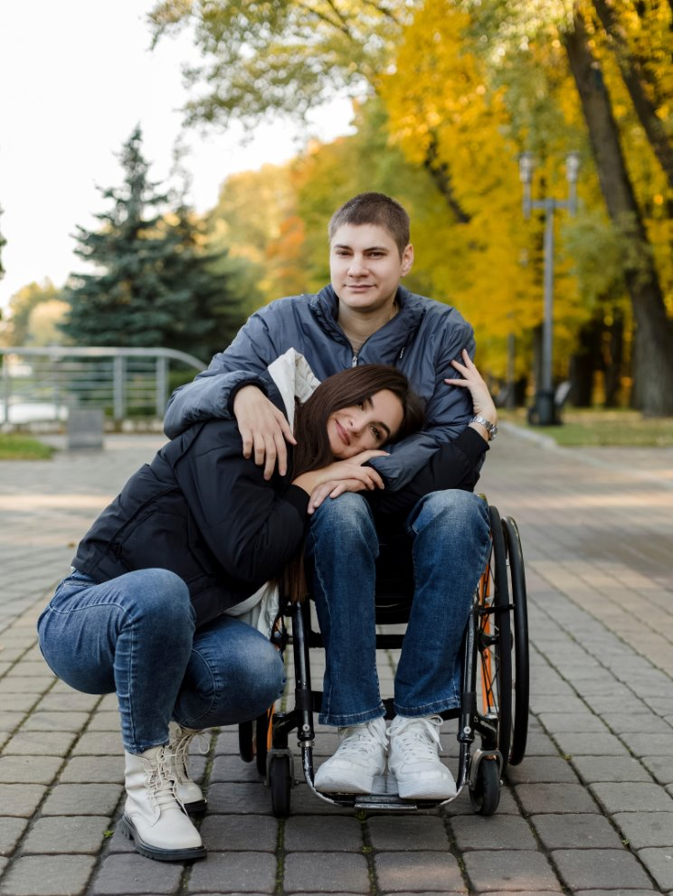
E-learning course
Use of student voice throughout with videos and quotes
Course free but participants need to enroll to access it, which allows us to gather data for evaluation purposes
Pre- and post-course evaluation survey
Course takes approximately 45 minutes to complete (does not have to be finished in one sitting)

Slide 37
Accessible design
Input received from Harriet Canon (Disability Services, University of Leeds)
Lessons learned from e-learning for HE staff to support care-experienced and estranged students:
Designed with accessibility in mind
Reduced number of mouse clicks needed to progress through course
Off-white background used throughout
Full course, including images, can be accessed by a screen reader

Slide 38
Example slide

Slide 39
Example of student voice

Slide 40
Evaluation
Course free but participants need to enroll to access it
This allows us to gather data for evaluation purposes
Pre- and post-course evaluation survey (non-mandatory)
Following the official launch in October 2024, 94 people have enrolled on the course
57 people have completed the course
On average taking around 36.5 minutes to complete

Slide 41
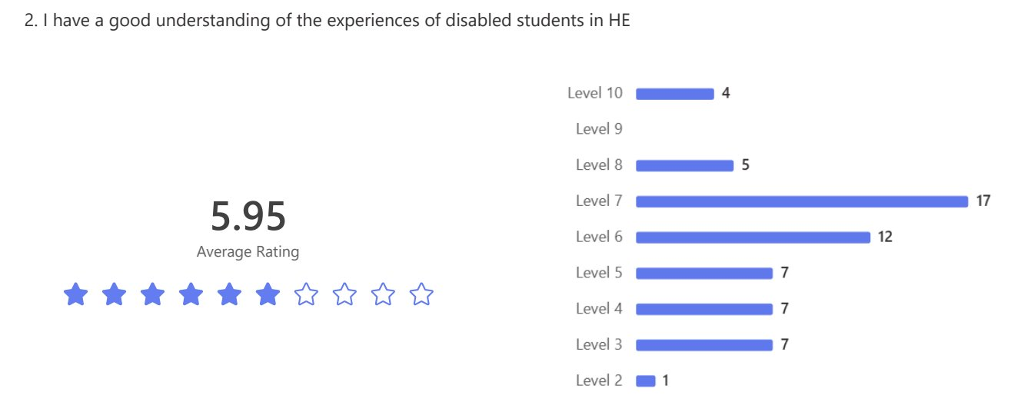
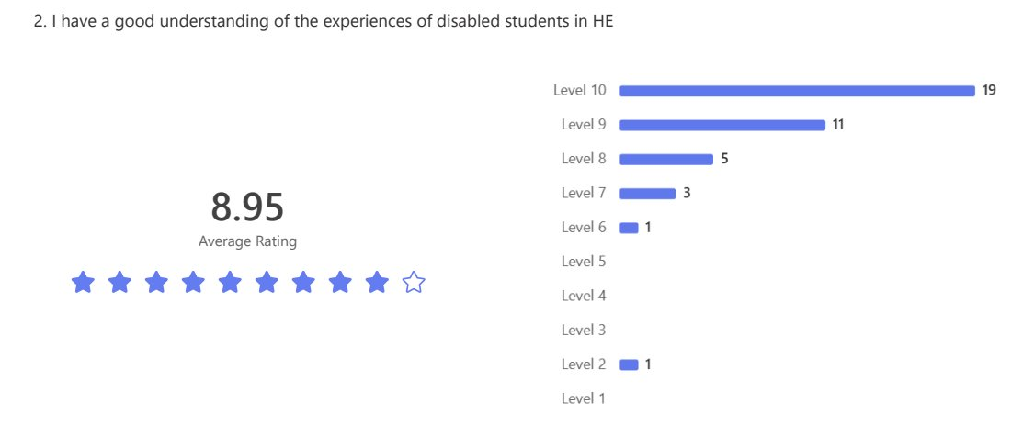
I have good understanding of the experiences of disabled students in HE

Slide 42
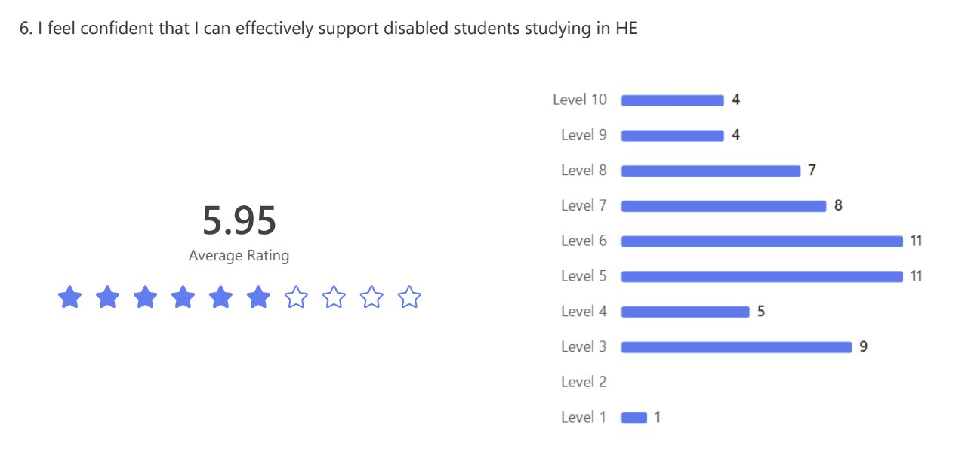
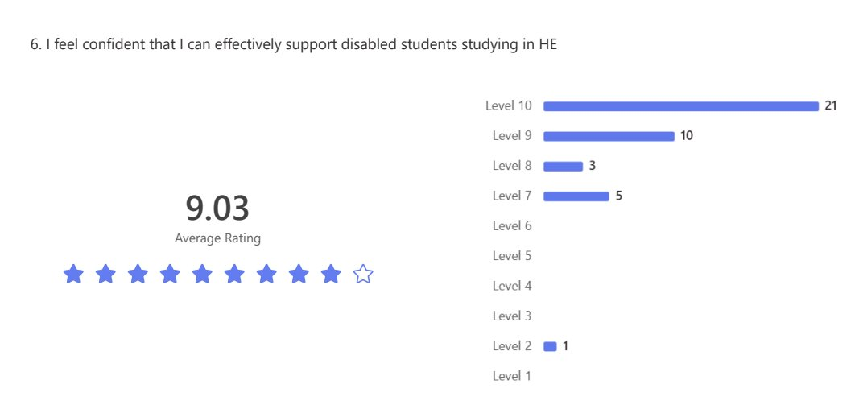
I feel confident that I can effectively support disabled students studying in HE

Slide 43
Qualitative feedback
"This was really helpful in understanding how to let the learner guide me when offering support."
"Very comprehensive and clear. Learned about several options that I can now bring into my work being an initial point of contact for students who may have additional needs."
"Excellent course. It was easy to follow and did not overwhelm me with complex information. I really liked the knowledge checks throughout."
"It is easy to schedule in your own time."

Slide 44
Impact
Presented at SHIFT online conference
Upcoming presentation at NEON Summer Conference at University of Salford
Blog featured on UCAS website
Evaluated via downloads and feedback
Will be updated annually to ensure sector updates and feedback are reflected

Slide 45
GHWY Under-represented Groups area of website
Tahera Mayat (Collaborative Outreach Officer)

Slide 46
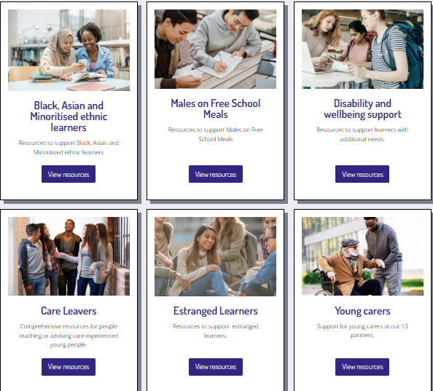
Rationale for website area
Aims to aid signposting to collated resources for specific under-represented groups
Previously resources in different areas of our website e.g. podcast, CPD, e-learning etc.
Now in one area

Slide 47
Content of website area
Transition Pack
Disabled Learners Transition Pack
Care-Experienced Learners Transition Pack
CPD
Understand and support Disabled Students e-learning
Understand and support Care-Experienced and Estranged Students e-learning
Care to Go Higher CPD-certified programme
Sustained outreach programme
Black Asian and Ethnic Minoritised Students
Males on Free School Meals
Collaborative resources
Care Leaver Covenant
Estranged Students Pledge

