Slide 1

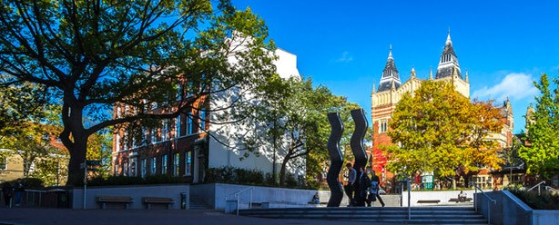
Lifelong Learning Centre
Foundation Years
Alternative pathways to HE study
LTft24

Slide 2

Lifelong Learning Centre
John Lees, External Liaison Officer, Lifelong Learning Centre - j.lees1@leeds.ac.uk

Slide 3
What is a foundation Year?

Slide 4

What is a Foundation Year?
A Foundation Year is an additional year of study at university that helps you prepare learners for their studies and develop academic understanding of their subject area before progressing onto an undergraduate degree course.

Slide 5

Why a Foundation Year?
Qualifications
Not predicted the grades required for direct entry onto chosen degree
Not studied the correct subjects at level 3 for degree pathway
Don’t have level 3 qualifications (mature learner)

Slide 6

Why a Foundation Year?
Bridging the gap to HE
Foundation Years offer a more gradual, supportive approach to beginning university studies
Focus on developing skills & understanding of academic subject area
Foundation years are taught in a context focused on ‘wrap around’ support, such as pastoral support, academic skills and academic personal tutoring.
Often smaller class sizes than UG degree course

Slide 7

Foundation Years
Qualification entry requirements for Foundation Years generally are lower than direct entry and a wide range of qualifications are accepted.
Foundation Years typically are Level 0 of an integrated degree programme
Progression directly onto chosen degree upon successful completion of your Foundation Year – no need to re-apply via UCAS.
Foundation Years provide a university learning experience from Level 0 onwards, as well as a supportive environment for settling into university study. Learners move into their future degree via a progression process.

Slide 8
Foundation Years at University of Leeds
Arts and Humanities
Interdisciplinary science
Business Studies
Social Science (Faculty of Social Sciences)
Gateway to Medicine (Faculty of Medicine and Health)
Interdisciplinary Studies With Preparation For Higher Education (PHE) part time 21+
International Foundation Year

Slide 9
Foundation Years at University of Leeds
Arts and Humanities
Interdisciplinary science
Business Studies
Social Science (Faculty of Social Sciences)
Gateway to Medicine (Faculty of Medicine and Health)
Interdisciplinary Studies With Preparation For Higher Education (PHE) part time 21+
International Foundation Year

Slide 10
Foundation Years
University of Bradford
Foundation years - Undergraduate - University of Bradford
Foundation Years in subjects including:
Foundation Year in Management, Law and Social Sciences - University of Bradford
Foundation Year in Health and Life Sciences - University of Bradford
Foundation Year in Engineering and Digital Technologies - University of Bradford
Foundation in Clinical Sciences and Medicine leading to BSc Clinical Sciences - University of Bradford

Slide 11

Foundation Years - what are the benefits?
A friendly and welcoming and supportive environment
A more gradual approach to beginning your university studies
Support available for the duration of your studies
Part of your university community from day one of studies
Access to libraries, sport facilities and student accommodation

Slide 12
Student finance for Foundation Years
A foundation year is classed as the normal duration of a degree programme and students are eligible for full financial support from Student Finance England.
There is no negative impact on the ability to access financial support simply by taking a foundation year.
Tuition fee decrease for some Foundation Years from 2025 onwards

Slide 13
Lifelong Learning Centre - Foundation Years
Foundation Years are a key pathway to the University of Leeds for students from under-represented groups.
Almost all Foundation Years taught at the Lifelong Learning Centre have widening participation entry criteria.
Majority of students on Foundation Years at University of Leeds are 18- 21.
Foundation Years provide a university learning experience from Level 0 onwards, as well as a supportive environment for settling into university study. Learners move into their future degree via a progression process.

Slide 14

Foundation Years – key information
Applications via UCAS for Foundation Years (Year 0).
Will count as one of student’s five UCAS choices
Maths & English GCSE (and Science for some routes) or equivalent qualifications generally required for Foundation Years.
Huge range of degrees students can progress onto after completing their Foundation Year
For up-to-date course entry requirements/application deadlines always check university course pages

Slide 15

Foundation Year student (Arts and Humanities)
“As somebody from West Yorkshire, I wanted to take advantage of the opportunities given to me by the local community. The University of Leeds offered me such an opportunity.”
“I had studied Science and Humanities subjects at A-level, so the Philosophy, Psychology and Scientific Thought BA, which the Foundation Year allowed me to progress onto, seemed to offer the best of both worlds.”
“I didn’t know what I wanted to do with my life — the Foundation Year was the first step I took towards figuring that out.”
“I discovered a passion for the subjects I was studying — something that might not have happened if I hadn’t taken the Foundation Year.”
“It made it possible for me to imagine a different future for myself, and to create that future at the same time.”
Changing direction with a Foundation Year — the supportive route towards studying a degree | by University of Leeds | University of Leeds | Medium

Slide 16
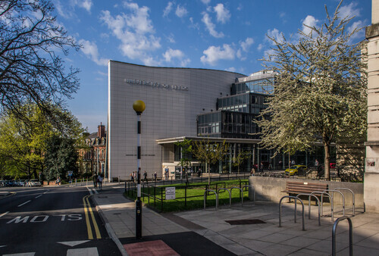
Thank you for listening!
Any Questions?

