Slide 1

Steph Metcalf
Sixth Form Careers Manager

Slide 2

An introduction to Roundhay
628 in the Sixth Form
40% (252) joined us in Y12 from other high schools (NtR)
We offer a mix of A levels and vocational courses
20% of students are disadvantaged (FSM)
Around 60% of students in the 2 most deprived deciles are NtR, and only around 30% of students in the 2 least deprived deciles are NtR

Slide 3
The Sixth Form Team (to give context later, on who tracks student participation!)
Director of Sixth Form (Head of Year 13)
Assistant Director of Sixth Form (Head of Year 12)
Sixth Form Careers Manager- Me!
Sixth Form Manager (Administrator/Admissions)
Sixth Form Attendance Officer
Sixth Form Achievement Manager
Sixth Form Achievement Leaders x 3

Slide 4

When reviewing the Gatsby Benchmarks
it was the following I felt needed more focus
Notes:
How we track participation

Slide 5
Linking curriculum learning to careers
Teachers as a minimum must explicitly link curriculum learning to careers during:
Year 12 Aspirations Week
National Apprenticeship Week
National Careers Week
But, as per this great resource from UCAS last week- it is about brief, regular links to careers in lessons, and providing teachers with a bank of easy to access, quality resources- I do this via our website for consistent access for teaching staff
'This skill is used in…' or
'People in [job role] apply this when…’

Slide 6
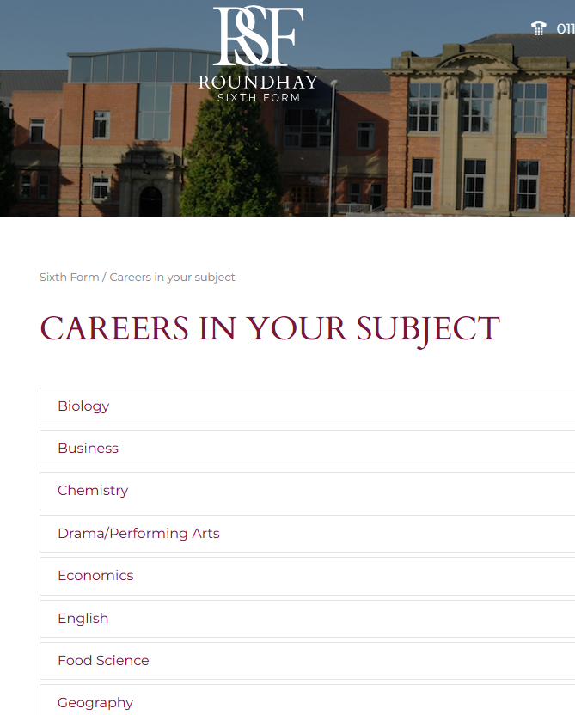





Slide 7
Addressing the challenge of providing careers opportunities for ALL learners
The challenge of careers provision in Sixth Form is that students can opt in and out!
Some groups of students are more likely to attend/sign up for opportunities
Some are more able to stay after school (not looking after younger siblings etc)
So, arranging employer engagement specifically through subjects, means ALL learners access the opportunities, and careers are continually linked to learning
And, a clear tracking system ensures ALL learners access opportunities
Notes:
How do students choose their careers? Throufgh exploring, through experiencing, through talking to professionals within the field

Slide 8
A careers opportunity in every subject
How can we best prepare students make Post 18 decisions? With high quality employer and educational engagement. Getting students over that ‘threshold’ onto a campus or into an employer, hearing directly from professionals both in school and externally
Since 2023 my aim has been to offer an in-person careers related opportunity in every subject we offer
I challenged each department to organise this themselves (with varying success!)
But, those that did have rebooked for the 3rd year this year- Bank of England, Chemistry practical at Leeds Uni great examples
Notes:
How do students choose their careers? Throufgh exploring, through experiencing, through talking to professionals within the field

Slide 9
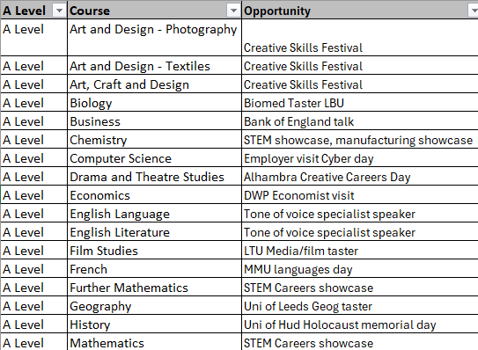
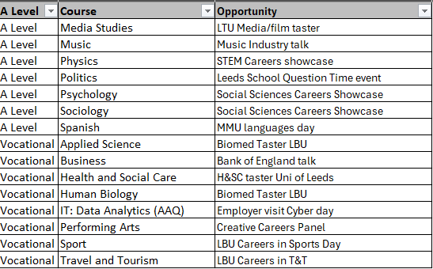
Mix of visiting speakers,
taster days, careers fairs
and trips
Careers opportunities
per subject

Slide 10
How I source the opportunities
Local universities
We have a fantastic relationship with Leeds Trinity, Leeds Uni, Leeds Beckett, University of Law
The school outreach teams there are so very willing to get our students on campus (and they each worked with my target list of subjects, and incorporated careers into the events)
We’re lucky our students can travel to all 4 independently so meet staff there (cuts down on admin/cost/organisation)
But Huddersfield, Bradford, Teeside offer so many opportunities too and many offer travel bursaries. Bradford are coming in to prep all Y13 healthcare candidates
If too much to get students out to campus for tasters- the universities are more than happy to run workshops in school/in lessons- we’ve got a forensic science taster booked in with Huddersfield, in our science lab
Use Microsoft forms for ALL trips/opportunities- no paperwork!

Slide 11
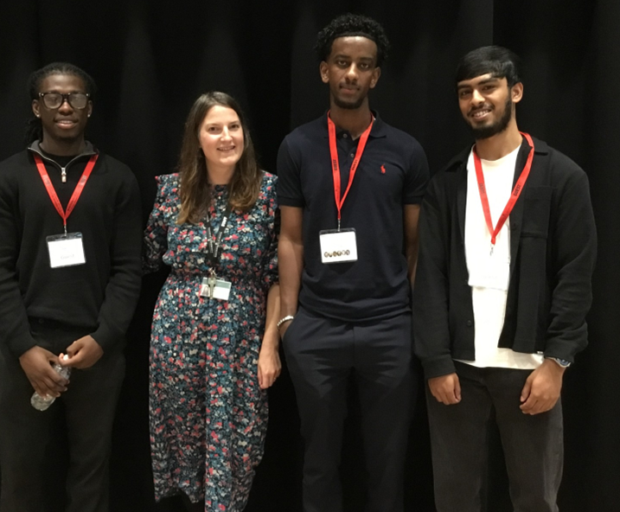
Visiting speakers into school
We ask our alumni- see pic!
We ask our parents/carers for volunteers
(or contact details of their company’s school
outreach team)
We use Futures For All the UK's Top Social Mobility Charity | Futures For All
We use the School Outreach Company
We also have requests from companies to come in

Slide 12
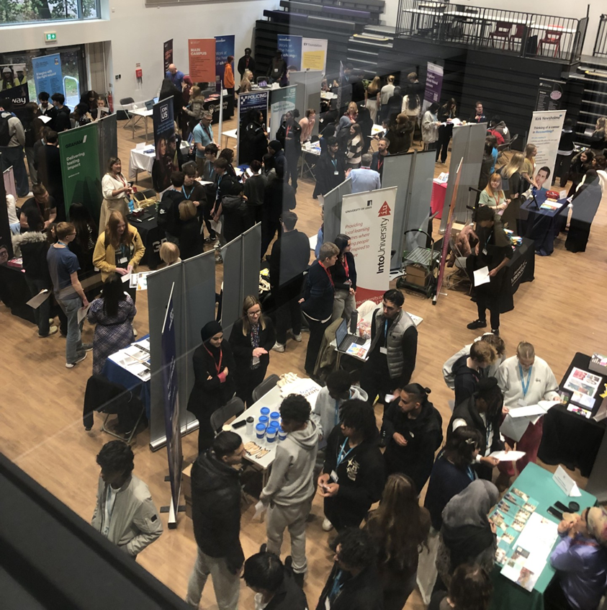
Large in school career events- encounters with employers- high impact in terms of learner numbers
New for 2025- we’ve just had our first Y12 Aspirations Week- Designed to inspire ALL students, early in their Sixth Form journey to think big and aim high.
Aspirations Careers Fair- ALL Y12 students attended – they had a 45 min slot within a lesson- this ensured ALL students came (their teachers brought them) rather than relying on them to turn up during free periods etc

Slide 13
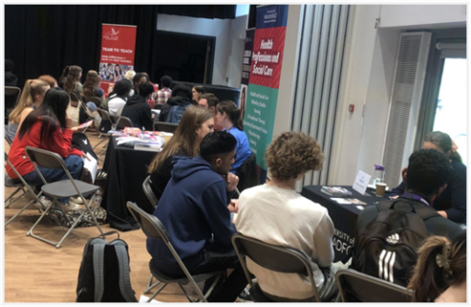
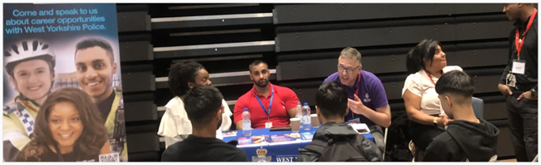
Subject specific large in school events- a more targeted approach but reaches a lot of students, and employers/HE enthusiastic about attending where a targeted group is identified
This will be 3rd year running large subject specific in-school events
Careers in Engineering* Showcase- Maths/Science students
Careers in Social Sciences Showcase- Psychology, Sociology, Economics
Speed networking style!
*Poss amending for 2026

Slide 14
Logistics of the speed-networking events
Take place over a double period- students attend but this is speed networking style, not careers fair
We ‘make’ students sit down with the employer for approx 8 mins to ask questions, hear about the industry, actually look another person in the eye (!) then move on to the next table
Each of these events is for 100ish students from specific subjects
Always allow students from other subjects to attend for the last 30 mins
This then led to mock interviews with LTU

Slide 15

Arranging the large school events
We ask our alumni
We ask our parents/carers for volunteers (or contact details of their company’s school outreach team)
Universities are fantastic at attending
We use the School Outreach Company
We also have requests from companies to come in
Leeds City Council employment and skills service email esemployers@leeds.gov.uk with your event details and they source volunteers

Slide 16

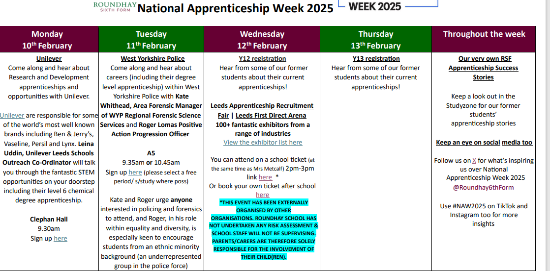
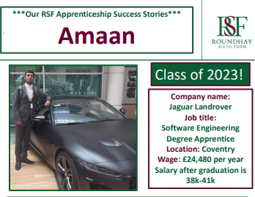
National Apprenticeship Week
I saw a similar plan on Twitter one year which inspired me- def have more student
interest when they’re sent a clear plan beforehand! Use MF forms for ALL events

Slide 17
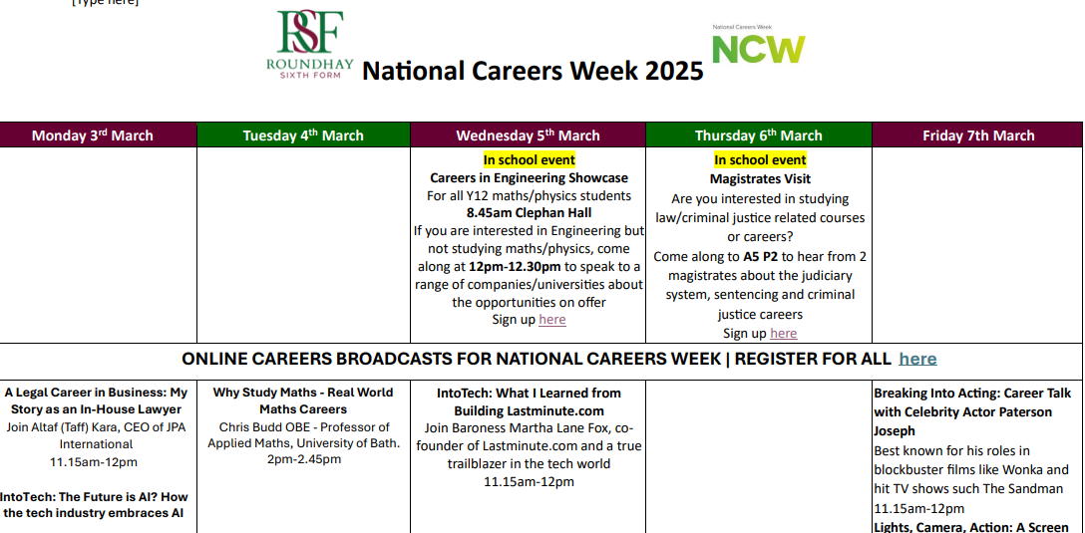
National Careers Week- more online opps for 2025 Online careers broadcasts on Inspirational Talks | Futures For All are fab!

Slide 18
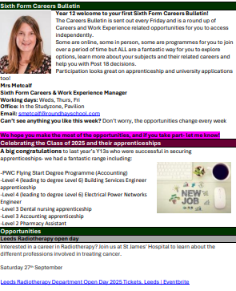
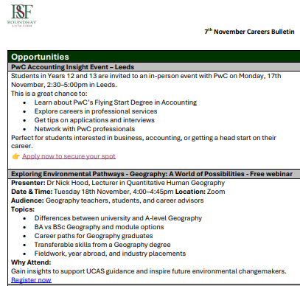
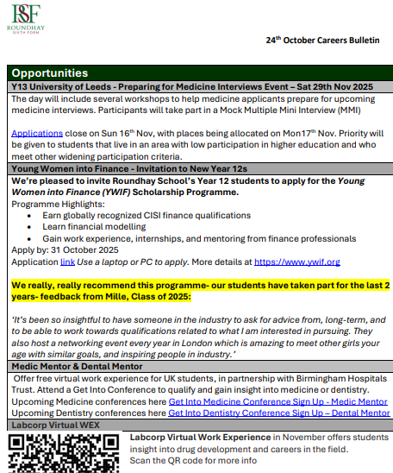
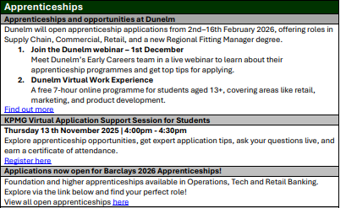
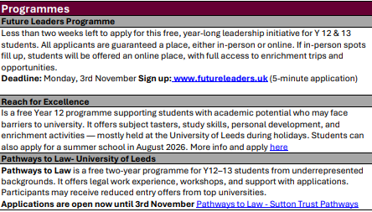
Weekly Careers Bulletin

Slide 19
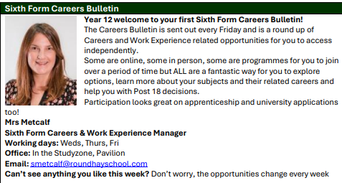
Sixth Form
Careers Bulletin
Goes out every Friday afternoon
To students, parents & carers
Includes opportunities for students
AND their parent/carers
All are free (I won’t include anything
that has a fee)
A lot is online so accessible for all
I get so many emails each week with opps. They just go in one folder then I put it all together Friday morning- AI helping to do this lots quicker!
Same one goes to Y12/Y13 (so Y12s can see apprenticeship vacancies etc early on)

Slide 20
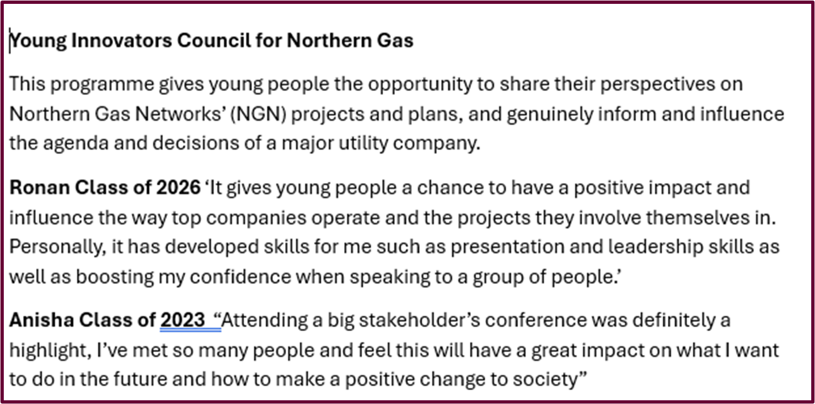
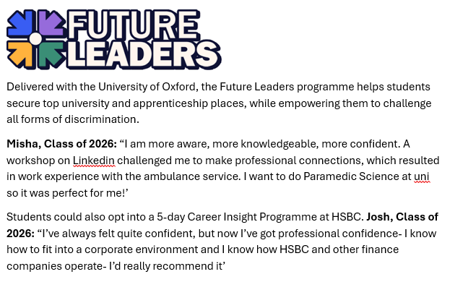
Best bits from the bulletin
Students access independently.
Minimal time/effort from me.
Great not only for careers but in terms of ‘contributing to society’ element of Personal development for Ofsted!

Slide 21
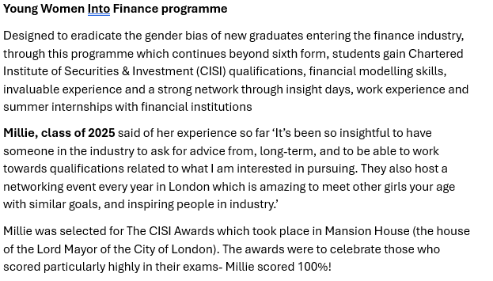
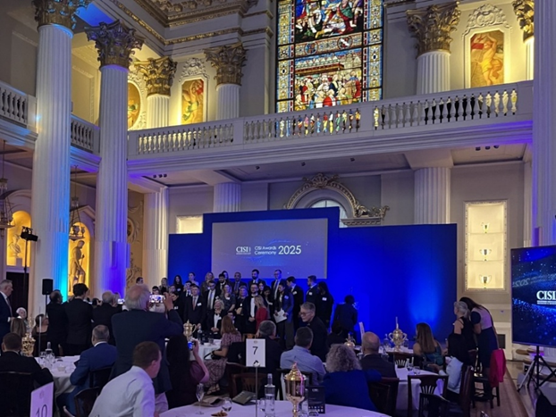
Best bits from the bulletin!

Slide 22
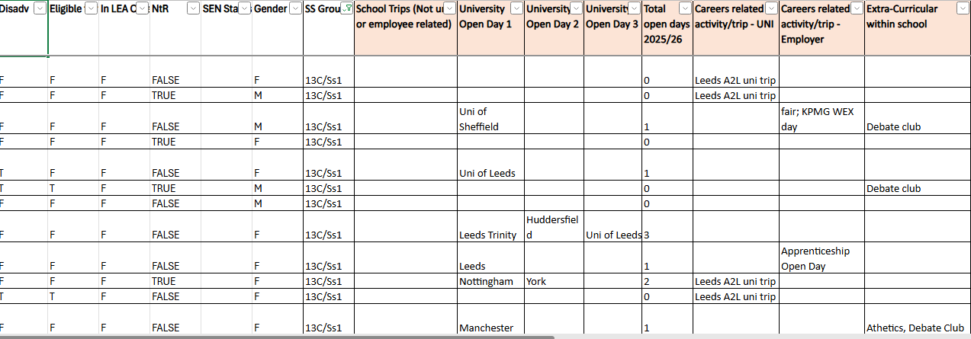
Tracking student participation- We use this online participation tracker
Our achievement team, during supported study sessions ask students on a fortnightly basis for
any open days they’ve attended, opportunities from the careers bulletin etc. I add on all school
Events and trips. Being able to filter by Disad/NtR/SEND means we can target students

Slide 23
Supporting disadvantaged students
Our Realise your Potential Programme of Opportunities brings together contextual offer schemes, visits from universities and practical support with things like UCAS application, student finance and arranging open day travel
Access to Leeds
York Black Access
Into University
Contextual Offers- lunch time session and communicated to parents/carers
Universities run a range of widening participation schemes for students to explore careers i.e:
Leeds Uni Reach for Excellence | Contextual Outreach Team
The Sutton Trust The Sutton Trust
University of Cambridge STEM SMART | Undergraduate Study
University of York Next Step York - Schools and colleges, University of York
These are all included in our weekly Careers Bulletin
Continual CPD for supporting staff

Slide 24
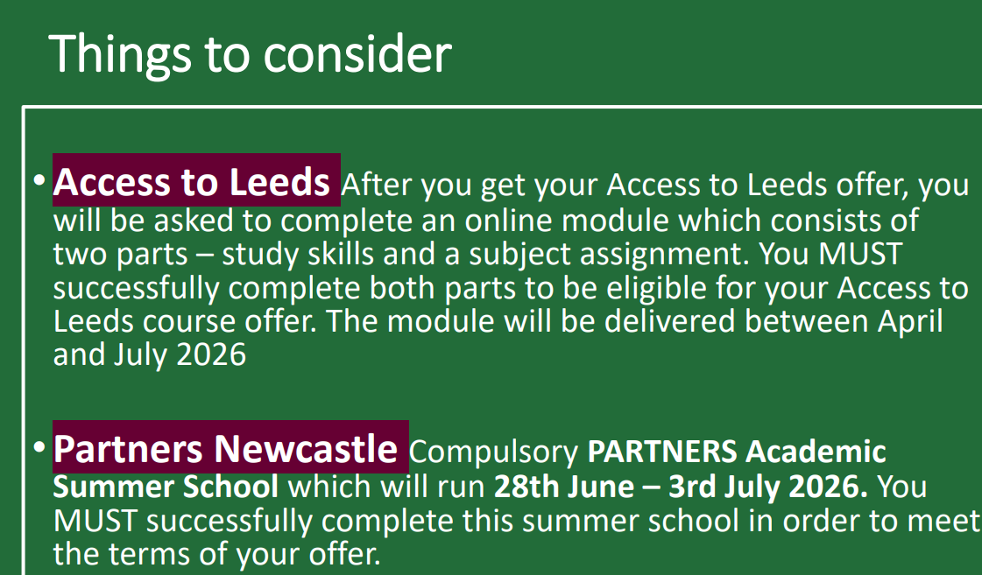
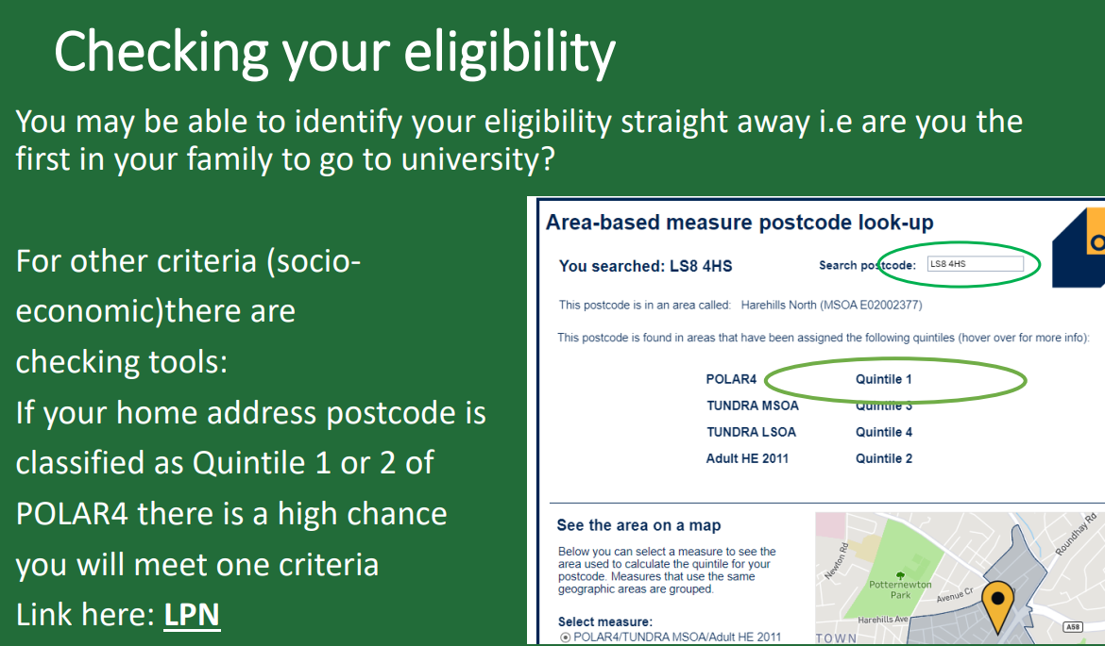
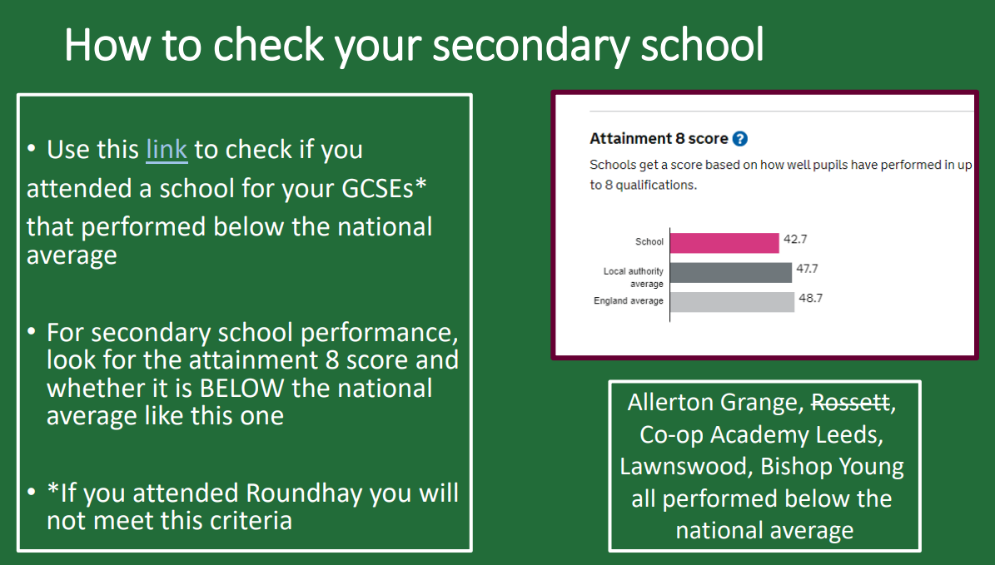
Clear information for students
and parents/carers EARLY on
re contextual offers

Slide 25
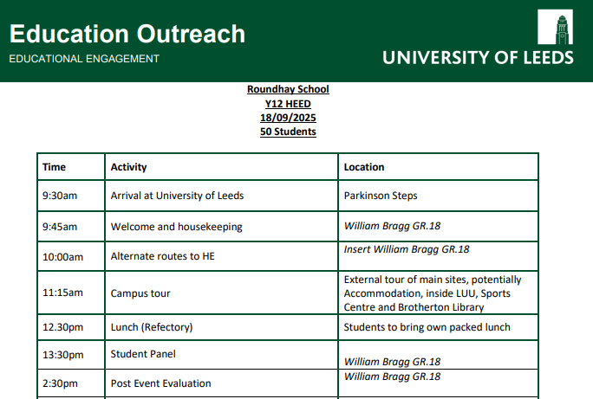
New for this year- University of Leeds campus day for our Y13 disadvantaged students
-50 of our Y13 disadvantaged students spent a day on campus.
-Really interactive workshops on student life and a campus tour
-The student panel was great and purposely diverse
-Sessions on Access to Leeds and foundation routes were really informative.

Slide 26
Ensuring disadvantaged students have access to the opportunities
Through the participation tracker we can track where students haven’t engaged
Have they only gone to local open days? Reminder of travel support on offer
Careers bulletin- teachers speak about in lesson, achievement team in s/study have on screen
When sending out sign up links for trips- give notice of when the link will open in the letter (not just first come first served as unfair to students whose parents/carers can’t access phone at work)
When allocating trip/opportunity spaces ensure proportionate places have gone to disadvantaged/NtR students

Slide 27
Any questions?

