Slide 1
Lifelong Learning Entitlement – SLC
Rob Scott, Training Delivery Officer
23/06/26
Notes:
Afternoon everyone, welcome to today’s CPD session on the Lifelong Learning Entitlement in partnership with the Student Loans Company. We really appreciate you taking the time out of your busy working schedules to be join us today. Just to introduce myself my name is Rob Scott, I'm the training delivery officer for Go Higher West Yorkshire. I'm also joined by one of my colleagues Maria O’ Sullivan who is our Senior Project Manager. Some of you may be aware of my colleague Jenny Scannell who led on our CPD programme, Jenny has moved onto a new role at the Uni of Leeds so myself and my colleague Maria will now be working on our CPD programme so you may be seeing and hearing from both of us. I'd like to thank you all for joining us.
Before I fully introduce our guest speaker who will be delivering today’s session and speakers I want to briefly cover some important info.

Slide 2
Important Information
Recording this session
Slides and webinar information will be sent out post session
Feel free to post questions/comments in the chat at any time during the session
Colleague Maria supporting this CPD session

Slide 3
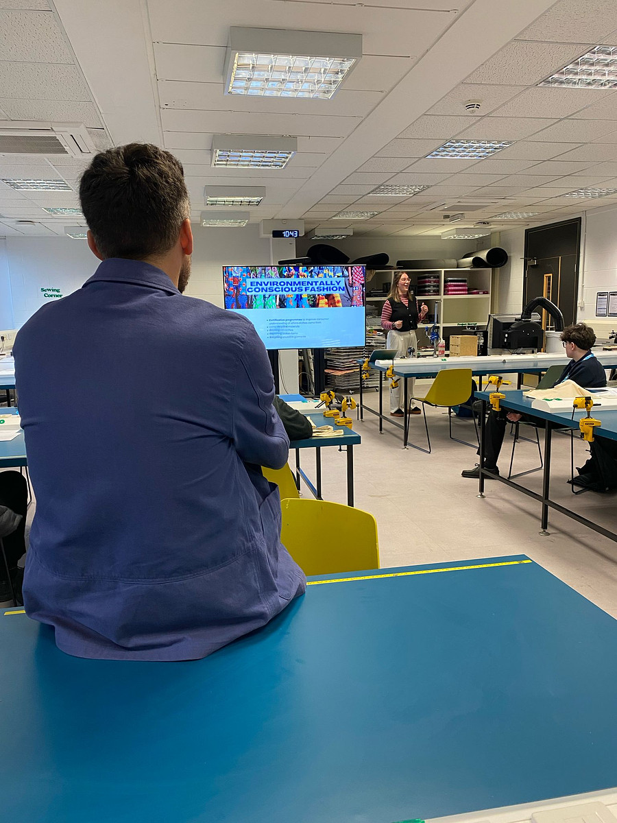
Who are GHWY?
Consortium of 13 HE providers/members formed in 2013.
Not a separate legal entity. Funded by the member institutions.
GHWY is hosted by the University of Leeds but work on behalf of all members equally.
Also fund staff in other HE member institutions.
Notes:
Some of you on the call may already know who we are and what we do but for those of you who don’t we are a consortium

Slide 4

Notes:
6 universities, 6 colleges and 1 specialist providers representing a wide variety of providers, courses and setting.

Slide 5
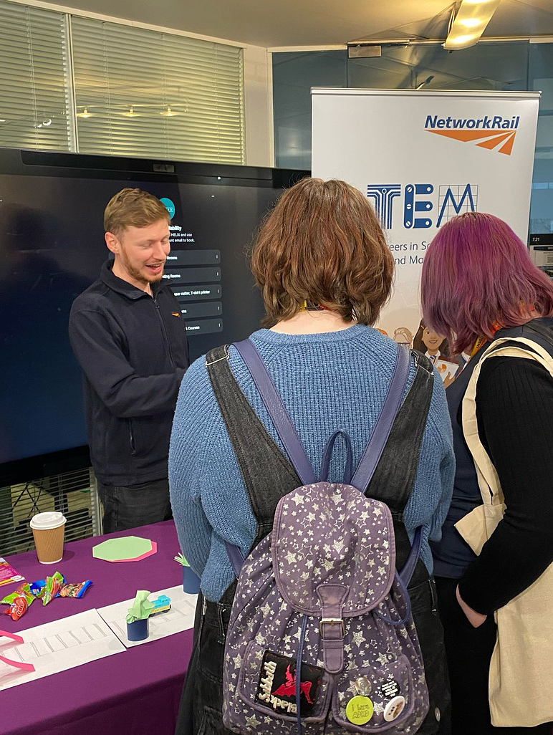
What is our mission?
We aim to make HE more accessible to people in our region.
We care about supporting every learner to make the right choices for them and removing barriers to progression.
ThePhoto by PhotoAuthor is licensed under CCYYSA.
Notes:
HE - impartial, Level 4 qualification or above

Slide 6






GHWY Uni Connect CPD
Funded by the Office for Students, Uni Connect aims to support learners
underrepresented in Higher Education to make positive educational choices
Our free to attend CPD programme is for key influencers of KS3- KS5 learners
It aims:
•To provide Information, advice and guidance in relation to progression, skills and making choices
•To share best practice from school, post-16 and HE settings to support underrepresented groups
•To spotlight pathways and courses linked to growth sectors in relation to local Labour Market information
Notes:
We deliver a lot of different programs and initiatives but the biggest one is the Uni Connect programme. Uni Connect is a national programme funded by the Office for Students, with 29 partnerships across England. In West Yorkshire, the programme has been delivered by GHWY since 2017, working directly with schools, colleges and learners to support those who are underrepresented in higher education to make informed and positive educational choices.
A key strategic priority of Uni Connect is to share learning, evidence and best practice. One way we do this is through our free-to-attend CPD programme, designed for key influencers of KS3–KS5 learners, including careers professionals, teachers, advisers and community practitioners. The programme is free-to-attend but is funded by the Office for students through the uni connect project.
The programme aims to:
Provide information, advice and guidance to support progression, skills development and educational decision-making.
Share best practice and effective approaches from school, post-16 and higher education settings to better support underrepresented groups.
Spotlight progression pathways and courses linked to local labour market information and growth sectors.
Increase practitioners’ knowledge, skills and confidence through access to current research, evaluation findings and sector expertise.
Our goal is that attendees can use and cascade this information to help the young people and learners they work with make informed choices about their future pathways.

Slide 7
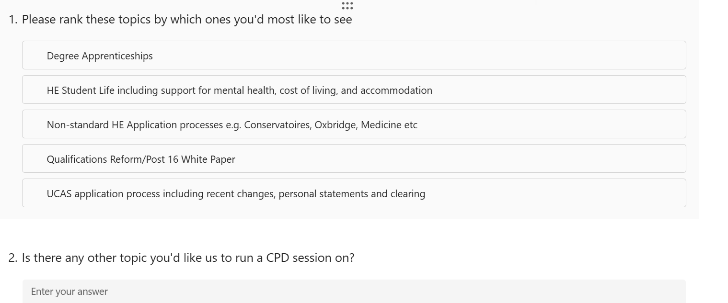
Help us shape next year’s CPD Programme
Notes:
Before we get started I want to take literally 90 seconds to ask you to please complete this Microsoft form. We want you to shape our CPD programme next year by telling us what kind of content you’re looking for. We have some suggestions that we want to rank in order of what you want most and then a free text box, it’s literally two questions but would really help us. I’ll pause for a minute but if you want to take some time to go away and think about it that’s no problem at all, so please also share with colleagues and people.
Help us shape next year's CPD Programme – Fill in form

Slide 8
Samantha Fletcher
Funding Information Services Account Manager
Student Loans Company
Notes:
I'm going to now introduce our guest speaker. We are very lucky to be joined by Samantha Fletcher who is the Funding Information Services Account Manager at the Student Loans Company. She is going to talk us through the key changes to student finance and the Lifelong Learning Entitlement. We have a lot to get through today so I will ask you to please hold questions to the end.
Welcome Sammie, thank you very much for joining us. I'm going to stop sharing now.

Slide 9
GHWY Uni Connect CPD
Thank you
Webinar and PP slides will be sent post CPD session
Please can you:
  Complete survey to generate ideas for 26/27 CPD programme – 1 min
  Promote our CPD programme to relevant colleagues/networks etc
  Respond to the polls in the chat
Notes:
Add links in the chat

